Slide 1
Blue Ocean Strategy Chapter 9: The Sustainability and Renewal
Jacob Felty, Sabrea Hebb, Alexandra Hill, Shaady Ibrahim, Callie Myers, Colby Wulf

Slide 2
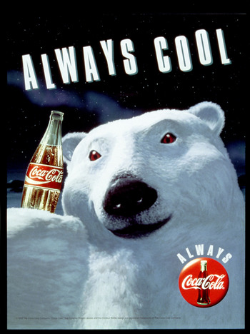
Barriers to Imitation
A value innovation move does not make sense based on conventional strategic logic
Ridicule does not inspire rapid imitation
Brand Image conflict prevents companies from imitating a blue ocean strategy
Signals an invalidation for current imitation business models
How can Pepsi produce holiday specials without imitating Coca-Cola?

Slide 3
Barriers to Imitation
Natural monopoly blocks imitation when the size of the market cannot support another player
Patents or legal permits block imitation
These factors may allow Blue Ocean Strategies to go 10-15 years without competition
Public utilities, such as electricity, are often natural monopolies – but are also heavily regulated by government to prevent exploitation

Slide 4
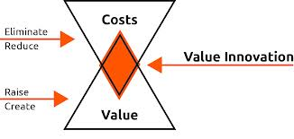
When to Value-Innovate Again
Almost every strategy will be imitated
You might fall into a trap of competition
Center of strategic thought

Slide 5
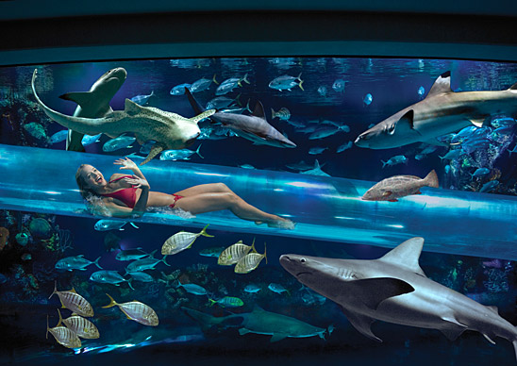
Avoid the Trap of Competition
Monitor value curves on strategy canvas
Signals when to value-innovate
Reach out for another Blue Ocean
Helps you choose when to pursue a new Blue Ocean

Slide 6
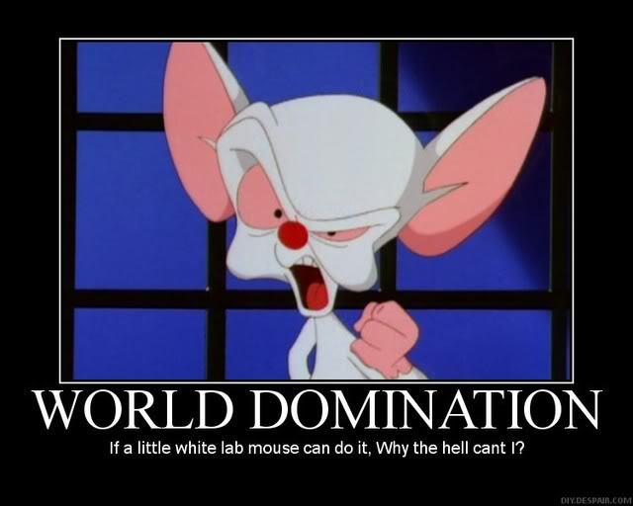
When to pursue another Blue Ocean…
Company’s value curve → resist temptation
Focus
Divergence
Compelling tagline
Dominate blue ocean over your imitators for as long as possible

Slide 7
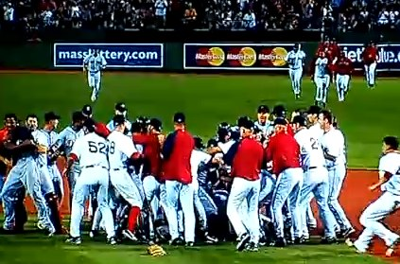
When the Blue Ocean turns Red…
Rivalry intensifies
Total supply exceeds demand
Reach out to create a new Blue Ocean
Chart your value curve and strategy canvas

Slide 8
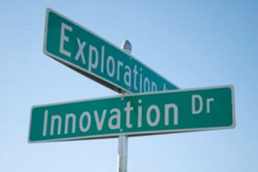
Value Re-Innovation
The Body Shop was in a Blue Ocean for a decade, but didn’t reach out for a new innovation.
[yellow tail] did, and is now in a clear blue ocean.
Companies should not only compete for a share of a blue ocean, but create one of their own.
This book aims to teach how to create blue oceans as easily as competing in red oceans.

Slide 9
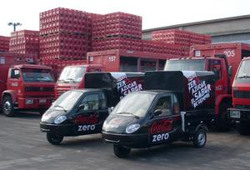
Barriers to Imitation
High volume of value innovation
Resulting cost advantages dissuade competitors
Wal-Mart’s economies of scale discourage imitation of their BOS
Coca Cola’s price remains the same for past 30 years
Network externalities
eBay’s size attracts even more buyers, sellers
few incentives to move to competitor
Coca Cola’s global distribution is the largest beverage network in the world
300 bottling partners, operating in 200+ countries

Slide 10
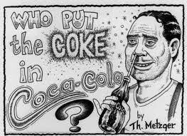
Barriers to Imitation
Significant corporate culture changes (likely) required
Imitation means changing operations drastically
Office politics can delay change for years
Southwest Airline’s BOS would require other airliners to make fundamental changes (very hard to copy)
Coca Cola’s dominance remains steady in US, growing elsewhere despite competition
Value leap
Earns “brand buzz” and customer loyalty
Even large advertizing can’t work against the ‘buzz’
Microsoft has failed for 15 years to compete with Intuit’s Quicken
Coca Cola’s ‘Diet Coke’ has surpassed popularity of Pepsi

