Slide 1
Industry and Competitive Situation Analysis
Team # 6
Kyle Kunkel
John Barron Parker
Teddy Lathrop
Thor Fink

Slide 2
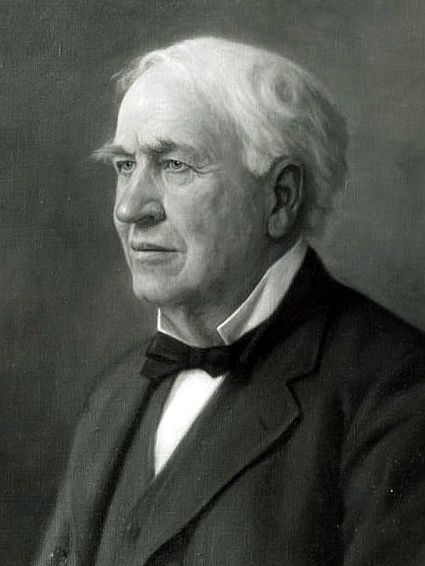
General Electric History
Founded in Schenectady, New York in 1892
Thomas Edison, Elihu Thomson, Charles Coffin, and Edwin Houston.
Merger between Edison General Electric
and Thomas Houston Company
Went public in 1896, 1 of 12 companies
On the DOW

Slide 3
Company Overview
American Multinational Conglomerate
Headquartered in Fairfield, Connecticut
10th Largest company in the world
Four Sectors: Energy, Capital Finance, Technology Infrastructure, and Consumer and Industrial
Notes:
consumer and business appliances, aviation for military and commercial use, Capital and Financing services, consumer electronics, energy management, healthcare products and services, home improvement, house wares, industrial solutions, intelligent platforms, lighting for business, lighting for consumers, mining, oil and gas, personal health care, power and water, software, and transportation.

Slide 4
Major Mergers, Buyouts, and Sells since GE’s Formation
1911 GE combined with the National Electric Lamp Company. (NELC)
1919 established the Radio Corporation of America
1960s one of the worlds largest computer companies
2002 Sold IS to Francisco Partners and Norwest Venture Partners.
2004 it took over the television company NBC and Media Conglomerate Vivendi

Slide 5
Overview Continued
Operate in more than 160 countries
305,000 Employees worldwide
Energy Products help Provide for over a ¼ of the worlds Electricity supply.
Market capitalization of about $227.6 billion as of April, 26, 2013

Slide 6
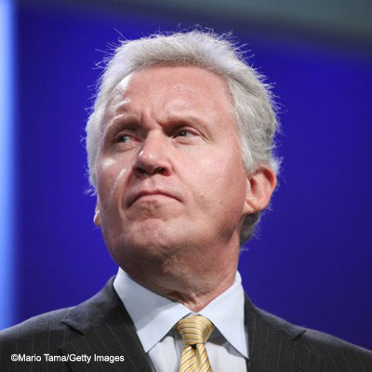
General Electric Leadership
Jeff Immelt; Current CEO and Board Member
Barron named Immelt the
Worlds best CEO 3 times
Appointed financial advisor
By President Barack Obama

Slide 7
Publication Recognition
“Most Admired Company” (Forbes)
19th “Most Innovative Company In the World” (FastCo)
15th “most admired company” (Fortune)
7th “for creating company leaders” (Fortune)
5th “best global brand” (Interbrand)
63rd “worlds greenest companies” (Newsweek)
2011 GE 6th “US Largest Firms” (Fortune 500)
Currently ranked 3rd “most profitable company”(Forbes)

Slide 8
2012 Awards
Named in Barron's list of the most respected companies.
Among Fortune's listing of the world’s most admired companies and the top companies for leaders.
Bloomberg BusinessWeek's list of the world's most innovative companies.
Named in Ethisphere's list of the world's most ethical companies.

Slide 9
Organizational Structure
Hierarchal system
Allowed more freedom for lower employees, enables them to move forward company without bureaucratic obstacles slowing them down.
Eliminate Bureaucratic “Roadblocks”
Helps Speed up decision making process/ insures the company is more productive and efficient.

Slide 10
Company Culture
Many companies try to adopt GE’s Methods and Co. Culture.
Upper MGMT encourages employees to speak their minds and compensate accordingly for innovativeness.
Draw innovation from all levels of employees
Former CEO Jack Welch implemented system called “Re-architecting”
Notes:
Jack Welch has stated ‘I want to get to a point where people challenge their bosses everyday: “Why do you require me to do these wasteful things? Why don’t you let me do the things you shouldn’t be doing so you can move on and create?” That’s the job of a leader—to create, not to control’
Control your destiny, or someone else will.
Face reality as it is, not as it was or as you wish it were.
Be candid with everyone.
Don’t manage, lead.
Change before you have to.
If you don’t have a competitive advantage, don’t compete.

Slide 11
4 Principles
GE lives by 4 Ideas
Imagine
Build
Solve
Lead
http://www.youtube.com/watch?v=loinY8MmVq8
Notes:
Imagine-Jeff Immelt says that “imagination fuels GE. It is through this innovation (funded with $6 billion dollars in 2009) that GE is shaping our world
Building is the key to the future. Building not so much a larger company but a stronger company. One who leads the industry with courage and efficiency. General Electric prides itself on being a mature company whose growth is strong and sustainable.
Solve- General Electric exists to solve problems. Whether it is a customer, society, or for the company itself, General Electric wants to take a hard look at major issues facing us today and provide an answer.
Leadership is the quintessential difference between companies who thrive and companies who survive. Management keeps the pace we established yesterday; leadership establishes the destination for tomorrow.

Slide 12
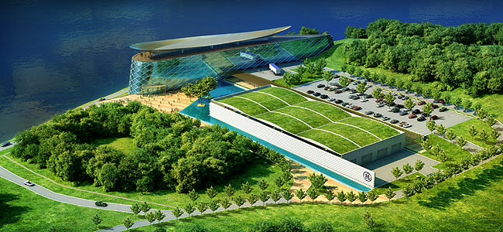
Research & Development
Approximately 36,000 technologist working R&D
10 R&D Centers worldwide
R & D centers in
Niskayuna, New York
San Ramon, California
Oklahoma City
Munich, Germany
Bangalore, India
Shanghai, China

Slide 13
R&D continued
Ranked 19th most innovative Co in 2011 (Fast Company)
Funded R&D for $4,601 million in 2011. $3,939 million 2010. And $3,288 million in 2009.
R & D capabilities allows GE to expand into new markets.
Notes:
“High research and development capability allows General Electric to bring in new products into the market and have a technological competitive advantage over competitors, which in turn enables General Electric to increase their customer base and generate higher revenues.”

Slide 14
Key Factors to Success
Diverse Portfolio
Creating Successful Leaders
Extensive R & D

Slide 15
Competition
Large number of competitors due to size of the CO.
Largest Competitors Include:
Siemens AG
ABB
Other Companies include:
BSH Bosch and Siemens
Whirlpool
AB Electrolux
Haier Group Company
Phillips Lighting BV
OSRAM GmbH

Slide 16
Economic Factors
Fluctuating interest rates
Foreign exchange rates
Money value affected by GE operations.
Over past years company suffered a decrease in revenue and sales

Slide 17
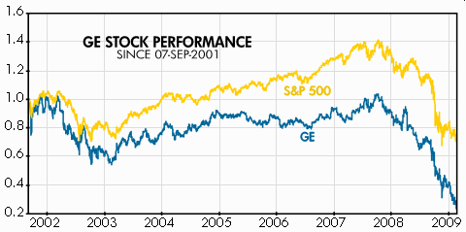
Stock Price
Notes:
GE’s stock price declined from $37.10 to $8.60 between January, 2nd, 2008 and February, 27th, 2009.

Slide 18
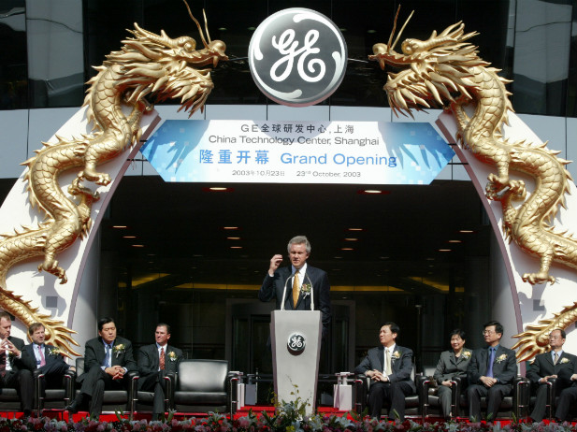
Political Factors
Located in 160 different countries
Company has to adjust to various government laws, regulations, and cultural norms.

Slide 19
Company Situation Analysis

Slide 20
Strategy taken
Financials have slowly been declining over the last couple of years due to the recession but revenues have been making a comeback
Environmentally friendly manufacturing
Ecokitchen idea

Slide 21
SWOT Analysis
Strengths
Managers and management school
Technology advances
Research and Development

Slide 22
SWOT continued
Weaknesses
Legal issues
Dependence on third party venders

Slide 23
SWOT continued
Opportunities
LED technology
Street-light programs
Business alliances: Chesapeake

Slide 24
SWOT continued
Threats
Government rules and regulations (EPA)
Intellectual property theft

Slide 25
Competitive analysis
In 2012, GE was named in Barron's list of the most respected companies.
In 2012, GE ranked among Fortune's listing of the world’s most admired companies and the top companies for leaders.
In 2012, GE was named in Bloomberg BusinessWeek's list of the world's most innovative companies.
In 2012, GE was named in Ethisphere's list of the world's most ethical companies,”(GE web page, 2013, company fact sheet).

Slide 26
Assets
Infrastructure
Technology
Cash that can be spent to invest

Slide 27
Cost Analysis
Growth
More expansion 8% compared 3%
Amount spent on R&D

Slide 28
Issues
Fukushima, Japan
Resource scarcity

Slide 29
Identify/Evaluate GE’s Options

Slide 30
GE’s Position in the Appliance Industry
In the appliance industry, General Electric is recognized as one of the best-known brand name appliance manufacturers in the world
The competitive strategy GE uses is based off the company’s core technology, manufacturing and marketing where they are able to produce approximately $5.5 billion in revenues
With technological advances over the past couple of years, energy efficient appliances has shown to be the future if the appliance industry

Slide 31
GE Becoming More Energy-Efficient
GE has shown to be on a steady rise with the production of energy efficient appliances
Smart meters
Smart platforms
Smart appliances
This new wave of energy-efficient products will save consumers money in the long run

Slide 32
What Options Does GE Appliances Have Moving Forward?
As GE continues to grow in the appliance industry, it is important for them to stay the course they have already established
Proven to be among industry leaders in innovative, energy-efficient technologies
In an industry that is becoming more promotionally driven, GE should focus more of its resources towards marketing and advertising in order to increase their sales revenues
Offering a greater incentive to buy GE appliances versus their competitors will bring new customers in and retain the customer base they already have

Slide 33
GE’s Position in the Lighting Industry
In the lighting industry, General Electric’s commercial and residential lighting division is leading the way as a proven expert in the light-emitting diode (LED) category
Acquisitions of Lightech and Nuventix in 2011 provided GE Lighting with the resources needed to develop industry leading LED products

Slide 34
GE’s position in the Lighting Industry cont.
With lighting consumer trends shifting towards an increase in demand for energy efficient products and fast-paced technology advances, GE lighting is at the top when it comes to producing innovative, industry leading, energy-saving lighting products

Slide 35
GE Making a Difference
The amount of money General Electric saves other businesses through their energy efficient products and business strategy is more than any other competitor in the lighting industry
Ex. Plaza Indonesia

Slide 36
What Options Does GE Lighting Have Moving Forward?
For GE to continue to grow in the lighting industry it is important that they do not out innovate themselves and they continue to grow LED technology
Phase out of out-dated incandescent designs
Develop a marketing strategy that exemplifies the benefits of LED technology

Slide 37
General Electric as a Whole
For General Electric as a whole, it is important that they keep the company divided into separate business entities
It is hard to analyze GE from a shareholder prospective because of the variety of industries they compete in
There is a tremendous unrealized shareholder value that needs to be exploited and the best way for that to happen is to let each business entity flourish as a separate company

Slide 38
GE Appliances & Lighting
Operates as part of GE’s Home & Business Solutions unit
Makes home appliances as well as provides appliance repair service
Home to GE’s lighting division
Make lighting products for residential and commercial markets

Slide 39
Products
Appliances
Lighting
Dishwashers
Dryers
Freezers
Ovens
Refrigerators
Room AC units
Washing Machines
CFL bulbs
Florescent bulbs
Halogen bulbs
Incandescent bulbs
LEB bulbs

Slide 40
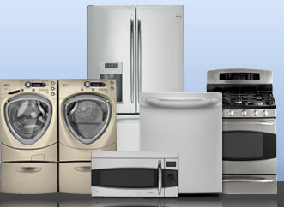
Appliance Industry
NAICS 3352 definition: Household Appliance Manufacturing
Comprises of establishments primarily engaged in manufacturing both small and major electrical appliances and parts.

Slide 41
Overview
Projected 4% annual growth in global demand through 2015
Mostly dominated by multinational conglomerates with a wide-range of products
Competition intense among leaders
Design and product innovation
Very high entry barriers

Slide 42
Other Features
Cyclical industry-dependent upon consumer discretionary spending
Highly concentrated market due to:
high fixed costs of maintaining and operating giant plants
huge investing into R&D
the need to have size and power in order to put pricing pressures on their suppliers

Slide 43
Current Trends & Beyond
Energy-saving and eco-friendly products, or “smart” appliances, are dominating demand
Technological innovation & user integrated features are important in the future
India is expected to have strongest rate of growth in the global major appliances market over the coming years

Slide 44
Main Competitors
Whirlpool Corp
Investing into emerging markets such as China
Major customer’s include: Lowe’s, Home Depot, Sears, and Best Buy
Bosch and Siemens (BSH)
Attempting to enter retail market
EPA Energy Star certified across its lineup
AB Electrolux
Reformation of manufacturing strategy
Company’s extensiveness makes them a worldwide leader
Haier Group Company
China's #1 appliance manufacturer
Pursues markets beyond appliances through acquisitions and joint ventures

Slide 45
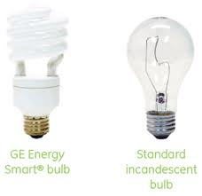
Lighting Industry
NAICS 3351 Definition: Electric Lighting Equipment Manufacturing
Comprises of establishments primarily engaged in manufacturing electric lamp bulbs, lighting fixtures, and parts.

Slide 46
Overview
Projected 4.5% annual growth in global demand through 2014
factors fuelling the market growth are: rise in personal income and recovery in automotive industry
LEDs and fluorescents (CFL) costs are forecast to decline, increasing demand
Demand for these products will encroach on demand for other types of lighting

Slide 47
Other Features
Demand depends primarily on residential, industrial, and commercial construction activity
Large companies have advantages in purchasing power, manufacturing volume, and distribution efficiencies
Small companies compete by offering specialized products and superior customer service in regional markets

Slide 48
Market Outlook
Developing countries are expected to have fastest growth in electric lighting demand
CFL and LED lighting are expected to show the fastest growth in the lighting industry
Technological advances and cost reduction are fueling the LED market growth
CFL is being used to replace incandescent lamps and will grow at a faster rate
The market has been quite concentrated to date
it is likely that competition will stiffen as new outfits enter the market

Slide 49
Main Competitors
Phillips Lighting B.V.
the #1 household light bulb maker
made good plans to expand into developing geographic markets
OSRAM GmbH
a division within Siemens AG's Industry business sector
Siemens spun off OSRAM during the spring of 2013 and will cut about 4,700 jobs or about 12% of its overall workforce
China Intelligent Lighting and Electronics, Inc.
does most of its business in China and sells its products through more than 60 original equipment manufacturers (OEMs)
intends to focus on increasing its OEM customer base and growing its distribution network

