Slide 1
GREAT BY CHOICE
Chapter 4
Fire Bullets, Then Cannonballs
John Barron Parker
Teddy Lathrop
Thor Fink
Kyle Kunkel

Slide 2
Chapter Overview
Empirical Creativity
Innovators are not always winners
Innovation and 10Xers
Threshold Innovation
Creativity and Discipline
Bullets then Cannonballs
Calibrating Cannonballs
Apple and GE using these methods

Slide 3
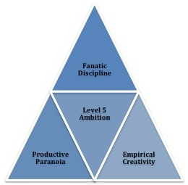
Empirical Creativity
“ You may not find what you were looking for, but you find something else equally important.”
-Robert Noyce
The second behavior that allowed 10x companies to thrive during chaotic and uncertain environments is EMPIRICAL CREATIVITY
“Intel’s founders believed that innovation without discipline leads to disaster”
Notes:
There is a common perception in leadership that innovation is the key to success. Or, put more plainly, the more innovative you are, the more successful you’ll be. However, Collins and Hansen discovered a different reality.

Slide 4
Southwest copies PSA
PSA had an excellent business model and was loved by their customers.
Small group of entrepreneurs in Texas came up with a simple business plan: copy PSA in Texas.
Southwest mimics PSA’s business model to the smallest detail.
Southwest lacked the innovation PSA displayed, but they were successful because they stayed disciplined which was one of the reasons PSA failed.

Slide 5
Why PSA Failed
PSA fired several uncalibrated cannonballs in the late 60s and early 70s.
Tried combining rental cars, flights, and hotels all in one package. Instead of firing bullets and testing this idea out they fired an uncalibrated cannonball and recorded losses every year this was attempted.
Also bought several new planes that went bust.
Notes:
Instead of firing calibrated cannonballs PSA fired several uncalibrated cannonballs in a desperate attempt to regain momentum in the airline industry. Because of these uncalibrated cannonballs PSA never regained its prior greatness.
PSA’s demise illustrates the danger of firing uncalibrated cannonballs in an uncertain world full of turbulent disruption. Uncalibrated cannonballs are more likely to have a catastrophic outcome.

Slide 6
Innovation and 10Xers
The evidence from our research does not support the premise that 10Xers will necessarily more innovative than their less successful comparisons.
Cases such as Southwest vs. PSA, and Amgen vs. Genentech, the 10x companies were less innovative than the comparisons.
In only three of the seven pairs, the 10x case proved more innovative the comparison company.
Notes:
When the authors began this research effort, they anticipated that innovation might be a primary distinguishing factor for 10x success in unstable environments characterized by rapid change.

Slide 7
Role Reversal

Slide 8
Pioneers don’t always succeed
Researchers found that only 9% of pioneers/innovators end up as the final winners in a market.
Gillette didn’t innovate the safety razor, Polaroid didn’t innovate the instant camera, Microsoft didn’t innovate the PC spreadsheet, Amazon didn’t innovate online book selling.
64% of pioneers failed outright.

Slide 9
Threshold Innovation
The 10Xers were innovative enough to be successful but generally not the most innovative.
The authors found that each environment has a level of “threshold innovation” that needs to be met to be a contender.
Once your above the threshold, being more innovative doesn’t seem to matter as much.

Slide 10
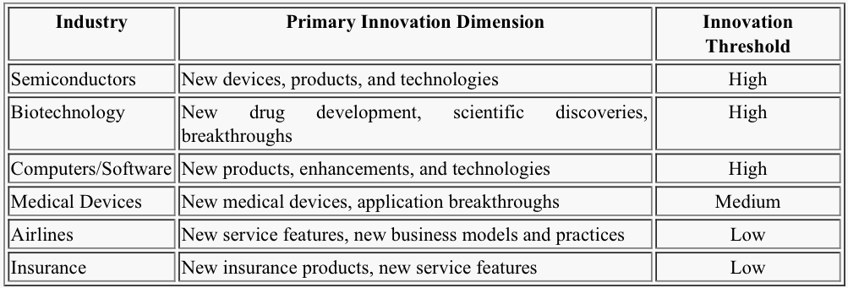
Threshold innovation

Slide 11
Creativity and Discipline
A company needs a mixture of creativity and discipline to become a 10x company and ensure survival and success in a given environment.
Intel vs. Advanced Memory Systems. Both made microprocessors, but Intel succeeded because they were disciplined.
Intel’s founders believed that innovation without discipline leads to disaster.
Notes:
Advanced memory systems had a better design than Intel, but the combination of creativity and discipline proved to be to great on the market place.

Slide 12
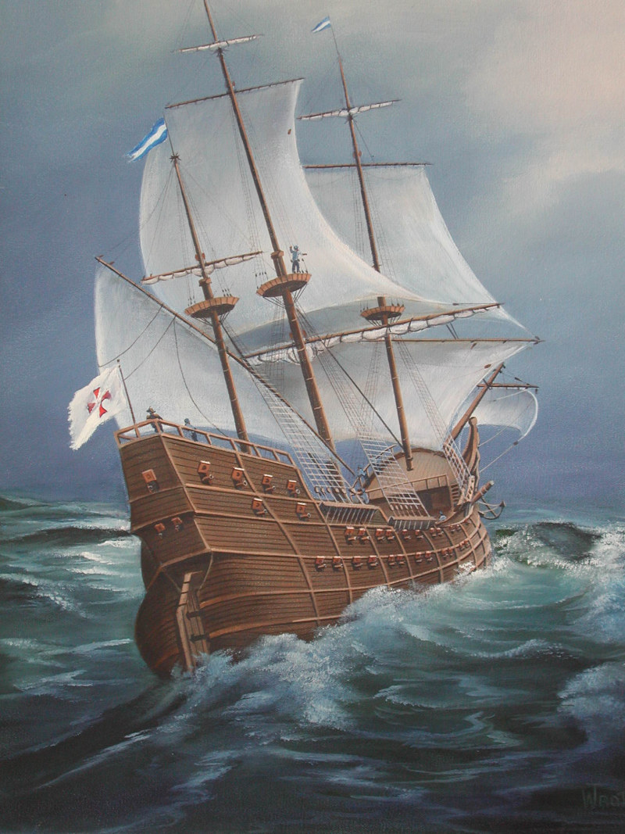
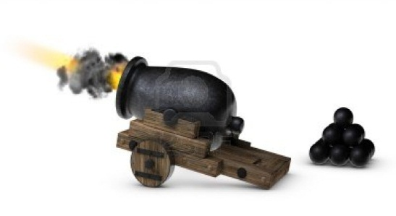
Bullets THEN Cannonballs

Slide 13
Bullets to Cannonballs
The idea is to fire small bullets (test new products, technologies, services, and processes) to see what works and what doesn’t.
Only after new ideas have been tested and proven should the organization fire a cannonball. Bullets don’t sink the ship, but a cannonball can.
Organizations should fire cannonballs (put large amounts of organizational resources and energy into ideas)
ONLY AFTER they have fired lots of small bullets (testing new ideas to prove whether or not they will work).

Slide 14
What makes a bullet?
A bullet is an empirical test aimed at learning at what works and that meets this three criteria:
1. A bullet is low cost. The size of the bullet grows as the enterprise grows.
2. A bullet is low risk. Low risk doesn’t mean high probability of success, low risk means there are minimal consequences if the bullet hits nothing.
3. A bullet is low distraction. Low distraction for the overall enterprise.

Slide 15
Amgen firing bullets
Amgen is a biotechnology company that used this strategy to become successful.
Fired many bullets; and then finally became successful with erythropoietin and decided to fire a cannonball
After many different ideas were researched (bullets were fired) Amgen developed a product that became successful and dedicated more resources to it.

Slide 16
Before firing cannonballs
A company should do the following before firing a potential uncalibrated cannonball.
Fire Bullets
Asses: did your bullets hit anything
Consider: do any of your successful bullets merit to conversion to a big cannon ball?
Convert: Concentrate resources and fire a cannonball once calibrated.
Don’t fire uncalibrated cannon balls.
Terminate bullets that show no evidence of eventual success.
Notes:
Failing to complete all of these can result in firing an uncalibrated cannonball.
10x companies that fired cannonballs rather than uncalibrated had a nearly 4 times higher success rate than those that fired uncalibrated cannonballs.

Slide 17
10Xers fire calibrated cannonballs
10Xers are able to recover and stay successful by returning to the discipline of firing cannonballs only when they have empirical validation.
Empirical Validation; “Be creative, but validate your ideas with empirical evidence.
More important than being first or being more creative is figuring out what works in practice, doing it better than anyone else, and then making the very most of it with a 20 mile march.
Notes:
In the face of instability, uncertainty, and rapid change, relying upon pure analysis will likely not work, and just might get you killed. Analytical skills still matter, but empirical validation matters much more.

Slide 18
Apple getting on track
Before making major innovative breakthroughs , Steve Jobs first increased discipline.
Jobs restructured Apple before working on new products.
Fired a bullet and created the iPod, and various other MP3 devices.
After firing many bullets, Apple was able to gather enough empirical validation and created iTunes and iPod for non-Mac computers.
Notes:
Jobs brought I Tim Cook, a world class supply chai expert, and together Jobs and Cook formed a perfect yin yang team of creativity and discipline. They cut perks, stopped funding the cooperate sabbatical program, improved operating efficiency, lowered overall cost structure, and got people focused on the intense work all day and all night ethos that characterized apple in Its early years.
The iPod story illustrates how a successful venture came about as a multi-step iterative process based more upon empirical validation than visionary genius.

Slide 19
GE firing bullets, then cannonballs
GE continually fires bullets in order to see what products will work and which ones will fail in the market place.
The reason the company is so successful is because they are able to see which bullets will fail, and which ones will work.
Even though they have fired cannonballs that didn’t work, they maintain success by practicing discipline and gathering empirical validation to more successfully calibrate their cannonballs.

Slide 20
Questions or comments?

