Slide 1
Blue Ocean: Get the Strategic Sequence Right
Yetunde Oyinwola, Laura Padilla, Taylor Mullings, Eric Carsten, Alex Kollaritsch

Slide 2
The Right Strategic Sequence
Buyer Utility
Is there exceptional buyer utility in your business idea?
Price
Is your price easily accessible to the mass of buyers?
Cost
Can you attain your cost target to profit at your strategic price?
Adoption
What are the adoption hurdles in actualizing your business idea? Are you addressing them upfront?

Slide 3
Buyer Utility & Price
Is there a compelling reason for the mass of people to buy it?
Is your offering priced to attract the mass of target buyers so that they have a compelling ability to pay for your offering?
These two address the revenue side of a company's business model
Net Buyer Value = (The utility buyers receive)-(Price they pay for it)

Slide 4
Cost & Adoption
Can you profit at the strategic price?
-You should not let cost drive prices
What are the adoption hurdles in rolling out your idea?
-Adoption hurdles include potential resistance to the idea by retailers or partners

Slide 5
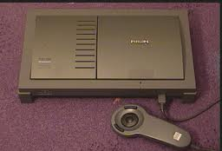
Testing for Exceptional Utility
Many companies fail to deliver exceptional value because they are obsessed by the novelty of their product or service.
Example: Philips’ CD-i
Theoretically it could do almost anything,
in reality it could do very little.

Slide 6
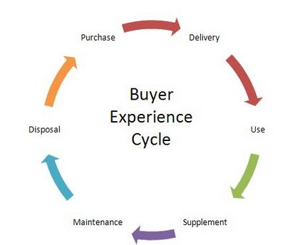
The Six Stages of the Buyer Experience Cycle
Spanning from purchase to disposal
Purchasing: eBay and Home Depot
Disposal: recycling
Notes:
Yetunde

Slide 7
The Six Utility Levers
Utility levers: the ways companies can unlock exceptional utility for buyers
Customer productivity
Block to utility
The buyer utility map
Ford Model T.
Convenience of use
Risk in maintenance phase

Slide 8
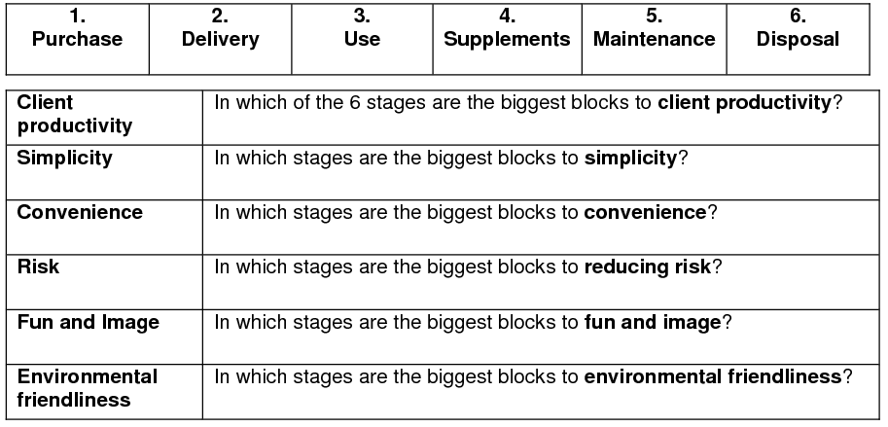
Uncovering the Block to Buyer Utility

Slide 9
Exceptional Utility to Strategic Pricing
To secure a strong revenue stream for your offering, you have to set the right strategic price.
Many companies may take the reverse course and test the product in different situations before deciding to their strategic pricing.
Volume generates higher returns than it used to.
Network externalities
Rival good vs. Nonrival good
The notion of excludability and free riding

Slide 10
Exceptional Utility to Strategic Pricing
Strategic pricing must not only attract but also retain buyers
Offer that can not be refused
Exceptional utility
Imitation is discouraged
Price corridor of the mass
The right price for an irresistible offer

Slide 11
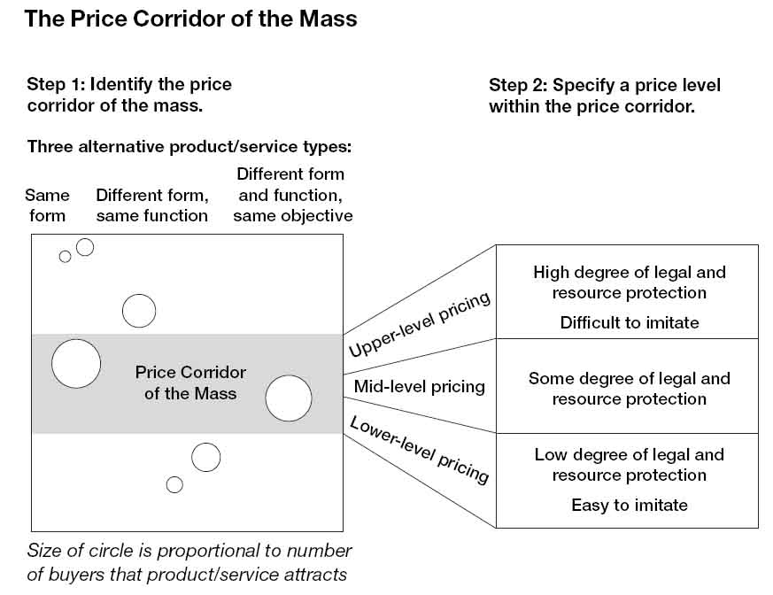
The Pricing Corridor of the Mass

Slide 12
The Pricing Corridor of the Mass
Step 1: Identify the Price Corridor of the Mass
Step 2: Specify a Level Within the Price Corridor
Step 3: Target Costing Applications

Slide 13
Step 1: Identify the Price Corridor of the Mass
Look outside your industry at different form products to better understand price sensitivity.
Different form, same function
Ford Model T vs horse-drawn carriage
Southwest Airlines vs cars
Different form, same objective
Cirque du Soleil vs bars and restaurants
This helps identify where the mass of target buyers is and what prices these buyers are prepared to pay for the products and services they currently use.

Slide 14
Step 2: Specify a Level Within the Price Corridor
Determine how high a price they can afford to set within the corridor without inviting competition from imitation products or services.
Depends on two principal factors:
The degree to which the product or service is protected through patents or copyrights.
The degree to which the company owns some exclusive asset or core capability.
ex: Dyson Vacuum Cleaners

Slide 15
Step 2: Specify a Level Within the Price Corridor (Cont.)
Uncertain patent and asset protection ⇒ Middle of the corridor
No protection ⇒ Low part of the corridor
Low to Mid boundaries should be pursued if the following applies:
Their blue ocean offering has high fixed costs and marginal variable costs
Their attractiveness depends heavily on network externalities
Their cost structure benefits from steep economies of scale and scope

Slide 16
Step 3: Target Costing Applications
To maximize the profit potential of a blue ocean idea, a company should start with the strategic price and then deduct its desired profit margin from the price to arrive at the target cost.
Target Cost = Strategic Price - Desired Profit Margin
Build a strategic profile that has not only divergence but focus, which makes a company strip out costs.
Cirque du Soleil eliminated costs of animals and other stars
Ford made the Model T in one color and one model

Slide 17
Step 3: Target Costing Applications (Cont.)
If companies just focus on increasing strategic price or cutting back on utility, they are not on the path to lucrative blue waters.
Can the product’s or service’s raw materials be replaced by unconventional, less expensive ones?
Can high-cost, low-value-added activities in your value chain be eliminated?
Can the physical location of your product or service be shifted from prime real estate locations to lower-cost locations?
Can you reduce the number of parts or steps used in production by shifting the way things are made?

Slide 18
From Strategic Pricing to Target Costing
Target Costing
To maximize profit of a blue ocean idea, start with the strategic price, deduct its desired profit margin to arrive at the target cost.
Price-minus cost method
Essential in order to arrive at a cost structure that is profitable and hard to match

Slide 19
Target Costing
When target costing is driven by strategic pricing = aggressive
Ford “Model T”
Assembly line
Cut labor hours by 60%
To hit target cost, companies have 3 levers
Streamline operations and introduce cost innovations
Partnerships
Change the pricing model

Slide 20
From Utility, Price, and Cost to Adoption
A company’s three main stakeholders
Employees
Business Partners
The General Public
Before investing in idea, the company must educate the stakeholders

Slide 21
Employees
Failure to address the concerns of employees on the impact of a new business idea can be expensive:
Merrill Lynch - online brokerage service
Make employees aware of threats; create a “win-win”
Morgan Stanley - open internal discussion of strategy towards internet challenges.
Employees understood the need for e-venture
Company shares rose 13% when venture was launched

Slide 22
Business Partners
Business partners often fear that their revenue streams or market positions are threatened by a new business idea.
SAP introduces “ASAP”
ERP system designed for small - medium business
The problem: Development of best-practice templates for ASAP required cooperation of large consulting firms who derived substantial income from lengthy implementation of SAP’s other products.
The solution: SAP resolved the dilemma by openly discussing issues with partners; executives were able to convince consulting firms that they stood to gain more business by cooperating.

Slide 23
The General Public
The general public often opposes new business ideas especially in the new idea is very new and innovative.
They are threatened by potential social or political changes.
PepsiCo- Caramel Coloring

Slide 24
Blue Ocean Idea Index
Utility
Is there exceptional utility?
Are the compelling reasons to buy?
Price
Is the price easily accessible to the mass buyers?
Cost
Does the cost structure meet the target cost?
Adoption
Have we addressed adoption hurdles up front?

