Slide 1
ExxonMobil
Dylan Taylor
Jenny Broussard
Grant Moffett
Scott Bednorz

Slide 2
Industry: Characteristics
Price of Oil and Natural Gas
Exploration and Production
Government Regulation

Slide 3
Change
Innovation and alternatives
Change in Governmental policies
Stakeholders

Slide 4
Major Competitors
Shell
Chevron
Marathon
British Petroleum
Conoco Phillips

Slide 5
Key Success Factors
Successful Exploration
Impression on Environment
Leases and Drilling rights

Slide 6
Current Industry Attractiveness
Very high on Oil side
Price of Oil is high
Extremely high demand for blue collar rig workers

Slide 7
Kearl Project
Oil/Tar Sands of Canada
Alberta Energy Resources Conservation Board
Plan to turn out 345,000 BPD

Slide 8
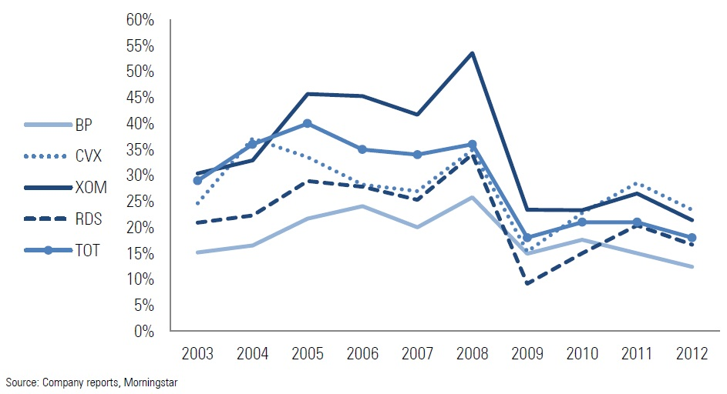
Relative Cost Position
Low cost intangible assets and low cost capital
Upstream Returns on Average Capital Employed (XOM)

Slide 9
Strategy
Fix public outlook on ExxonMobil (get CEO in line)
Focus on downstream sales (more creative with gas stations)
Capitalize on Kearl Project
Focus on Oil not natural gas

Slide 10
Economic
Price of Oil $95.51 per barrel
Price of Gas $4.64 per thousand cubic feet
Rival local gas stations (price wars)

Slide 11
Political Factors
Government Regulation
Fracking
Educating public on true dangers and facts on drilling (ExxonMobil website)

Slide 12
Environmental Threat and Opportunity Profile
Five Factors
Economic
Political
Social
Technological
Geographical

Slide 13
Economic Factors
Fiscal and monetary policies
Recession effects
Effects of a down turning or struggling economy

Slide 14
Political Factors
Political Instability
OPEC embargo
Government regulations
Fracking
Drilling in Alaska

Slide 15
Social Factors
Age and income distribution, education, and values
Customers values affect their perception of company

Slide 16
Technological Factors
Changing and new technology
More effective
Make getting oil cheaper and easier

Slide 17
Geographical Factors
Ability of corporate offices and gas stations to be anywhere
Oil can only be found in certain areas
Not overly abundant

Slide 18
Company Capability Profile

Slide 19
Company Capability Profile

Slide 20
Company Capability Profile

Slide 21
Company Capability Profile

Slide 22
Industry Assessment
Environmental Stability
Strength of the Industry

Slide 23
ExxonMobil History
1870
Standard Oil is established by John D. Rockefeller
1911
Standard Oil breaks up into 34 different companies, including Jersey Standard, Socony, and Vacuum Oil
1931
Socony and Vacuum Oil Company merge to form Socony Vacuum
1955
Mobil celebrates 100 years since founding the Vacuum Oil Company in 1866 and changes the company name to Mobil Oil Corporation
1966
1972
Jersey Standard changes its name to the Exxon Corporation
1989
On March 24th, the Exxon Valdez tanker crashes in Prince William Sound, AK, spilling over 11 million gallons of crude oil
1999
Exxon and Mobil join to form ExxonMobil Corporation, the largest company in the world
2010
ExxonMobil acquires XTO Energy Inc.
Socony Vacuum becomes Socony Mobil Oil Company

Slide 24
Organization Chart
ExxonMobil
13 Board of Directors
Rex Tillerson Chairman & CEO
Upstream
Downstream
Chemical
Other
6 Presidents
3 Presidents
1 President
1 President

Slide 25
Upstream
XTO Energy Inc.
R.J. Cleveland
ExxonMobil Development Company
N.W. Duffin
ExxonMobil Gas & Power Marketing Company
R.S. Franklin
ExxonMobil Exploration Company
S.M. Greenlee
ExxonMobil Upstream Research Company
S.N. Ortwein
ExxonMobil Production Company
T.R. Walters

Slide 26
Downstream
ExxonMobil Refining & Supply Company
D.W. Woods
ExxonMobil Fuels, Lubricants & Specialties Marketing Company
A.J. Kelly
ExxonMobil Research & Engineering Company
T.J. Wojnar, Jr.

Slide 27
Chemical
Plants in 15 countries
Provides the building blocks for a wide range of products
ExxonMobil Chemical Company
President – S.D. Pryor

Slide 29
SWOT Analysis

Slide 30
Competitive Strength Assessment

Slide 31
Cultural Strengths
Maturity of organization
Level of job security
Level of technology
Degree of innovation
Sense of belonging

Slide 32
More Strengths
ExxonMobil has consistently produced the highest revenue, income, and returns on capital employed out of the top six major players.
Their financial strength and marketing capabilities are what set this company apart from their rivals.

Slide 33
Strategic Posture
Competitive: Differentiation through strong R&D efforts funded through mergers and acquisitions.
Conservative: Focus and selective diversification through acquisitions of companies in other market segments.

Slide 34
Strategy for a Sustainable Future
Sustainability starts with reducing the environmental impact of ExxonMobil’s own operations
Entails supplying value-added products that benefit customers and help them reduce their own environmental impact
These both must be done in a manner that delivers attractive returns to shareholders while benefiting society

Slide 35
Bottom Line
Sustainability is good business, benefitting the environment, customers, shareholders and society.

