Slide 1
Technology-based Industries and the Management of Innovation
Matt Powers, Kyle Harris, Shea Gordon, Bradley Peters

Slide 2
Opening Case: eBook Readers
Softbook Press (1997)
NuvoMedia (1998)
Gemstar: REB 1100, 1200
Sony PRS 500 (2006)
Amazon Kindle (2007)- 50% disc on eBooks
Barnes & Noble Nook (2010)

Slide 3
Apple iPad
2010
More functions
3rd-4th quarter sales: 3 - 7.3 Million
Many copies
Publishers free to set retail price
Amazon soon followed suit

Slide 4
The Innovation Process
Key link between technology and competitive advantage: innovation
Basic Knowledge
Invention: creation of new product
Innovation: initial commercialization of invention
Diffusion:
Demand (customer purchase)
Supply (imitation by competitors)

Slide 5
Who Profits from Innovation?
Innovator
Imitators and “followers”
Suppliers
Customer

Slide 6
Competitive Advantage in Innovation
Property Rights
Complexity of Technology
Lead-Time
Complementary Resources

Slide 7
Who Will Appropriate the Value of E-Book Readers?
Difficult to establish strong property rights
ARM Holdings is the exception
Innovation is easy to reproduce
Major players are adapting to technology
E-Book sales have the advantage over e-reader sales

Slide 8
Strategies to Exploit Innovation
Licensing
Outsourcing Certain Functions
Strategic Alliance
Joint Venture
Internal Commercialization

Slide 9
Timing Innovation: Lead or Follow?
Evidence is mixed
Success Factors of Early Movers:
Protection of Property Rights
The Importance of Complementary Resources
The Potential to Establish a Standard
Resources and capabilities has largest effect on strategic window
Sometimes best for both: Apple and IBM

Slide 10
Managing Risks
Two main sources of uncertainty
Technological Uncertainty
Market Uncertainty
Useful strategies for reducing risk
Cooperating with lead users
Limiting risk exposure
Flexibility

Slide 11
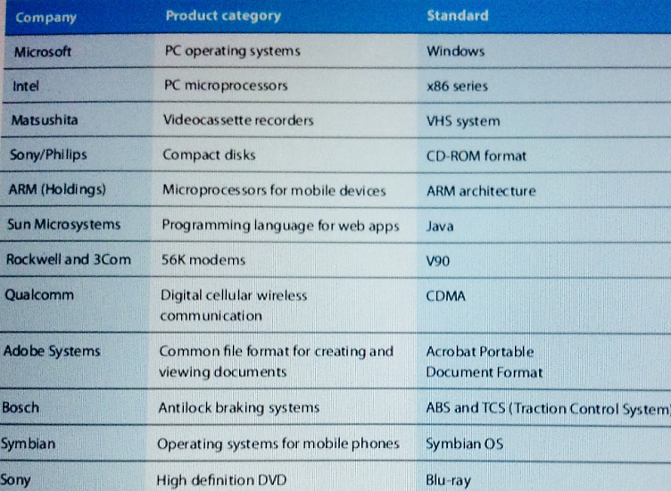
Competing for Standards
Standard:
A format, an interface, or a system that allows interoperability (the ability to exchange and use information).

Slide 12
Standards
Public (open)
Standard that are available to all either free or for a nominal charge.
Linux, freeware, etc.
Private (proprietary)
Standards where the technologies and designs are owned by companies or individuals.
Microsoft Windows, iPod, etc.
Notes:
A problem with effective standards is that they may take a long time to emerge, resulting in a duplication of investments and delayed development of the market.

Slide 13
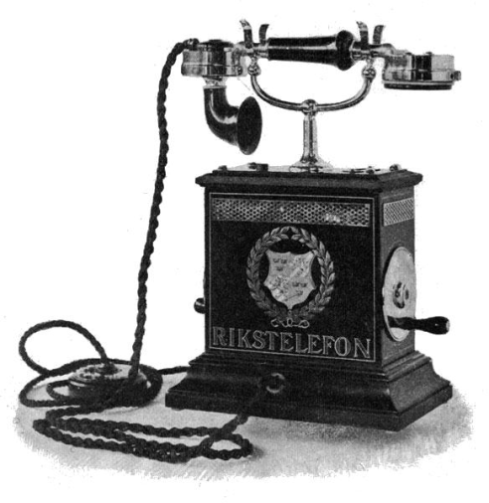
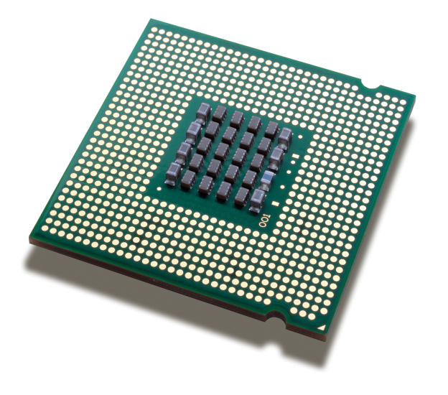
Standards
Network Externalities:
Whenever the value of a product to an individual customer depends on the number of other users of that product.
Requires that the products are compatible with one another.
Notes:
Negative externalities: the value of the product is less is many other people purchase the same product
Positive feedback:
Once technology gains market leadership, it attracts a growing proportion of new buyers
Intel
Tipping
“winner takes all scenario”
Intel vs. AMD
Markets subject to significant network externalities tend to be dominated by a single supplier (microsoft for pc operating systems, ebay for internet auctions, amazon for online shopping.
Once est., tech and design standards tend to be highly resilient. Standards are difficult to displace due to learning effects and collective lock-in. Intel vs. AMD

Slide 14
Winning Standard Wars
Determine whether we are competing in a market that will converge around a single technical standard.
Intel x86
Recognize the role of positive feedback
Notes:
Control over standards = competitive advantage
The tech that can establish early leadership will rapidly gain momentum
Adopt evolutionary strategy (i.e. backwards compatibility) vs. revolutionary compatibility (new iphone charger)

Slide 15
Winning Standard Wars
Assemble Allies
Pre-empt the market
Manage expectations
Notes:
Control over an installed base of customers
Owning intellectual property rights
Ability to innovate and adapt
First-mover advantage
Strength in complements
Reputation and brand name

Slide 16
Creating the Conditions for Innovation
Innovation is an act of creativity requiring knowledge and imagination
“Essence of play”
Creative abrasion
Notes:
Nurturing the drive to create may require a degree of freedom and flexibility hat conflicts with conventional HR practices
Creative abrasion: fostering innovation through the interaction of different personalities and perspectives

Slide 17
Balancing Creativity and Commercial Direction
Disney’s acquisition of Pixar
In emerging and technology-based industries, nurturing and exploiting innovation is the fundamental source of competitive advantage.

Slide 18
Valve
Creation of “steam”

Slide 19
Stimulating new product development
Cross-functional Product development team
Product champions
Buying innovation
Open innovation
Corporate incubators

Slide 20
Around the World
Innovation | Strategy | Standards | Creativity
What company created the Kindle eBook reader? | Who benefits greater in profit: E-Books or e-readers? | What does a public standard mean? | Give and example of buying innovation.
What is the definition of invention? | Name one of the success factors for early movers/innovators | What is one of the three steps for winning standards war? | In the Disney example what company did they acquire to boost innovation?
When was the Apple iPad released? | What company was able to hold strong property rights in the E-Book market? | Why is control over standards important? | Explain what the term Corporate Incubators means.
What company purchased the patent of xerography to launch office copiers in 1958? | Name two of the three useful strategies in reducing risk. | What is creative abrasion? | What is a cross functional product development team?
How long does a patent last in the U.S.? | Which of the 5 strategies to exploit innovation requires the least amount of resources? | What is evolutionary strategy | Name all 5 organizational approaches to the management of innovation
1
1
1
1
1
1
1
1
2
2
2
2
2
2
2
2
3
3
3
3
Notes:
Innovation:
1. What company created the Kindle eBook reader? Amazon
2. What is the definition of invention? The creation of new product (or process)
3. When was the Apple iPad released? 2010
4. What company purchased the patent of xerography to launch office copiers in 1958? Xerox
5. How long does a patent last in the U.S.? 17 years
Strategy:
Easy
Who benefits greater in profit: E-Books or e-readers?
E-Books
Name one of the success factors for early movers/innovators
Protection of Property Rights
The Importance of Complementary Resources
The Potential to Establish a Standard
Medium
What company was able to hold strong property rights in the E-Book market?
ARM Holdings
Name two of the three useful strategies in reducing risk.
Cooperating with lead users
Limiting risk exposure
Flexibility
Hard
Which of the 5 strategies to exploit innovation requires the least amount of resources?
Licensing
What does a public standard mean?
open ware or afforable software/tech
What is one of the three steps for winning standards war?
Assemble Allies
Pre-empt the market
Manage expectations
Why is control over standards important?
competitive adv
What is creative abrasion?
fostering innovation through the interaction of different personalities and perspectives
What is evolutionary strategy
backwards compatability

