Slide 1
Chapter 6, BOS: “Get the Strategic Sequence Right”
Team II
Josh Pavlik, Jennifer Rogas, Logan Reynolds, Corbin Ray, Marlee Armstrong, Amy Drake

Slide 2
The Next Step
So far, you’ve discovered possible blue oceans, constructed a strategy canvas for that blue ocean, and you’ve explored how to aggregate the largest possible mass of buyers for your idea.
The next challenge is to build a robust business model to ensure that you make a healthy profit on your blue ocean idea.

Slide 3
The Sequence of Blue Ocean Strategy

Slide 4
The Revenue Side
Buyer Utility
Does your offering unlock exceptional utility?
Is there a compelling reason for the mass of people to buy it?
Price: set the right strategic price
Is the offering priced to attract the mass of target buyers so that they have a compelling ability to pay for your offering?

Slide 5
Final Two Steps
Cost
Can you produce your offering at the target cost and still earn a healthy profit margin?
Can you profit at the strategic price- the price easily accessible to the mass of target buyers? (You should NOT let costs drive prices)
Adoption
What are the adoption hurdles in rolling out your idea? Ex: potential resistance to the idea by retailers or partners

Slide 6
Testing For Exceptional Utility
Utility: Product or service that is useful
Many companies fail to deliver exceptional value because they are obsessed by the novelty of their product or service, especially when new technology plays a part in it.
Example: Phillips CD-I and the technology trap

Slide 7
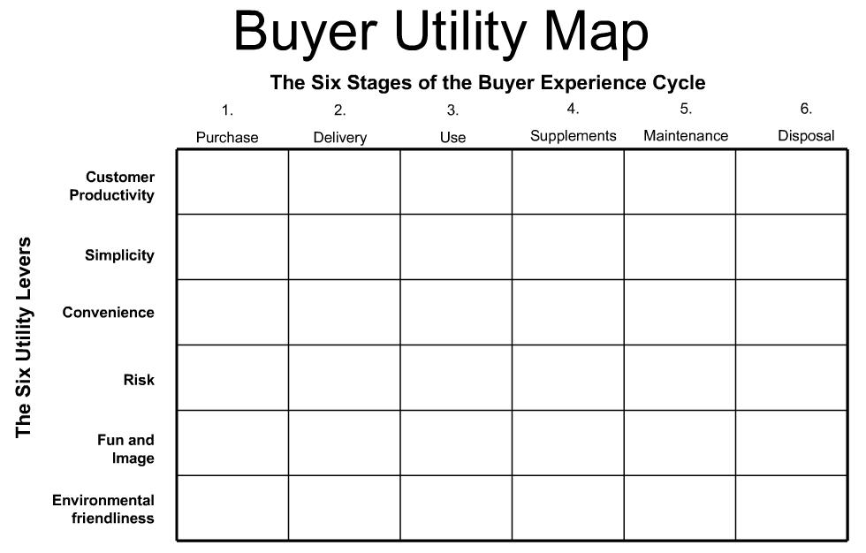
The Buyer Utility Map
Outlines all the levers companies can pull to deliver exceptional utility to buyers as well as the various experiences buyers can have with a product

Slide 8
6 Stages of the Buyer Experience
The columns of the table represent the 6 stages of the buyer experience cycle
These are all the activities a buyer will do with the product
Purchase
Delivery
Use
Supplement
Maintenance
Disposal

Slide 9
Utility Levers
The rows of the table represent the 6 utility levers
The utility levers are the ways in which utility or value can be offered to the customer:
Productivity
Simplicity
Convenience
Risk
Fun and Images
Environmental friendliness

Slide 10
Uncovering Blocks to Utility
To test for exceptional utility, companies should check whether their offering has removed the greatest blocks to utility
Ask the Question: In which stage are the biggest blocks to convenience?
The greatest blocks to utility often represent the greatest opportunities to unlock value

Slide 11
From Exceptional Utility to Strategic Pricing
Set the right Strategic Price
Strong Revenue Stream
Customers want to purchase
Have the means to pay
Numerous companies do the Opposite
Price high to novelty seekers
Price to mainstream overtime

Slide 12
Two Reasons to Strategically Set Price
Volume Generates Higher Returns
High initial R&D costs subsequent lower costs in the future
Example: Apple OS initially cost billions, selling to the masses cost the means of delivery, a CD
To a buyer, value of product is tied to the number of total users
Example: EBay, the website would not be utilized if only a few used the services

Slide 13
Important Vocab
Rival Good: Once used by one firm can not be used by another
Employees
Raw Material
Non-rival Good: Use by one firm does not limit its use by another
Virgin Atlantic Airways- Upper Class Brand
Can be mimicked by other airlines

Slide 14
Important Vocab & Meaning
Excludability: Dependent on nature of product and legal system
Excludable if you can prevent others from using it
Patents-excludable
Floor Plan/Business Idea or Plan- not excludable
Strategic Pricing
Must attract large numbers of buys
Must Retain them

Slide 15
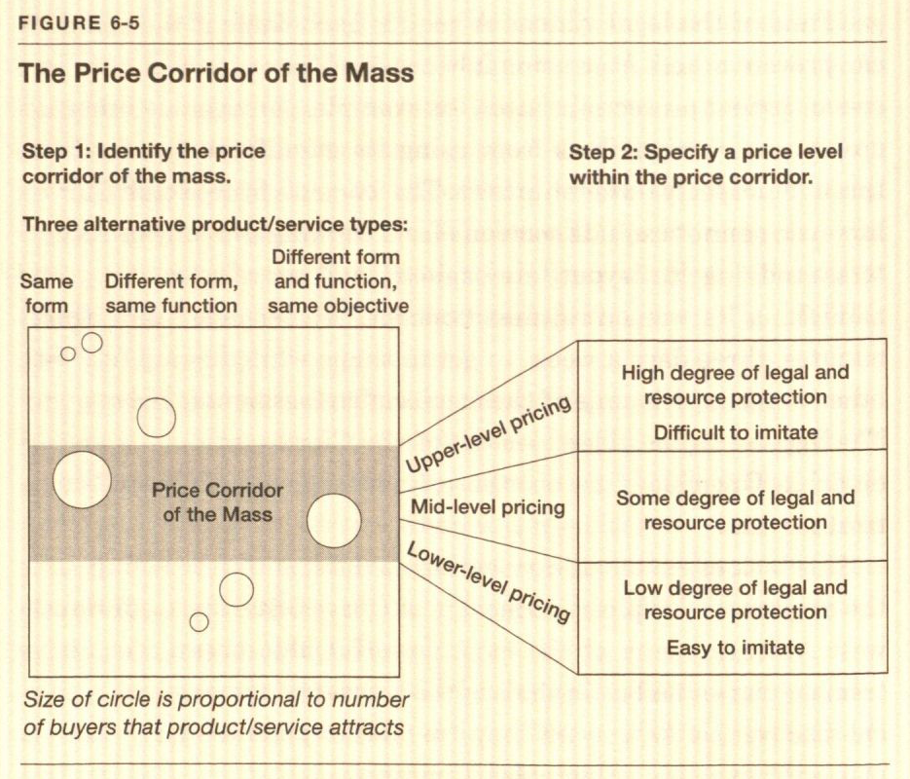

Slide 16
ID Price Corridor of the Mass
Challenge- Understand the price sensitivities of your potential customers
List Products and Services into 2 Categories
Different Form same Function
Same core utility, different form
Ford Model T
Priced against horse draw carriages VS auto industry
Families from point A to B
Different Form and Function, same Objective
Cirque de Soleil, night time entertainment
Competes with bars, movies…
Price against industries that have the same goal

Slide 17
Specify a Level Within the Price Corridor
How High to Price within the Corridor?
Two Principle Factors
Degree of protection legally through patents and copyrights
Ownership of exclusive assets or core capabilities
Manufacturing plant, knowledge…
Mid to Low Pricing if…
Blue Ocean high FC & marginal VC
Attractiveness depends heavily on network externalities
Cost Structure benefit from steep economies of scale
Volume brings significant cost advantages

Slide 18
From Strategic Pricing to Target Costing
3rd step in strategic sequence is target costing
Use PRICE-MINUS costing to arrive at TARGET COST
Strategic Price
- Desired Profit Margin
Target Cost
Price-minus costing allows maximization of profit potential

Slide 19
After calculating target cost, companies must find ways to meet the target cost
Company should NOT increase the strategic price to meet the target cost; this leads to decreased profit potential
Companies should utilize the 3 Principal Levers to hit target cost:
1) Streamlining and cost innovations
2) Partnering
3) Pricing innovation

Slide 20
1) Streamlining and Cost Innovations
Streamlining operations and introducing cost innovations from manufacturing to distribution
Use less expensive raw materials
Metal to plastic
Eliminate, reduce, or outsource high-cost, low-value activities
Move to lower-cost location
Southwest uses secondary airports instead of major ones
Reduce number of parts or steps in production process
Swatch reduced parts in watch from 150 to 51

Slide 21
2) Partnering
Partnering allows a company to utilize other companies’ expertise and capabilities to decrease costs
IKEA meets its target cost by partnering with around 1,500 manufacturing companies to find the lowest prices for materials and production
Nike partnered with Apple to use Apple’s technological expertise and production facilities to create its Nike + iPod running shoes

Slide 22
3)Pricing Innovation
When the first two principal levers do not make it possible for the company to meet its target cost, the company should change the pricing model of the industry
Blockbuster rented videos for a few dollars when no one would buy them at the initial price of around $80
NetJet uses a timeshare to make its jets available to corporate customers who do not want to purchase a jet
HP gave servers to Silicon Valley startups in return for part of their revenues
Companies were able to meet target cost while still earning large amounts of revenue

Slide 23
From Utility, Price, and Cost to Adoption
Blue Ocean Ideas do not always guarantee success
Changing your business model to incorporate blue ocean ideas can provoke fear and resistance among a companies 3 main stakeholders:
Employees
Business Partners
General Public

Slide 24
Addressing Employees
Failure to adequately address the concerns of employees about the impact of a new business idea can be expensive
Merrill Lynch’s stock price fell by 14% because of resistance among employees
Companies should make a conscious effort to communicate their awareness of the threats posed by execution of new plans
Companies should work with employees to find ways of defusing the threats so everyone in the company wins
Morgan Stanley engaged employees in an open discussion to address the new strategies and by doing so the company's shares rose 13%

Slide 25
Addressing Business Partners
Business Partners are fearful that their revenue streams or market positions are threatened by the new business idea
Because implementing new ideas can be harmful to the company's market position, it is important to communicate and ensure the success to the partners
SAP incorporated a new software program that left investors skeptical, but by engaging in an open discussion the SAP executives were able convince the partners that they stood more to gain more business than to lose

Slide 26
Addressing the General Public
If your new business ideas are very new and innovative, it could threaten social or political norms
It is important to make the public aware of the new business plan and how it can benefit them and not harm them
Make the public a part of your new ideas and you will eliminate some of the public outcry against your companies efforts

Slide 27
The Key Challenges
Engage in open discussion about why the adoption of the new idea is necessary
Explain the new ideas merits, set clear expectations for its ramifications, and describe how the company will address them
Remember that stakeholders need to know that their voice have been heard
Companies that take the time to have such discussions with stakeholders will find that it considerably repays the time and effort involved

Slide 28
The Blue Ocean Idea Index
What is BOI Index?
A simple but robust tool to verify if a new business idea meets the criteria of a Blue Ocean Strategy.
Often, companies believe that a great idea is enough to generate a commercial success.

Slide 29
The Blue Ocean Idea Index
Great ideas must create a significant leap in buyer utility.
Offering must be priced so that it is within the reach of the mass of target buyers, while at the same time guaranteeing a profit to the company by reducing cost structure.

Slide 30
Blue Ocean Idea Index cont.
Managers need to ensure that before going through the strategy, they have to address the following:
Company fears
Resistant employees
Business partners
General public
All need to be on the same page in response to change.

Slide 31
What Does BOI Index Test?
Does the new offering provide exceptional utility?
Is the price easily accessible to the mass of target buyers
Does the cost structure meet the target cost?
Are adoption hurdles addressed up front?
If the answer is no to any step, it is important to return until the answer is yes.

Slide 32
Brief Summary of Concepts
Building a Business Concept
Buyer Utility Map
Strategic Price Setting
Target Costing
Business Relations
Partners
Employees
Customers

