Slide 1
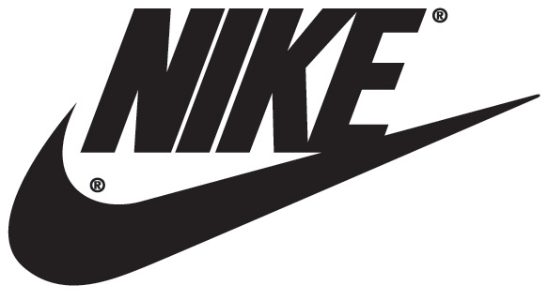
Team 3: Riley Drummond Andrew Rich Rick Henson James Everett Brittany Fowlkes Ann-Marie Nanny Kara vickers
Nike, Inc.

Slide 2
Company Background
Founded Jan. 25, 1964 as Blue Ribbon Sports by Bill Bowerman and Philip Knight & officially became Nike, Inc. on May 30, 1978
The largest publicly traded sportswear & equipment supplier & the leading supplier of athletic shoes & apparel w/ 2010 revenues of over $19 billion
Operates over 20,000 retail accounts in the U.S. alone and is known for sponsoring some of the most high profile athletes and sports teams around the world with trademarks of “Just Do It” & the Nike Swoosh logo

Slide 3
Industry Profile
In 1998, American consumers spent approx. $38 billion purchasing more than 1.1 billion pairs of shoes
Athletic footwear accounts for 35% of all footwear purchases
Due to recession sales in athletic footwear dropped, however, sales are back on the rise & Nike is combating this by continuously creating new, cutting edge, quality styles at reasonable price points

Slide 4
Industry Profile
Sales are improving in the areas of running shoes, cross-trainers, & basketball shoes slightly but surely, so companies with strong brands such as Nike, are increasingly turning to international markets for growth
Nike & Adidas pretty much set the standard currently with Reebok, Puma, & Under Armour as lurking competitors
Barriers to entry:
-There are a few, the athletic footwear industry is a very competitive industry with a mature market and very well established leaders of the industry, namely Nike
-Economies of Scale: must compete on all levels such as reasonable pricing, efficient production, and high quality products. This is hard to accomplish without the resources of an already est. manufacturer, which is what Nike has capitalized on

Slide 5
Industry Profile
Leaders in the footwear industry, such as Nike, have made the industry what it is today & it will forever be hard to compete with them
Industry is stuck in a red ocean due to it being already so saturated & uneasy for new entrants to enter
Nike has tried to break this trend with their evolving, new lightweight running shoe, which they first came out with and other companies followed suit

Slide 6
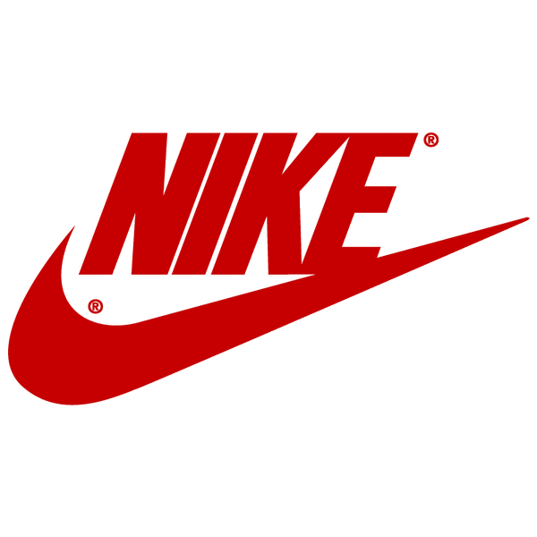
Competitive Stengths →→→ Distinctive Competencies
Distinctive competency
-irreplaceable, rare, non-substitutable, non-imitable
-company is sole benefiter of distinctive competency
NIKE® and Swoosh Design®
-very valuable (worth billions)
-trademarked

Slide 7
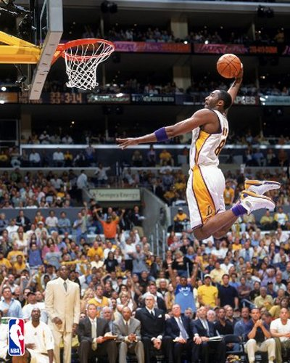
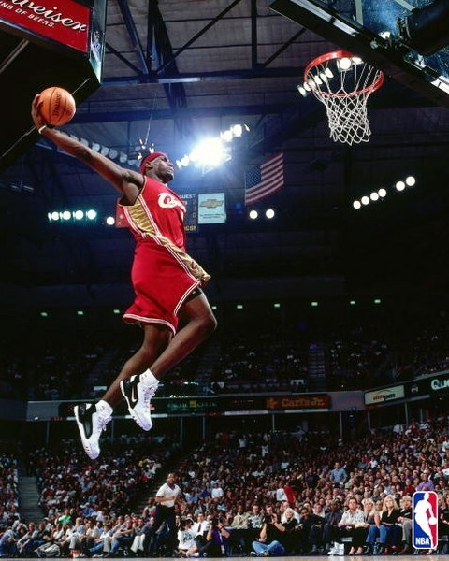
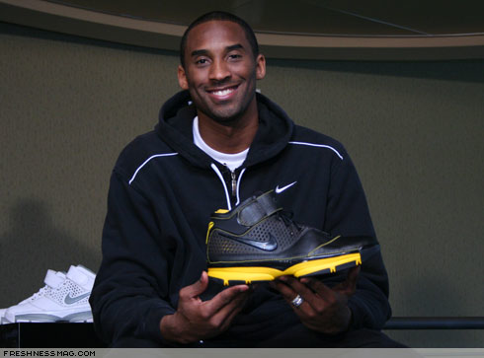
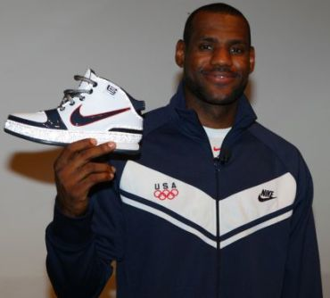
Nike’s Distinctive Competencies
The Contracting of the BEST athletes
Nike is the leader of this
Example: Kobe Bryant and LeBron James -can’t replace them, and Nike takes advantage -one of a kind

Slide 8
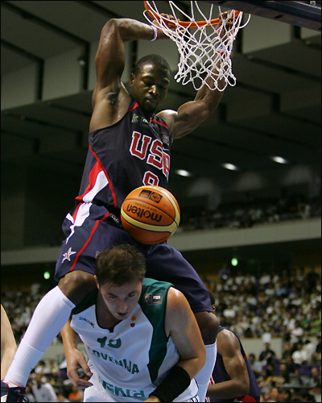
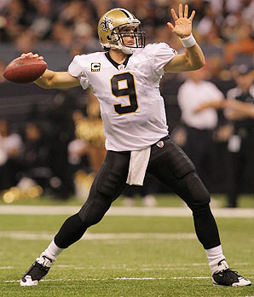
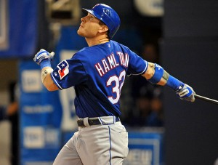
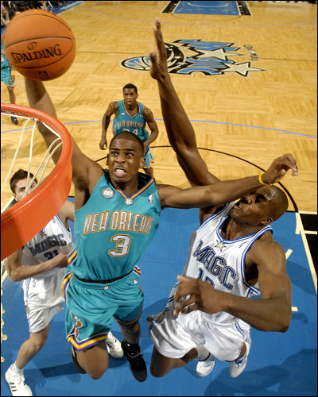
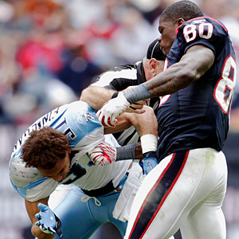
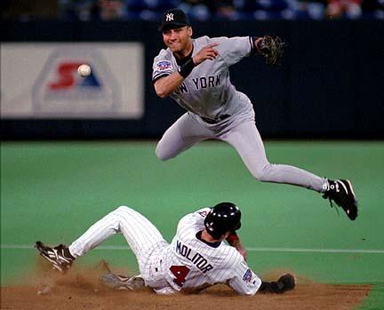
Nike’s Distinctive Competencies
Josh Hamilton
D-Wade
Drew Brees
Andre Johnson
CP3
Derek Jeter

Slide 9
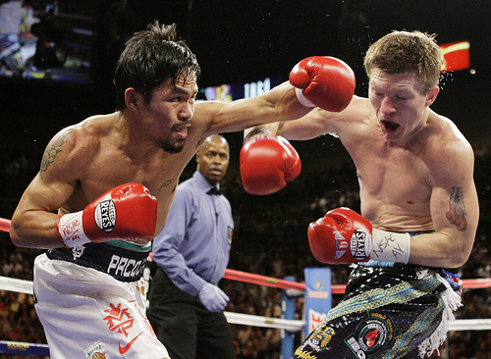
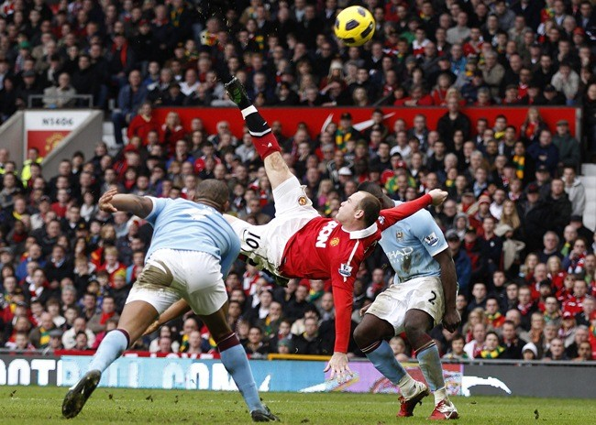
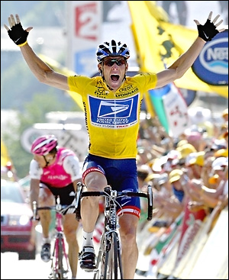
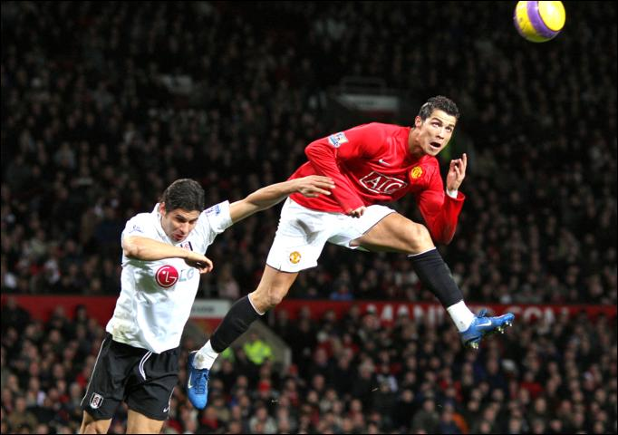
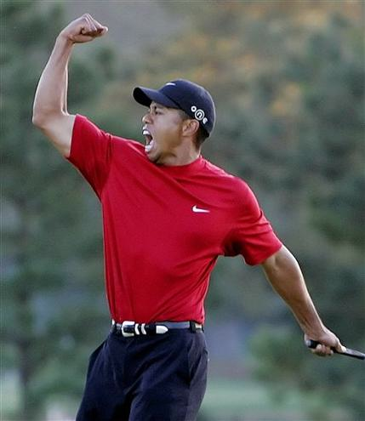
Manny
Rooney
Lance
Ronaldo
Tiger

Slide 10
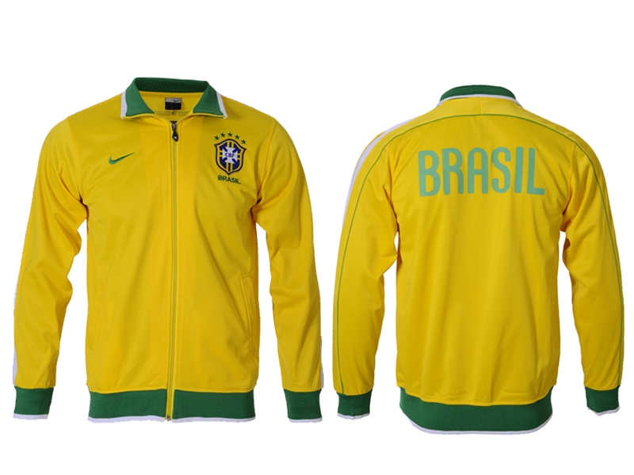
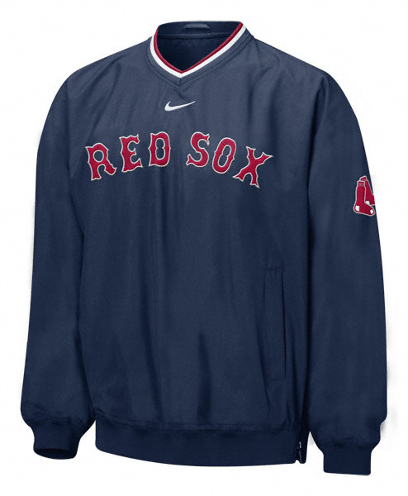
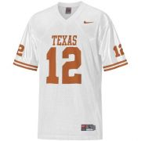
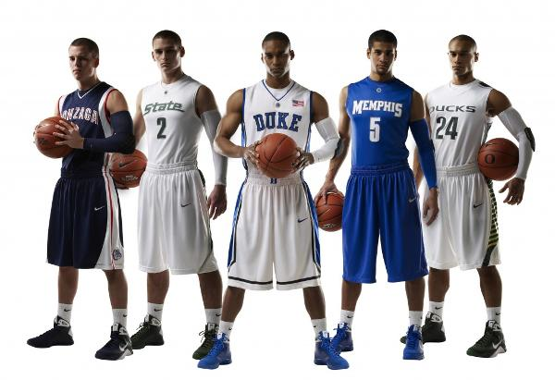
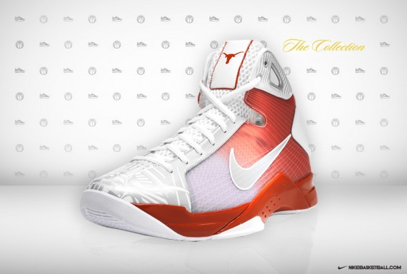
Sole Sponsor= Distinctive Competency

Slide 11
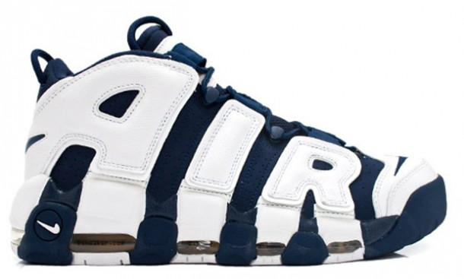
Nike’s Distinctive Competencies
Unique manufacturing process -possess many licenses and patents
-”Air” Technology (utilizes pressurized gas encapsulated in polyurethane)
-Allows for more efficient and effective manufacturing than competitors

Slide 12
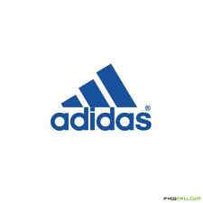
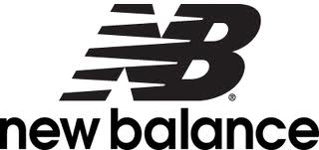
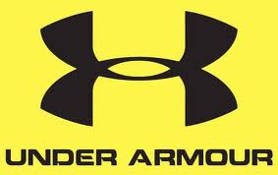
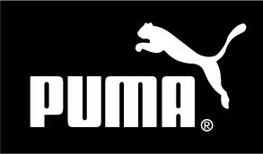
Porter's Five Forces Model
Intensity of rivalry between firms: High
Highly competitive industry
Strong brand identity and product differentiation
R&D is the key to assessing the market
Nike’s biggest competitors are Adidas, New Balance, puma, and recently Under Armour

Slide 13
Porter’s Five Forces Model
Bargaining power of buyers: Moderate
Price sensitivity affects customers desire to buy
However, Nike has created a strong loyalty based clientele which ultimately decreases their buying power
Bargaining power of suppliers: Low
Raw materials are commodities
Low switching costs

Slide 14
Porter’s Five Forces Model
Threat of New Entrants: Low
New entrants suffer a severe cost disadvantage
Intense competition and price conscious consumers limit industry growth
Maturing industry
Threat of Substitutes: Low
There are very few substitutes for sports performance shoes

Slide 15
Competition
Firms compete on:
Pricing
Innovation
Nike id, the Hyper-DUNK
Product differentiation
Marketing strategies
Celebrity Endorsements
Nike “The Chosen”
Adidas

Slide 16
Nike SWOT Analysis
Distinctive competencies in areas of mkt, consumer brand awareness, & brand power
Inability to easily be replicated
Value/benefit offered is unmatched
Star athletes associated w/ slogans such as “Just Do It”
Positive influence with younger consumer
Strong R&D dept. always coming out with biggest, latest trend
Mkt is very price sensitive
Footwear industry suffers from tight competitive rivalry
Mkt is very saturated
Bad publicity in late 90’s from int’l labor practices still plagues Nike
Footwear Industry is stuck in a red ocean
Strengths
Weaknesses

Slide 17
Nike SWOT Analysis
Technology is always changing
Large global mkt & large acceptance all over globe
Athletic shoes have become a staple in wardrobes worldwide
Increasing # of people starting to exercise
Trend towards more casual footwear
Cost cutting due to restructuring of operations will give Nike a chance to price products competitively
Increasing financial recovery overseas
Rise of the internet is cutting out the middle man, therefore, cutting costs
R&D is becoming more prominent & producing cutting edge trends
Industry is very price competitive
Industry has reached a level of maturity
Companies now need to differentiate their lines
Inflation is threatening the U.S. economy, which is in turn causing a cutback in consumer spending
Consumers are shopping for the better deal
Consumer now maintains more control in the market
Consumers are more industry savvy about their purchases
Consumers may be scanning the market for new & different designers who have the next up and coming design
Opportunities
Threats

Slide 18
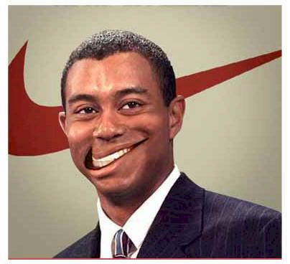
Key Success Factors
Marketing Activities
Research and Development
Production and Manufacturing
Extensive Distribution Facilities
Wide Range of Products
Capable Workforce
Innovative Activities

Slide 19
Strategic Issues and Problems
Sweatshop image in the 90’s
With overseas production there is an increased difficulty of monitoring the quality of uncontrolled working conditions in the factories.
Solution
Now employ teams of four expatriates for each of the big three countries of China, Indonesia, and Vietnam.
Also Nike developed their code of conduct in 1992 and have implemented the code across the globe.

Slide 20
Social Responsibility
Source: www.epa.vic.gov.au/lifecycle/.../tool-1-product-lifecycle-mapping.doc
Source: www.epa.vic.gov.au/lifecycle/.../tool-1-product-lifecycle-mapping.doc
Source: www.epa.vic.gov.au/lifecycle/.../tool-1-product-lifecycle-mapping.doc
Now instead of the products being deposed of in a Landfill, Nike has set up programs to redirect the products back into the cycle.
Closed Loop System
-Reuse-A-Shoe Program
http://www.youtube.com/watch?v=DiRFVI0e_qw&feature=related
-Decrease in usage of oil and water.
-Recycles scrap materials.
Nike’s past life cycle of a product:

Slide 21
Economic Factors
Headquartered in Beaverton Oregon
Sells products through retail stores, internet sales, and distributors in more than 180 countries worldwide.
As of 2010 it operated 346 retail stores in U.S. and 343 internationally
In 2010 Nike Ranked second in most valuable U.S. personal goods companies at $29,231.5 million

Slide 22
Consumption
Over a 25 year span consumers spent $300 billion on 7.5 billion pairs of athletic shoes
Nike was the first company to become a $9.5 billion company
Even when production declined in 2001 consumption increased from 1.2 to 1.3 billion pairs of shoes
Athletic footwear became the largest-selling category of footwear

Slide 23
Employment
Nike is the largest shoe company in the world with 34,400 employees
They invested in computers to combine several operations with fewer operators which reduced the handling time and number of employees in the late 2000’s.

Slide 24
Ideologies and Social Stability
Nike’s community investment strategy has three primary areas of focus
The Nike Foundation
Brand and retail engagement
Involving in a better world through sports
As a separate nonprofit organization the Nike Foundation focuses on adolescent girls in the developing world as powerful agents of change in their community

Slide 25
Ideologies and Social Stability
We see research that shows for every $1 invested in sport $4 is saved in health care costs
Nike believes that finding a way to invest more in sports and physical activities and getting others to invest in an active youth the potential that we can save on health care would dramatically cut the cost of health care.
Sports have a positive impact on economies of the world.

Slide 26
Legislation and Regulation
Nike is a member of the multi-stakeholder Observatory and Counterfeiting organization
Nike is a founding Member of Quality Brands Protection Committee
They are a member of International Anti-Counterfeiting Coalition
Nike has been a strong advocate for passage of U.S. Employment Non-Discrimination Act of 2009

Slide 27
Operating Segments of NIKE Brand
North America
Western Europe
Central/Eastern Europe
Greater China
Japan
Emerging Markets
The design
Production
Marketing and selling of sports and fitness footwear
Apparel
Equipment

Slide 28
Maximize Value for Shareholders
In 2006 Nike surpassed Wall Streets estimates of their sales and earnings
Sales reached $15 billion
Earnings per share up 18%
Over the past 5 years…
Earnings per share up 20%
Gross margins averaged 42%

Slide 29
Compared to the Footwear Industry
Nike’s performance still fell
Growth in stock
Industry 14.25%
Nike 10.48%
However
Prove to have financial stability and continuous growth

Slide 30
Nike HR & Management
Nike HR is dedicated to creating a dynamic & diverse work environment by partnering each division of the company, finding the right individuals to staff Nike’s departments
Every staff member is placed in their perfect environment where they flourish at what they do and are effective while at the same time efficient
Sports footwear industry has remained “fairly low-tech, employing low-skilled labor”

Slide 31
Nike HR & Management
Lasting impression on this model has been that human resource policies have been placing low value on Nike’s workers
Today, this view has been thrown out the window:
-Nike’s supply chain is undergoing a huge transformation by implementing a lean manufacturing system, which is an “approach that delivers the highest quality product while eliminating all types of waste”
-This new approach includes worker empowerment, giving factory workers the skills & abilities needed to manage production & immediately address issues as they arise, such as quality or process improvements

Slide 32
Nike HR & Management
Now workers have more confidence and trust in employee relations with management, creating a trustful and motivated workforce
Having this trust in employees requires a high level of support to ensure they have the skills and confidence to consistently produce top of the line products, especially footwear.
Nike management believes this transformation will be more effective and maintainable and will inspire regular change and improve the lives of their workers, Nike’s ultimate goal.

Slide 33
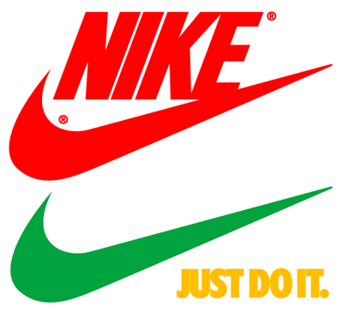
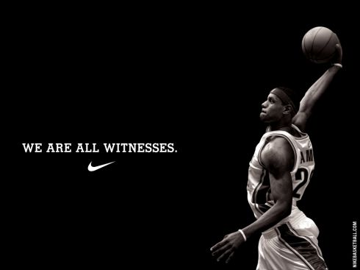
Marketing

Slide 34
Marketing
Basic Strategy: “success depends on our ability to identify, originate and define product trends as well as to anticipate, gauge and react to changing consumer demands in a timely manner”

Slide 35
Marketing
Basic Strategy: “success depends on our ability to identify, originate and define product trends as well as to anticipate, gauge and react to changing consumer demands in a timely manner”

Slide 36
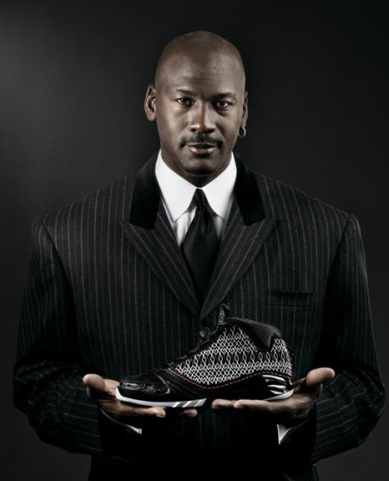
Marketing
Contracts with influential athletes, teams, coaches, sports leagues, etc.
Sponsor sporting events/clinics
2002 Secret Tournament
Product line/mix depth
Advertisement campaigns
Just Do It
The Chosen
Notes:
because NIKE is a consumer products company, the relative popularity of various sports and fitness activities and changing design trends affect the demand for our products. We must therefore respond to trends and shifts in consumer preferences by adjusting the mix of existing product offerings, developing new products, styles and categories, and influencing sports and fitness preferences through aggressive marketing. Failure to respond in a timely and adequate manner could have a material adverse effect on our sales and profitability.

Slide 37
Marketing
Demographics
53 countries
Male/female athletes between 18-35
high, medium, and low end customers with varying income levels

Slide 38
Social Factors
Nike Slam Dunk Challenge
Save The Children
Nike and RED
Fight against HIV/AIDS in Africa
Notes:
Nike has teamed up with Bono and the RED organization to form a “a two-pronged approach to fight HIV/AIDS in Africa by delivering funds to support programs that offer education and medication on the ground and will harness the power of sport to engage youth around the world in the fight against AIDS in Africa

Slide 39
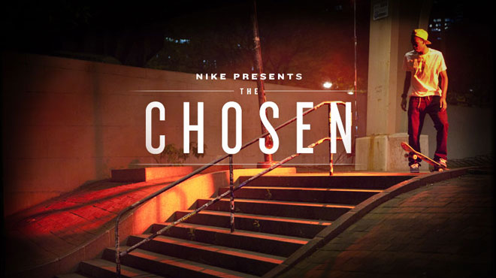
Future Strategy
Mainstream markets vs. small markets:
Growing trends
“The Chosen”

