Slide 1
Dell in Brazil
Kent Copeland
Adam Stone
Chase Luft
Eric Hamilton

Slide 2
History of Dell
Kent Copeland

Slide 3
History of Computers
Developed in mid-1940s
In 1975, the Sphere 1 was first PC
In 1977, mass-market pre-assembled computers became available
Early 1980s, consumers purchased hardware then purchased and installed software.
Michael Dell stepped in

Slide 4
What is Dell?
Dell is a multinational information technology corporation that develops, sells, and supports computers and related products and services.

Slide 5
PCs Limited
Founded November 4, 1984 in Austin, Texas by Michael Dell.
Originally called PCs Limited
Direct to consumer model
First PC was the Turbo PC ($795)
Grossed $73 million in first year

Slide 6
Dell Computer Company
In 1988, changed name to Dell Computer Company
Market capitalization grew from $50 million to $80 million
IPO of 3.5 million shares at $8.50 per share
In 1996, sold computers through their website

Slide 7
Dell Inc.
Expanded into multimedia and home entertainment
In 2003, changed name to Dell Inc.
In 2004, Kevin Rollins new CEO
Early 2005, “Most Admired Company”
Late 2005, “It’s Bad to Worse at Dell”

Slide 8
Poor Performance
Informal SEC investigation
Misreporting quarterly financial information
Class action lawsuits and NASDAQ de-listing
Restate earnings after internal audit
As of April 2010, investigation still open

Slide 9
Alienware
Acquired in 2006
Switched to AMD processors
Michael Dell resumes position as CEO

Slide 10
Dell and Linux
Alternative to Microsoft Windows
Pre-installed Ubuntu Linux operating systems
Success prompted more international marketing
Currently – Ubuntu version 8.04

Slide 11
Financials 2010
Revenue - $52.9 billion
Operating Income - $2.17 billion
Net Income – $1.43 billion
Total Assets - $33.6 billion
Total Equity - $5.6 billion

Slide 12
Financials 2010
As of December 6, 2010:
1,944,708,000 shares outstanding
$13.70 per share ($13.51 last presentation)
Market value of $26,642,499,600
P/E Ratio of 10.15
EPS of $1.35

Slide 13
Financials 2011
Second Quarter (July 30, 2010) of Fiscal Year 2011:
Revenue - $15.5 billion
Operating Income - $745 million
Net Income - $545 million
EPS - $0.28

Slide 14
Dell Facilities
Round Rock, TX
Nashville, TN
OK City, OK
Peoria, IL
Winston-Salem, NC
Miami, FL
Malaysia
China
India
UK
Philippines
Brazil
Poland
Ireland
United States
International

Slide 15
Dell in Brazil
Porto Alegre, Rio Grande de Sol in 1999
Growth of 74% in 2006
70% of customers in Southeast region
In 2007, opened Hortolandia, Sao Paulo

Slide 16
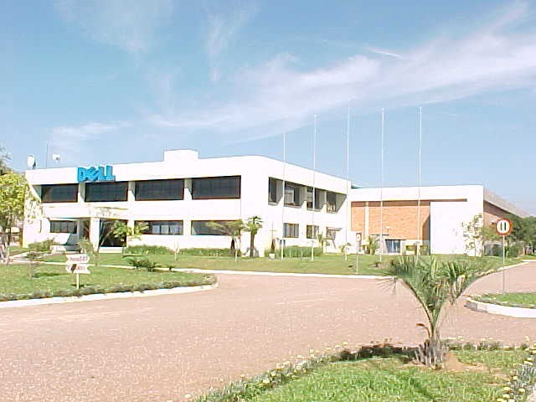
Hortolandia

Slide 17
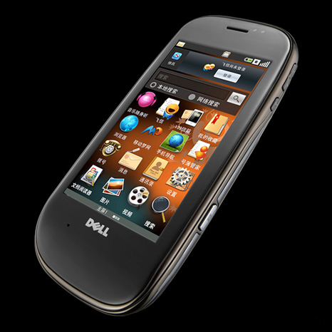
Mini 3 Smartphone
Introduced second in Brazil in 2010
Android system
Cheaper than Blackberry and iPhone

Slide 18
Challenges in Brazil
States can offer different tax incentives
Guerra Fiscal
Rio Grande de Sol used private agency, POLO
Sao Paulo didn’t offer tax breaks
Tax policies change with political parties

Slide 19
Negotiations
Dell would donate money to non-government organizations
Provide computers to low-income favelas
Direct to consumer model ensured taxes
Computers democratized the state
In the end, Dell received the same deal

Slide 20
Other Things to Consider
Register FDI with Central Bank
Capital gains subject to 15% tax when repatriated
Article of Incorporation with Registry of Companies
Federal and State VAT
Brazilian Patent and Trademark Office
Labor Issues

Slide 21
Education
Projeto Cidadao Digital
Connected Classrooms
http://en.community.dell.com/dell-blogs/education-blog/b/education/archive/2010/10/11/taking-brazil-s-educational-challenges-to-the-21st-century.aspx

Slide 22
Social Inequality
Educational Programs for the poor
Dell provides over 1,000 jobs
Protects workers from discrimination
2010 Corporate Equality Index
Perfect score (100) for 6th straight year

Slide 23
Legal – Marketing - Competition
Adam Stone

Slide 24
Foreign Investment
Foreign investment has been welcome in Brazil for a long time
Constitutes an important source of capitol for development of the Brazilian economy
Foreign Investments in currency or assets must be registered with the Central Bank of Brazil

Slide 25
Foreign capitol may be freely invested in Brazil with a few exceptions
Purchase of rural land by non-residents is restricted to 25,000 acres without requiring a permit
Non-residents are forbidden to manage press and broadcasting companies and are restricted to 30% ownership
Opening of new foreign banks in Brazil is frozen until a new law is enacted
Most of these restrictions are expected to be removed in the near future

Slide 26
Forming a New Business
Process of opening a local branch by foreign companies requires an executive order (decreto) issued by the federal government.
Two main types of business organizations in brazil
Limitada – resembles a U.S. Limited Liability Company (LLC)
Sociedade Anonima – similar to a U.S. Corporatation
Some types of Brazilian companies may be structured to qualify as “partnerships” for U.S. tax purposes.

Slide 27
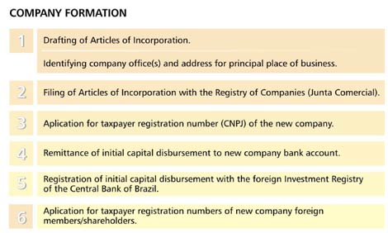

Slide 28
Labor Rights
Basic Labor rights granted through the Consolidation of Labor Laws (CLT):
Limit 44 hrs per week or 8 hrs per day (over pays 150%)
After 12 months, entitled to up to 30 days paid vacation and payment of 1/3 of the vacation
Minimum Wage: R$510/month ($302.29 US)
13th Salary: bonus paid at end of year
120 days paid maternity leave (no US laws mandate)
5 days paternity leave
30 days notice required before termination without cause
24-hour rest for each week of work, preferably on Sundays
Social Security
Employment Security Fund

Slide 29
Visas
Temporary Visa
Max of 2 years
Considered tax payer after 12 months and person’s worldwide income will be subject to Brazilian taxation
Permanent Visa
usually granted to foreigners transferred to Brazil from foreign companies to work in their subsidiaries or affiliates as officers or directors
Foreigners who marry Brazilian citizens or have Brazilian children or have a job in Brazil may also apply for a permanent visa.
Considered a taxpayer upon arrival in Brazil.

Slide 30
Taxes
Federal Taxes
Corporate Income Tax
Import Duties
Export Tax
Tax on Manufactured Products
Tax on Financial Transactions
Social Contribution on Profits
Contribution to the Social Integration Plan
Contribution for Financing of the Social Security
Provisional Contribution on Financial Movements
Contribution for Intervention in the Economic Domain
State Tax
Tax on the Circulation of Goods and Services
Tax on Vehicles Property
Tax on Donation and on Inheritances
Municipal Tax
Service Tax
Real Estate Transfer Tax
Real Estate Property Tax

Slide 31
Environmental Concerns
growing consciousness in Brazil has brought about the adoption of a National Policy Law for the Environment
Recent federal regulations that establish liability of the manufacturers of batteries for the final disposal after the end of the life cycle of the respective products.

Slide 32
Marketing
Large Customers
Small Customers
Small Customers
Consumers
Small Comapnies
Large Companies
Government and Education
Midsize Companies
Global Enterprise Accounts
Large Companies
Federal
State and Local
Education
Strategies Include:
include lowering prices at all times of the year
offering free bonus products (such as Dell printers)
offering free shipping in order to encourage more sales and to stave off competitors
Direct Model Approach
Extensive range of products and services

Slide 33
Competitors in Brazil
Positivo: Positivo has the lion's share of Brazil's retail market, accounting for nearly a third of retail sales and selling more than a million PCs last year in South America alone
Itautec: offshoot of a leading Brazilian bank, Itautec was the first PC maker in Brazil to sell Windows 3.1 preinstalled and localized in Portuguese
Semp Toshiba: Based in Salvador de Bahia, Semp Toshiba manufactures Toshiba electronic equipment under license in Brazil
World-Wide Competitors
Lenovo - Hewlett-Packard - Sony

Slide 34
Dell Business Structure
Eric Hamilton

Slide 35
Dell Business Structure
Board of Directors (governing body)
Management planning and oversight
Leadership Development and Compensation Committee
Strategic and operational planning
Financial reporting
Governance, compliance and risk management
General advice to management

Slide 36
Dell Business Structure
Committees on Board
Audit Committee
Leadership Development and Compensation Committee
Governance and Nominating Committee
Finance Committee

Slide 37
Strategic Approach
IT Infrastructure
IT Consulting
Online Buying
Cell Phones

Slide 38
Employee Training/Wages
Leadership/Professional Development Programs
Learning Through Experience
Learning Through Others
Training and Learning Programs
Wages

Slide 39
Product/Price Comparison
Laptops
Desktops
Workstations
Servers
Services
Monitors
Printers
Accessories
Price Comparisons

Slide 40
Benefits of Dell in Brazil
Chase Luft

Slide 41
Cost / Benefit for Dell
Positives
Brazil largest population in Latin America
Personal computer sales increasing greatly
Incentives (Guerra Fiscal)
Help of POLO with Rio Grande de Sul
Mercosul free trade (60% production)
Negatives
Change in State government control

Slide 42
Cost/Benefit for Brazil
Positives
Individual states could use as “anchor” investement
For Rio Grande de Sul, before change in State Government - POLO
Negatives
Guerra Fiscal created intense competition
TNC’s care only about their well being and not about country
For Rio Grande de Sul, after change in State Government - POLO

Slide 43
Success Factors
Culture Assimilation
Understanding the Brazilian Business Environment
Learning what the people like
Figure out the market for technology and as a whole
Reaching out to Latin American retailers
Working through lack of infrastructure in areas
Find ways to build stronger technology infrastructure

Slide 44
Quality Assurance
Quality Management System
Category / Task Order Specific Quality Control Plans
Annual Self-Assessments
Government Performance Assessment and Feedback

Slide 45
Future Outlook
Foreign Sales
2008, overseas growth in first quarter over 70%
Cut U.S. jobs to cut cost, but China and other booming areas see job growth with sales growth
“Green” Production
Focus on Retailers
Dropping of all kiosk stores in North America
Focus on Online and Retail sales

Slide 46
The End

