Slide 1
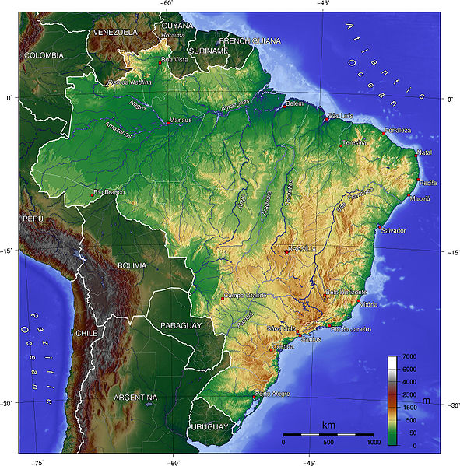
Brazil
Group Update

Slide 2
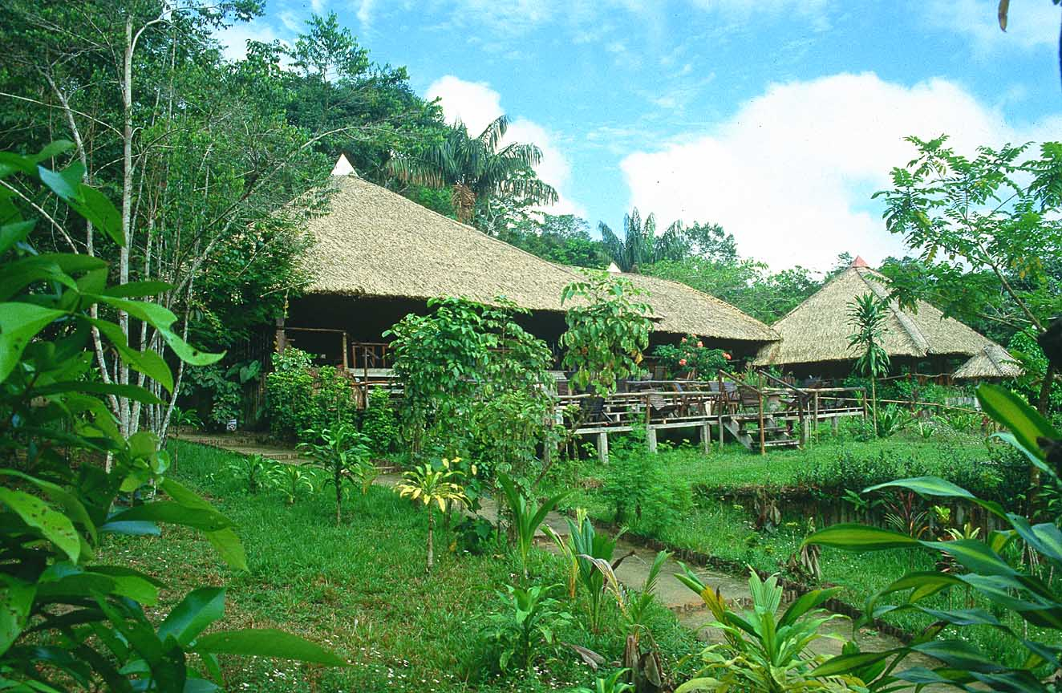
Macro Description
Kent Copeland

Slide 3
Demographics
Population – 201,103,330 (July 2010 est.)
Birth rate – 18.11/1,000 pop.
Death rate – 6.35/1,000 pop.
86% of population lives in urban areas

Slide 4
Economy
GDP – $2.013 Trillion (2009 est.)
GDP per capita - $10,100
Labor Force – 101.7 million
Labor Force Breakdown
Services = 66%
Industry = 14%
Agriculture = 20%

Slide 5
Natural Resources
Gold
Iron ore
Platinum
Uranium
Petroleum

Slide 6
Political System
Federal Republic
26 states and 1 federal district
Gained independence from Portugal on September 7, 1822

Slide 7
Environmental Issues
Deforestation of Amazon Basin
Illegal wildlife trade
Air and water pollution in large cities

Slide 8
Misc.
Legal System – based on Roman codes
Geography – 5th largest country, shares border with all but two South American countries
Climate – tropical, temperate in south
Religion
Roman Catholic = 73.6%
Protestant = 15.4%

Slide 9
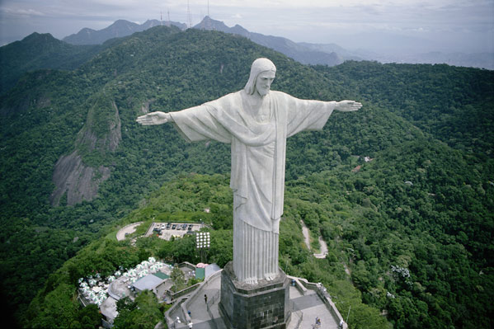
Sociological Aspects
Adam Stone

Slide 10
Religion
Worlds largest Catholic Population
73.6% Roman Catholic
15.4% Protestant

Slide 11
Education
88.6% literacy rate (age 15 and over)
4% of GDP is spent on Education
14 year school life expectancy
The official language of Brazil is Portuguese; however Spanish is spoken in border areas and taught in schools.

Slide 12
MBA Schools in Brazil
Universidade de Sao Paulo
Fundacao Getulio Vargas (Sao Paulo, Brazil)
Fundacao Getulio Vargas (Rio de Janeiro, Brazil)
Ibmec (Rio de Janeiro & Sao Paulo, Brazil)
FIA Business School (Sao Paulo, Brazil)
Universidade Federal do Rio de Janeiro
Business School Sao Paulo (BSP)

Slide 13
Universidade de Sao Paulo
Two-year Full-time MBA
Part-Time MBA
Executive MBA
International Executive MBA
Largest and most prestigious university in Brazil
75,000 students enrolled in 11 campuses
98.5% Brazilian-born students

Slide 14
Fundacao Getulio Vargas
Private Higher Education Institution
Campuses in Sao Paulo and Rio de Janeiro
Two-Year Full-Time MBA (Sao Paulo campus only)
Part-Time MBA (Sao Paulo campus only)
Executive MBA (Both campuses)
International Executive MBA (Sao Paulo campus only)
Top-5 "policymaker think-tank" worldwide (Foreign Policy Magazine)
Original goal was to train people for the country's public- and private-sector management

Slide 15
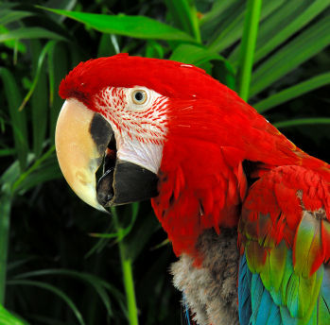
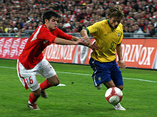
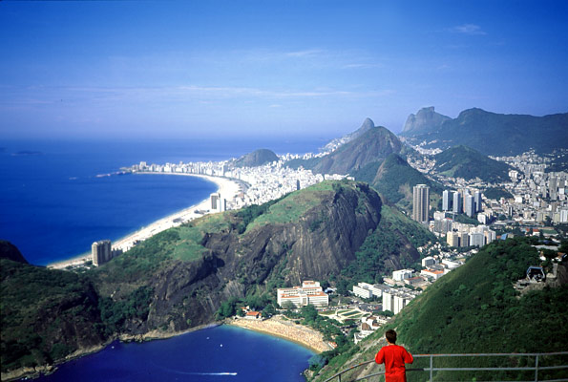
Cultural Aspects

Slide 16
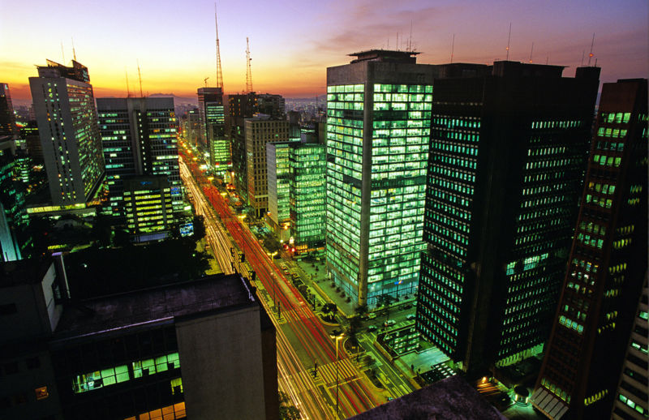
Business Environment in Brazil
Eric Hamilton

Slide 17
Technology
One of most advanced industrial sectors in Latin America
Advances in drilling
Hydroelectric power = 73% of electricity
World’s largest exporter of biofuels
World’s third largest airplane producer
Nuclear technology

Slide 18
Distribution
Declining Infrastructure
-1.8 million km roads, 50K km waterways, 29K km railways, 36 deep-water ports
Growth Acceleration Program (PAC) -$624 million USD
State/local government responsible for public infrastructure
High taxes, fees, interest rates
Common External Tariff (14%-20%)

Slide 19
Ethics
Considerable corruption within government
15 different political parties
Business decisions based on political views

Slide 20
Business Relationships
$153 billion in exports
$128 billion in imports
Government very active in businesses
Open to foreign businesses
Uruguay, Paraguay, Argentina (Mercosul)
Columbia, Ecuador, Venezuela, Peru, Chile, Bolivia (South American Community of Nations)
Positive view of American businesses/government

Slide 21
Management Aspects
Relationships are very important
Relaxed and chatty
High on authority in workplace
Vertical Hierarchy, management makes decisions (primarily men)
Emphasis on social class status

Slide 22
Human Resources
Numerous family members working for same company
Common to hire a despechante (middle man)
Extensive business regulations
2009 Minimum wage = $465 Reals/mo. ($273 USD)

Slide 23
Business Practices
Shocked by American clothing
Business formal dress
Business informal (still nice)
Laid back time/work schedules 8:30-5:00
Business cards in English and Portuguese

Slide 24
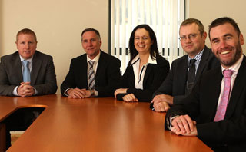
Brazilian MBA Students
Chase Luft

Slide 25
Brazilian MBA Students
Gustavo Alcimin
Livia C. Mello
Luiz Lamardo
Alves Silva

