Slide 1
Dell
Group Update on Company

Slide 2
Getting Started
Kent Copeland

Slide 3
What is Dell?
Dell is a multinational information technology corporation that develops, sells, and supports computers and related products and services.

Slide 4
Dell Inc.
Founded November 4, 1984 in Austin, Texas
Founder – Michael Dell
Original name was PCs Limited
Changed name to Dell Computer Corporation in 1988
Became Dell Inc. in 2003 to recognize their expansion beyond computers

Slide 5
Financials
Revenue - $52.9 billion (2010)
Net Income - $1.433 billion
Total Assets - $33.65 billion
Employees – 96,000

Slide 6
Major Competitors
Apple
Oracle
Hewlett-Packard
IBM
Gateway

Slide 7
Stock Prices
November 15, 2010 (close)
Dell - $13.51 (increased $0.09 or 0.67%)
Apple - $307.035
Oracle - $28.40

Slide 8
Manufacturing Process
Configure to order
Assemble close to customers
Implement JIT to reduce inventory
Recently began to outsource the manufacturing process

Slide 9
Dell Business Structure in America
Eric Hamilton

Slide 10
Dell Business Structure
Direct supplier
Selected channel partners
IT Consulting
Dell Remote Support Service
large enterprise, public, small and medium business, and consumer

Slide 11
Dell Business Structure
Management
Organizing management
Strategic and operational planning and implementation
Managing risk
Financial reporting

Slide 12
Dell Business Structure
Board of Directors (governing body)
Management planning and oversight
Leadership Development and Compensation Committee
Strategic and operational planning
Financial reporting
Governance, compliance and risk management
General advice to management

Slide 13
Dell Business Structure
Committees on Board
Audit Committee
Leadership Development and Compensation Committee
Governance and Nominating Committee
Finance Committee

Slide 14
Dell International
Adam Stone

Slide 15
Dell International
51.8% of Employees are outside the United States
13,000 Retail locations around the world
International Revenue of $16.1billion (28% of TR)
Began expanding globally in 1988 – first in Ireland
In 1988 Dell’s Market Capitalization grew by $30 million
1992 Made Fortune 500 list – Michael Dell youngest ever CEO of a Fortune 500 company

Slide 16
Facilities Worldwide
Penang, Malaysia
Xiamen, China
Bangalore, India
Hyderabad, India
Chandigarh, India
Delhi, India
Bracknell, UK
Manila, Philippines
Chennai, India
Hortolandia, Brazil
Lodz, Poland
Limerick, Ireland

Slide 17
International Impact
Irelands largest exporter of goods and second largest foreign investor
Plants in Malaysia and China assemble 95% of Dell notebooks
Desktop and PowerEdge server manufacturing for the South American market takes place in Hortolandia, Brazil
The Dell Global Executive Management Committee sets strategic directions

Slide 18
Retail around the World
Ships to Staples Business Depot (one of Canada’s largest office-supply retailers)
April 2007, Opened a Retail Store in Budapest
October 2007, Opened a store in Moscow
In the UK, Dell sells through many outlets including: Trocadero, DSGi, Currys, PC Word, and Tesco.
In Australia, sell through 400 Dick Smith Electronics stores and The Good Guys discount electronics retailer

Slide 19
Dell in Brazil
Chase Luft

Slide 20
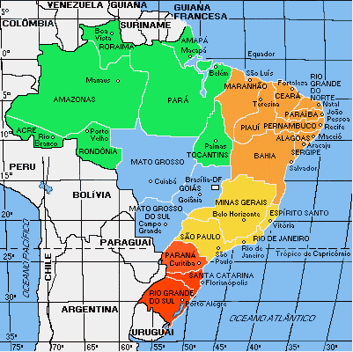
Dell in Brazil
First site selection in 1998-1999
Site selection process
Rio Grande do Sul
Second site selection in 2006-2007
Hortolândia, Sâo Paulo
Geography of Plants
Dell enters the smartphone market

Slide 21
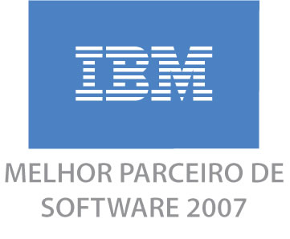
Dell Competitors in Brazil
IBM
Hewlett-Packard
Positivo Informatica

