Slide 1
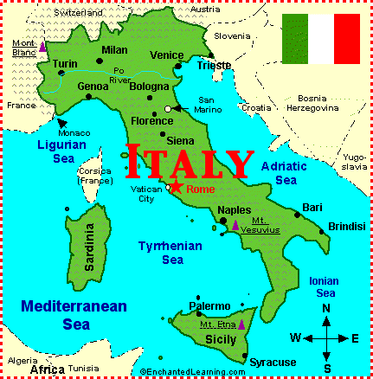
Italy
Connor McMahon, Ben Roye, Naveen Kumar, Nathan Maedgen

Slide 2
Demographics
Population
  The population of Italy as of July 2010 is 58.09 million people. In comparison to the rest of the world Italy is the 23rd most populous country. China is number one with 1.3 billion and the United States is third with 310.2 million people.
  The annual population growth rate is -0.075%, currently many other developed countries such as Australia, the U.S., Ireland all have positive population growth.
  The Ethnic group is primarily Italian but there are small group of German and French.
  The religion for the majority of the population is Roman Catholic.
  The official language for the country is Italian
  The population has a literacy rate of 98%
  There is an infant mortality rate of 3.7 to every 1000 births; currently the life expectancy is 78.8 years for men and 84.1 years for women.
  The workforce of the population is 24.7 million, this workforce is 67% services, 29% industry and commerce and the country has an unemployment rate of 7.8%

Slide 3
Birth and Death Rates
  The birth rate for Italy as of 2007 is 8.5 for every 1,000 when comparing this to other developed countries is low. For example Australia has a birthrate of 12.0, France 11.9, Ireland 14.4, and the United States 14.2
  The death rate for Italy as of 2007 is 10.5 for every 1,000. These numbers indicate that Italy’s domestic population is losing more people to death than are being born.
  Currently the fertility rate for Italy is 1.32 children born per woman.
  Italy currently has a higher death rate than birthrate. The other developed countries like Ireland have only a death rate of 7.8 and a birthrate of 14.4, Australia has a death rate of 7.6 and a birthrate of 12.0. While many other countries are growing, Italy’s domestic population is shrinking.

Slide 4
Age Categories by percentage
  The age structure for Italy is:
    0-14 years: 13.5% (male 4,056,156/female 3,814,070)
    15-64 years: 66.3% (male 19,530,696/female 18,981,084)
    65 years and over: 20.2 (male 4,903,762/female 6,840,444)
  The median age for Italy is 43.7 years, the average age for males is 42.3 years and the females’ average age is 45.3 years.
  Italy has a aging population their workforce is aging and there are fewer younger people coming up. Also when looking at the younger population of the country there are more males than females.

Slide 5
Natural Resources
  The countries main natural resources include: Fish and natural gas.
  Agriculture includes: wheat, rice, grapes, olives, citrus fruits, potatoes, sugar beets, soybeans, beef, and dairy products.
  Italy has few natural resources. Much of the land is unsuited for farming; the country is a food importer.
  There are no sustainable deposits of oil, coal, or iron. The proven natural gas reserves are found in the Po Valley and offshore in the Adriatic. These natural gas finds are the largest important mineral resources.
  The company is forced to import the majority of the raw materials needed for manufacturing. The country is also forced to import 80% of its energy sources.

Slide 6
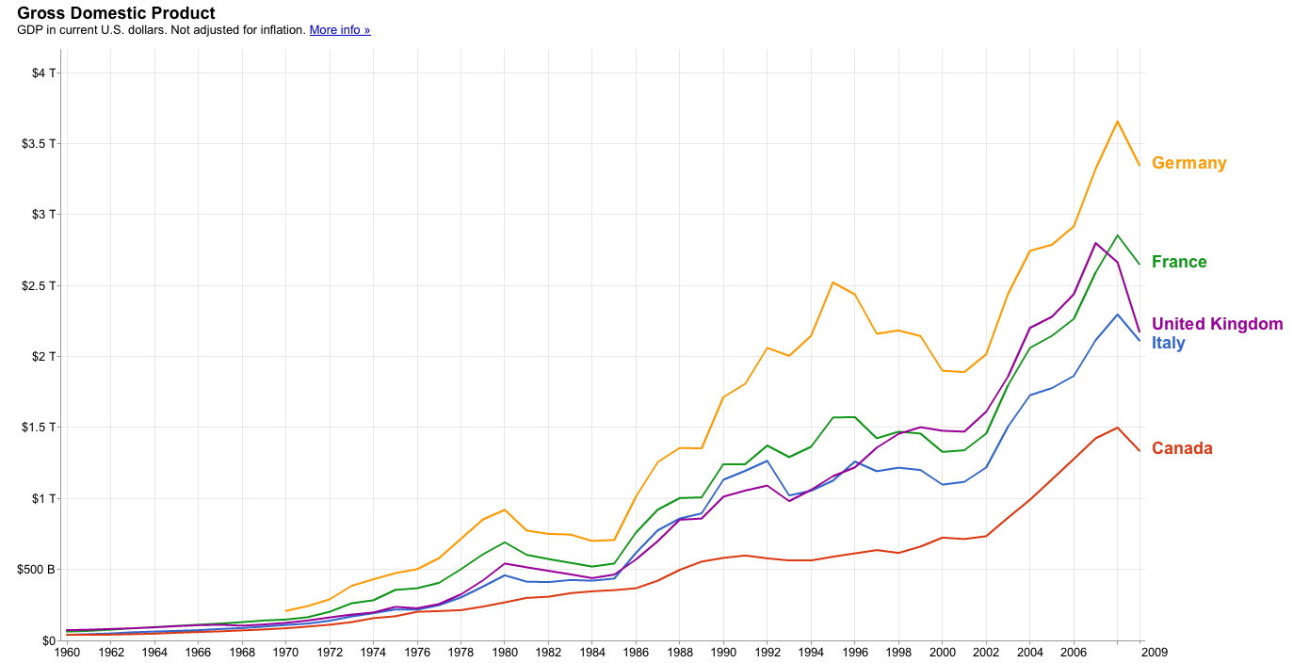
Economic Environment
Economic Indicators
  The Italian GDP for 2009 was $2.11 Trillion
  This GDP of $2.11 Trillion places Italy as the 6th or 7th largest economy in the World. For example Germany has a GDP of 3.3T the United Kingdom has a GDP of 2.17.
  The GDP growth rate for Italy in 2009 was -5.1%. The world economic down turn affected the Italian economy much like the rest of the world. Italy's economic growth averaged only 0.8% in the period 2001-2008.

Slide 7
Inflation Rate and Unemployment Rate
  Inflation rate
  While the country experienced a GDP growth rate of -5%, it has a small positive inflation rate of 0.8%. This inflation rate ranked it 42 in the world.
  The inflation ration rate for 2008 was 3.4%, the country was effected by the economic downturn.
  Unemployment Rate
  The unemployment rate in Italy is a regional issue. Often the unemployment rate is low in the north and height in the south. Even with the economic factors plaguing the world. The Italian unemployment rate is at its lowest since 1992. The reason for the higher rates of unemployment in the South. Can be blamed on the inadequate infrastructure, corruption, and organized crime. All of these factors add to the disincentives for companies to invest in job creation in the South.
  For 2009 the unemployment rate is 7.8% for comparison the unemployment rate for the U.S. is 9%.

Slide 8
Currency Regulations
Currency Regulations
  Italy is a part of The Euro currency. There were originally 12 European countries that began the euro currency. These countries make up the European Union; any country in the union including Italy has changed their currency over to the Euro.
  The European Central Bank (ECB) regulates the euro as the central bank for Europe. The goal of this group is to grow and stabilize the purchasing power of the euro.
Exchange Rate
  The exchange rates fluctuate on a daily basis but as of Nov. 28th one Euro will buy 1.3239 U.S. Dollars.
  There are many factors that affect the exchange rate such as the Fed’s target rate, and the current economic environment of the European Union.

Slide 9
Tax System
  The Italian tax system is progressive, meaning the higher an individuals income the higher their taxes.
  In 2010 the tax rate for an individual was between 23%-43%
  The standard corporate tax rate in Italy for 2010 was 27.5%.
  The rate of tax payable on capital gains from shareholding is 12.5%.
  Companies pay 27.5% tax on capital gains with the sale of the participation being 95% tax exempt.

Slide 10
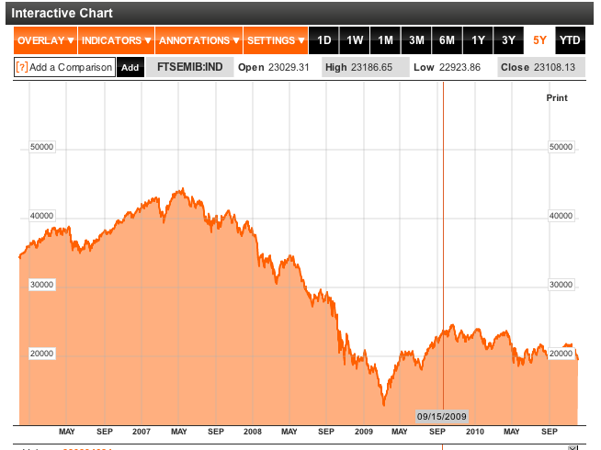
Stock Market
  Italy’s main financial exchange is the Borsa Italiana. This exchange was established in 1808 for the trading of stocks, bonds, and derivatives. The Borsa went private in 1997 and then was bought by the London Stock Exchange in 2007.
  Italy’s main stock market index is the FTSEMIB. The index consists of the 40 most liquid and capitalized stocks listed on the Borsa Italiana.

Slide 11
Key Business Segments
  Italy’s economic strength is in the processing and the manufacturing of goods. Most of these goods are made in small and medium-sized family-owned firms.
  The major industries for Italy production are precision machinery, motor vehicles, chemicals, pharmaceuticals, electric goods, and fashion and clothing.
  The Italian economy is driven in large part by the manufacture of high-quality consumer goods.
  There is also a very sizeable underground economy that by some estimates may account for as much as 15% of the countries GDP. These activities are most common with construction, agriculture, and service sectors.

Slide 12
Major Imports and Exports
  Italy’s main export partners include: Germany, France, Spain, US, and the UK
  Italy’s main exports include: Engineering products, Textiles and clothing, Production Machinery, Motor Vehicles, Transport Equipment, Chemicals, Food, Beverages and Tobacco, Medicinal, Dental and Pharmaceutical preparations, Wine & related products, Footwear, Jewelry, Household furniture, Industrial engines, Pumps, Generators, Stone, Sand, Cement, Lime. The Italian economy is well diversified.
  Italy’s main import partners include: Germany, France, China, Netherlands, Libya, Russia
  Italy imports some of the following goods: Chemicals, Transport Equipment, Energy Products, Minerals, Textiles, Food, and Beverages.
  The countries export volume decreased due to the world recession. In 2008 the country exported $546.9 billion and in 2009 it exported $369 billion. Even with this decrease the company ranked 8th in the world in terms of exports volume.

Slide 13
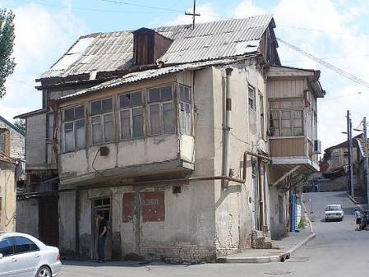
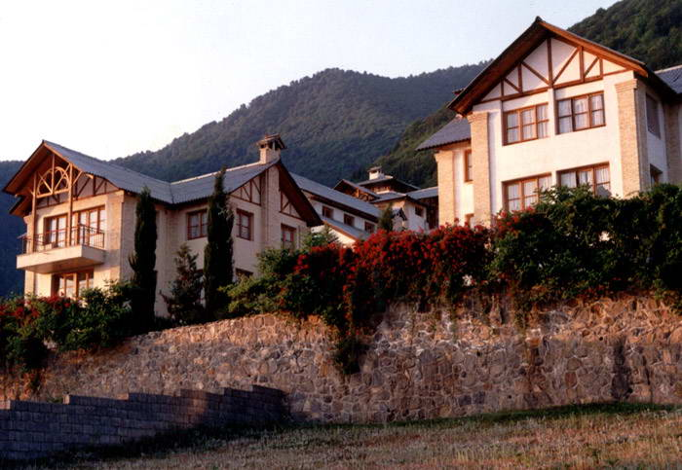
Standard of Living
  The standard of living within the country depends on the location of the population.
  In the north the standard of living is high while in the south the standard of living drops.

Slide 14
History Facts/Events
  1804 Napoleon Declares himself Emperor of Italy
  1849 Austria regains control of most of Italy
  1911 Italy Defeats the Ottoman Empire
  1915 Italy Joins WW I on the side of the Allies
  1925 Mussolini becomes dictator
  1943 Italy surrenders to the Allies in WW II
  1946 Italy abolishes the monarchy and establishes a republic
  This establishment of the democracy government brings us to the current type of government.

Slide 15
Political System
Type of Government
  Italy has been a democratic republic since 1946.
  The Italian state is centralized.
Civil Liberties
  Freedom from Internal Control
    Italian Citizens are free to move within the boundaries of the country as they please
  Freedom of Speech
    The Italian constitution gives great power to freedom of speech.
  Private Property
    Italian constitution protects private property.

Slide 16
Stability of the Country
  Until recently, there had been frequent government turnovers (more than 60 and counting) since 1945.
  The government in the last three elections has changed 3 times from right wing to left wing to central party. All of these parties have different ideas but due to all the changes their effectiveness is very low.
  Institutional stability in Italy is unstable the government has changes in the last 4 elections 4 time. The country is always bouncing from left wing to right wing. But when looking at the U.S. often the control of the country switches from right to left.
  When looking at the country as a democracy and protecting people’s rights the Italian country is a stable democracy and stable country for business
  The country is very stable based on civil rights and the rights of private property holders.

Slide 17
Geography
  Terrain: Mostly rugged and mountainous.
  Italy is a peninsula in the Mediterranean Sea
  Much of Italy is covered by mountains
  The Apennine mountains cut down the center of Italy, stretching from north to south, dividing the east and west coasts.
  Italy includes two large islands: Sicily and Sardinia. Sicily is the largest island in the Mediterranean, with active volcanoes and earthquakes. Sardinia is basically mountains rising out of the ocean.
  Italy has two independent countries within its borders. Vatican City is the center for the Roman Catholic Church, and is the world’s smallest country. San Marino, on the north east coast of Italy, is an independent republic.
Natural Hazards
  Based on region there can be a risk of landslides, mudflows, avalanches, earthquakes, volcanic eruptions, flooding
Land use
  Arable Land: 26.41%, this is one reason Italy must import food
  Permanent crops: 9.09%

Slide 18
Environmental Issues
Italy has been slow to confront its environment problems
  Of Italy’s mammal species, 10 are endangered, as well as 7 bird species and 202 plant species.
Current Issues
  There is air pollution from industrial emissions such as sulfur dioxide
  The inland and coastal rivers are polluted from industrial and agricultural business
  There is acid rain that damages lakes and inadequate waste treatment disposal facilities.
Environmental Agreements
  The country is attempting to repair its past mistakes with the environment. It has signed agreements to help protect and repair the environment.
  The country is a party to: Air Pollution, Air Pollution-Nitrogen Oxides, Air Pollution-Persistent Organic Pollutants, Air Pollution-Sulfur 85, Air Pollution-Sulfur 94, Air Pollution-Volatile Organic Compounds, Antarctic-Environmental Protocol, Antarctic-Marine Living Resources, Antarctic Seals, Antarctic Treaty, Biodiversity, Climate Change, Climate Change-Kyoto Protocol, Desertification, Endangered Species, Environmental Modification, Hazardous Wastes, Law of the Sea, Marine Dumping, Ozone Layer Protection, Ship Pollution, Tropical Timber 83, Tropical Timber 94, Wetlands, Whaling
  These agreements are signed but not ratified

Slide 19
Key Advantages to Investing in Italy
Languages
  Knowledge of English is reasonably extensive in Italian business
Economic Overview
  Italy belongs to the Group-of-Eight (G8)
Geographical Location
  Italy is at the center of the Mediterranean and the infrastructural links with countries in Europe
  Many opportunities with its geographical location
Population
  Northern Italy has one of the highest per capita incomes in Europe.
  Italian consumers are sophisticated and demanding.
  Italy has the fifth highest population density in Europe.
Business Benefits
  Italian economy has a propensity toward entrepreneurship
  The most developed sectors of the Italian industry include the manufacturing, mechanical, construction sectors, chemicals, and the transport industry
  One of the worlds most advanced industrial economies, offering substantial opportunities for people wanting to invest and do business in Italy.

Slide 20
SDA Bocconi School of Management
Milan, Italy
Full Time MBA
  12 month full-time in general management
  2 classes in English
  For Graduates with work experience
Global Executive MBA
  20 months for executives in English
  Alternating distance learning
  10 on campus modules, 3 held at international partners
Executive MBA
  20 months alternating distance learning
  10 on campus modules

Slide 21
Sofia Silva
Global Executive MBA Program
Pricewater House Coopers September 2007 to November 2009 Consultant
SDA Bocconi ’07 Degree in Fashion, Design and Experience Management
Wants to go into Financial Sector
Speaks 3 Languages English, German, Italian
Giovanni Luca Randisi
Full Time MBA
Bachelors International Studies '08 University of California San Diego
Bachelor Economia Aziendale (bachelor of science in business)
Graduate Marketing Management Master of Science
MBA Università Bocconi Marketing Management
Wants to be a Professor
Speaks 4 Languages English, French, German, Italian

Slide 22
Sociological Aspects of Italy

Slide 23
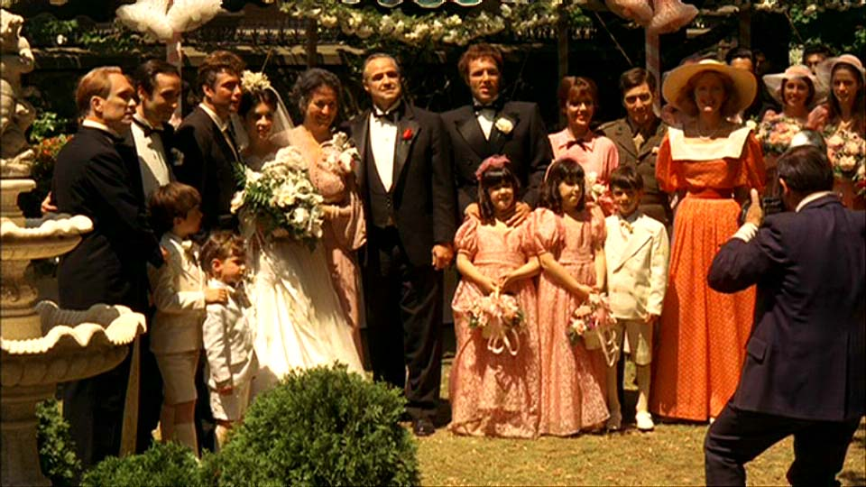
Italian Family Structure
Clear gender roles, but have been undergoing change.
Extremely close-knit, collective families.
Children often live with parents until late in life.

Slide 24
Social Problems
Poverty (27.1%, varies greatly by region)
Divorce (Divorce Laws of 1987- Joint Custody)
Child Abuse
D’Ambrosio, Conchita, and Carlos Gradin. 2003. “Income Distribution and Social Exclusion of Children: Evidence from Italy and Spain in the 1990s.” Journal of Comparative Family Studies 34: 479-495.
Ronfani, Paola. 2001. “Children, Law and Social Policy in Italy.” International Journal of Law, Policy and the Family 15: 276-289.

Slide 25
Social Class Structure
A hierarchy of social class rank in Italy today, going from highest to lowest:
1. Bourgeoisie (10% of the working population) includes high-class entrepreneurs, managers, politicians, self-employed people, etc.
2. White-collar middle class (17% of the working population) includes middle class workers not employed in manual work.
3. Urban petit bourgeosie (14% of the working population), is mainly made up of shopkeepers, small-business entrepreneurs, self-employed artisians etc.
4. Rural petit bourgeosie (10% of the working population) consists of small entrepreneurs or estate owners who operate in the countryside, mainly in agriculture and forestry.
5. Urban working class (37% of the working population) refers to the people employed in manual work.
6. Rural working class (9% of the working population) consists of people operating in the primary industry, such as farmers, loggers, fishermen etc.

Slide 26
Ethnic Groups
Origin of the Italy population as of 1 January 2009
Origin | Population | Percent
Italian | 56,153,773 | 93.52%
Romanian | 796,477 | 1.32%
North African | 606,556 | 1.01%
Albanian | 441,396 | 0.73%
Chinese | 170,265 | 0.28%
Ukrainian | 153,998 | 0.26%
Asian (non-Chinese) | 445,795 | 0.74%
Latin American | 298,860 | 0.50%
Sub-Saharan African | 264,570 | 0.44%
Other | 713,378 | 1.19%

Slide 27
Religion In Italy
Catholicism is 87.8% of nation
Christianity is 91.6%
No religion is 5.8%
Islam is 1.9%
Date taken from “Eurobarometer” by EU Commision

Slide 28
Education In Italy
Ranked #36 in the world, well below the OECD average. US typically in 20’s.
Current educational reforms are giving more control to individuals schools.
Graduate programs are often much more specialized than those in the US.
The recession is causing Italy and many other EU nations to raise tuition “fees,” which is extremely unpopular politically.
Italy has an inclusive education policy and children with special needs are educated in mainstream classrooms.

Slide 29
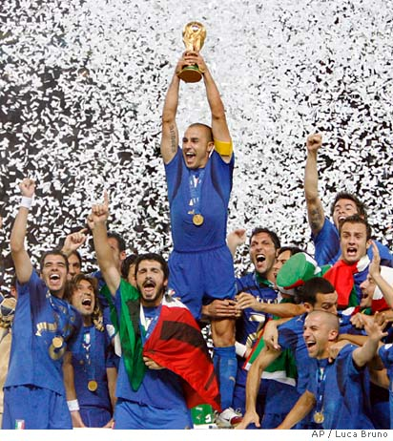
Leisure Activities In Italy
Soccer is the most popular sport.
Italy won the 2006 World Cup tournament.
Only Brazil has won more World Cups.
Basketball and volleyball are also very popular.
The Italian mentality is “work to live.”
Minimum of four weeks of vacation.
Tourism both domestically and abroad.

Slide 30
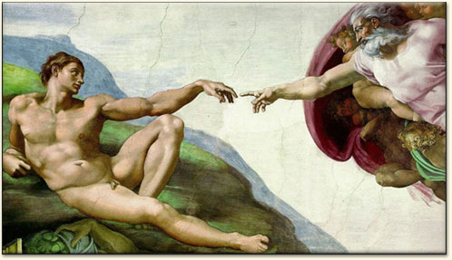
The Arts
Italy is estimated to have over 70% of world’s art/architecture.
Etruscans (Roman precursors)
Romans (heavily influenced by Greeks)
Renaissance (revival of Classical art)
Post-Modern (highly controversial and diversified)

Slide 31
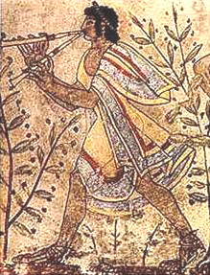
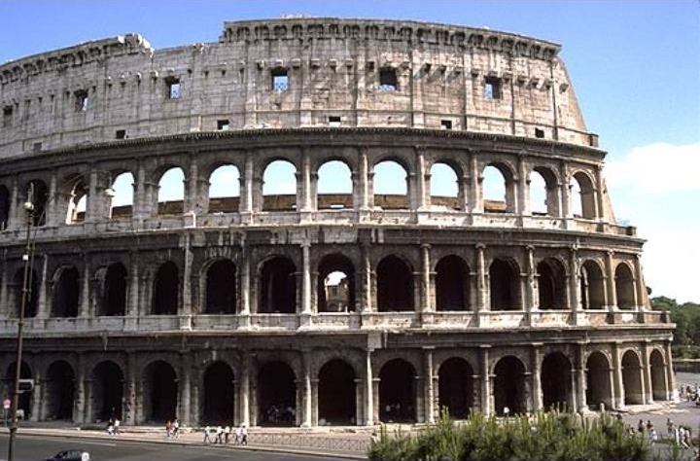
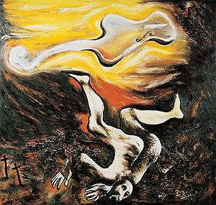
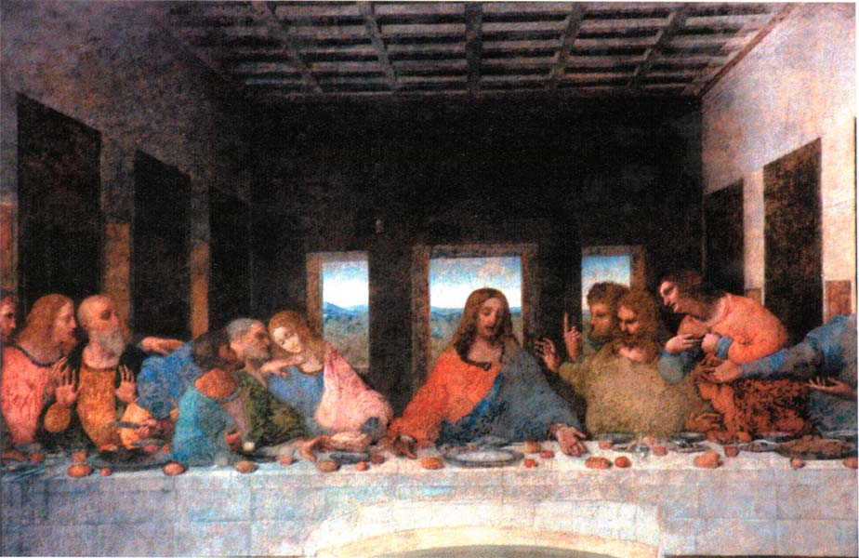

Slide 32
Maria Laura Riccardi
University of Bologna
MBA Design (Cosmetic/Fashion Products)
Plans to do internship with L’Oreal
Bachelors degree is in economics
Speaks English, Italian, and German
UB Business school only 20 years old, but UB is nearly 1000 years old.

Slide 33
Cultural Aspects

Slide 34
Cultural Groups
Ethnic Composition
  Italy is comprised of mostly Italians (94.1%). This includes small clusters of Albanian-, Catalan-, Croatian-, French-, Friulian-, German-, Greek-, Ladin-, Occitan-, Sardian-, Slovene-, Roma- and Sinti-Italians.
  2.7% of the population is Sardinian.
  1.3% is Rhaetian.
  The other 1.9% is labeled as Other.

Slide 35
Regional Subcultures
  Northern and southern Italy are characterized by highly different historical backgrounds.
  In the Middle Ages, northern Italy consisted of independent communes. They lived relatively unrestrained by the monarchy, and civic freedom flourished.
  Southern Italy was ruled with an iron hand by the Norman kings. This fostered the development of the mafia and the clientelismo.
  Because of these historical differences, slight variations in the cultures of the north and south still exist today!
  Southerners tend to use collective insults more, “your mother!”
  Northerners are more socially independent, similar to Americans. Southerners are interdependent, much like the holistic view of Asians.

Slide 36
Cultural Dimensions
Kluckhohn & Strodtbeck
Good, neutral, or evil? | Good
Harmony, subjugation, or mastery over nature? | Subjugation
Relationships with humans: lineal, collective, or individual? | Collective
Basic orientation is becoming, doing, reflecting? | Reflecting
Focus on past, present, future? | Past, present
Is space public, private, or mixed? | Public

Slide 37
Cultural Dimensions, cont.
Hofstede’s | Italy | US
Power distance | Higher | Lower
Individualism | More collective | More individualistic
Masculinity | More masculine | More feminine
Uncertainty Avoidance | Strong | Weak
Trompenaar’s | Italy | US
Universalism vs. Particularism | Universalistic | Universalistic
Individualism vs. Communitarianism | More communitarian | Individualistic
Affective vs. Neutral | More affective | More neutral
Specific vs. Diffuse | More diffuse | Specific
Achievement vs. Ascription | More ascriptive | Achievement
Locus of Control | Internal | Internal
Time Orientation | Past and present – More synchronous | Future/sequential

Slide 38
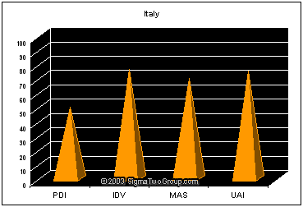

Slide 39
Important Values
  The constant warring that has occurred over a long history has led Italians to have inherent cynicism versus authority, a survivor’s mentality, and a strong need to put family in the forefront of their lives. In the past, up to four generations of a family have been housed under one patriarchic roof. The family tended to be run by the grandfather, with patriarchy being passed on to the eldest son upon the grandfather’s death. The son would then take over his father’s business. The mother would perform domestic chores, traditionally.
  After the 1960s, Italians moved towards nuclear families. The average number of family members decreased to 2.8. Even so, 30% of people younger than 34 still live with their parents. However, it is a popular trend for urban young professionals to live on their own.

Slide 40
Important Values, cont.
  Italians tend to be less class-conscious than most Europeans. For example, snobbishness is limited to quality of clothes worn and to their furniture and so on.
  Italians are very money-conscious. In fact, they are the most thrifty of all Europeans. Italians, on average, have 40% of their personal investments in treasury bonds. They love wealth but hate risk. Italy is just recently economically prosperous, and therefore people want to live lifestyles of the rich and famous. However, Italians still fear the poverty that could assail them at any moment. Mostly, though, Italians enjoy the little things in life, the things that money can’t buy.

Slide 41
Important Values, cont.
  Italians generally don’t have problems with foreigners. There are 1.2 million Africans and Asians in Italy. About half of them work illegally or semi-legally. Still, Italians tend to like foreigners.
  Italians dislike authority. This is because memories of fascist rule and of the State Police still are fresh in their minds. Still, Italians respect their government officials.

Slide 42
Consequences of non-conforming behavior
  In general, non-conforming behaviors such as dressing poorly and not observing respect of elders are met with abhorrence or rudeness.
Work ethic
  Italians, and generally Southern Europeans, have a more relaxed work ethic than is observed in America. For instance, most Italian businesses are closed on Sundays and Mondays, Saturdays, and in the afternoons. Many Italians skip work with a fake doctor note while really attending soccer games. In the past, people have also given gifts as an incentive to do something as a return gesture.
Attitude towards change
  Since the 90s, the Italians have started to embrace change. Italy is a big proponent of a unified Europe as well as having close economic and cultural ties with the United States. However, a need for close-knit family inheritance systems is still abundant.

Slide 43
Customs
Greetings
  It is important to stand up if you are a man when someone is introduced to you. Women should only stand when meeting a person of great prestige. Women and elderly people should offer their hand or make a slight bow of their head. The lesser person should always be introducing themselves to the greater person in power. Likewise, a man should always introduce himself to all women present. Finally, a younger person should introduce him/herself to an older person.
Gift giving related to business
  Never give chrysanthemums as they are used at funerals. Likewise, red flowers are a symbol of secrecy and shouldn’t be given. Yellow flowers indicate jealousy. If you bring wine, make it a good vintage. Gifts wrapped in black are for mourning; wrapped in purple, they indicate bad luck. Gifts are opened upon reception.
  Historically, giving gifts dictated an unspoken agreement that something was wanted in return.

Slide 44
Customs, cont.
Key Holidays and Ceremonies
  Every village celebrates their respective Saints Day.
  Many businesses are shut down for part or all of August since many Italians take their holidays at this time.
  Ferragosto, on August 15, is an important public holiday. The Catholic Church celebrates this holiday in semblance of Virgin Mary going to Heaven.
Tipping
  Tipping is included automatically in most bills, whether at a restaurant or hotel. An additional 10 euros can be tipped if the service was excellent.
  Tipping hotel porters and concierges is highly appreciated if they were helpful.
  Tipping cab drivers in unusual.

Slide 45
Communication
Languages spoken and in what setting
  The national language is Italian. There is a strong tendency towards Roman dialect since it was a center for film-making after World War II.
  Most Italians speak Italian at least one dialect. Many Italians are multilingual: English, French, German, Slovene, Friulian, Catalan, Greek, Albanian, Ladin, and Provencal.
  In business with internationals, English is the language of choice.
Business language
  The usual handshake is given with direct eye contact and a smile.
  If a relationship exists, air kissing on the cheeks is acceptable. A pat on the back is followed by men.
  One must wait until invited to be on a first name basis.
  First impressions are important; give propriety and respect to those when you first meet them.
  Calling cards are given in social situations. They are usually larger than business cards and include a person’s name, address, title, academic honors, and telephone number.

Slide 46

Communication, cont.
Acceptable topics of conversation
  Italians love talking. Feel free to jump in with your thoughts at any time.
  Italians enjoy talking about architecture, sports such as soccer, food and wine, opera, current events and more.
  As in most societies, try to avoid politics and religion, especially the Vatican.
  Don’t talk about World War II or the Mafia either.
Nonverbal communication
  Italians touch much more than Anglos and Asians. Touch of the forearm during a formal conversation is accepted.
  Walking arm in arm is considered friendly between sexes.
  Shaking hands is common. Hugs are usually given between family and friends. It is accepted to kiss lightly on the cheek.

Slide 47
Conflict Style
  Composizione dei conflitti – conflict resolution: the IRI Protocol of 1984 instituted better settlement of disputes. These include a compulsory cooling off time and bilateral parties for dispute resolution.

Slide 48
Negotiation Style
  Italians are direct and to the point. They prefer to get to know the person they are doing business with before business discussions commence.
  Italians respect power and age.
  Haggling over price and delivery date is common.
  Decisions are made on the basis of how you are viewed by the other party, rather than by concrete business objectives.

Slide 49

Food and Eating Etiquette
  Even if you are told to dress informally, wear something stylish.
  Punctuality is informal. You may show up 15 minutes late if invited to dinner and 30 minutes late if invited to a party.
  Remain standing until invited to sit. You may have a seat pre-chosen for you as well.
  The hostess is to be followed in all things: sitting first, first bite, and first to rise at the end of a meal.
  The host gives the first toast. An honored guest may reciprocate later in the meal.
  Take a small portion at first so that you can be offered a second helping.
  It’s acceptable to leave some food on your plate.
  If you do not want more wine, leave your glass half-full.

Slide 50
Questionnaire
What is the name of your business program? Bachelor Degree in Business Administration
What is the focus of your degree? Business Management
What languages do you speak? I speak English and Spanish.
What countries have you lived in and visited? I Live in Turin but in January I’m going to Las Palmas for the Erasmus program
Do you have any prior work experience? I worked in the sport management field
What do you plan on doing after graduation? I want to improve my skill with a good master.
What is your perception of the United States? I have a good perception of United States. It is a very rich country and one of the best economies in the world.
Do you have any international students in your program? In the University of Turin there many international students, especially Chinese and Brazilian students
Are there any challenges in communicating or working with international students? English is the language we use to communicate. If you know English there are no challenges.
What was the application process for your program? I took a test and after I applied and I got selected
How is job searching/placement conducted at your University? We have a job placement office, which helps us in finding job opportunities. Plus, to complete my program I need a 3-month work experience.
What organization accredits your program? I do not know.

Slide 51
Business Environment
Technology
  Internet and Telecommunication
    100% population to have cell phones by 2007
    Internet penetration growing fast , big internet boom in 2001
(Forbes magazine, 1999)

Slide 52
Business Environment
Science and Technology manpower
  In 1987–97, Italy had 1,318 scientists and engineers and 798 technicians per million people engaged in research and development.
  Expenditures on research and development during that period totaled 2.2% of GDP.
  Italy has 47 universities offering courses in basic and applied sciences.
  In 1987–97, science and engineering students accounted for 30% of university enrollment.

Slide 53
Business Environment
Infrastructure
  Efficient and modern infrastructure but ranks lower as compared to other western european countries
  136 airports, the most important being Fiumicino (Rome), Malpensa and Linate (both serving Milan), Ronchi dei Legionari (Trieste), Caselle (Turin), and Marco Polo (Venice).
  most goods in Italy are transported by road -constantly upgraded and improved.
  rail system is also highly developed and traverses a distance of 19,394 kilometers
  Infrastructure is not the same quality throughout the country – North is better than South

Slide 54
Business Environment
Tariffs and Taxation
  High tax rates - 43.3 percent of the GDP
  Income tax accounts for 34.9 percent of total tax revenues
  value-added tax (VAT) contributes 35.4 percent
  local governments also levy other indirect taxes
  Lot of Tax Evasion

Slide 55
Business Environment
Ethics
  Lot of Corruption, organized crime
  Bribes, use of influence very common
  Plenty of "mafia" and bureaucratic obstacles
  Difficult to be successful without a network of connections
  Corporate scandals like Enron
    “Parmalat Scandal “- 13 billion Euros had disappeared from the food company's accounts and debt amounting to billions of Euros was concealed in hidden bank accounts and empty shell companies.

Slide 56
Business Environment
Transparency Index and Italy’s rank in 2010, 2009 and 2008
Source: Transparency International

Slide 57
Business Environment
Business Relationships
  Connections, usually family or political ties, are required
  Personal relationships in Italy are critical for successful business negotiations
Impression of Americans
  quite loud, bold and very confident
  Overweight
  carry guns in certain states
  Foreign U.S. multinational corporations are also well represented in Italy. They include IBM, Texas Instruments, Texaco, Mobile, Goodyear, Procter & Gamble
  United States and Italy cooperate closely on major economic issues, including within the G-8

Slide 58
Management Aspects
Employee/employer Relationships
  Unions claim to represent 40% of the work force
  four major confederations: the General Italian Confederation of Labor (CGIL), the Italian Confederation of Workers' Unions (CISL), the Italian Union of Labor (UIL), and the General Union of Labor (UGL),
  Privatization, liberalization, and budget cuts have reduced the unionism, and businesses have a far freer hand in dealing with the workforce.

Slide 59
Management Aspects
Typical management style
  Paternalism in family orientation
  manager is expected to act like a manager and appear authoritative and in control
  Power Distance
  Leadership Style - authoritative with direct instructions given by a strong leader
  larger traditional Italian businesses – “hierarchical” – Only the most senior managers make decisions.

Slide 60
Management Aspects
Women in Business
  number of women in senior management positions is quite small
  Approximately 36 percent of the workforce is female,
  Managers in female-oriented businesses dealing in fashion, art, cosmetics.
  Women receive up to 22 weeks for maternity leave.
  no equal opportunities legislation and there is considerable discrimination against women.

Slide 61
Management Aspects
Hiring Practices
  enroll in the employment list at the local employment office
  enrollments are then divided into the following categories:
    First category – unemployed, seeking first job, or part-time workers
    Second category – employed workers seeking a new job
    Third category – old-age or retirement pensioners

Slide 62
Management Aspects
Compensation Practices and Minimum wages
  Minimum wages in Italy are set, not by law, but by national collective bargaining agreements.
  Must pay Christmas and year-end bonus
Employee Benefits
  National Social Insurance Institute, which is a social insurance system, covers old age, disability, and death benefits
  Most businesses in Italy are closed in the months of July and August
  11 official statutory bank holidays
  sick leave of absence
  maternity leave still receives 80% of their salary for up to 2 months before and 3 months after the birth of the baby.
  Another 6 months can be taken by either parent at a rate of 30% of their salary.

Slide 63
Business Practices
Business Dress code
  very well-groomed, wearing good quality, well-cut clothes.
  if you want to be respected- look good!
  very hot in the summer- don’t have to be in suits
Business cards
  Exchange of business cards at the beginning
  translated into Italian on one side
  include any advanced educational qualifications and your full title and position
Work Schedule
  40 hrs a week
  two hour lunch break for siesta in south, so the working day may last until 7 pm
  9 to 5 work day in north

Slide 64
Business Practices
Business Meeting Etiquette
  Appointments are mandatory
  Do not try to schedule meetings in August – vacation time
  Punctuality important in North
  goal of the initial meeting is to develop a sense of respect and trust
  use last names and professional titles
  printed material available in both English and Italian
  common to be interrupted while speaking
  written agendas may not be followed always
  Decisions are not reached in meetings
  Meetings are meant for a free flow of ideas and to let everyone have their say

Slide 65
Business Practices
Business etiquette in Italy (Do's and Don'ts)
  DO maintain eye contact while talking. This is a sign to your Italian business
  colleagues that you are sincere and honest.
  DO shake hands with everyone when being introduced during a business or
  social meeting. However, men should wait for women to extend their hand
  first.
  DO ensure that you knock before entering an office in Italy and always close
  the door behind you.
  DON'T appear impatient or rush your Italian colleagues in their business
  negotiations. Italians may see this as a sign of weakness.
  DON'T give a business gift until you receive one first. In addition, gifts showcasing your company's logo should be avoided.
  DON'T be surprised if during business meetings your Italian colleagues speak
  simultaneously or interrupt one another. It is a common trait of the Italian communication style.

