Slide 1
Mexico, Russia, and China Chapter 8: Building the Global Organization
Kayla, Kelli, Jia, and Tim

Slide 2
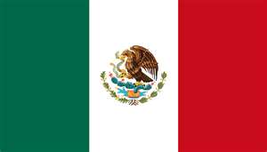
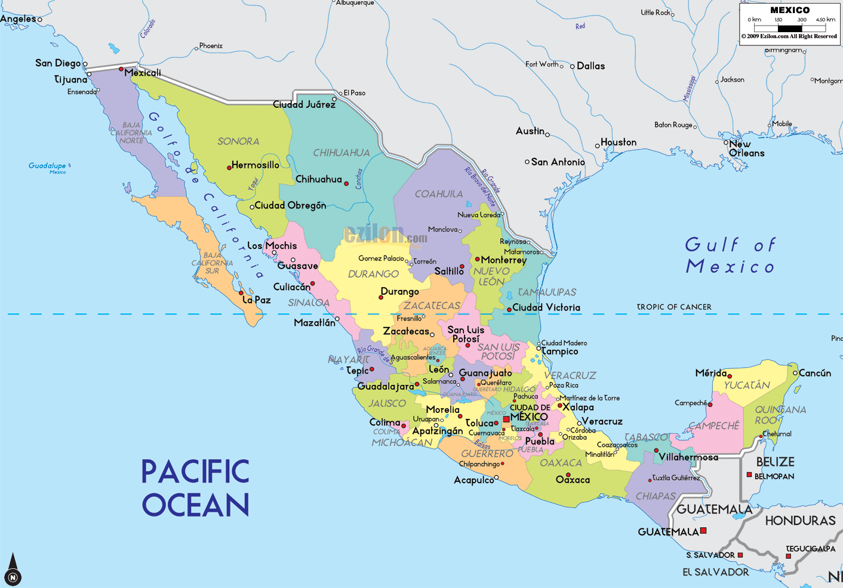
Mexico
Notes:
-Three times larger than Texas, and one fifth the size of the United States

Slide 3
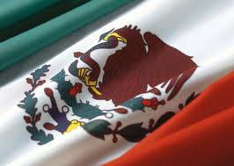
Highlighted Facts
Official Language- Spanish
Government- Federal Republic
Capital- Mexico City
Population- 114,975,406
Size- 1,964,375 sq km
Notes:
About 3 times the size of texas and 1/3rd the size of the us

Slide 4
Influence of Past
Past is celebrated
Mexico’s budget
Remains of current interest
Notes:
-past is celebrated in numberous statues, streets names and in the calendar. Ex. The entire month of September is devoted to ceremonies commemorating Mexico’s independence from spain.
-mexico’s government spends more of its budget on anthropological research of its past than does any other country
-News a half-centary old is highlighted in interviews and columns. Symbols are sometimes taken from prehistoric times.
-The past is important for understangding Mexican though and action. There for it is important to know a brief review of their history.

Slide 5
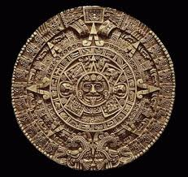
History
Classic Period (300-900 AD)
Teotihuacan
Maya Culture
Cortez arrives (1519)
War of Independence (1810)
Mexican War (1853)
Revolution (1920)
Mexico's Revolution
Notes:
-The first great highland culture of the Classic period had its capital at Teotihuacan, the "City of the Gods“. . A society seemingly based on agriculture, obsidian mining and trade, Teotihuacan held widespread influence throughout Mesoamerica.
-the Maya are generally considered the most brilliant of all the Classic groups. Considered the most outstanding intellects of ancient Mexico, the Maya devised a complex style of hieroglyphic writing that has yet to be fully deciphered. They refined the exact sciences learned from other prehispanic civilizations. Through their knowledge of astronomy and mathematics they calculated the lunar cycle, predicted eclipses and other heavenly events with great precision and formulated a unique calendar system more exact than the one we use today.
Mexico was populated by hundreds of indigenous tribes including the Aztecs, the Incas and the Mayas. Only took 2 years for Cortes to conquer the indigenous people in the name of Spain. Although most of the indigenous people were wiped out by the conquest and European deseases, those remaining were instructed by the spanish in Catholic faith during the colonial era.
-Independece from spain
-Half of Mexicos territory was acquired bgy the united states mainly during this war.

Slide 6
Economy
Free market economy
High foreign debt
Improved over the last 50 years
President-Felipe Calderon
Notes:
-improved since the discovery of oil and the north american free trade agreement, which helped to increase trade. US buys nearly 90% of Mexicos exports.
-president just met with obama and canada’s Prime Minister Stephen Harper to talk about drug trade.

Slide 7
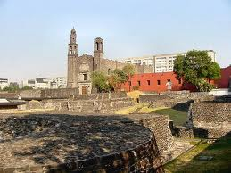
Culture
Torn Nation
Three distinctive cultures: Indian (30%), Spanish (9%) and Mestizo (60%)
Plaza of Three Cultures
Notes:
-Def-They have been torn from the cultural roots by invaders and external factors.
-Mestizo-mix of Indian and Spanish.
-Order in terms of status-Spanish, Mestizo and Indian. Plays a role in business situations, leads to conflict. Some business firms have fallen on hard times because the Spanish and mestizo owners and managers have found it difficult to work together and the Indians have experienced many forms of discrimination
-Plaza-Significance-here are buildings from the three cultures, Three tragedies took place here: 1) Aztecs took their final stand against the Spanish, The battle is memorialized in the plaza by a plaque which reads in part, "Neither a victory nor a defeat, but the painful moment of birth of the Mexico of today, of a race of Mestizos". 2) Mexican soldiers, equipped with tanks and machine guns, fired into a crowd of 14,000 unarmed students who were staging a protest against spending on the 1968 Summer Olympics being held in Mexico City 3) Earthquake which killed 8,000

Slide 8
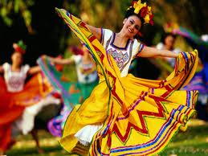
Mexican Fiesta
Between 500-600
Aspects revealed: People, religion, experiencing the present and freedom within social order
Notes:
-How the book explained Mexicos culture
-They are held for a variety of reasons, including celebrating historical events, reinforcing the traditions of individual towns cities and states, honoring catholic saints, paying homage to special foods and crops, and birthdays, baptisms, weddings and graduations.
-People- primamry focus of the mexicans is on people and the fiesta offers them a chance to be with and enjoy the company of their family, friends and community. Religion- is important throughout the mexican’s life and the abundant religious fiestas are a chance for mexicans to communicate with god. Experiencing the present is and opportunity to do this. Freedom-last within the social order mexicans find freedom and whin the social order of the fiesta mexicans exhibit this freedom.

Slide 9
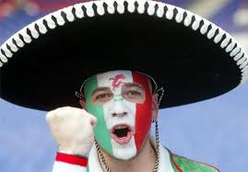
Primary Focus on People
Mexico is collectivist
Building block is the immediate family
Importance of friends
Relationships rule
Notes:
-There is a tight social framework in which members of the in-group, particularly those in positions of authority, are expected to look after all of its members in exchange for their loyalty. Mexicans display concern for others and use accommodation and collaboration more than for example individualistic US Americans do.
-Not uncommon to have several generations living together. Children are encouraged to stay depended on the famly and not leave home. The family spends most of its non working hours together and the childredn go everywhere with the parents. The family is an informatl welfare system in mexico.
-once a person becomes a friend, he or she is incorportated into the vast family network and becomes one of the trusted members of the in-group. Friends almost become a part of the family and are often called by familial titles such as brother, sister and cousin.
-ruled much more by relationships than by abstract concepts. Mexicans will interrupt whatever they are doing at the sight of a friend or a relative. This has a great influence on the way they conduct business which will be covered late.r

Slide 10
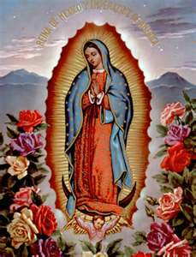
Religion
89% Christian, 6% Protestant, 5% other
Religious celebrations
Fest day of Our Lady Guadalupe
Holy week
Village Saints
Day of the Dead
Notes:
During the Spanish conquest and colonization of Mexico, Roman Catholicism was established as the dominant religion of Mexico, and today, about 89% of Mexicans identify themselves with that division of Christianity. Nation with the second largest catholic population (brazil 1st, US 3rd)
The significance and number of religious fiestas demonstrates the importance of religion to life in Mexico. Lady Guadalupe-the anniversary of the day when the virgin Mary is said to have appeared on the hill of Tepeyac. Week before Easter. Each village or city has an annual fiesta for its patron saint. Day of the dead-also called all souls day is celebrated with a fiesta to honor and remember the dead. Mexicans tend to believe life is beyond their control and they tend to share a fatalistic attitude. They exhibit a fascination and even an obsession with death. Newspapers are full of gory stories about death.

Slide 11
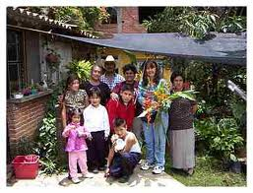
Experiencing the Present
Finding happiness
View of work
Time
Friends and family
Notes:
-Celebrated not only through fiesta but their way of life
-Work is only done only because it has to e done. Mexicans need a balance between work and lisure. There is no strict dichotomyh between work and leisure. They like to have friends and relatives working with them to make work more fun. They deemphasize the future and little long-term planning occurs. Take everyday as it comes

Slide 12
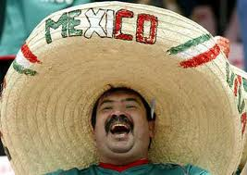
Freedom Within Social Order
Vertical Collectivism
Family order
Rigid hierarchy in the work place
Notes:
-Everyone has a role within society. Society accepts wihout question unequal distribution of weath and authority. For ex. there are two forms of you, tu to be used informally and between friends. Formally usted to show respect to superiors and elders.
-The father is the authority figure and traditionally the mother’s role is to love her children and husband and to lead a life of self-sacrafice for them. Family members take care of each other
-work- subordinantes traditionally do not even question the boss. Will be covered in detail next.

Slide 13
Conducting Business
High need for uncertainty avoidance
Importance of family
Consensus seekers
Authoritarian Administration
Greetings and salutations take a long time
Notes:
Mexicans feel threatened by uncertain situation and strangers and try to avoid them. Therefore, knowing someone before hiring or doing business with him or her is important. If business must be done with strangers, much time is spent getting to know the person before any deals are made. Mexicans are not loyal to an organization but they are committed to the people in the organization
Showing for ex concern when an employees family member is sick is a good way for a foreign manager to build good relations.
Mexicans will lie to avoid hurt feelings. They will frequently say what you want to hear to avoid confrontation and the loss of someone’s dignity. Problem with a typical authoritarian administration is that Mexicans tend to withhold negative info even if its important and convey only good news. Questioning is not encouraged. However this is starting to break down and move toward more participative management styles.
Lots of handshakes, hugs and kisses. More physical contact and smaller interpersonal distances.

Slide 14
Conducting Business Cont’d
Concept of time
Freer from guilt and obligation
Work up to important topics
Respect the holidays
Problems
Notes:
Concept of time is relaxed and there is always plenty of it. This is called polychronic time, meaning more than one thing goes on at a time. Interruptions and tardiness are common and deadlines are flexible. Absence on Monday after a long weekend is accepted if a person uses the excuse Saint Monday. Arriving on time is considered rude. And Mexicans are dismayed over North American invitations that state in advance what time a party will be over. More modern companies are moving toward the western concept of time and try to stick to strict deadlines.
Mexicans as individuals may be freer from guilt and obligation than U.S. Americans. It is not the individual that is guilty, the group shares the blame. The obligation is not the individual's but the groups.
The average Mexican business executive will spend most of the time discussing general topics, waiting for the final moments of conversation to bring up the matter at hand. Yet in the “every second counts” mentality of the U.S., light conversation like this is often viewed as an expensive waste of time. In Mexico’s typical business culture meetings start off slowly, with Mexican businessmen exhibiting behavior that is gentle and compromising as they warm up to the actual topics and purpose of the meeting.
Holidays tend to be lengthy so prepare for delays and interruptions in work.
Problems today to consider when wanting to do business in mexico, poverty (40%), unemplyment, inadequate educational system and an inefficient industry and agriculture

Slide 15
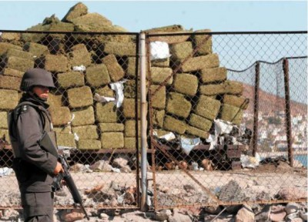
Current News
Drug War
Extreme violence
Caution for foreign companies
Notes:
-Lots of violence between drug cartels trying to gain conrol. Immediately upon taking office in 2006, Calderon launched an attack on drug trafficking cartels. But the violence only increased, with the toll from drug-related violence rising to more than 50,000 people during the past six years
-Some estimates place the annual profits of
Mexico’s drug trade at 3 percent to 4 percent of the country’s GDP—on the order of $30 billion per
year—and around half a million people are said to earn a substantial portion of their income through
the narcotics business.
-The FBI has reported 75 open cases of Americans kidnapped in Mexico.

Slide 16
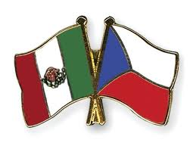
Mexico vs. Czech Republic
Population: 114,975,406
Size: 1,964,375 sq km
GDP: $1.185 trillion
Government: Federal Republic
Population: 10,177,300
Size:78,867 sq km
GDP: $220.3 billion
Government: Parliamentary Democracy

Slide 17
References
http://www.mexinsider.com/religion-in-mexico.html
http://www.mexconnect.com/articles/3148-history-time-line-overview-resource-page
https://www.cia.gov/library/publications/the-world-factbook/geos/ez.html

Slide 18
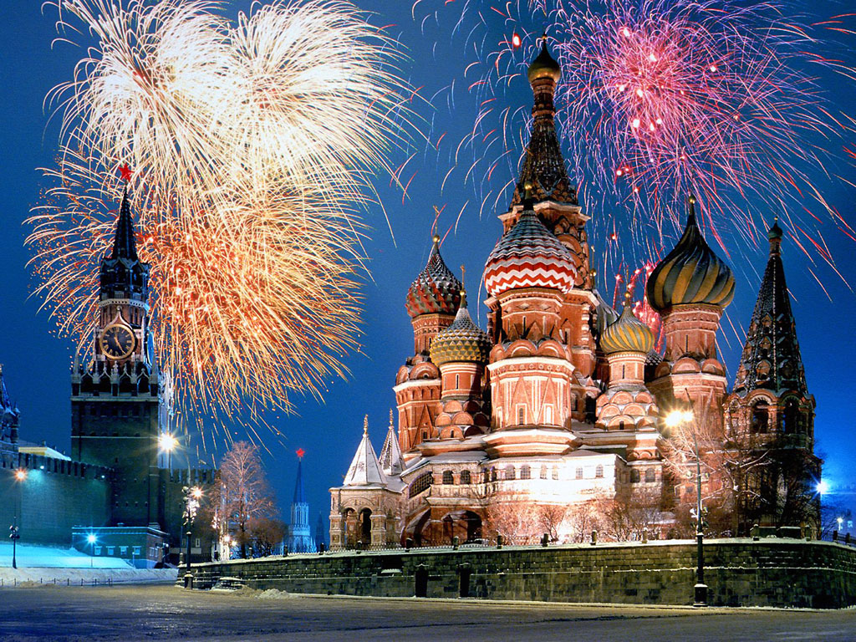
Russia

Slide 19
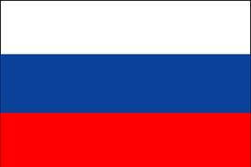

Slide 20
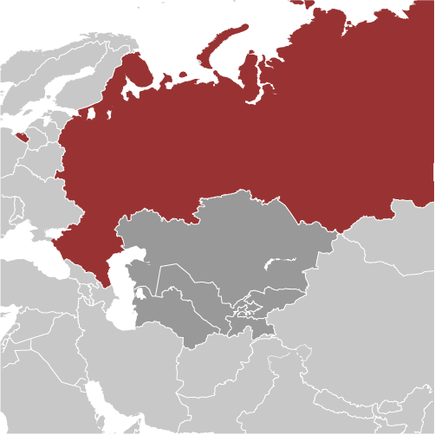
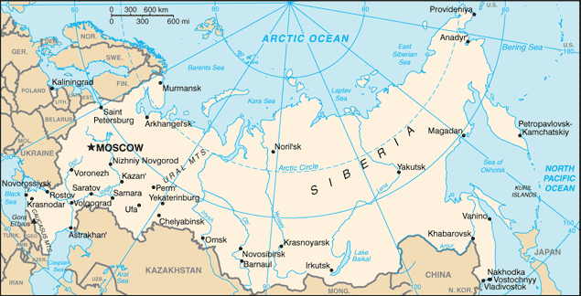
Area: 17,098,242 sqkm
Notes:
Largest country by land
Land mass almost double the US

Slide 21
People and Society
Population: 138,082,178
Ethnic Groups:
Russian:79.8%, Tatar 3.8%, Ukrainian: 2%, Bashkir: 1.2%, Chuvash: 1.1%
Religions:
Russian Orthodox: 15-20%, Muslim: 10-15%, Christian Other: 2%
Notes:
9th largest population wise in the world
note: estimates are of practicing worshipers; Russia has large populations of non-practicing believers and non-believers, a legacy of over seven decades of Soviet rule

Slide 22
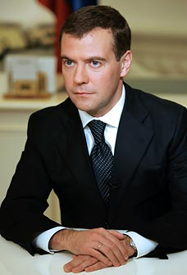
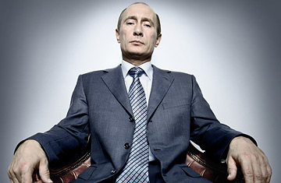
Government
Federation
12 states
Chief of State: President Dmitriy Medvedev
Prime Minister: Vladimir Putin

Slide 23
History
First Period
12th century
Mongols from central Asia invaded
Brutally subjugated the country for 400 years
Notes:
History of russia broken into 4 periods

Slide 24
History
Second Period
Peter the Great
Westernized Russia
Deemphasized its Asian influences
Created Russian Navy to facilitate trade
Constructed St. Petersburg out of swamp land

Slide 25
History
Third Period
Started in 1917
Moved to communism
Millions imprisoned and died
World War II
“Iron Curtain”
Notes:
Economy became weak after WWII as the russian gov poured most of its resources into military and atomic weapons
Churches were destroyed
Religious worship banned

Slide 26
History
Fourth Period
Started in 1992
Movement toward Capitalism
Economic improvement due to oil and gas preserves
Notes:
Gorbachev moved into a more capitalist government

Slide 27
Present Russia
No multinational firms to compete globally
Performing poorly in:
Public safety
Health
Corruption
Security of property rights

Slide 28
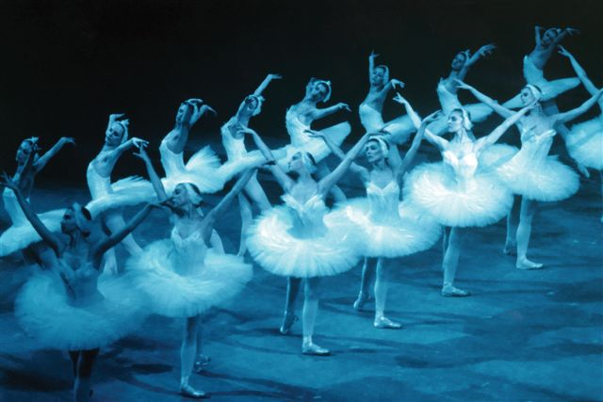
Russian Ballet
Notes:
Ballet did not originate in russia but russia has been able to enrich this art form immeasurably since the 17th century
The words “Russian Ballet” evoke feelings of tremendous job in anyone who is familiar with the finesse and style of the assured dancers associated with any part of this art form
Video of anna pavlova

Slide 29
Ballet as a metaphor for Russia
3 characteristics
Echelons
Drama and realism
Russian soul

Slide 30
Echelons
Russia
20% of population were members of Communist Party and received preferential treatment
Westernness of ballet reflects Russian dignity and superiority

Slide 31
Drama and Realism
Russian Citizens:
Personal favors to accomplish anything
In negotiations, each offers something the other desires
Notes:
Like ballet dancers, russian citizens try to make an impression on those who are in a position to help
Personal favors are expected to be redeemed at a later date

Slide 32
Drama and Realism
Culture:
Bargain and negotiate to beat the system
Favoritism and corruption used
Disobeying laws
Friends and connections important
Continual gift givers to generate generosity
Publicly distasteful to admit anything has gone wrong

Slide 33
Drama and Realism
Negotiating
Take extreme views
Offer few concessions
Little authority to make on-the-spot decisions
Prefer to not make decisions spontaneously

Slide 34
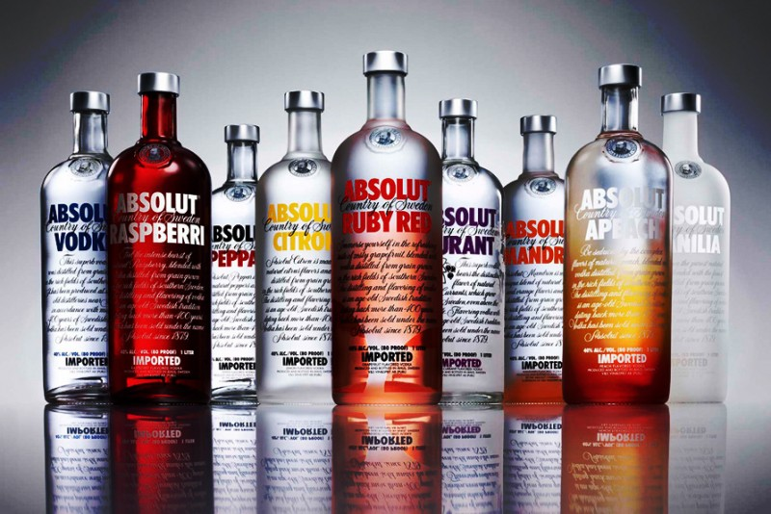
Drama and Realism
Vodka Pastime
National pastime
Drunkenness
Socially acceptable
Approved method of entertainment
Part of any festivity

Slide 35
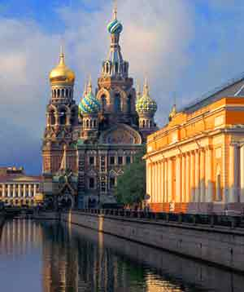
Drama and Realism
Religion
Atheism became official policy during Communism
risky to openly participate in religion
Led to underground system of beliefs
Law allowing religious freedom
1990
Renewed interest in Orthodox Church
Notes:
In 1991 Orthodox Christmas Day became national holiday after 70 years

Slide 36
Drama and Realism
Personal Qualities
Can be characterized as serious and unexpressive but is a false front
Public roles:
Characterized as careful, cagey, and passive
Private lives:
Characterized as honest and direct
With friends:
Pour out woes to one another and are not burdened by the need to disguise the realities

Slide 37
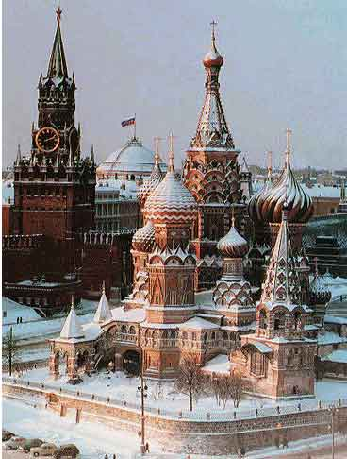
The Russian Soul
Contact Culture
Result of harsh winters
Notes:
To keep warm during the winter the entire family would sleep together on top of the fireplace to survive harsh conditions

Slide 38
The Russian Soul
Contact culture
Russians are:
Emotionally expressive
Communicate warmth, closeness, and availability for conversation
Intense eye contact
Frequent touching
Smiling emphasized

Slide 39
The Russian Soul
Housing
Crowded with multigenerational families
Small living spaces
No privacy
Notes:
Beds serve as couches in sitting areas and bathrooms are shared
No russian word exists to describe isolation in positive terms

Slide 40
The Russian Soul
Group Ethic
Can be traced to the mir
Collective Behavior
Communal seating in restaurants
Jostling and pushing among strangers in crowds
Holding hands among friends of same sex
Older russians provide unsolicited advice
Not impolite to drop in unannounced
Notes:
Mir- small village cooperative that make all farming decisions for the community. Also collected taxes and resolved conflicts

Slide 41
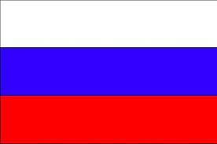
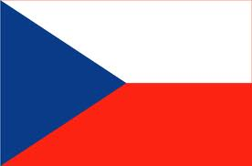
Comparison
Russia
Czech Republic
Area: 17,098242 sq km
Population: 138,082,178
Government: Federation
GDP: $2.38 trillion
Area: 78,867 sq km
Population: 10,177,300
Government: Parliamentary Democracy
GDP: $272.2 billion

Slide 42
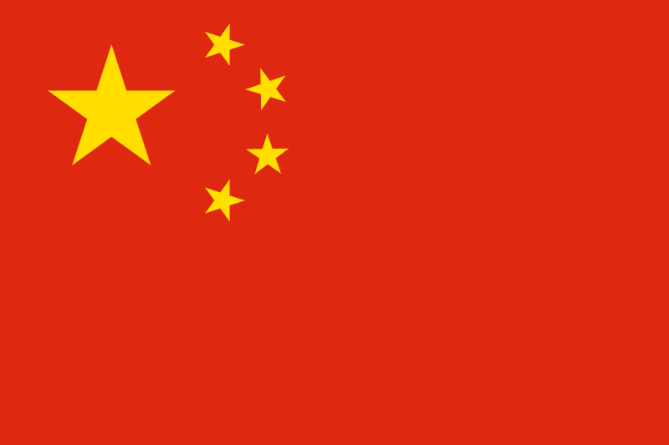
China
http://www.youtube.com/watch?v=4Dl2UFs2U_A

Slide 43
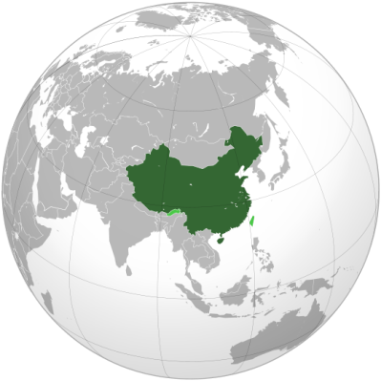
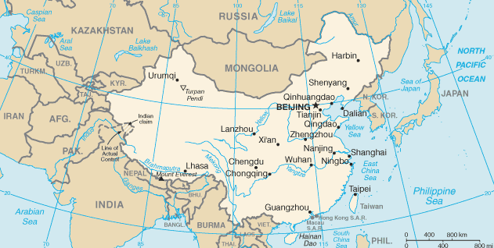
Map
9.6 million sq. km (3.7 million sq. miles)
Notes:
China has the longest combined land border in the world, measuring 22,117 km (13,743 mi) from the mouth of the Yalu River to the Gulf of Tonkin. China borders 14 nations, more than any other country except Russia, which also borders 14. China extends across much of East Asia, bordering Vietnam, Laos, and Burma in Southeast Asia; India, Bhutan, Nepal and Pakistan^{[90]} in South Asia; Afghanistan, Tajikistan, Kyrgyzstan and Kazakhstan in Central Asia; a small section of Russian Altai and Mongolia in Inner Asia; and the Russian Far East and North Korea in Northeast Asia.

Slide 44
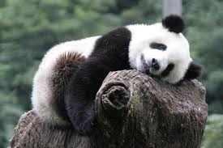
Facts
Official name: People’s Republic of China
Population: 1.3 billion
Capital: Beijing
Time zone: UTC+8
Official language: Mandarin Chinese
Government: Communist Party
President: Hu Jintao
Notes:
Official name
Most populous country by 2011 data, followed by India and United States
Single party country, one of the five remaining communist countries in the world. Issues still remain on the Internet, the press, freedom of assembly, reproductive rights, and freedom of religion.

Slide 45
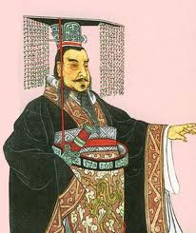
Brief history
A total history of 5,000 years
First unification of China: 221 BC—Qin Dynasty
Establishment of Republic: January 1, 1912
Proclaim of People’s Republic: October 1, 1949
Notes:
History textbook back to Palaeolithic Age

Slide 46
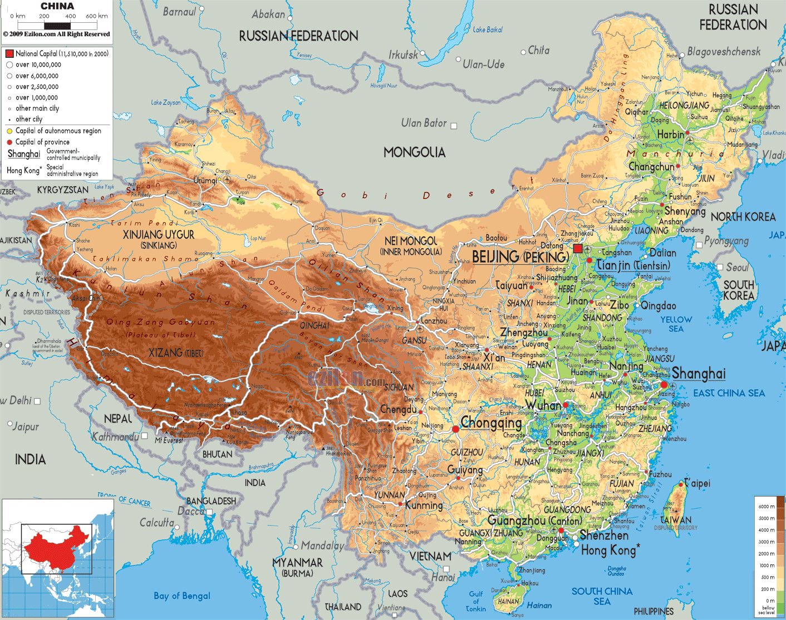
Vast and diverse landscape
Notes:
There are three stairs of the landscape. China has a vast area yet the major cultivable land locates in the east part, and only 13.5% of the land is cultivatable.
Supporting 23% of world’s population by 7% of the world cultivable land.

Slide 47
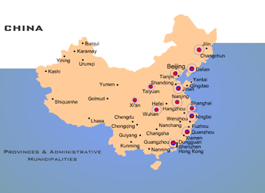
Population density and big cities allocation
Notes:
Due to the characteristics of the landscape, the population and the big cities also allocate accordingly. Most joint ventures and foreign investments poured in firstly in these parts.

Slide 48
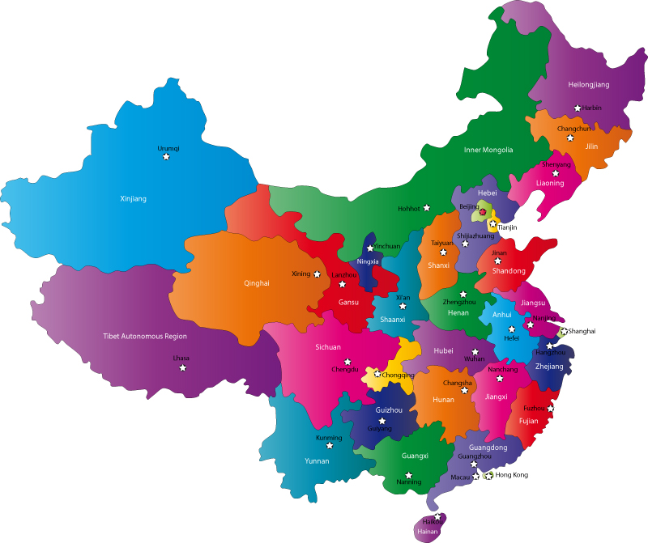
Administrative divisions
Provinces: 22
Autonomous regions: 5(Tibet, Xinjiang, Inner Mongolia, Guangxi, Ningxia)
Municipalities: 4(Beijing, Tianjin, Shanghai, Chongqing)
Special administrative regions:
2(Hong Kong and Macau)

Slide 49
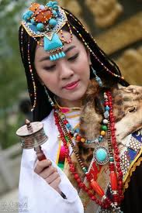
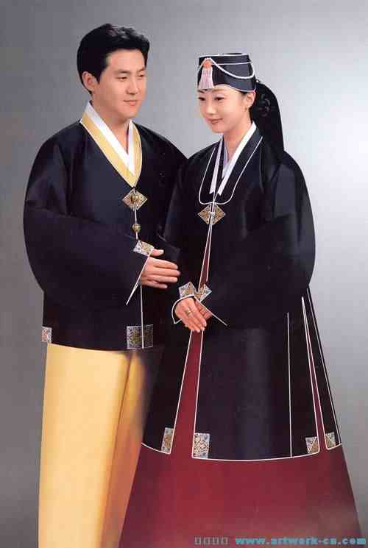
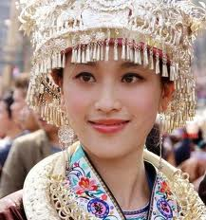
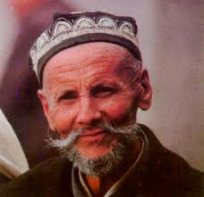
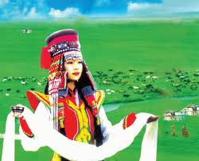
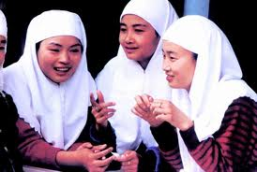
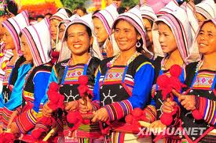
Demographics
Majority: Han—91.5%
55 minority ethnic groups: Zhuang, Man, Hui, Tibetan, Mongolian, Uyghur, Korean, Kazakh, and etc.
Notes:
1.布依族
最后基诺族

Slide 50
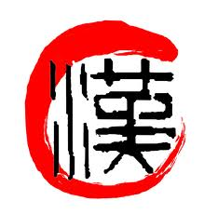
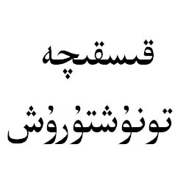
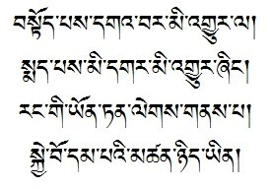
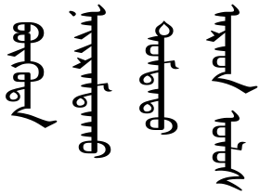
Languages
Sino-Tibetan language family
Most spoken: Mandarin, Wu(Shanghainese), and Cantonese
Non-Sinitic languages: Zhuang, Mongolian, Tibetan, Uyghur, Korean, Kazakh
Tibetan
Uyghur
Mongolian
Notes:
Mandarin is based on Beijing dialect, it’s the national official language.
Non-sinitic languages are spoken widely by minorities. Thanks to Mandarin Chinese, people all around the China could communicate with each other.

Slide 51
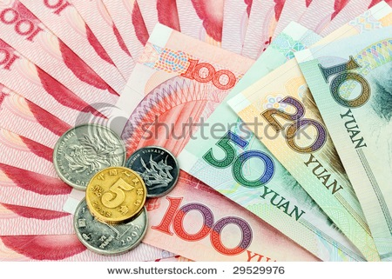
Economy
GDP: $7.3 trillion (2011--2nd)
Per capita: $5,184 (2011--90th)
Currency: yuan(CNY)
Exchange rate: $1= ¥6.3
World’s largest exporter and World’s second-largest importer
Second-largest trading power with $2.85 trillion foreign exchange reserves.
Member of WTO, APEC, ASEAN Plus Three, SCO
Notes:
Foreign co. numbers, investment scale
China's annual average GDP growth between 2001 and 2010 was 10.5%, and the Chinese economy is predicted to grow at an average annual rate of 9.5% between 2011 and 2015.
China's growth has been uneven, with some geographic regions growing faster than others, and a pronounced urban-rural income gap contributing to a national Gini coefficient of 46.9%. Development has been mainly concentrated in the heavily urbanized eastern coastal regions, while the remainder of the country has lagged behind.

Slide 52
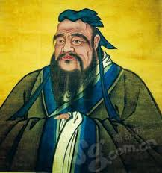
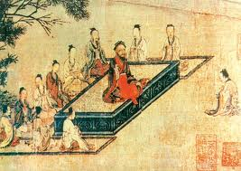
Culture—Confucianism
Confucius(551 BCE-479 BCE), great philosopher and educator
Core values: human-heartedness, sincerity, propriety
Conservative philosophies, Face is important
Respect and worship of ancestors
Emphasis on collectivism
http://www.youtube.com/watch?v=ylWORyToTo4
Notes:
1. Humanity toward others and respect for oneself
Trying not only to preserve face but to give face, saving themselves and everyone else from embarrassment.

Slide 53
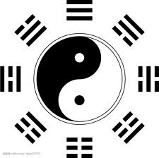
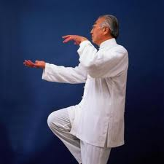
Culture—Taoism
It is all about balance and harmony
Yin and Yang
Wu wei or creative quietude, never forcing or training.
Letting behavior flow spontaneously
Seeking union with nature and simplicity of life more than materialistic possessions.
Notes:
A person can gain power only by leading a life in harmony with the dictates of the universe.
Simultaneous action and relaxation. 老子死了媳妇还唱歌的故事

Slide 54
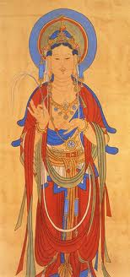
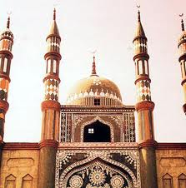
Religion
Buddhism—introduced from India in Han Dynasty around 9AD (18%)
Three Faiths: Confucianism, Taoism, and Buddhism
Christianity—first introduced to China during Tang Dynasty in 635AD (1.2%)
Islam dates back to 651, only 18 years after Prophet Muhammad’s death (1.7%)
Notes:
Most Chinese people are more culturally than spiritually influenced by the Three Faiths.
Besides, there are about 0.3% of the population believe in Catholicism.

Slide 55
Food
Cuisines and tastes vary a lot
Healthy, fresh, and good at matching
Food is something for Chinese
Chinese like cooking and spend time enjoying their cooking with family and friends
Dining is not dining that simple
Foreign restaurants poured in and gained profit

Slide 56
Something fun
Love red;
Think number 6, 8,
and 9 are lucky and
good, do not like 4, and 7;
You have to bring your own bag or buy the plastic bags after shopping in the supermarket
http://www.youtube.com/watch?v=mBdiyKMUuF4&feature=related

Slide 57
Conducting business
High context language: A “yes” can be a “no”
Being neutral is not always bad
Trying to show interest and gain trust
Bringing business to the dining table
http://www.youtube.com/watch?v=loL97DgsvdE
Notes:
“I am responsible for what I said, but not for what you understood.” What unsaid might be more important than what said.

Slide 58
Comparison
China
Area: 9.6 million sq. km
Population: 1.3 billion
Capital: Beijing
Language: Mandarin
GDP: $7.3 trillion
Czech Republic
Area: 78,866 sq. km
Population: 10.6 million
Capital: Prague
Language: Czech
GDP: $218.363 billion

Slide 59
Resources:
http://wenwen.soso.com/z/q78617691.htm?sp=3001
http://www.doingbusiness.org/data/exploreeconomies/china/

Slide 60
Building the Global Organization
Chapter 8

Slide 61
Organization Factors
Third corner of the globalization triangle
Other two are industry globalization drivers and global strategy levers
Achieving balance between autonomy and integration

Slide 62
Four Factors
Organization Structure
Managements Processes
People
Culture

Slide 63
Three Geographic Strategies
Global
Some form of centralized global authority
Multilocal
Each country makes its own decisions
Export-Based
Centralized authority but only takes view of home country

Slide 64
Organization Structure
Global
Centralized global
Global Sector Head
Country based organization structure
Global Business Directors
Operate across the functional and geographic organizations

Slide 65
Organization Structure
Global
Eliminating Domestic-International Split
“Transnational” companies

Slide 66
Unilever vs. P&G
Unilever
Coordinators for separate sectors
Coordinators at head office
P&G
Used integrated structures in 1980’s
Mid-1990’s reorganized to seven global business units

Slide 67
Corporate Strategies
Fragmented Multilocal
Integrated Country
Integrated Business Global
Integrated Corporate Global
Mixtures can be best

Slide 68
Designating Strategic Leaders
Different countries get different responsibilities
Requires cooperation
Nobody singled out

Slide 69
National Differences
Three major regions
United States
Slower to go international
Japan
Need to retain global integration while allowing local autonomy
Europe
Most advanced in multinationalization
Need to increase global integration

Slide 70
Management Processes
Global Strategy Information System
Imperative to have worldwide information to formulate a global strategy
Most importantly, headquarters needs to send information back
Coordinating Globally
Range of coordination (least to most coercive)
Share information
Negotiate
Required to clear
Directed

Slide 71
Management Processes
Global Strategic Planning
Idea is to have a strategic planning process involving key parties
Most multinational corporations have yet to develop this
Global Budgeting
Transferring resources
Adjusting prices accordingly
Global budgets

Slide 72
Management Processes
Global Process Review and Compensation
Need the way managers are evaluated and rewarded to reinforce global objectives
Also need rewards to also be tied into overall performance of a region, not just one country

Slide 73
People
Early stages
Rely on expatriates
Global
Multicountry careers
Foreign nationals in home and third countries
Extensive travel

Slide 74
People
Multilocal
Professional expatriates
Nationals run local business
Limited travel
Export-Based
Home country nationals run local marketing subsidiaries

Slide 75
Foreign Nationals
Need to gain experience in other countries
3 benefits
Broadens talent pool
Shows commitments to internationalization
Development opportunity

Slide 76
Working Internationally
Jacques Maisonrouge
Former head of IBM’s international arm
Had policy that no executive could become a general manager without an overseas assignment
Very common practice now

Slide 77
Culture
Global
Global identity
Interdependence
Multilocal
Multinational identity
Autonomy
Export-Based
Home country culture

Slide 78
Culture
Global Identity
Strong national identity can be damaging
Still a need to have roots in local culture
Best to avoid nationalistic displays

Slide 79
Krispy Kreme
All international stores are franchises
Global strategy does not come into play as much
International section of the company
Based at the home office in the US
Not really integrated into any other specific country

