Slide 1
Sunglass Industry

Slide 2

Sunglass Industry Information
Invented in1929 by Sam Foster
By the 1930’s the industry was vastly popular
Army Air Corps commission

Slide 3
Sunglass Industry Info Cont’d
Recession of 2001
Sunglasses make up over 10% percent of the worldwide vision care
Decline is sales in 2009

Slide 4
Sunglass Industry Info Cont’d
High Profit Margins
Cheaper Materials
Paying for brand recognition

Slide 5

Sunglass Industry Info Cont’d
Luxottica
Sales Generated
Profit
Brands
Other leaders

Slide 6

Oakley
The company of Oakley was started by Jim Jannard in 1975 in his garage with only an initial investment of 300 dollars.
Their mission is to be driven to ignite the imagination through the fusion of art and science through the products they produce.
Oakley brand also manufacturers products such as apparel, footwear, goggles, electronics, and watches.

Slide 7
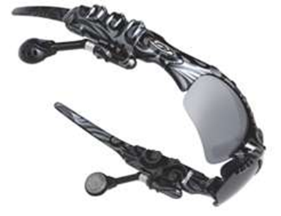
Oakley
Headquarters and manufacturing plant
Innovation & Creativity
Technology & Design

Slide 8
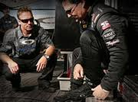
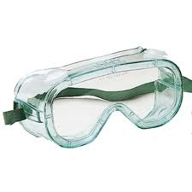
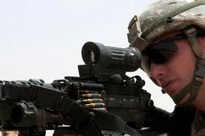
Oakley
Protective Eyewear

Slide 9


Oakley
Fox Racing
Oliver Peoples® eyewear

Slide 10
Oakley

Slide 11
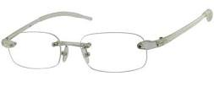
Oakley
Brand Location
Prescription Industry

Slide 12

Oakley
It is clear to observe that Oakley is a world leader in their respected industry as well as a trend setter.
Having seen this information we feel that the Oakley brand would be well suited in the Chilean Market place.

Slide 13

In 2007, Oakley was bought by the Milan-based Luxottica Group for US $2.1 billion. They are now one of the most successful brands in Luxottica’s portfolio.
Luxottica’s size, strength and reach give Oakley all the necessary resources for a successful expansion of the business into new markets like South America.

Slide 14
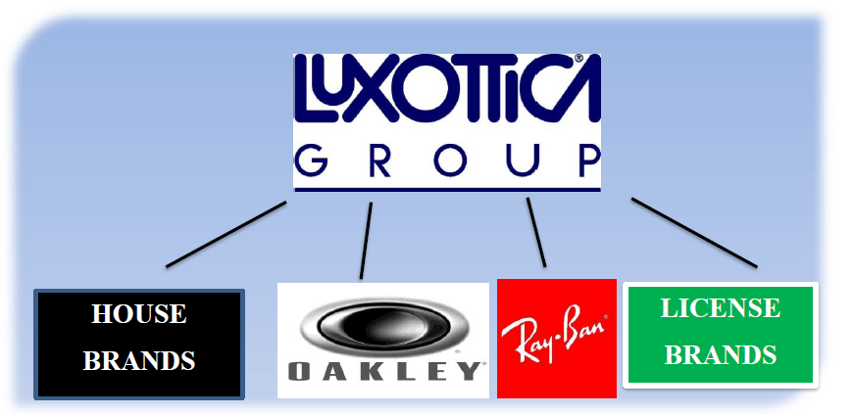
6.2 billion euros in sales in 2011
65,000 global employees
Presence on all continents

Slide 15
TWO MAIN INDUSTRY SEGMENTS
RETAIL DISTRIBUTION
MANUFACTURING & WHOLESALE DISTRIBUTION

Slide 16
OPTIMAL BRAND BALANCE
HOUSE BRANDS
LICENSE BRANDS

Slide 17
FINANCIAL STRENGTH

Slide 18
CASH ON HAND
HALF A BILLION EURO IN MID 2011
- ACQUISITIONS
- OPPORTUNITIES
EMERGING MARKET GROWTH

Slide 19
DOUBLE DIGIT GROWTH

Slide 20
LUXOTTICA’S 2012 STRATEGY

Slide 21
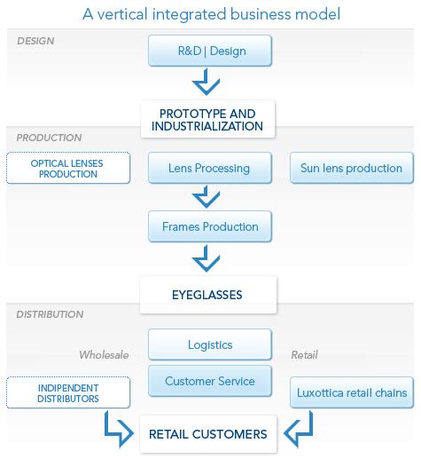
AND HOW THEY WILL DO IT

Slide 22
WHERE OAKLEY FITS IN
THE MOST VALUE ADDED ACQUISITION IN THE COMPANY’S HISTORY
  THE ONLY ONE TO EXPERIENCE CONTINUED DOUBLE DIGIT GROWTH
GREAT FIT IN THE AMERICAN MARKETS
GROWTH OPPORTUNITIES FOR SPORTING AND ACTIVE LIFESTYLES (TOURISM)
A PART OF THE OVERALL GLOBAL STRATEGY
  RETAIL, MANUFACTURING AND DISTRIBUTION
  START WITH MULTI-LOCAL, EXPAND TO GLOBAL

Slide 23
Oakley In Chile

Slide 24
Total Market Availability
Chile has a GDP(gross domestic product) of $279.9 billion
PPP (price purchasing parity) of $13,331
The public is likely able to purchase Oakley's sunglass products.

Slide 25
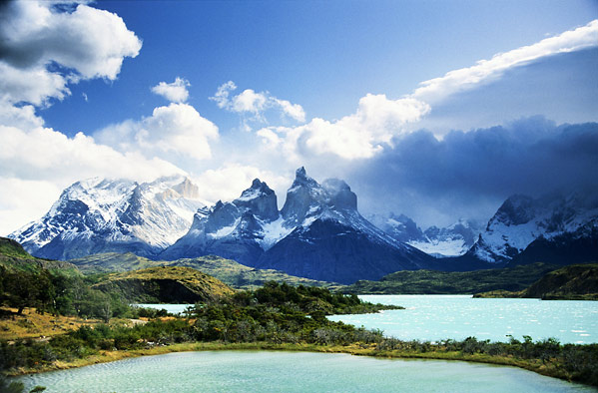
Total Market Availability
Vast increase in tourism
High amount of brand recognition
Chilean people high on fashion sense

Slide 26
Current Participation In Chile
Acquisition of GMO Opticas
Proven track record of mobility
Customer service center already operating in Chile

Slide 27

Using Luxottica’s Infrastructure
The manufacturing plant in Brazil
High amount of recourses from a top notch company (Luxottica)
Many south American recourses
Market research

Slide 28
Total Strategy

Slide 29

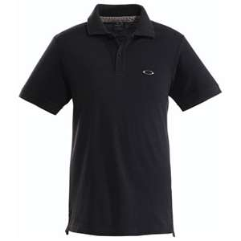
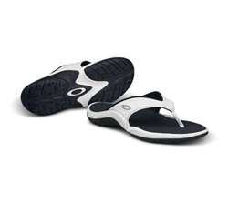

Oakley Brand
Optics
Product Variety
575 patents and 1100 trademarks

Slide 30
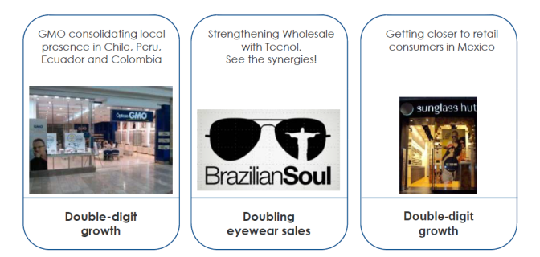
Goal
South American Market

Slide 31
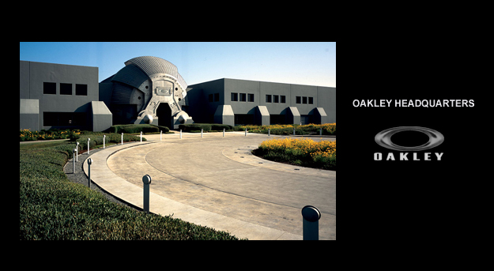
Manufacturing Facilities
Foothill Ranch facility California
Dayton, Nevada
India
CHILE? Soon!
Notes:
Foothill Ranch facility in California (US) manufactures high performance sunglasses and prescription frames and lenses and assembles most of Oakley’s eyewear products, while Oakley’s second manufacturing centre in Dayton, Nevada (US), produces the frames used in its X Metal® (a proprietary alloy) eyewear products. Lastly, there is a small plant in India, serving the local market.

Slide 32

Regional Strategy
US operations
2013 Brazil Manufacturing plant
Multioptica International
Regional distribution

Slide 33
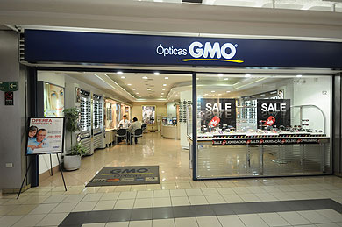
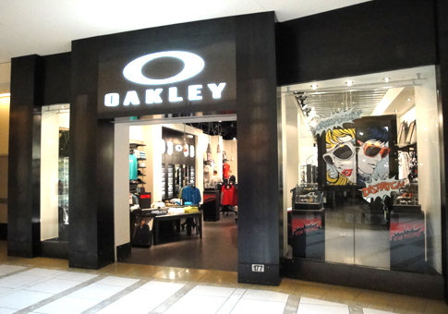
Introducing Oakley
Over 470 in South America
GMO Optica
221 stores in Chile

Slide 34
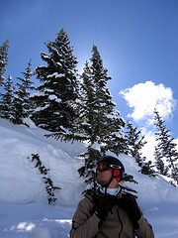
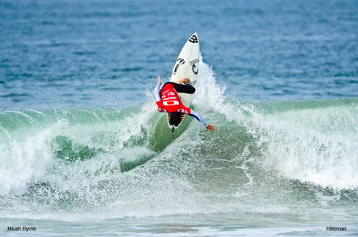
Local Market
Geographical features
Year-round sporting and outdoors
Beaches to snow
Notes:
There are five distinct and well-defined geographic regions: the northern desert, the high Andean sector, the central valley, the southern lake district, and the archipelago. Santiago is the capital and the commercial center of the country.
Climate temperate; dessert in the north; Mediterranean in the central region; cool and damp in the south
6,435 km of coast line, Elevation ranging from 0m to 6,880m

Slide 35
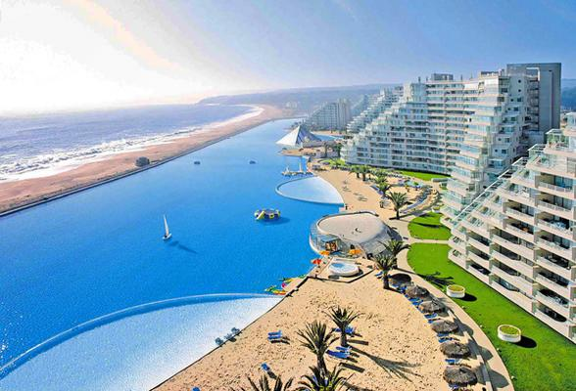
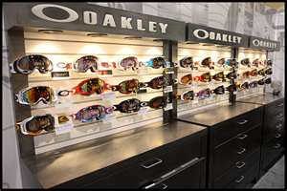
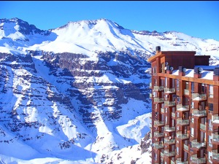
Tourism
Resorts
Kiosk

Slide 36
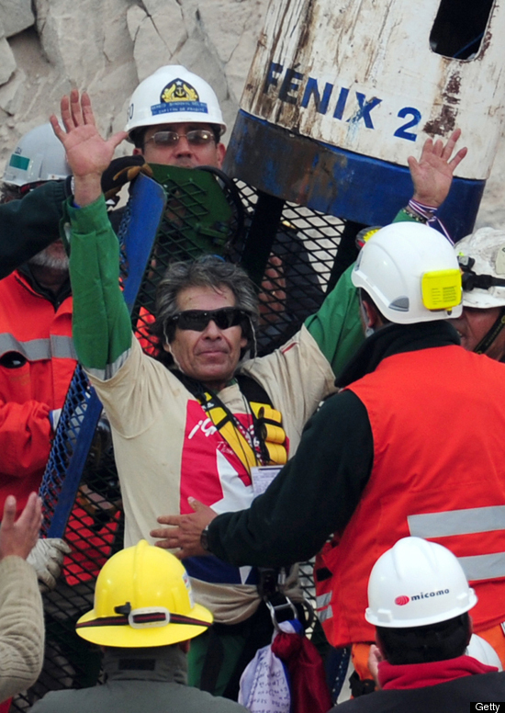
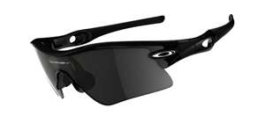
Marketing Moves
Chilean mining accident of 2010
35 pairs of Radar sunglasses

Slide 37
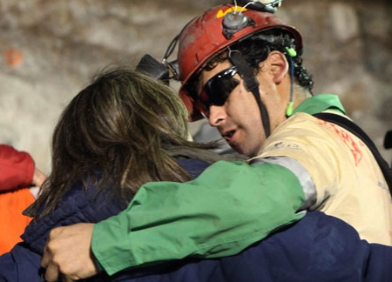
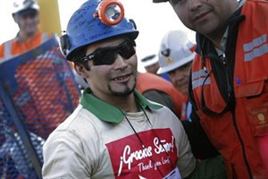
Marketing Moves
$41 Million

Slide 38
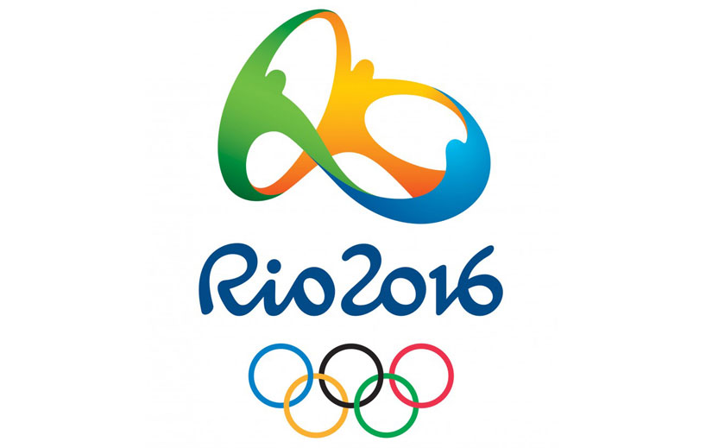
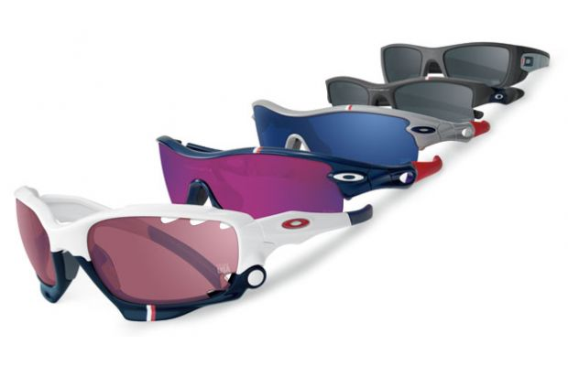
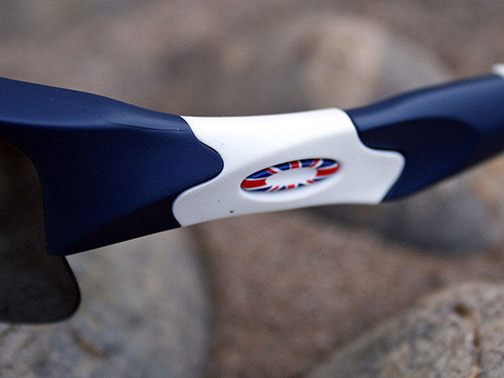
Olympics 2016
Rio de Janeiro, Brazil
600 athletes from more than 30 countries

Slide 39
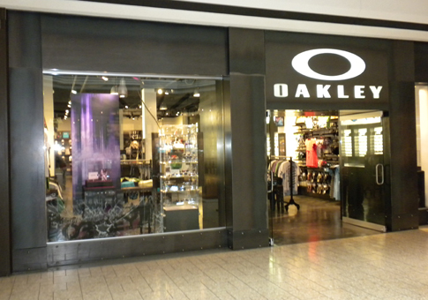
Oakley Retail Store
AFA third parties
Current infrastructure

Slide 40


