Slide 1
Chapter 10: Managing Conflict and Negotiation

Slide 2
Agenda
Causes and types of conflict
Conflict resolution styles
Relationship between conflict and performance
Conflict across cultures
Negotiation

Slide 3
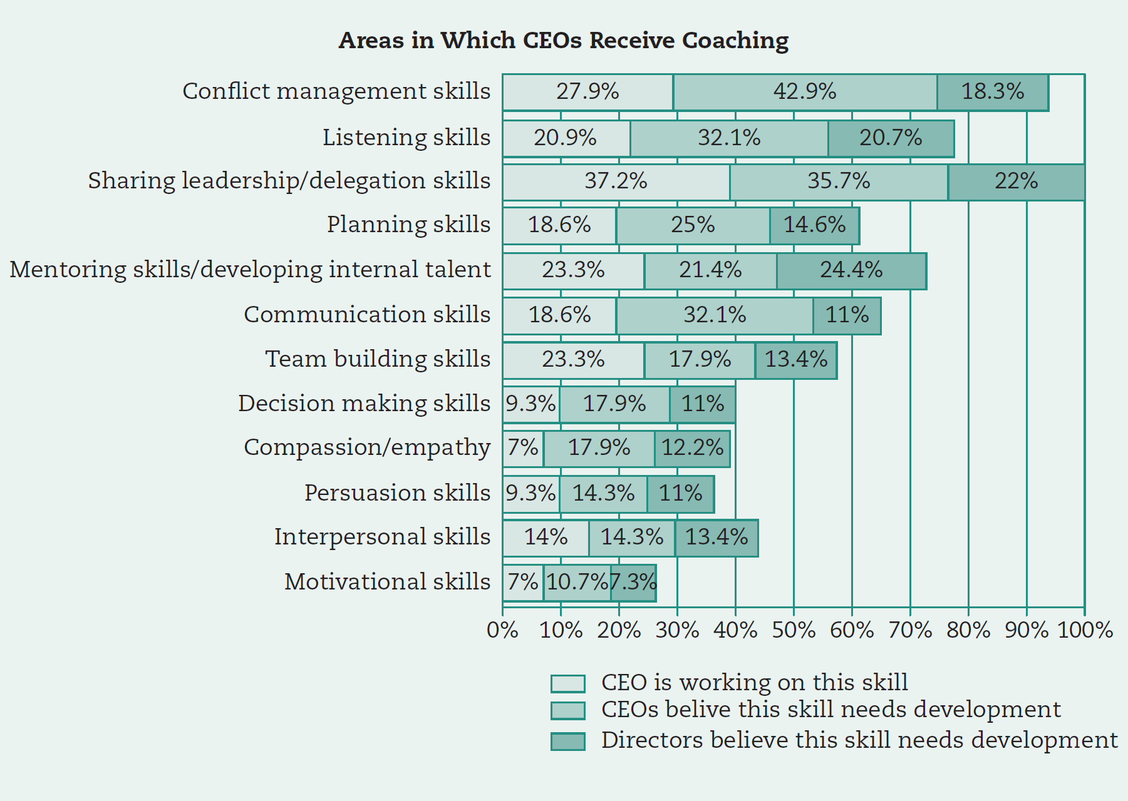
Source: Gavett, G. (2013). Research: What CEOs really want from coaching. (retrieved on December 23, 2013 from: http://blogs.hbr.org/2013/08/research-ceos-and-the-coaching/)

Slide 4
What is Conflict?
Conflict is defined as “the process that begins when one party perceives that the other has negatively affected, or is about to negatively affect, something that he or she cares about” (Thomas, 1992).
Conflict is a perception.
Perceptions don’t always line up with reality.
However, they do influence behavior and they can be changed.

Slide 5
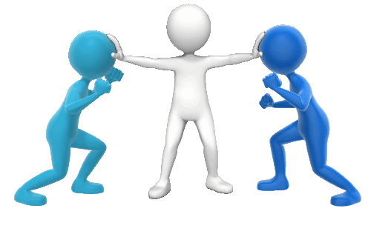
Sources of Organizational Conflict
Substantive conflict
Affective conflict
Process conflict

Slide 6
Is Conflict Always Bad?
Unproductive (dysfunctional) organizational conflict can harm relationships between leaders and followers and among teammates; ultimately harms performance
Productive (functional) conflict is productive; improves performance if it aligns with the goals of the organization

Slide 7
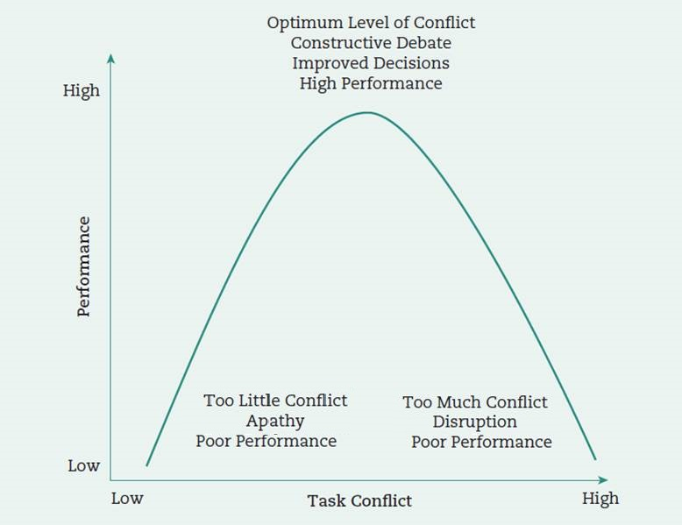
Optimizing Conflict
Source: Adapted from: Duarte, M., & Davies, G. (2003). Testing the conflict–performance assumption in business-to-business relationships. Industrial Marketing Management, 32(2), 91–99.

Slide 8
Task vs. Relationship Conflict
Task conflict -- Disagreements about resource allocation, policies, or even interpretation of data
Relationship conflict -- involves personality clashes or differences in values

Slide 9
WORKPLACE incivility and VIOLENCE
2 million acts of workplace violence a year
Employees likely face at least 1 instance of incivility a week
To resolve these problems leaders must
Know their employees and what is going on among them
Help with conflict resolution

Slide 10
Conflict Resolution Styles
Integrating (problem solving)
Obliging (smoothing)
Dominating (forcing)
Avoiding (withdrawing from conflict)
Compromising (creating a solution that everyone can agree on)

Slide 11
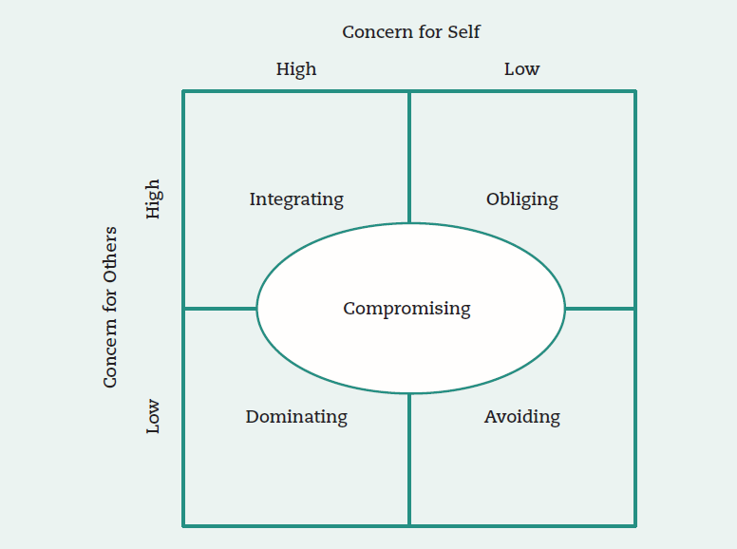
Styles of Handling Interpersonal Conflict
Source: Rahim, M. A. (1985). A strategy for managing conflict in complex organizations. Human Relations, 38(1), 81–89. p. 84.
Notes:
Figure 10.2 on page 263.

Slide 12
CONFLICT RESOLUTION STYLES
DOMINATE
INTEGRATE
MY WAY
OUR WAY
COMPROMISE
HALF-WAY
Assertiveness
AVOID
OBLIGE
NO WAY
YOUR WAY
Cooperativeness

Slide 13
USE DIFFERENT STYLES in DIFFERENT SITUATIONS
Dominate -- quick action is vital
Integrate -- to gain commitment with consensus
Avoid -- the issue is trivial
Oblige -- when you’re wrong
Compromise -- opponent has equal power and you hold mutually exclusive goals

Slide 14
Team Conflict and OUTCOMES
All types of conflict are detrimental to member satisfaction.
Moderate levels of task conflict can improve team performance.

Slide 15
TEAM CONFLICT RESOLUTION STRATEGIES
Focus on content of interactions not delivery style.
Explicitly discuss reasons behind decisions in distributing work assignments.
Assign work to members with relevant task expertise rather than using means such as volunteering, default, or convenience.

Slide 16
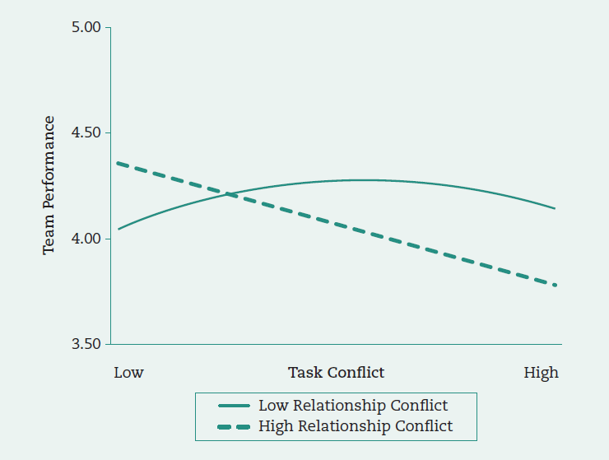
TASk and Relationship Conflict in Predicting Team Performance
Source: Shaw, J. D., Zhu, J., Duffy, M. K., Scott, K. L., Shih, H. A., & Susanto, E. (2011). A contingency model of conflict and team effectiveness. Journal of Applied Psychology, 96(2), 391–400. p. 397.
Notes:
Figure 10.3 on page 268.

Slide 17
Third-Party CONFLICT RESOLUTION Interventions
Is the intervention necessary or appropriate?
If so, what type of intervention is most appropriate?
Is the manager the appropriate person to intervene?
If not, should the services of an independent resource person be provided?
If so, how might the manager make use of the resource person?

Slide 18
Types of Interventions
Facilitation by the leader
Alternative dispute resolution
Ombudsmen
Peer review
Mediation
Arbitration

Slide 19
Resolving Conflict Across Cultures
Be a good listener.
Be sensitive to the needs of others.
Be cooperative, rather than overly competitive (equal with skill above).
Advocate inclusive (participative) leadership.
Compromise rather than dominate.

Slide 20
Resolving Conflict Across Cultures (continued)
Build rapport through conversations.
Be compassionate and understanding.
Avoid conflict by emphasizing harmony.
Nurture others (develop and mentor).

Slide 21
Conflict Resolution and Negotiation
Distributive bargaining
“Fixed pie” perspective
Hardball tactics -- leads to higher economic outcomes
Integrative bargaining
Tries to reach an agreement that satisfies all concerns -- leads to higher emotional outcomes such as satisfaction and relationship development

Slide 22
Necessary Conditions for Integrative Bargaining
Both parties must be:
Open with information and candid about their concerns
Sensitive to the other’s needs
Able to trust each other
Willing to be flexible
Notes:
In order for integrative bargaining to be successful, parties must be open with information and candid about their concerns. In addition, both parties must work to pay attention to the needs of the others involved. This all needs to happen so trust occurs. In the process both parties must be willing to be flexible in working towards a solution.

Slide 23
Prepping for Your Negotiation
What are your interests? What are theirs? How can you find out?
Best Alternative To a Negotiated Agreement (BATNA)
What’s our BATNA? What’s theirs?

Slide 24
Prepping for Your Negotiation
What’s your WATNA (Worst Alternative…)? Theirs?
What do we know about their circumstances that might affect the negotiations?
What’s their negotiation style?

Slide 25
The Negotiation Process
Source: Thompson, L. (2012). The mind and the heart of the negotiator (5th ed.). Upper Saddle River, NJ: Prentice Hall.
Notes:
Figure 10.4 on page 271. Conflict resolution is best understood through the negotiation process. The grid in this slide outlines the steps: Preparation and planning, definition of ground rules, clarification and justification, bargaining and problem solving and closure and implementation. You should determine your BATNA and that of the other party before proceeding with negotiations. BATNA represents the Best Alternative To a Negotiated Agreement or the lowest acceptable value you will take for a negotiated agreement. Than anything above your BATNA is a good negotiated outcome.

Slide 26
Leadership Implications: Perspective Taking
The ability to see things from another person’s perspective when they hold a view that conflicts with your own.
Fosters empathy and more positive attributions in conflict resolution and negotiation

Slide 27
Open-access student resources
Checklist action plan
Learning objective summaries
Mobile-friendly quizzes
Mobile-friendly eFlashcards
Video and multimedia resources
SAGE journal articles
edge.sagepub.com/scandura

