Slide 1
Chapter 12: Cross-cultural differences and adjustments

Slide 2
Agenda
Culture
Cultural intelligence
Cultural adjustment and retooling
Expatriation and culture shock
Cultural agility

Slide 3
Global Diversity as A Key Workforce Trend
Organizations as global villages
Buy, sell, recruit, and operate in a global market
Leaders have to be effective in cross-cultural interactions.

Slide 4
What is Culture?
Unstated standard operating procedures or ways of doing things.

Slide 5
WHAT IS CULTURE?
Culture is something that
Is shared by almost all members of a social group,
Older members of the group pass on to younger members
Shapes behavior, or structures perceptions of the world (e.g., morals, laws, and customs)

Slide 6
Culture as an Iceberg
Source: Adapted from Hall, E. T. (1977). Beyond culture. New York, NY: Random House.
Notes:
Figure 12.1 on page 311

Slide 7
High-Context vs. Low-Context Cultures
High-context cultures
Rely on situational cues for meaning when communicating with others
Low-context cultures
Do not rely on situational cues
Expects the message alone to convey meaning

Slide 8
Examples of High- and low-context cultures
Notes:
Figure 12.2 on page 312

Slide 9
Hofstede’s Cultural Values
Power distance
Collectivism vs. individualism
Uncertainty avoidance
Relationship orientation
Confucian dynamism

Slide 10
Criticisms and Usefulness of the Hofstede’s Research
Limited dimensions
Dated (1980s, updated in the 1990s)
Did not take the political times into account
Data collected in one organization

Slide 11
GLOBE Studies of Cross-Cultural Leadership
Power distance
Uncertainty avoidance
Humane orientation
Institutional collectivism
In-group collectivism
Assertiveness
Gender egalitarianism
Future orientation
Performance orientation

Slide 12
Culturally Endorsed Implicit Leadership Theory (CLT)
1. Charismatic/value based
2. Team oriented
3. Participative
4. Humane oriented
5. Autonomous
6. Self-protective

Slide 13
Ethics Across Cultures
GLOBE suggests the following seen as important to being an effective leader in all cultures studied:
Character/integrity
Altruism
Collective motivation
Encouragement
However, cultures differed in the relative importance of each of these dimensions.

Slide 14
Cultural Tightness-Looseness
Cultural tightness-looseness is described as the strength of social norms and the level of sanctioning within societies.
Tightness – higher norms and sanctions
Looseness – lower norms and sanctions

Slide 15
Developing Global Leaders
Global mindset
Developed through three skills:
Cultural intelligence
Cultural retooling
Integrative acculturation (becoming bicultural)

Slide 16
The Third Culture
The construction of a mutually beneficial interactive environment in which individuals from two different cultures can function in a way beneficial to all involved.

Slide 17
THE THIRD CULTURE
Consists of:
Shared frameworks
Development of shared value systems
Unique communication patterns that emerge when people from different cultures interact

Slide 18
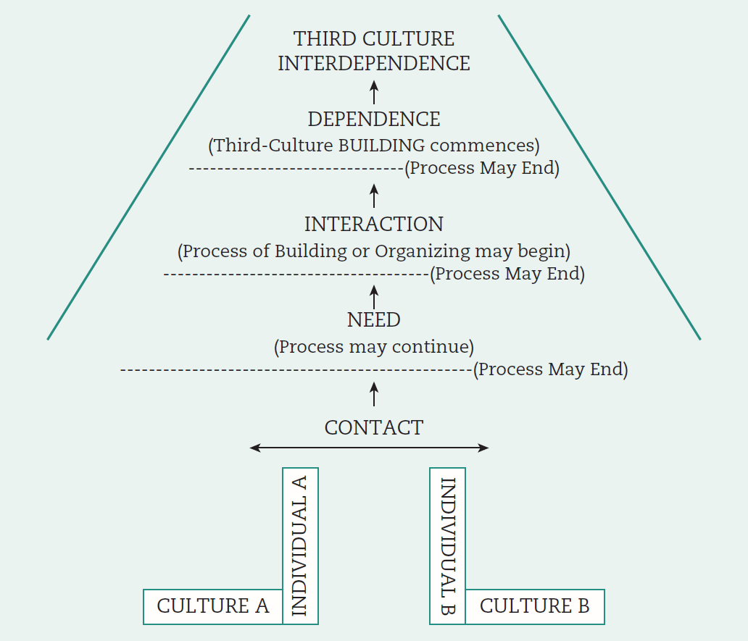
Building The Third Culture
Source: Casrnir, F. L. (1999). Foundations for the study of intercultural communication based on a third-culture building model. International Journal of Intercultural Relations, 23(1), 91–116.

Slide 19
Cultural Intelligence (CQ)
Cultural intelligence has been defined as individual’s capabilities to function and manage effectively in culturally diverse settings.
Cognitive (and metacognitive)
Motivational
Behavioral

Slide 20
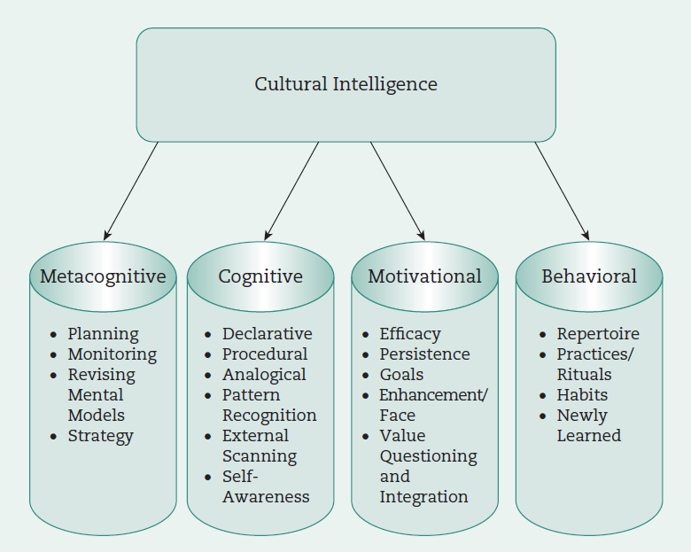
Dimensions of Cultural Intelligence
Sources: Adapted from Earley, P. C., & Ang, S. A. (2003). Cultural intelligence: Individual interactions across cultures. Stanford, CA: Stanford University Press; Eisenberg, J., Lee, H., Bruck, F., Brenner, B., Claes, M, Mironski, J., & Bell, R. (2013). Can business schools make students culturally competent? Effects of cross-cultural management courses on cultural intelligence. Academy of Management Learning & Education, 12(4), 603–621.

Slide 21
Cultural Retooling
The psychological process of adaptation to another culture
Individuals often experience internal conflict

Slide 22
CULTURAL RETOOLING: PHASES
Phase 1. Deep conflict—feeling illegitimate and awkward
Phase 2. Ambivalence—adjusting and not feeling as negative about the behavior
Phase 3. Authenticity—naturally engaging in the new behavior consistent with the new culture

Slide 23
Cross-Cultural Adjustment
Assimilation
Separation
Marginalization
Integration (becoming bicultural)

Slide 24
Integrative Acculturation
Biculturals are defined as “people who have internalized more than one cultural profile” (Thomas, 2010).
Have greater integrative complexity

Slide 25
Culture Shock
A series of phases a person goes through when immersed in new culture.
Occurs during:
Cross-cultural adjustment processes for expatriates
Repatriation
Short international assignments to increase cultural agility

Slide 26
Symptoms of Culture Shock
Stress due to the effort required to make necessary adjustments.
A sense of loss from missing family and friends—“homesickness”
Wanting to avoid interactions with persons from the host culture.
Feeling helpless and wanting to depend on those from one’s home country.

Slide 27
Symptoms of Culture Shock
Fear of being robbed, injured or becoming ill.
Anger at delays and inconveniences experienced.
Feeling incompetent from not being able to cope with the new environment.

Slide 28
Stages of Culture Shock
Source: Gaw, K. F. (2000). Reverse culture shock in students returning from overseas. International Journal of Intercultural Relations, 24(1), 83–104; Oberg, K. (1960). Culture shock adjustment to new cultural environments. Practical Anthropology, 7, 177–182.
Notes:
Figure 12.5 on page 325

Slide 29
Cultural Agility
1. Switch your frame of reference—set aside your own beliefs, listen, and watch
2. Be curious—ask non-judgmental questions
3. Look for commonalities—ask what seems familiar and find value in this situation
4. Reflect and learn—process your experiences, reflect on what is familiar and what is new
5. Champion others—let others know when you discover the expertise of others or learn that someone is doing something valuable

Slide 30
LEADERSHIP IMPLICATIONS: “EXPLAIN BEFORE BLAME”
The effective leader must
Be able to suspend judgment
Use cultural intelligence (CQ) to effectively adjust to those from other cultures

Slide 31
Open-access student resources
Checklist action plan
Learning objective summaries
Mobile-friendly quizzes
Mobile-friendly eFlashcards
Video and multimedia resources
SAGE journal articles
edge.sagepub.com/scandura

