Slide 1
Chapter 13: Stress in the Context of Organizational Change

Slide 2
Agenda
Types and sources of stress
Impact on the individual
Impact on the organization
Coping with stress

Slide 3
Road warriors
Executives facing travel stress
Pre-trip stressors
Trip stress
Post-trip stress

Slide 4
What is Stress?
Stress is the difference between the demands (or stressors) placed on people and their ability to cope with the demands and reach their goals.
Person–environment (P-E) fit

Slide 5
WHAT IS STRESS?
Job strain—the combination of greater psychological job demands and lower job control

Slide 6
STRESS AND ORGANIZATIONAL PERFORMANCE
Stress:
Costs organizations billions of dollars per year
Reduces productivity and increases accidents
Relates to lower job satisfaction, organizational commitment, and job involvement and higher frustration
Harms employee health and well-being

Slide 7
Stress and organizational performance
Source: Stress in America. (2013). American Psychological Association. Retrieved on March 3, 2014, from www.stressinamerica.org.
Notes:
Figure 13.1 on page 342

Slide 8
TYPes of Stress
Challenge-related stress may be positive, or what is known as eustress, or “good stress”
Hindrance-related stress
Results from constraining job experiences
Lessens loyalty, increases job search and intentions to quit, and negatively affects learning

Slide 9
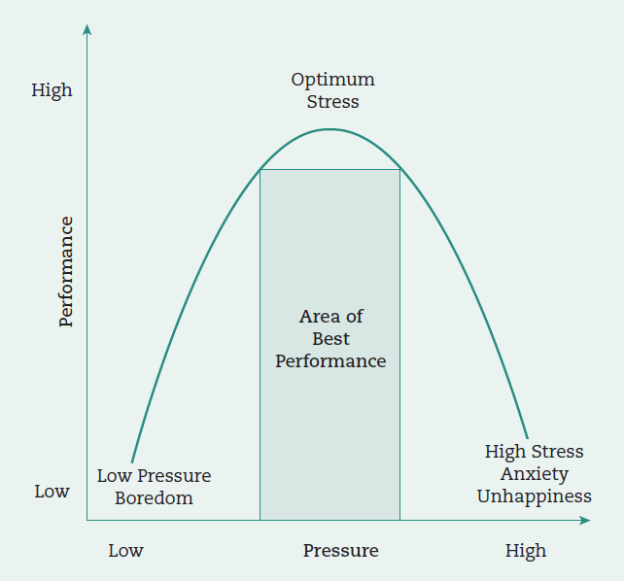
Pressure and Performance
Source: Diamond, D. M., Campbell, A. M., Park, C. R., Halonen, J., & Zoladz, P. R. (2007). The temporal dynamics model of emotional memory processing: a synthesis on the neurobiological basis of stress-induced amnesia, flashbulb and traumatic memories, and the Yerkes-Dodson law. Neural Plasticity, 1–33. p. 3.
Notes:
Figure 13.2 on page 343

Slide 10
Change-Related Stress
Organizational change—most common source of work stress
Change uncertainty

Slide 11
Sources of Work-Related Stress
Stressors -- situations and events that result in an employee experiencing job strain.
Role stress
Role ambiguity
Role conflict
Role overload
Work–family conflict

Slide 12
Sources of Work Stress
“Toxic” workplaces
Hostile behaviors between employees
Abusive supervision
Supervisors ridicule, spread rumors, take credit for work done by followers, give the “silent treatment,” and/or withhold information

Slide 13
Stress Episode
A stress response “is the generalized, patterned, unconscious mobilization of the body’s natural energy resources when confronted with a demand or stressor” (Quick et al., 1997, p. 3)
Fight or flight response

Slide 14
Strains
1. Physiological
2. Psychological
3. Behavioral

Slide 15
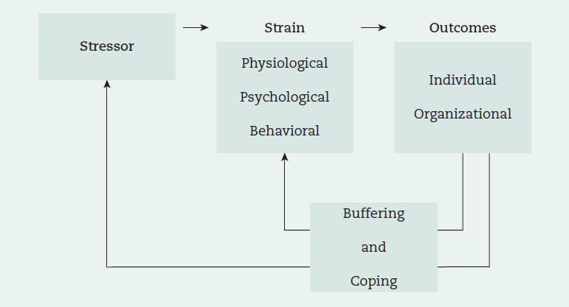
Stress Episode
Source: Viswesvaran, C., Sanchez, J. I., & Fisher, J. (1999). The role of social support in the process of work stress: A meta-analysis. Journal of Vocational Behavior, 54(2), 314–334.
Notes:
Figure 13.3 on page 351

Slide 16
Stress is a Global Concern
Job strain is becoming more prevalent around the world
Why?
Advances in technology
Continuous industrial revolutions
Poor pay, working conditions and long hours in some countries

Slide 17
Coping
Changing cognitive and behavioral efforts to manage external and/or internal demands taxing or exceeding the resources of the person
Behavioral methods (problem-solving)
Cognitive methods (managing thoughts and emotions)

Slide 18
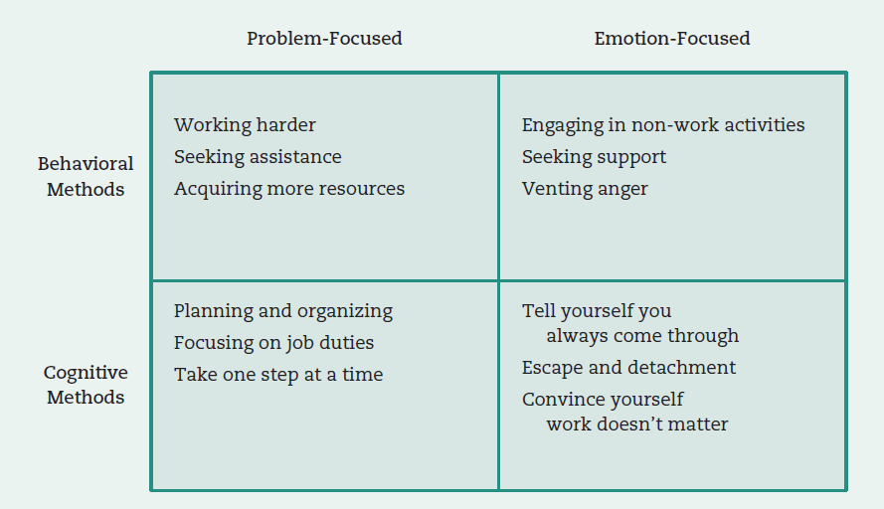
Coping Strategies
Source: Adapted from Latack, J.C., & Havlovic, S. J. (1992). Coping with job stress: A conceptual evaluation framework for coping measures. Journal of Organizational Behavior, 13(5), 479–508.
Notes:
Figure 13.4 on page 353.

Slide 19
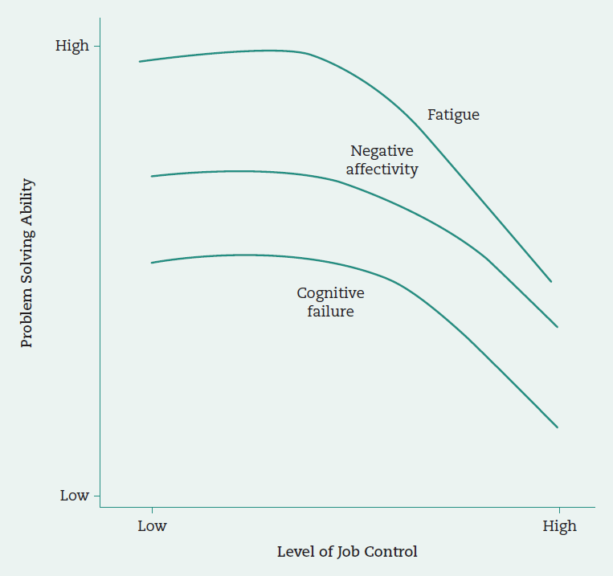
Relationship Between Job Control, Fatigue, Negative Affectivity, and Cognitive Failure on Problem solving
Source: Daniels, K., Beesley, N., Wimalasiri, V., & Cheyne, A. (2013). Problem solving and well-being exploring the instrumental role of job control and social support. Journal of Management, 39(4), 1016–1043. p. 1033.
Notes:
Figure 13.5 on page 356

Slide 20
Other Ways to COPE WITH STRESS
Social support
Help that people receive from others
Preventive stress management
Methods that promote health at the workplace and avoid stress (wellness programs)
Employee assistance programs
Organization-sponsored counseling
Work redesign

Slide 21
Leadership Implications: Helping Employees Cope
Leaders need to show support and have compassion for their subordinates
Should take action to reduce employees’ suffering

Slide 22
Open-access student resources
Checklist action plan
Learning objective summaries
Mobile-friendly quizzes
Mobile-friendly eFlashcards
Video and multimedia resources
SAGE journal articles
edge.sagepub.com/scandura

