Slide 1
Chapter 14: Organizational Culture

Slide 2
Agenda
Organizational culture
Organizational subcultures
Socialization
Organizational climates

Slide 3
When Elephants learn to Dance
IBM was hierarchical and traditional, and facing bankruptcy
New CEO changed the culture
Empowered employees to act
Focus on bringing value to customers

Slide 4
What is Organizational Culture?
Pattern of assumptions developed to cope with problems of external adaptation and internal integration
The group has invented, discovered, or learned these assumptions.
The assumptions have worked well enough to be considered valid.
Taught to new members as the correct way to perceive, think, and feel in relation to problems.

Slide 5
Three Levels of Culture
Artifacts and creations
Values
Espoused -- spoken
Enacted -- behaviors
Assumptions

Slide 6
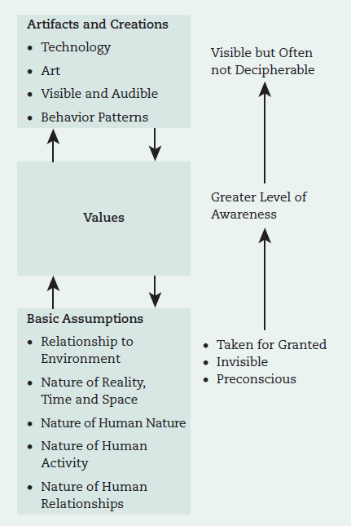
Interaction between Cultural Levels
Source: Schein, E. H. (1984). Coming to a new awareness of organizational culture. , 25(2), 3–16. p. 4.
Notes:
Figure 14.1 on page 367

Slide 7
7 Characteristics of Culture
1. Innovation and risk-taking
2. Attention to detail
3. Outcome orientation
4. People orientation
5. Team orientation
6. Aggressiveness (easygoingness reversed)
7. Stability

Slide 8
Signs of Problems within A Culture
High turnover and low morale
Ongoing inconsistency
Lack of focus on the external environment
Short-term thinking
Rise of destructive subcultures
Undermining the success of others
Increased cynicism

Slide 9
National and organizational culture
Leader values, founder values, and national culture influence organizational culture
However, four consistent elements of organizational culture found around the world:
Adaptability
Involvement
Mission
Consistency

Slide 10
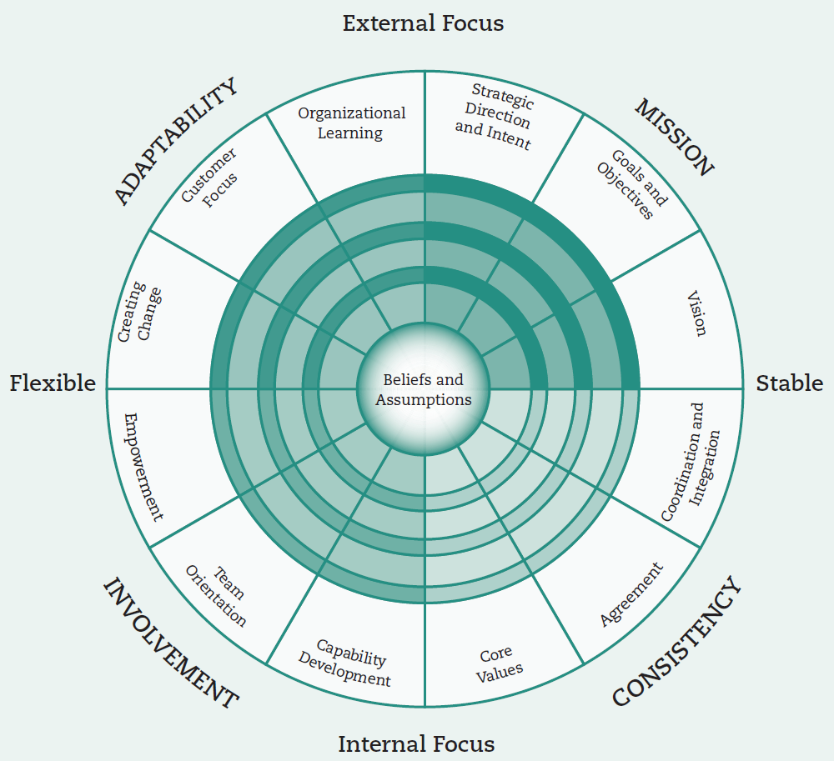
Denison Model OF CULTURE
Source: Denison, D. R., Haaland, S., & Goelzer, P. (2004). Corporate culture and organizational effectiveness: Is Asia different from the rest of the world? Organizational Dynamics, 33(1), 98–109. p. 101.
Notes:
Figure 14.2 on page 369

Slide 11
Organizational Subcultures
Operators
Engineers
Executives

Slide 12
socialization
The process an organization uses so new members acquire necessary attitudes, behaviors, knowledge, and skills to become productive organizational members

Slide 13
SOCIALIZATION
3-stage process:
Anticipatory socialization
Organizational entry and assimilation
Metamorphosis

Slide 14
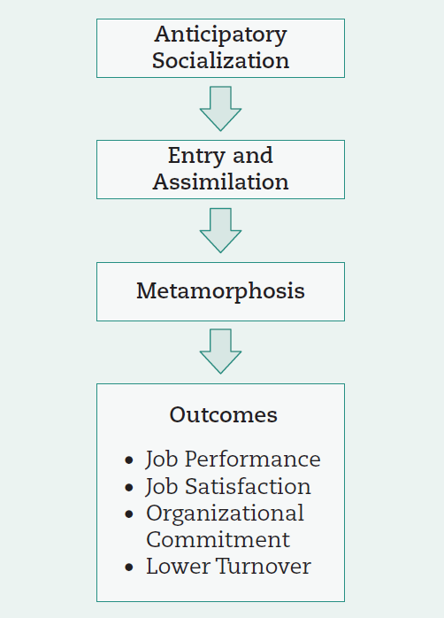
The SOCIALIZATION Process
Source: Jablin, F. M. (1987). Organizational entry, assimilation, and exit. In: L. L. Putnam, K. H. Roberts, & L. W. Porter (eds), Handbook of organizational communication: An interdisciplinary perspective (pp. 679–740). Beverly Hills, CA: Sage.

Slide 15
How EMPLOYEES learn culture: EXAMPLES
Stories
Ray Kroc McDonald’s story
Rituals
Wal-Mart cheer
Symbols
Papa John’s Camaro
Language
Disney: Guests vs. customers

Slide 16
Organizational Climate
Organizational climate -- shared perceptions about the organization and work environment
The difference between culture and climate is that culture is an evolved context and climate is a situation that employees are in.

Slide 17
Diversity climate
Employees’ shared perceptions of policies, practices, and procedures that implicitly and explicitly communicate the extent to which fostering and maintaining diversity and eliminating discrimination is a priority

Slide 18
Ethical Climate
Aspects:
Caring
Law and code
Rules
Instrumental
Independence

Slide 19
LEADERSHIP IMPLICATIONS: CHANGING ORGANIZATIONAL CULTURE
Tool #1: Recruit and select people for culture fit
Tool #2: Manage culture through socialization and training
Tool #3: Manage culture through the reward system
Source: Chatman, J. A. & Cha, S. E. (2003). Leading by leveraging culture. California Management Review, 45(4), 20-34.

Slide 20
Open-access student resources
Checklist action plan
Learning objective summaries
Mobile-friendly quizzes
Mobile-friendly eFlashcards
Video and multimedia resources
SAGE journal articles
edge.sagepub.com/scandura

