Slide 1
Organizations and Organization Theory
Organization Theory and Design
Twelfth Edition
Richard L. Daft

Slide 2
Organization Design in Action
Current Challenges
Globalization
Intense Competition
Ethics and the Green Movement
Speed and Responsiveness
Social Business and Big Data
Organization design helps us explain what happened in the past, as well as what may happen in the future, so that we can manage organizations more effectively
©2017 Cengage Learning. All Rights Reserved. May not be scanned, copied or duplicated, or posted to a publicly accessible website, in whole or in part

Slide 3
What is an Organization?
Social entities that are goal-directed
Designed as deliberately structured and coordinated activity systems
Linked to the external environment
©2017 Cengage Learning. All Rights Reserved. May not be scanned, copied or duplicated, or posted to a publicly accessible website, in whole or in part

Slide 4
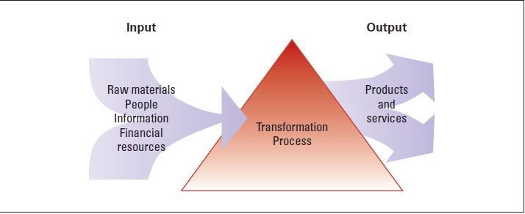
The Organization is an Open System

Slide 5
Importance of Organizations
Organizations are a means to an end
The corporation has played a significant role in the last 100 years
Produce goods and services efficiently
Facilitate innovation
Adapt to and influence a changing environment
Create value for owners, customers, and employees
Accommodate ongoing challenges of diversity, ethics, and the motivation and coordination of employees
©2017 Cengage Learning. All Rights Reserved. May not be scanned, copied or duplicated, or posted to a publicly accessible website, in whole or in part

Slide 6
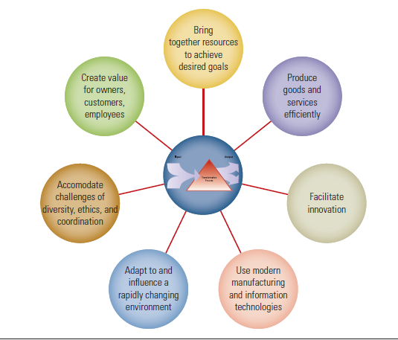
The Importance of Organizations
©2017 Cengage Learning. All Rights Reserved. May not be scanned, copied or duplicated, or posted to a publicly accessible website, in whole or in part.

Slide 7
Dimensions of Organization Design
Structural Dimensions
Formalization
Specialization
Hierarchy of Authority
Complexity
Centralization
Contingency Factors
Size
Organizational technology
Environment
Goals and strategy
Culture
©2017 Cengage Learning. All Rights Reserved. May not be scanned, copied or duplicated, or posted to a publicly accessible website, in whole or in part

Slide 8
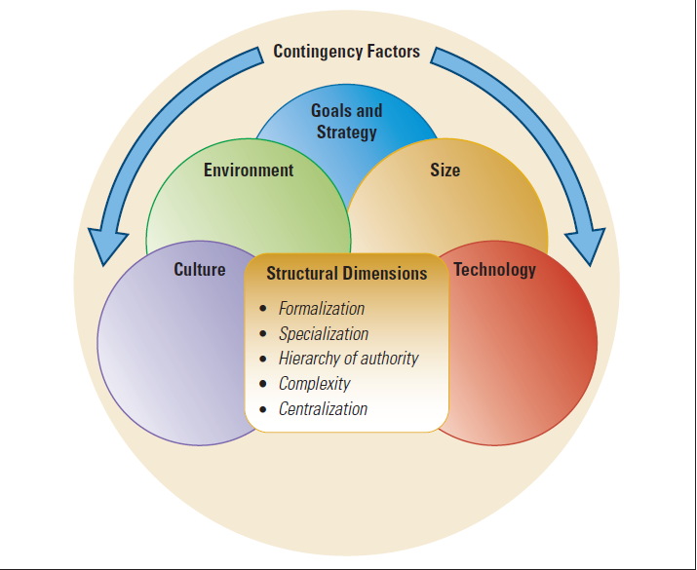
Interacting Structural Dimensions of Design and Contingency Factors
©2017 Cengage Learning. All Rights Reserved. May not be scanned, copied or duplicated, or posted to a publicly accessible website, in whole or in part.

Slide 9
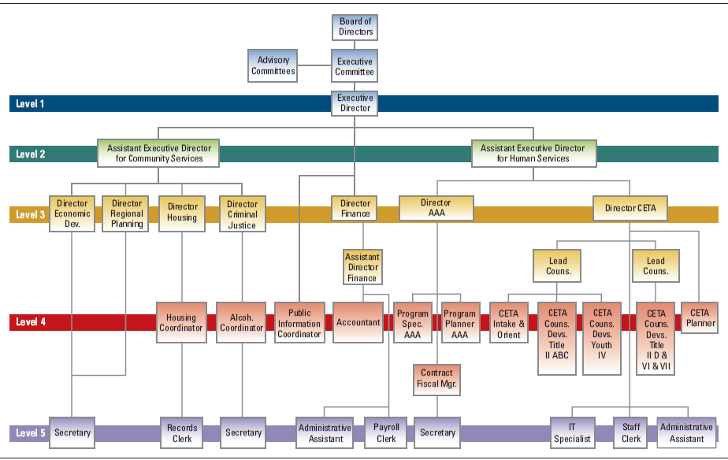
Organization Chart
©2017 Cengage Learning. All Rights Reserved. May not be scanned, copied or duplicated, or posted to a publicly accessible website, in whole or in part.

Slide 10
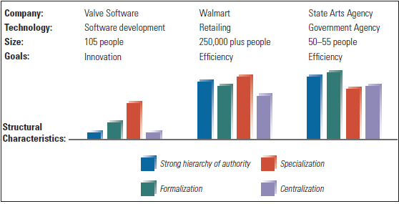
Differing Characteristics of Three Organizations
©2017 Cengage Learning. All Rights Reserved. May not be scanned, copied or duplicated, or posted to a publicly accessible website, in whole or in part.

Slide 11
Performance and Effectiveness Outcomes
Efficiency – amount of resources used to achieve the organization’s goals
Effectiveness – the degree to which an organization achieves its goals
Stakeholder Approach – balancing the needs of groups in and outside of the organization that has a stake in the organization’s performance
©2017 Cengage Learning. All Rights Reserved. May not be scanned, copied or duplicated, or posted to a publicly accessible website, in whole or in part.

Slide 12
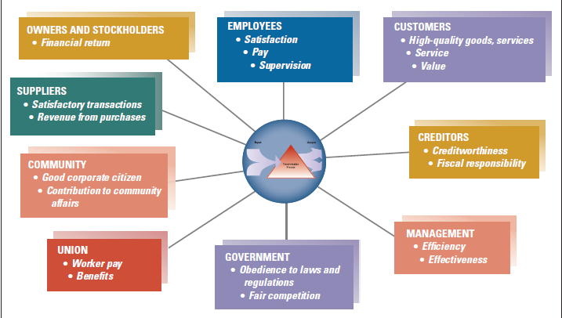
Major Stakeholder Groups and What They Expect
©2017 Cengage Learning. All Rights Reserved. May not be scanned, copied or duplicated, or posted to a publicly accessible website, in whole or in part.

Slide 13
The Evolution of Organization Theory and Design
Historical perspectives provide insight into how organization design and management practices have varied over time in response to changes in society.
©2017 Cengage Learning. All Rights Reserved. May not be scanned, copied or duplicated, or posted to a publicly accessible website, in whole or in part.

Slide 14
Historical Perspectives
Efficiency is Everything
Scientific Management: Pioneered by Frederick Winslow Taylor
How to Get Organized
Administrative Principles
Contributed to Bureaucratic Organizations
What about People?
Hawthorne Studies
Can Bureaucracies Be Flexible?
Flexible and lean; focused on service, quality, and engaged employees (1980s)
It All Depends: Key Contingencies
Contingency: there is no “one best way”
©2017 Cengage Learning. All Rights Reserved. May not be scanned, copied or duplicated, or posted to a publicly accessible website, in whole or in part.

Slide 15
Organic vs. Mechanistic
Mechanistic – characterized by machine-like standard rules and procedures with clear authority
Organic – design of organization is looser, free-flowing, and adaptive
Depends upon:
Structure
Tasks/Roles
System Formality
Communication
Hierarchy versus Collaboration
©2017 Cengage Learning. All Rights Reserved. May not be scanned, copied or duplicated, or posted to a publicly accessible website, in whole or in part.

Slide 16
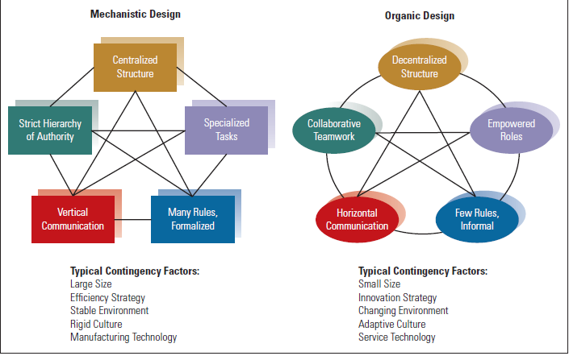
Organic and Mechanistic Designs
©2017 Cengage Learning. All Rights Reserved. May not be scanned, copied or duplicated, or posted to a publicly accessible website, in whole or in part.

Slide 17
Contemporary Ideas
Today’s organizations are still imprinted with hierarchical, formalized mechanistic approach
A few organizations have shifted to an organic “bossless” design
Open Systems are adaptive and interact with the environment
Culture has to engage employees to support a non-hierarchical environment
©2017 Cengage Learning. All Rights Reserved. May not be scanned, copied or duplicated, or posted to a publicly accessible website, in whole or in part.

Slide 18
Framework for the Book
Four levels of analysis characterize organizations
Organizational behavior is the micro approach
Organization theory and design is the macro examination
Organization design is concerned with the big picture of the organization and its major departments
©2017 Cengage Learning. All Rights Reserved. May not be scanned, copied or duplicated, or posted to a publicly accessible website, in whole or in part.

Slide 19
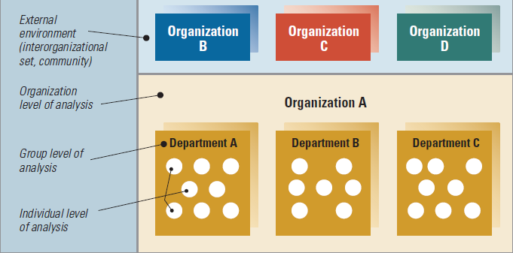
Levels of Analysis in Organizations

Slide 20
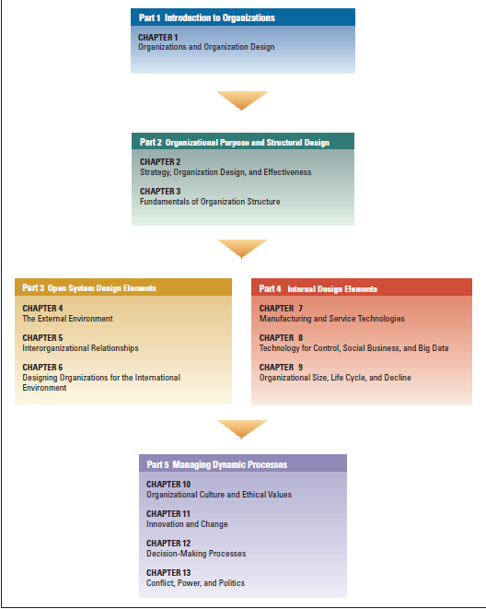
Framework
for the Book

Slide 21
Design Essentials
Organization design provides tools for a
changing environment.
❖ Managers face new challenges including
globalization and ethical scrutiny.
Organizations are open systems that obtain
inputs from the environment, add value, and
discharge products and services.
Managers shape organizations to perform well
for society

Slide 22
Design Essentials
❖ Organization design perspectives have varied
over time.
Organization designs range from mechanistic
to organic.
Most concepts pertain to the top- and middle
management levels of the organization.

