Slide 1
Fundamentals of Organization Structure
Organization Theory and Design
Twelfth Edition
Richard L. Daft
©2017 Cengage Learning. All Rights Reserved. May not be scanned, copied or duplicated, or posted to a publicly accessible website, in whole or in part.

Slide 2
Organization Structure
Formal Reporting Relationships
Number of levels
Span of control
Grouping of Individuals
Creation of departments
Design of Systems
Communication, coordination, and integration of efforts
Horizontal information and coordination reflected in organization chart
©2017 Cengage Learning. All Rights Reserved. May not be scanned, copied or duplicated, or posted to a publicly accessible website, in whole or in part.

Slide 3
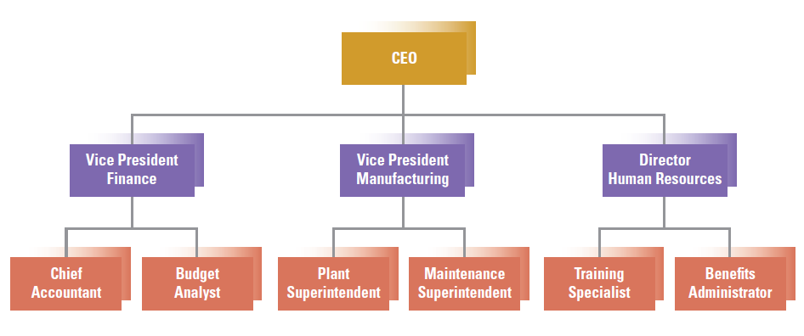
A Sample Organization Chart
©2017 Cengage Learning. All Rights Reserved. May not be scanned, copied or duplicated, or posted to a publicly accessible website, in whole or in part.

Slide 4
Information-Sharing Perspective on Structure
Vertical and horizontal information flow
Traditional organization designed for efficiency?
Centralized authority focused on top level decision-making
Learning organization which emphasizes communication and collaboration
Decentralized authority focused on shared tasks and decisions
©2017 Cengage Learning. All Rights Reserved. May not be scanned, copied or duplicated, or posted to a publicly accessible website, in whole or in part.

Slide 5
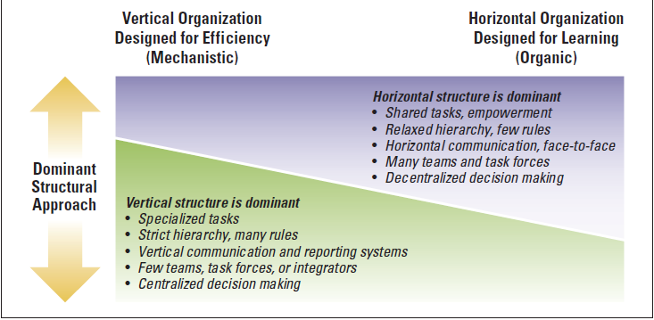
Efficiency versus Learning Outcomes
©2017 Cengage Learning. All Rights Reserved. May not be scanned, copied or duplicated, or posted to a publicly accessible website, in whole or in part.

Slide 6
Vertical Information Sharing
Vertical linkages coordinate activities between the top and the bottom of the organization
Hierarchical referral are the vertical lines which identify the chain of command
Rules and Plans create vertical links
Reports, computer systems, and written information are vertical information systems
©2017 Cengage Learning. All Rights Reserved. May not be scanned, copied or duplicated, or posted to a publicly accessible website, in whole or in part.

Slide 7
Horizontal Information Sharing
Horizontal linkage coordinates activities across organizational departments - not traditionally drawn on the organizational chart
Information Systems
Liaison Roles
Task Forces
Full-Time Integrator
Teams
©2017 Cengage Learning. All Rights Reserved. May not be scanned, copied or duplicated, or posted to a publicly accessible website, in whole or in part.

Slide 8
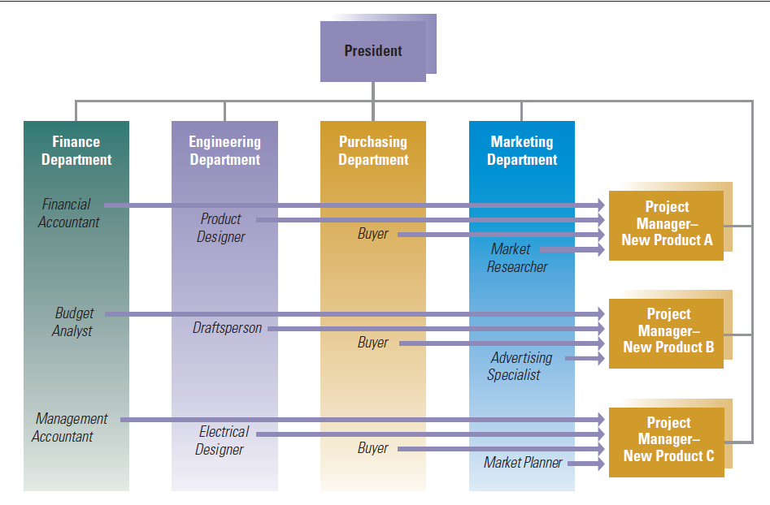
Ladder of Mechanisms for Horizontal Linkages
©2017 Cengage Learning. All Rights Reserved. May not be scanned, copied or duplicated, or posted to a publicly accessible website, in whole or in part.

Slide 9
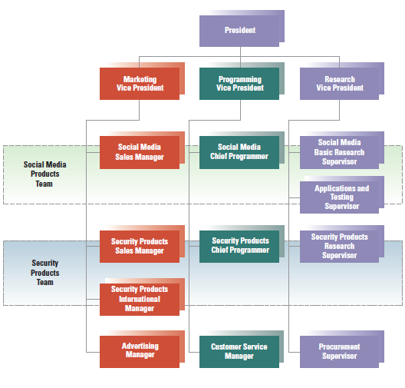
Teams and Horizontal Coordination
©2017 Cengage Learning. All Rights Reserved. May not be scanned, copied or duplicated, or posted to a publicly accessible website, in whole or in part.

Slide 10
Relational Coordination
High level of horizontal coordination
Frequent, timely, problem-solving communication
Relationships of shared goals, shared knowledge, and mutual respect
©2017 Cengage Learning. All Rights Reserved. May not be scanned, copied or duplicated, or posted to a publicly accessible website, in whole or in part.

Slide 11
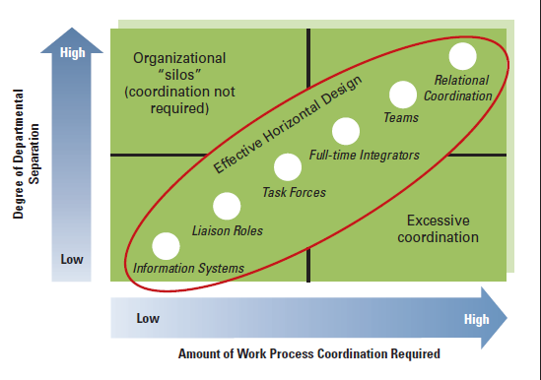
Horizontal Coordination and Linkages
©2017 Cengage Learning. All Rights Reserved. May not be scanned, copied or duplicated, or posted to a publicly accessible website, in whole or in part.

Slide 12
Organization Design Alternatives
Required Work Activities
Reporting Relationships
Departmental Grouping Options
©2017 Cengage Learning. All Rights Reserved. May not be scanned, copied or duplicated, or posted to a publicly accessible website, in whole or in part.

Slide 13
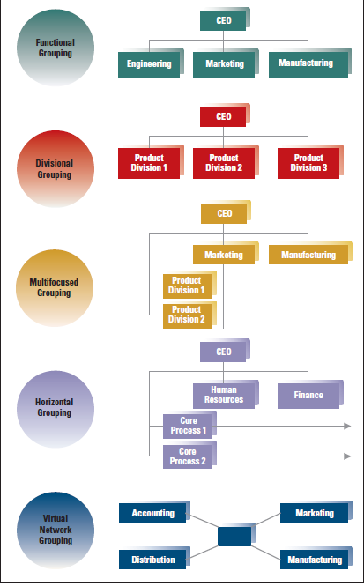
Departmental
Grouping
Options

Slide 14
Functional Structure
Activities grouped by common function
All specific skills and knowledge are consolidated
Promotes economies of scale
Slow response to environmental changes
Prevalent approach but few companies can respond in today’s environment without horizontal linkages
©2017 Cengage Learning. All Rights Reserved. May not be scanned, copied or duplicated, or posted to a publicly accessible website, in whole or in part.

Slide 15
Functional: Strengths & Weaknesses
©2017 Cengage Learning. All Rights Reserved. May not be scanned, copied or duplicated, or posted to a publicly accessible website, in whole or in part.

Slide 16
Divisional Structure
Product structure or strategic business units
Divisions organized according to products, services, product groups
Good for achieving coordination across functional departments
Suited for fast change
Loses economies of scale
Lacks technical specialization
©2017 Cengage Learning. All Rights Reserved. May not be scanned, copied or duplicated, or posted to a publicly accessible website, in whole or in part.

Slide 17
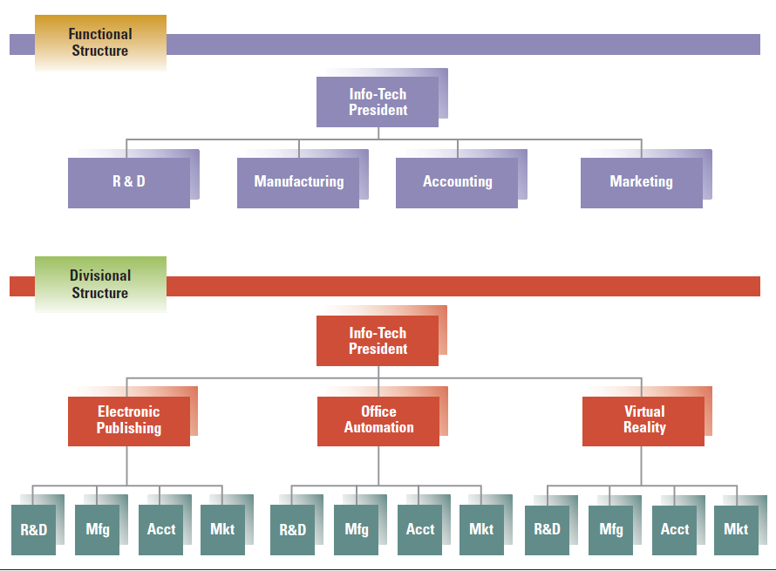
Reorganization from Functional to Divisional
©2017 Cengage Learning. All Rights Reserved. May not be scanned, copied or duplicated, or posted to a publicly accessible website, in whole or in part.

Slide 18
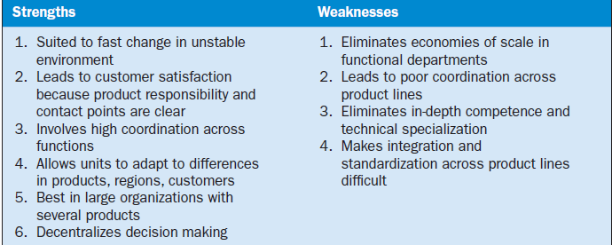
Divisional: Strengths & Weaknesses
©2017 Cengage Learning. All Rights Reserved. May not be scanned, copied or duplicated, or posted to a publicly accessible website, in whole or in part.

Slide 19
Geographic Structure
Organizing to meet needs of users/customers by geography
Many multinational corporations are organized by country
Focuses managers and employees on specific geographic regions
Strengths and weaknesses similar to divisional organization
©2017 Cengage Learning. All Rights Reserved. May not be scanned, copied or duplicated, or posted to a publicly accessible website, in whole or in part.

Slide 20
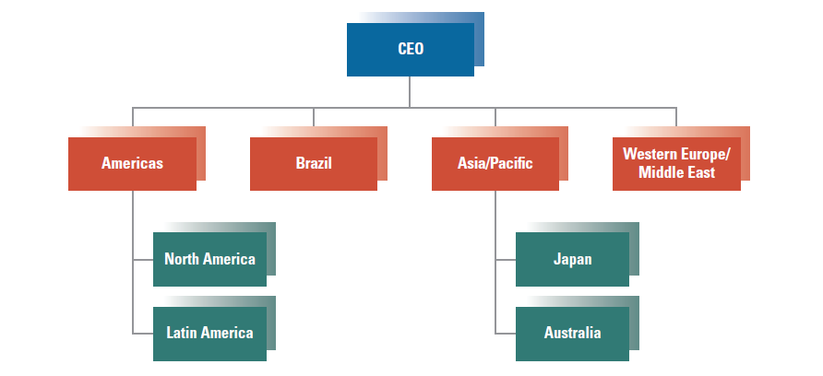
Sample Geographic Structure
©2017 Cengage Learning. All Rights Reserved. May not be scanned, copied or duplicated, or posted to a publicly accessible website, in whole or in part.

Slide 21
Matrix Structure
Multifocused with strong horizontal linkage
Conditions for Matrix:
Share resources across the organization
Two or more critical outputs required: products and technical knowledge
Environment is complex and uncertain
Allows organization to meet dual demands
Largest weakness is that employees have two bosses and conflicting demands
©2017 Cengage Learning. All Rights Reserved. May not be scanned, copied or duplicated, or posted to a publicly accessible website, in whole or in part.

Slide 22
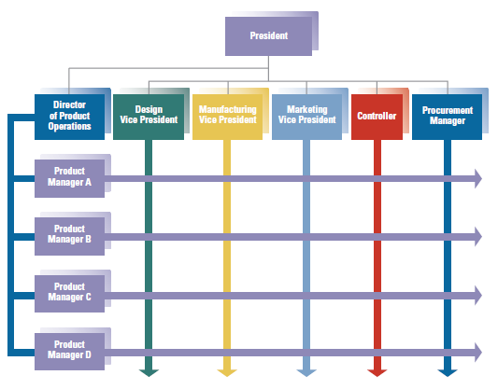
Sample Matrix Organization
©2017 Cengage Learning. All Rights Reserved. May not be scanned, copied or duplicated, or posted to a publicly accessible website, in whole or in part.

Slide 23
Conditions for Matrix Structure
Need for shared and flexible use of people across products
Two or more critical outputs like new products and technical knowledge
The environment is complex and uncertain
©2017Cengage Learning. All Rights Reserved. May not be scanned, copied or duplicated, or posted to a publicly accessible website, in whole or in part.

Slide 24
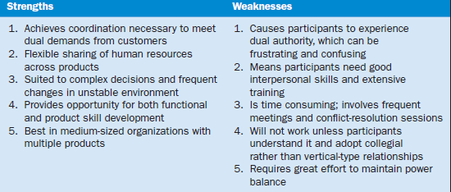
Matrix: Strengths & Weaknesses
©2017 Cengage Learning. All Rights Reserved. May not be scanned, copied or duplicated, or posted to a publicly accessible website, in whole or in part.

Slide 25
Horizontal Structure
Organization around core processes
Processes refers to tasks and activities
Shift towards horizontal structure during reengineering
Eliminates vertical hierarchy and departmental boundaries
©2017 Cengage Learning. All Rights Reserved. May not be scanned, copied or duplicated, or posted to a publicly accessible website, in whole or in part.

Slide 26
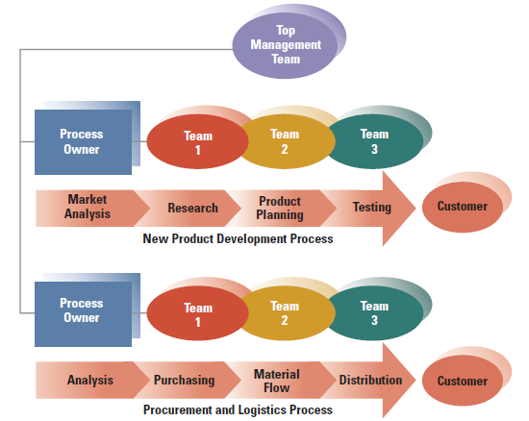
Sample Horizontal Structure
©2017 Cengage Learning. All Rights Reserved. May not be scanned, copied or duplicated, or posted to a publicly accessible website, in whole or in part.

Slide 27
Characteristics of Horizontal Structure
Structure is created around cross-functional processes
Self-directed teams, not individuals, are dominant players
Process owners are responsible for entire process
People on the team are given authority for decisions
©2017 Cengage Learning. All Rights Reserved. May not be scanned, copied or duplicated, or posted to a publicly accessible website, in whole or in part.

Slide 28
Characteristics of Horizontal Structure
Can increase organization’s flexibility
Customers drive the organization, measured by customer satisfaction, employee satisfaction, and financial contribution
Culture is one of openness, trust, and collaboration; focus on continuous improvement

Slide 29
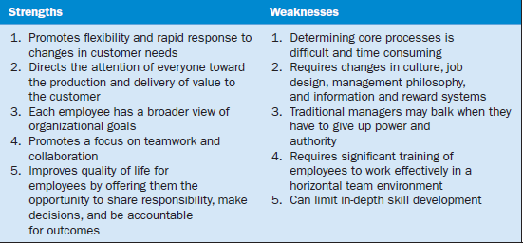
Horizontal: Strengths & Weaknesses
©2017 Cengage Learning. All Rights Reserved. May not be scanned, copied or duplicated, or posted to a publicly accessible website, in whole or in part.

Slide 30
Virtual Networks and Outsourcing
Extend horizontal coordination beyond the boundaries of the organization
Most common strategy is outsourcing
Contract out certain tasks/functions
Virtual or modular structures subcontract most of its major functions to separate companies
The virtual network organization serves as a central hub with contracted experts
©2017 Cengage Learning. All Rights Reserved. May not be scanned, copied or duplicated, or posted to a publicly accessible website, in whole or in part.

Slide 31
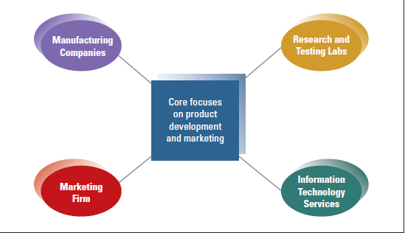
Virtual Network Example
©2017 Cengage Learning. All Rights Reserved. May not be scanned, copied or duplicated, or posted to a publicly accessible website, in whole or in part.

Slide 32
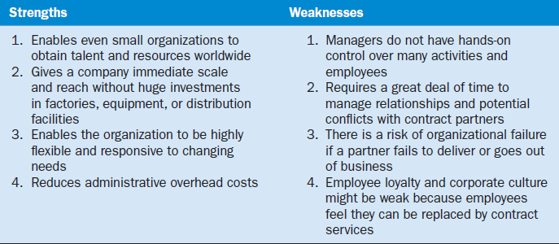
Virtual Network Strengths and Weaknesses
©2017 Cengage Learning. All Rights Reserved. May not be scanned, copied or duplicated, or posted to a publicly accessible website, in whole or in part.

Slide 33
Hybrid Structure
Combination of various structure approaches
Tailored to specific needs
Often used in rapidly changing environments
Greater flexibility
©2017 Cengage Learning. All Rights Reserved. May not be scanned, copied or duplicated, or posted to a publicly accessible website, in whole or in part.

Slide 34
Two Hybrid Structures

Slide 35
Application of Structural Design
Each structure meets different needs and is a tool that can help managers be more effective
Structural alignment aligns structure with organizational goals
Symptoms of Structural Deficiency:
Decision making is delayed or lacking quality
Organization cannot meet changing needs
Employee performance declines, needs are not meet
Too much conflict
©2017 Cengage Learning. All Rights Reserved. May not be scanned, copied or duplicated, or posted to a publicly accessible website, in whole or in part.

Slide 36
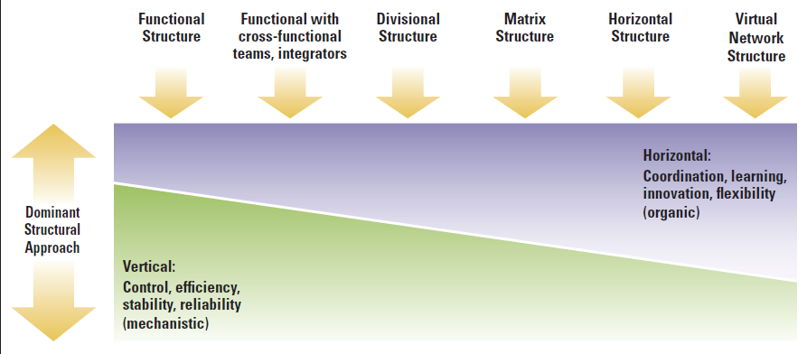
Structure to Organization’s Need for Efficiency vs. Learning
©2017 Cengage Learning. All Rights Reserved. May not be scanned, copied or duplicated, or posted to a publicly accessible website, in whole or in part.

Slide 37
Design Essentials
Structure must provide a framework, linking organization into whole
Provide vertical and horizontal linkages
Variety of alternatives for grouping
Virtual network extends horizontal
coordination
©2017 Cengage Learning. All Rights Reserved. May not be scanned, copied or duplicated, or posted to a publicly accessible website, in whole or in p
art.

Slide 38
Design Essentials
Matrix structure attempts to achieve
balance
Managers must find right balance
The purpose of the organization chart is
to encourage and direct activities

