Slide 1
Interorganizational Relationships
Organization Theory and Design
Twelfth Edition
Richard L. Daft
©2017 Cengage Learning. All Rights Reserved. May not be scanned, copied or duplicated, or posted to a publicly accessible website, in whole or in part.

Slide 2
Organizational Ecosystems
Interorganizational relationships – resource transactions, flows, and linkages that occur among two organizations
Organizational ecosystem – a system formed by the interaction of a community of organizations and their environment
©2017 Cengage Learning. All Rights Reserved. May not be scanned, copied or duplicated, or posted to a publicly accessible website, in whole or in part.

Slide 3
Is Competition Dead?
Changing technology and new regulations present organizations with international competition
Organizations are involved in complex networks; the number of corporate alliances are increasing
Traditional competition no longer exists
©2017 Cengage Learning. All Rights Reserved. May not be scanned, copied or duplicated, or posted to a publicly accessible website, in whole or in part.

Slide 4
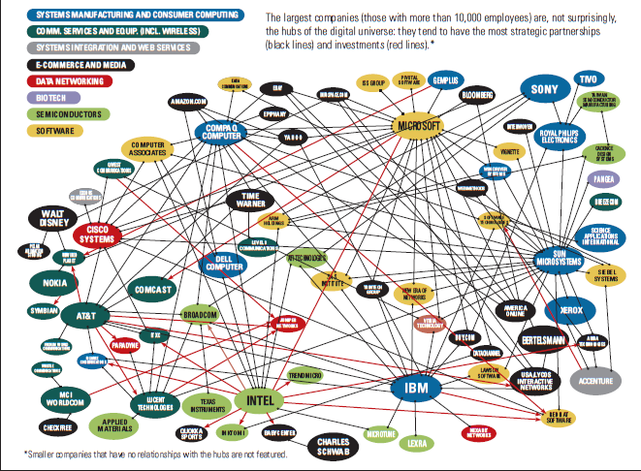
Organizational Ecosystem
©2017 Cengage Learning. All Rights Reserved. May not be scanned, copied or duplicated, or posted to a publicly accessible website, in whole or in part.

Slide 5
The Changing Role of Management
In ecosystems, managers move beyond traditional responsibilities
Managers must think about horizontal processes
The old role of management relied on operation roles and boundaries
Collaborative roles are becoming more important for success
©2017 Cengage Learning. All Rights Reserved. May not be scanned, copied or duplicated, or posted to a publicly accessible website, in whole or in part.

Slide 6
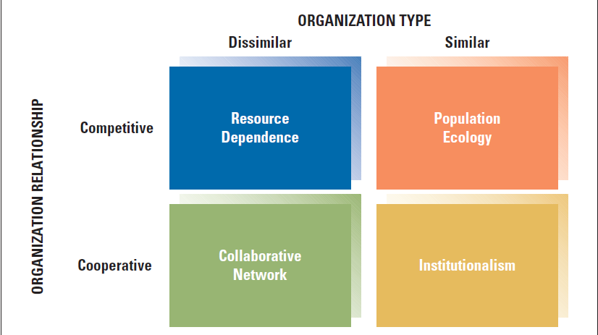
A Framework for Interorganizational Relationships
©2017 Cengage Learning. All Rights Reserved. May not be scanned, copied or duplicated, or posted to a publicly accessible website, in whole or in part.

Slide 7
Resource Dependence
Organizations minimize their dependence on other organizations for the supply of resources
Organizations succeed by striving for autonomy
Organizations alter interdependent relationships through ownership, contracts, and joint ventures
©2017 Cengage Learning. All Rights Reserved. May not be scanned, copied or duplicated, or posted to a publicly accessible website, in whole or in part.

Slide 8
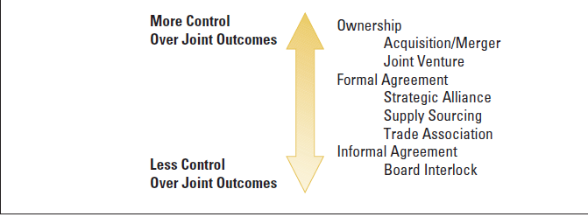
Resource Dependent Relationships
©2017 Cengage Learning. All Rights Reserved. May not be scanned, copied or duplicated, or posted to a publicly accessible website, in whole or in part.

Slide 9
Collaborative Networks
Emerging alternative to resource dependency
Companies join together to become more competitive and to share scarce resources
Alliances require managers who are good at building networks
Companies can share risk and cooperation is a prerequisite for greater innovation, problem solving, and performance
©2017 Cengage Learning. All Rights Reserved. May not be scanned, copied or duplicated, or posted to a publicly accessible website, in whole or in part.

Slide 10
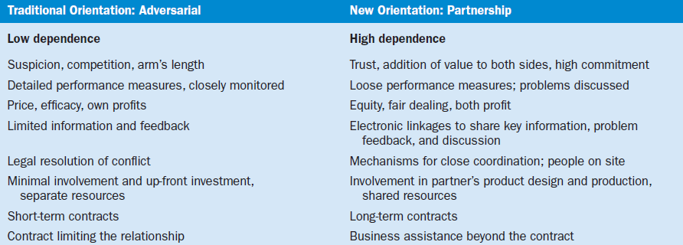
Changing Characteristics of Interorganizational Relationships
©2017 Cengage Learning. All Rights Reserved. May not be scanned, copied or duplicated, or posted to a publicly accessible website, in whole or in part.

Slide 11
Population Ecology
Organizational diversity and adaptation within a population of organizations
Population is a set of organizations engaged in similar activities
The theory notes that large, established organizations often become dinosaurs
They have difficulty adapting
The changing environment determines survival or failure
Heavy investments can limit organizational adaptation
Model looks at organizational form
Organizational niche can help aid in the survival of an organization
©2017 Cengage Learning. All Rights Reserved. May not be scanned, copied or duplicated, or posted to a publicly accessible website, in whole or in part.

Slide 12
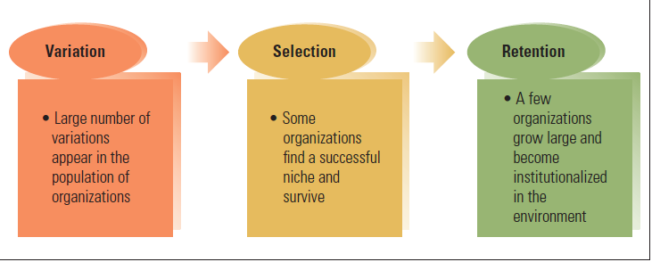
Elements in the Population-Ecology Model of Organizations
©2017 Cengage Learning. All Rights Reserved. May not be scanned, copied or duplicated, or posted to a publicly accessible website, in whole or in part.

Slide 13
Strategies for Survival
Organizations struggle for existence (competition)
Generalist strategies – wide niche or domain, broad range of products or services to a broad market
Specialist strategies – narrow range of goods or services that serve a narrow market
©2017 Cengage Learning. All Rights Reserved. May not be scanned, copied or duplicated, or posted to a publicly accessible website, in whole or in part.

Slide 14
Institutionalism
Institutional perspective:
Manage survival
Balance expectations of environment
Institutional Environment
Norms and values of stakeholders
Adopt structures and processes to please outsiders
Legitimacy - an organization’s actions are desirable, proper, and appropriate
©2017 Cengage Learning. All Rights Reserved. May not be scanned, copied or duplicated, or posted to a publicly accessible website, in whole or in part.

Slide 15
Institutional View and Organizational Design
Technical Structure
Day-to-day work
Technology
Operating requirements
Governed by norms
and rationality of efficiency
Institutional Structure
Visible to the public
Governed by expectations of the public
©2017 Cengage Learning. All Rights Reserved. May not be scanned, copied or duplicated, or posted to a publicly accessible website, in whole or in part.

Slide 16
Three Mechanisms for Institutional Adaptation
©2017 Cengage Learning. All Rights Reserved. May not be scanned, copied or duplicated, or posted to a publicly accessible website, in whole or in part.

Slide 17
Design Essentials
There has been an evolution in inter-organizational relationships
Four perspectives explain relationships among organizations. Resource dependence is the most traditional
Collaboration is an emerging alternative to
resource dependence
©2017 Cengage Learning. All Rights Reserved. May not be scanned, copied or duplicated, or posted to a publicly accessible website, in whole or in part.

Slide 18
Design Essentials
The population-ecology perspective explains why organizational diversity increases, and new organizations fill niches
The institutional perspective notes that interorganizational relationships are shaped by legitimacy as well as products/services
Each of the four perspectives is valid

