Slide 1
Design Organizations for the International Environment
Organization Theory and Design
Twelfth Edition
Richard L. Daft
©2017 Cengage Learning. All Rights Reserved. May not be scanned, copied or duplicated, or posted to a publicly accessible website, in whole or in part.

Slide 2
Entering The Global Arena
More companies are doing business globally
Companies need top leaders who have a global outlook
Advancements in technology and world communications have changed the competitive landscape
©2017 Cengage Learning. All Rights Reserved. May not be scanned, copied o2r duplicated, or posted to a publicly accessible website, in whole or in part.

Slide 3
Motivations for Global Expansion
Economic, technological, and competitive forces have combined to push companies from a domestic to a global focus
Motivations for Global Expansion:
Economies of Scale
Economies of Scope
Low-Cost Production Factors
©2017 Cengage Learning. All Rights Reserved. May not be scanned, copied or duplicated, or posted to a publicly accessible website, in whole or in part.

Slide 4
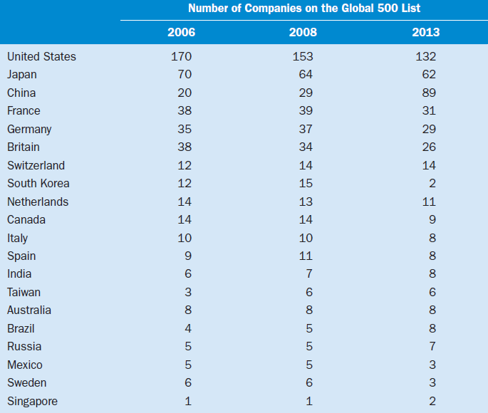
The Global Economy as Reflected in the Fortune Global 500
©2017 Cengage Learning. All Rights Reserved. May not be scanned, copied or duplicated, or posted to a publicly accessible website, in whole or in part.

Slide 5
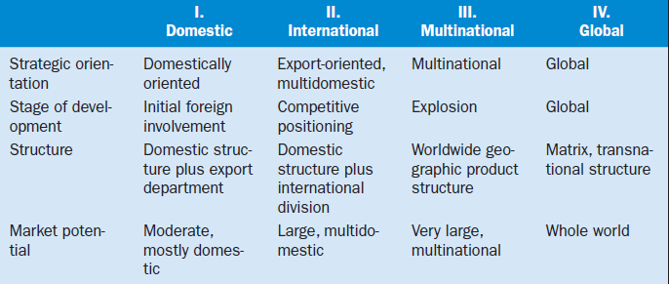
Stages of International Evolution
©2017 Cengage Learning. All Rights Reserved. May not be scanned, copied or duplicated, or posted to a publicly accessible website, in whole or in part.

Slide 6
Global Expansion ─ International Alliances and Acquisitions
Licensing – allowing another firm to market your brands
Joint Ventures – separate entity of two or more firms
Acquisitions – offer greater control than joint ventures
©2017 Cengage Learning. All Rights Reserved. May not be scanned, copied or duplicated, or posted to a publicly accessible website, in whole or in part.

Slide 7
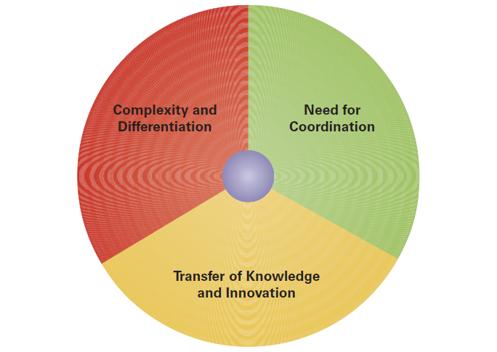
Challenges of Global Design
©2017 Cengage Learning. All Rights Reserved. May not be scanned, copied or duplicated, or posted to a publicly accessible website, in whole or in part.

Slide 8
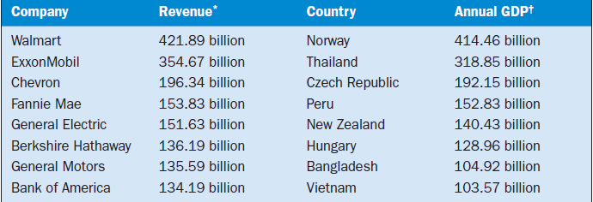
Leading Multinationals and Selected Countries 2010

Slide 9
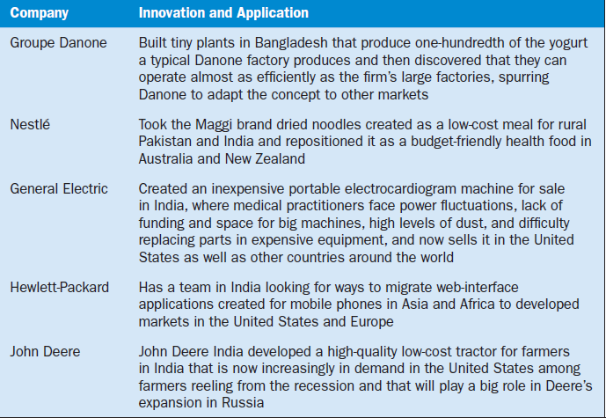
Examples of Trickle-Up Innovation

Slide 10
Strategies for Global vs. Local Opportunities
Global standardization versus local responsiveness
Globalization or multidomestic strategy
Globalization strategy - products are standardized throughout the world
Multidomestic strategy - competition is handled in each country independently
©2017 Cengage Learning. All Rights Reserved. May not be scanned, copied or duplicated, or posted to a publicly accessible website, in whole or in part.

Slide 11
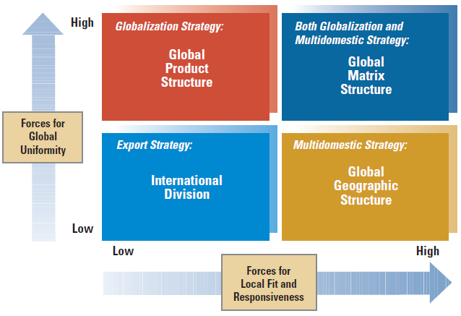
Fitting Organization Structure to International Advantages
©2017 Cengage Learning. All Rights Reserved. May not be scanned, copied or duplicated, or posted to a publicly accessible website, in whole or in part.

Slide 12
Global Organization Structure
International Division
Global Product Division
Global Geographic Division
Global Matrix Structure
©2017 Cengage Learning. All Rights Reserved. May not be scanned, copied or duplicated, or posted to a publicly accessible website, in whole or in part.

Slide 13
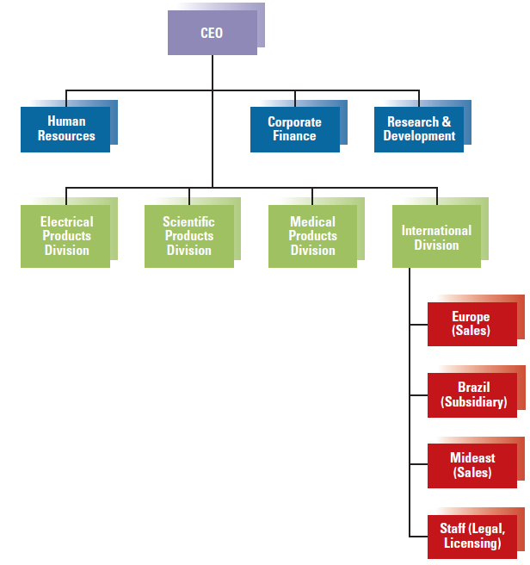
Domestic Hybrid Structure with International Division
©201713 Cengage Learning. All Rights Reserved. May not be scanned, copied or duplicated, or posted to a publicly accessible website, in whole or in part.

Slide 14
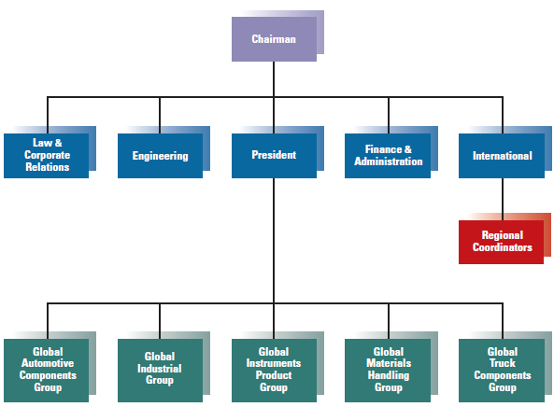
Partial Global Product Structure
©2017 Cengage Learning. All Rights Reserved. May not be scanned, copied or duplicated, or posted to a publicly accessible website, in whole or in part.

Slide 15
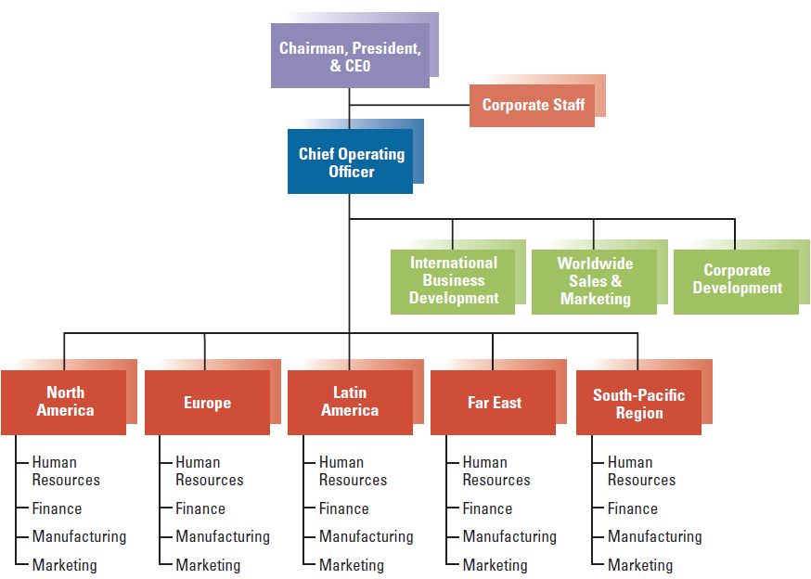
Global Geographic Structure
©2017 Cengage Learning. All Rights Reserved. May not be scanned, copied or duplicated, or posted to a publicly accessible website, in whole or in part.

Slide 16
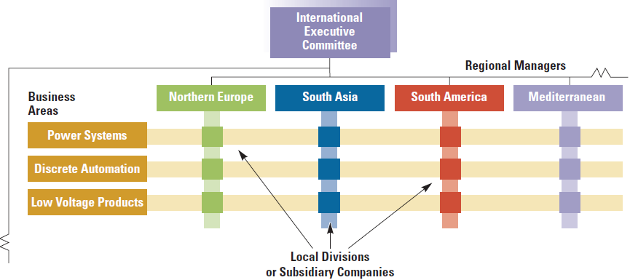
Global Matrix Structure
©2017 Cengage Learning. All Rights Reserved. May not be scanned, copied or duplicated, or posted to a publicly accessible website, in whole or in part.

Slide 17
Global Coordination Mechanisms
Global Teams
Headquarters Planning
Expanded Coordination Roles
©2017 Cengage Learning. All Rights Reserved. May not be scanned, copied or duplicated, or posted to a publicly accessible website, in whole or in part.

Slide 18
Benefits of Collaboration
Cost Savings
Better Decision Making
Greater Revenue
Increased Innovation
©2017 Cengage Learning. All Rights Reserved. May not be scanned, copied or duplicated, or posted to a publicly accessible website, in whole or in part.

Slide 19
The Transnational Model of Organization
Advanced international organization to deal with multiple, interrelated, complex issues
Theory is based on interdependence
Useful for large, multinational companies with subsidiaries
Create an integrated network of individual operations that are linked together
Not an organizational chart; it is a managerial state of mind
©2017 Cengage Learning. All Rights Reserved. May not be scanned, copied or duplicated, or posted to a publicly accessible website, in whole or in part.

Slide 20
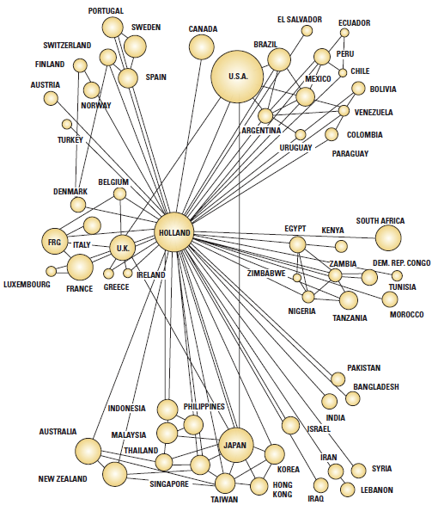
International Organizational Units
©2017 Cengage Learning. All Rights Reserved. May not be scanned, copied or duplicated, or posted to a publicly accessible website, in whole or in part.

Slide 21
Transnational Organizations
Assets and resources are dispersed worldwide
Structures are flexible and ever-changing
Subsidiary managers initiate strategy and innovations that become strategy for the whole organization
Corporate culture, shared vision, and management style guide the organization
©2017 Cengage Learning. All Rights Reserved. May not be scanned, copied or duplicated, or posted to a publicly accessible website, in whole or in part.

Slide 22
Design Elements
Managers must design organizations for complex international coordination
Organizations’ international strategies and
structures evolve
There are diverse options for specific international strategies
©2017 Cengage Learning. All Rights Reserved. May not be scanned, copied or duplicated, or posted to a publicly accessible website, in whole or in part.

Slide 23
Design Elements
There are a variety of challenges for global
organizations
Diverse national and cultural values influence
an organization’s approach
Companies operating globally require broad
coordination

