Slide 1
Manufacturing and Service Technologies
Organization Theory and Design
Twelfth Edition
Richard L. Daft
©2017 Cengage Learning. All Rights Reserved. May not be scanned, copied or duplicated, or posted to a publicly accessible website, in whole or in part.

Slide 2
Service and Manufacturing Technologies
Technology refers to the work processes, techniques, machines, and actions used to transform input into outputs
Technology influences organizational structure
Understanding technology helps dictate how organizations can be designed for efficiency
Core technology relates to the transformation process to provide goods/service
Non-core technology is not directly related to the primary mission of the organization
©2017 Cengage Learning. All Rights Reserved. May not be scanned, copied or duplicated, or posted to a publicly accessible website, in whole or in part.

Slide 3
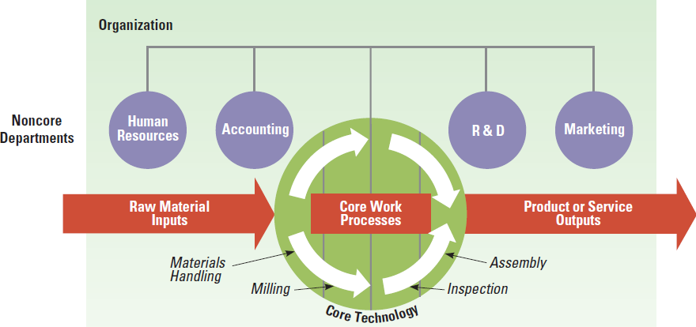
Core Transformation Process for a Manufacturing Company
©2017 Cengage Learning. All Rights Reserved. May not be scanned, copied or duplicated, or posted to a publicly accessible website, in whole or in part.

Slide 4
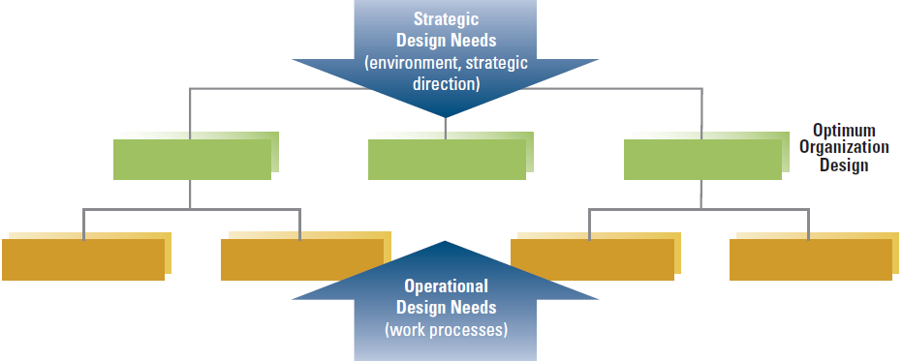
Pressures Affecting Organization Design
©2017 Cengage Learning. All Rights Reserved. May not be scanned, copied or duplicated, or posted to a publicly accessible website, in whole or in part.

Slide 5
Core Organization Manufacturing Technology
Manufacturing Technologies include
● Traditional Manufacturing Processes
● Contemporary Applications
─ Smart factory
─ Lean manufacturing

Slide 6
Manufacturing Firms
Technical complexity defines the extent of mechanization of the manufacturing process
Three basic technology groups defined by Woodward:
Small-batch and unit production
Large-batch and mass production
Continuous-process production
©2017 Cengage Learning. All Rights Reserved. May not be scanned, copied or duplicated, or posted to a publicly accessible website, in whole or in part.

Slide 7
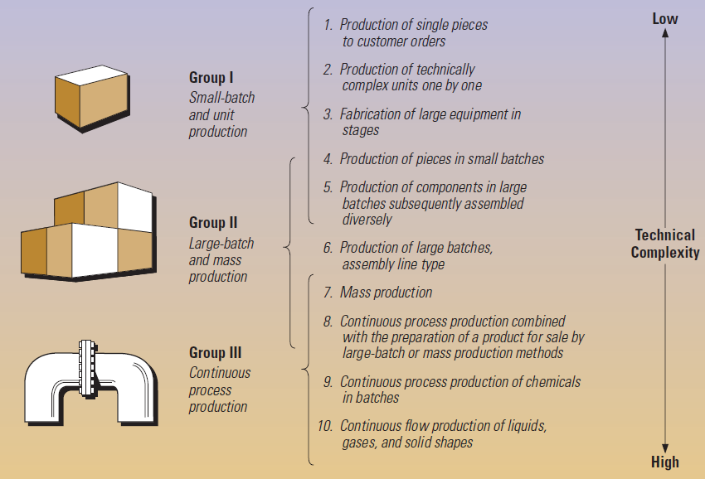
Woodward’s Classification Based on System of Production
©2017 Cengage Learning. All Rights Reserved. May not be scanned, copied or duplicated, or posted to a publicly accessible website, in whole or in part.

Slide 8
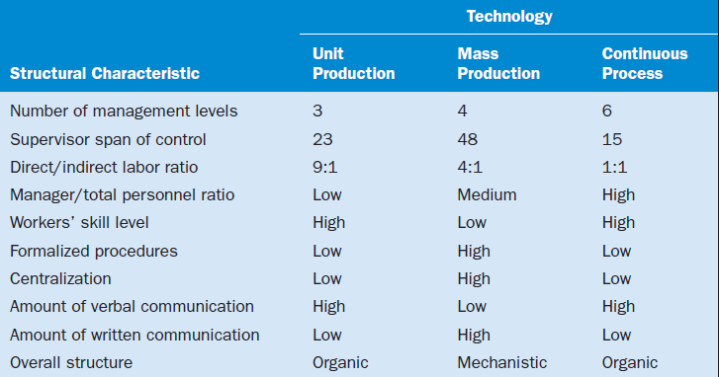
Relationship between Technical Complexity and Structural Characteristics
©2017 Cengage Learning. All Rights Reserved. May not be scanned, copied or duplicated, or posted to a publicly accessible website, in whole or in part.

Slide 9
Strategy, Technology, and Performance
Strategy, structure, and technology need to be aligned
Successful firms have complementary structures and technologies
Failing to adopt a new technology or failing to realign strategy can lead to poor performance
©2017 Cengage Learning. All Rights Reserved. May not be scanned, copied or duplicated, or posted to a publicly accessible website, in whole or in part.

Slide 10
The Smart Factory
Also called computer-integrated manufacturing, flexible manufacturing systems, digital factories, advanced manufacturing technology, and agile manufacturing
Smart Factory subcomponents
Computer-aided Design (CAD)
Computer-aided Manufacturing (CAM)
Robots
3-D Printing (Additive Manufacturing)
©2017 Cengage Learning. All Rights Reserved. May not be scanned, copied or duplicated, or posted to a publicly accessible website, in whole or in part.

Slide 11
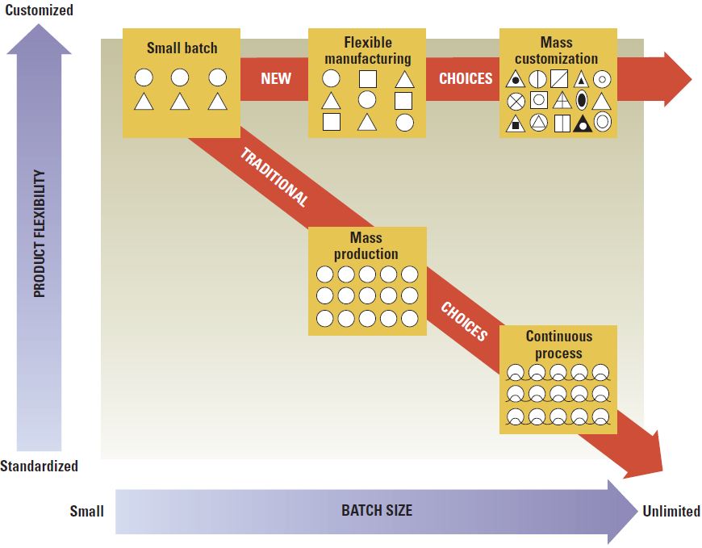
Smart Manufacturing Technology vs. Traditional Technologies
©2017 Cengage Learning. All Rights Reserved. May not be scanned, copied or duplicated, or posted to a publicly accessible website, in whole or in part.

Slide 12
Lean Manufacturing
Highly trained employees at every stage of production
Sigma Six
─ Cuts waste and improve quality
─ Incorporates technological elements
Kaizen ─ continuous improvement
Paved the way for mass customization
Using mass-production technology to quickly and cost-effectively assemble individual goods for customers
©2017 Cengage Learning. All Rights Reserved. May not be scanned, copied or duplicated, or posted to a publicly accessible website, in whole or in part.

Slide 13
Performance and Structural Implications
Flexible manufacturing allows diverse products to be made on one assembly line
Computer-aided craftsmanship
More efficient
Increased productivity
Decreased scrap
Customer satisfaction
©2017 Cengage Learning. All Rights Reserved. May not be scanned, copied or duplicated, or posted to a publicly accessible website, in whole or in part.

Slide 14
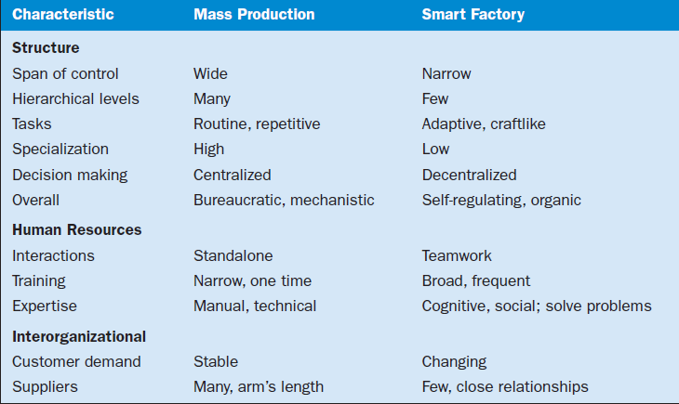
Comparison of Organizational Characteristics
©2017 Cengage Learning. All Rights Reserved. May not be scanned, copied or duplicated, or posted to a publicly accessible website, in whole or in part.

Slide 15
Core Organization Service Technology
Service technologies are different from manufacturing technologies and require different organizational design – education, banking
Intangible output
Simultaneous production and consumption
Labor and knowledge intensive
Direct interaction between customer and employee
Importance of human element
Quality of service cannot be directly measured
©2017 Cengage Learning. All Rights Reserved. May not be scanned, copied or duplicated, or posted to a publicly accessible website, in whole or in part.

Slide 16
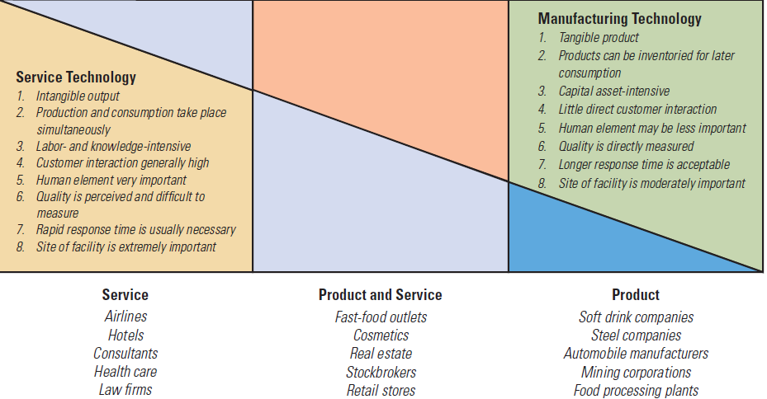
Core Organization Service Technology
©2017 Cengage Learning. All Rights Reserved. May not be scanned, copied or duplicated, or posted to a publicly accessible website, in whole or in part.

Slide 17
Trend Toward Lean Services
Customer expectations are rising
Expectations have required that service firms must become lean, too
Cut waste
Improve customer service
Adopt continuous improvement approach
©2017 Cengage Learning. All Rights Reserved. May not be scanned, copied or duplicated, or posted to a publicly accessible website, in whole or in part.

Slide 18
Structural Characteristics of Service Organizations versus Product Organizations
©2017 Cengage Learning. All Rights Reserved. May not be scanned, copied or duplicated, or posted to a publicly accessible website, in whole or in part.

Slide 19
Designing the Service Organization
Service organizations are not necessarily large
Often small locations, close to customers
Service organizations require technical core employees – close to customer
Service customers interact directly with technical employees
The skills of technical employees need to be high
Employees need knowledge, awareness, and interpersonal skills
Decision making is often decentralized
©2017 Cengage Learning. All Rights Reserved. May not be scanned, copied or duplicated, or posted to a publicly accessible website, in whole or in part.

Slide 20
Non-Core Departmental Technology
Every department in an organization has a production process
Variety: frequency of unexpected and novel events
Analyzability: ability to apply standard procedures
Routine vs. Nonroutine Dimension
Engineering Technologies
Craft Technologies
©2017 Cengage Learning. All Rights Reserved. May not be scanned, copied or duplicated, or posted to a publicly accessible website, in whole or in part.

Slide 21
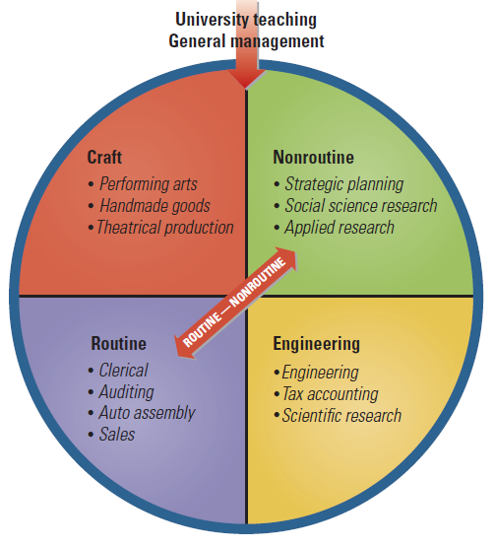
Framework for Department Technologies
©2017 Cengage Learning. All Rights Reserved. May not be scanned, copied or duplicated, or posted to a publicly accessible website, in whole or in part.

Slide 22
Department Design
Overall design is either organic or mechanistic
Design characteristics vary depending on work unit
Formalization
Decentralization
Employee skill level
Span of control
Communication and coordination
©2017 Cengage Learning. All Rights Reserved. May not be scanned, copied or duplicated, or posted to a publicly accessible website, in whole or in part.

Slide 23
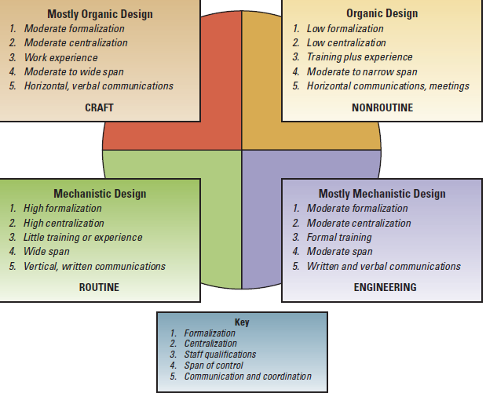
Relationship of Department Technology to Structural and Management Characteristics
©2017 Cengage Learning. All Rights Reserved. May not be scanned, copied or duplicated, or posted to a publicly accessible website, in whole or in part.

Slide 24
Workflow Interdependence Among Departments
The extent to which departments depend on each other for resources or materials
Low interdependence means that departments can do their work independently
High interdependence means departments depend on each other
©2017 Cengage Learning. All Rights Reserved. May not be scanned, copied or duplicated, or posted to a publicly accessible website, in whole or in part.

Slide 25
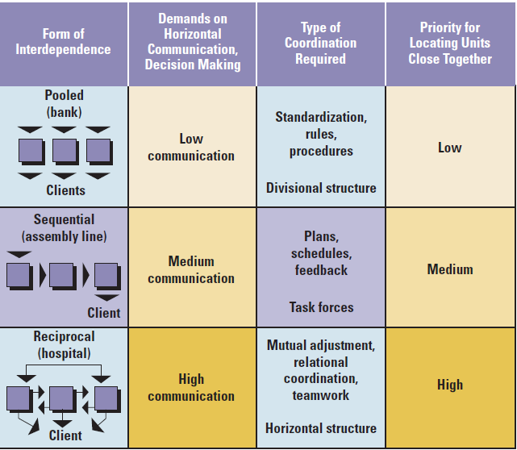
Interdependence and Management Implications
©2017 Cengage Learning. All Rights Reserved. May not be scanned, copied or duplicated, or posted to a publicly accessible website, in whole or in part.

Slide 26
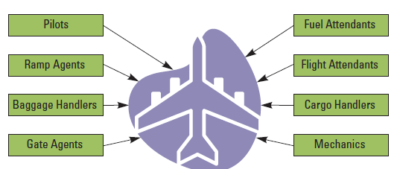
Interdependence of Departments Involved in the Flight Departure Process
©2017 Cengage Learning. All Rights Reserved. May not be scanned, copied or duplicated, or posted to a publicly accessible website, in whole or in part.

Slide 27
Structural Priority and Implications
Reciprocal interdependence should receive first priority
Reciprocal activities should be grouped together
Poor coordination will cause poor performance
Organizations should be designed to address interdependence
©2017 Cengage Learning. All Rights Reserved. May not be scanned, copied or duplicated, or posted to a publicly accessible website, in whole or in part.

Slide 28
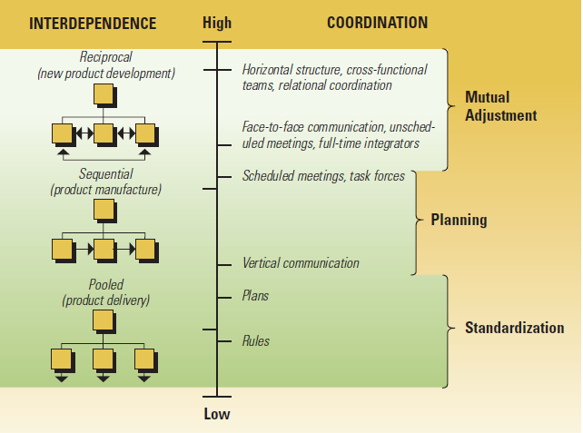
Coordination for Interdependence
©2017 Cengage Learning. All Rights Reserved. May not be scanned, copied or duplicated, or posted to a publicly accessible website, in whole or in part.

Slide 29
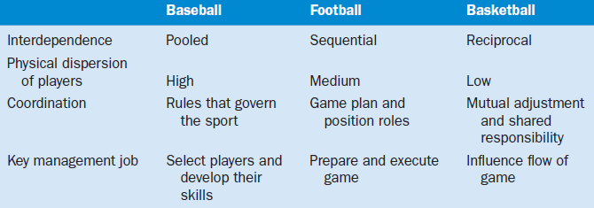
Relationship of Interdependence and Team Play Characteristics
©2017 Cengage Learning. All Rights Reserved. May not be scanned, copied or duplicated, or posted to a publicly accessible website, in whole or in part.

Slide 30
Sociotechnical Systems
Sociotechnical systems approach recognizes the interaction of technical and human needs
An organization functions best when the social and technical systems are designed to fit one another
People are resources and should be provided with appropriate skills, meaningful work and suitable rewards.

Slide 31
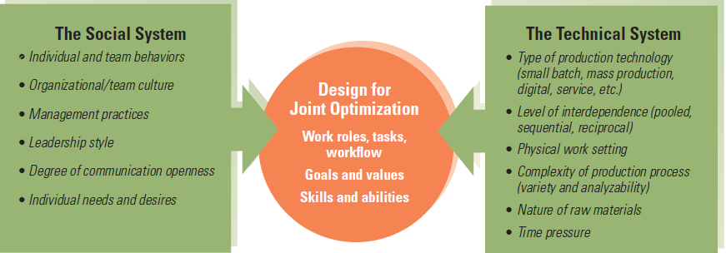
Sociotechnical Systems Model
©2017 Cengage Learning. All Rights Reserved. May not be scanned, copied or duplicated, or posted to a publicly accessible website, in whole or in part.

Slide 32
Design Essentials
Key research notes that technology and
structure can be co-aligned
Service technologies differ in a systematic
way from manufacturing technologies
It is important to apply the correct
management system to a department
©2017 Cengage Learning. All Rights Reserved. May not be scanned, copied or duplicated, or posted to a publicly accessible website, in whole or in part.

Slide 33
Design Essentials
Interdependence among departments dictates
the amount of communication and
coordination required in design
New technologies are enriching jobs to make
organizations a happier place to work
Sociotechnical system theory attempts to
design systems that meet technical and
human aspects

