Slide 1
Technology for Control, Social Business, and Big Data
Organization Theory and Design
Twelfth Edition
Richard L. Daft
©2017 Cengage Learning. All Rights Reserved. May not be scanned, copied or duplicated, or posted to a publicly accessible website, in whole or in part.

Slide 2
Information Technology Evolution
Transaction Processing Systems (TPS)-automates business transactions
Data warehousing- use of huge databases
Business intelligence- high-tech analysis of data
Social business- using social media technologies
Big data analytics – examining massive sets of data

Slide 3
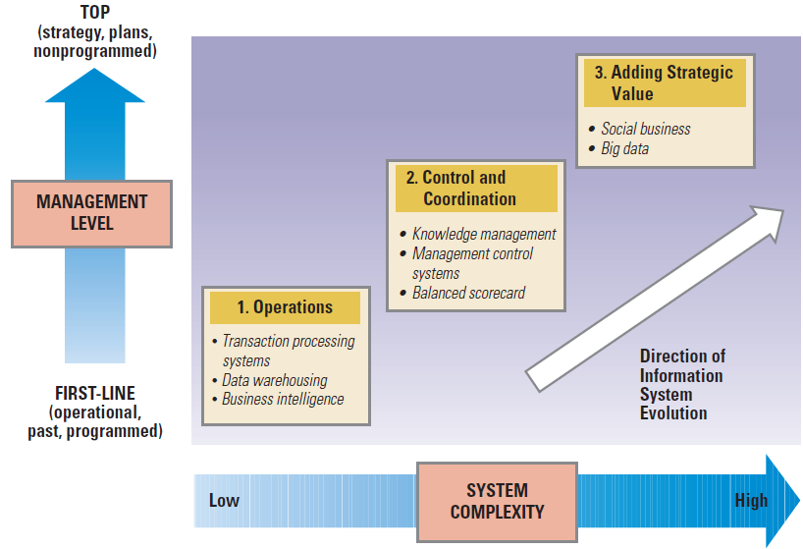
Evolution of Organizational Applications of IT
©2017 Cengage Learning. All Rights Reserved. May not be scanned, copied or duplicated, or posted to a publicly accessible website, in whole or in part.

Slide 4
The Changing Philosophy of Control
Hierarchical control- monitoring employee behavior through rules, policies, hierarchy of authority, written documentation, reward systems, formal systems
Decentralized control – based on values and assumptions opposite to those of hierarchical control
©2017 Cengage Learning. All Rights Reserved. May not be scanned, copied or duplicated, or posted to a publicly accessible website, in whole or in part.

Slide 5
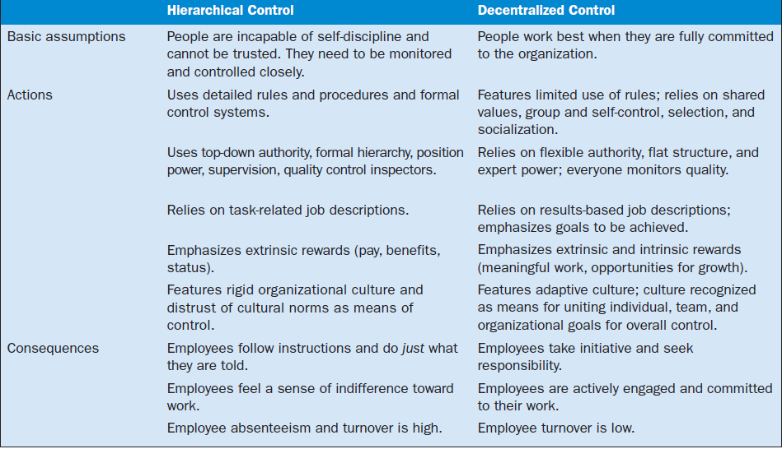
Hierarchical and Decentralized Control
©2017 Cengage Learning. All Rights Reserved. May not be scanned, copied or duplicated, or posted to a publicly accessible website, in whole or in part.

Slide 6
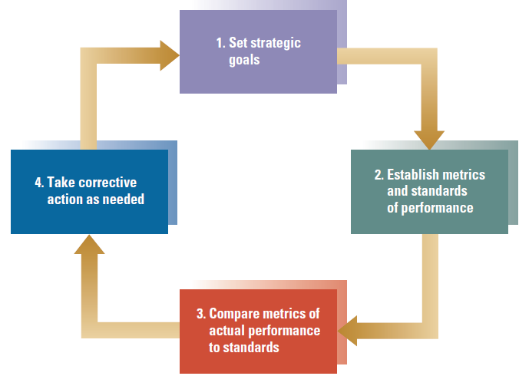
A Simplified Feedback Control Model
©2017 Cengage Learning. All Rights Reserved. May not be scanned, copied or duplicated, or posted to a publicly accessible website, in whole or in part.

Slide 7
The Level and Focus of Control Systems
Organizational Level: The Balanced Scorecard
Measures financial, customer, employee, and market concerns
Comprehensive management control system
Strategy map – visualization of organization success drivers and how they are linked
Departmental Level: Behavior versus Outcome Control
How people do their jobs
Outcomes people produce
©2017 Cengage Learning. All Rights Reserved. May not be scanned, copied or duplicated, or posted to a publicly accessible website, in whole or in part.

Slide 8
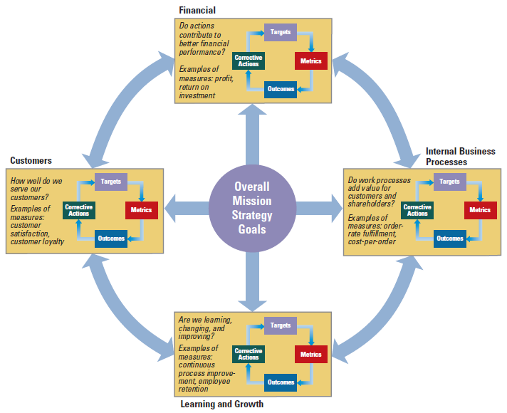
Major Perspectives of the Balanced Scorecard
©2017 Cengage Learning. All Rights Reserved. May not be scanned, copied or duplicated, or posted to a publicly accessible website, in whole or in part.

Slide 9
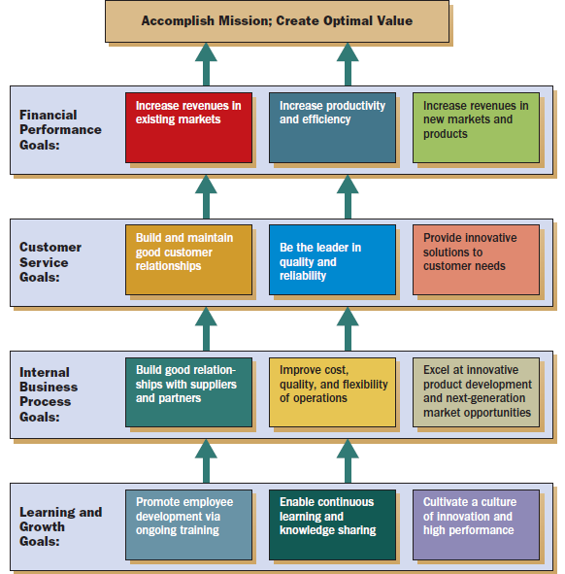
Strategy Map
for
Performance
Management
©2017 Cengage Learning. All Rights Reserved. May not be scanned, copied or duplicated, or posted to a publicly accessible website, in whole or in part.

Slide 10
Department Level: Behavior vs. Outcome Control
Behavior control –based on managers’ direct observation and supervision of employee actions to see whether the individual follows rules and policies and performs tasks as instructed
Outcome control – based on monitoring and rewarding results without supervision
©2017 Cengage Learning. All Rights Reserved. May not be scanned, copied or duplicated, or posted to a publicly accessible website, in whole or in part.

Slide 11
Facilitating Employee Coordination and Efficiency
Improving coordination and knowledge sharing among employees, enhancing efficiency, and improving collaboration
Intranets
Knowledge
Management
Social
Network
Analysis
Social Business
©2017 Cengage Learning. All Rights Reserved. May not be scanned, copied or duplicated, or posted to a publicly accessible website, in whole or in part.

Slide 12
Knowledge Management
Knowledge Management- efforts to organize and make available the company’s intellectual capital and foster a culture of learning
Intellectual capital –sum of knowledge, experience, understanding, relationships, processes, innovations, discoveries
- codified knowledge- formal knowledge
- tacit knowledge- experience

Slide 13
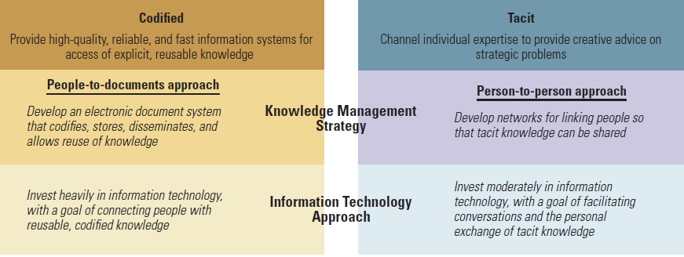
Two Approaches to Knowledge Management
©2017 Cengage Learning. All Rights Reserved. May not be scanned, copied or duplicated, or posted to a publicly accessible website, in whole or in part.

Slide 14
Social Network Analysis
Social Network Analysis – informal relationships and network structures within an organization
Roles
- Hub: Center of an informational network
- Peripheral players: Fewest connections
- Brokers: Connecting people

Slide 15
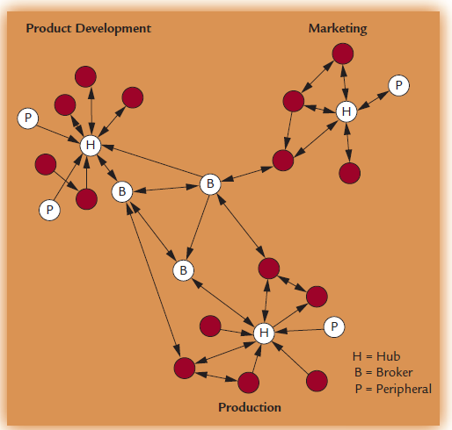
Roles in a Social Network
©2017 Cengage Learning. All Rights Reserved. May not be scanned, copied or duplicated, or posted to a publicly accessible website, in whole or in part.

Slide 16
Adding Strategic Value
Using IT for Social Business and Big Data analytics
Social Business- using social media technologies
Social Media
- company online pages, blogs, Facebook,
YouTube
- provides effective sharing of tacit knowledge
- builds trusting relationships with consumers
- builds rapport between managers and
employees
©2013 Cengage Learning. All Rights Reserved. May not be scanned, copied or duplicated, or posted to a publicly accessible website, in whole or in part.

Slide 17
Structural Design for Social Business
Social Media Directors are blending marketing, promotions, customer service, and support
77% of Fortune 500 companies use Twitter
70% of Fortune 500 companies are on Facebook
34% of companies use company blogs to communicate with customers
Social Media Command Centers monitor comments about the company on social media
©2017 Cengage Learning. All Rights Reserved. May not be scanned, copied or duplicated, or posted to a publicly accessible website, in whole or in part.

Slide 18
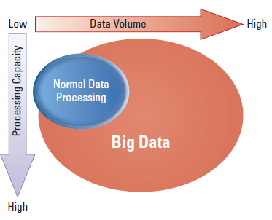
Big Data is Really Big
©2017 Cengage Learning. All Rights Reserved. May not be scanned, copied or duplicated, or posted to a publicly accessible website, in whole or in part.

Slide 19
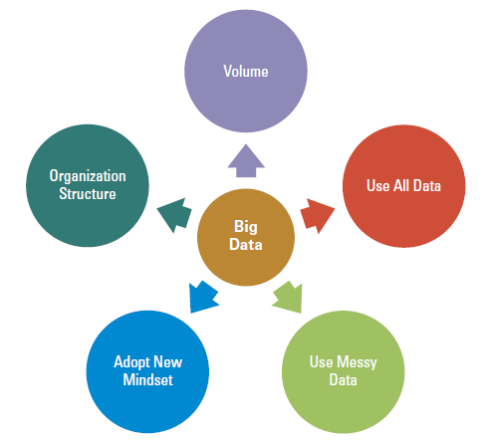
Elements of Big Data Function
©2017 Cengage Learning. All Rights Reserved. May not be scanned, copied or duplicated, or posted to a publicly accessible website, in whole or in part.

Slide 20
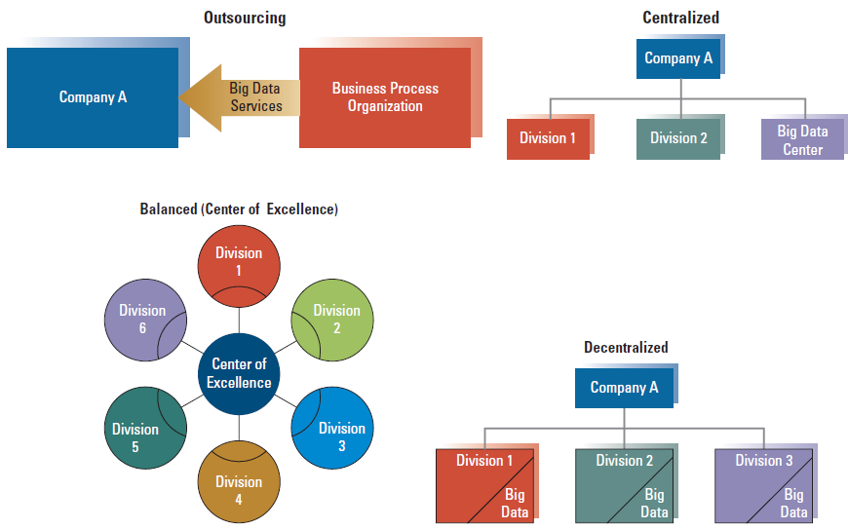
Structures for Organizing Big Data
©2017 Cengage Learning. All Rights Reserved. May not be scanned, copied or duplicated, or posted to a publicly accessible website, in whole or in part.

Slide 21
Impact on Organization Design
Smaller Organizations
Decentralized Organization Structures
Improved horizontal coordination and collaboration
Enhanced Network Structures

Slide 22
Design Essentials
Successful organizations effectively
apply technology
IT systems are used for better control and coordination of the organization- hierarchical to decentralized control
The balanced scorecard provides a balanced view of the organization
©2017 Cengage Learning. All Rights Reserved. May not be scanned, copied or duplicated, or posted to a publicly accessible website, in whole or in part.

Slide 23
Design Essentials
Knowledge management and social network analysis increase coordination
Social business using social media technologies is a growing area of activity
Big data is a recent advance in IT
Advances in IT have impacted organization design

