Slide 1
Organization Size, Life Cycle, and Decline
Organization Theory and Design
Twelfth Edition
Richard L. Daft
©2017 Cengage Learning. All Rights Reserved. May not be scanned, copied or duplicated, or posted to a publicly accessible website, in whole or in part.

Slide 2
Organization Size: Is Bigger Better?
Pressures for Growth
Industry consolidation, global expansion, and diversification have made firms grow
Size enables companies to take risks
Dilemmas of Large Size
Large organizations can get back to business more quickly following a disaster
Large companies are standardized, mechanistic, and complex
Small companies are flexible and responsive
Many companies want a big company/small-company hybrid
©2017 Cengage Learning. All Rights Reserved. May not be scanned, copied or duplicated, or posted to a publicly accessible website, in whole or in part.

Slide 3
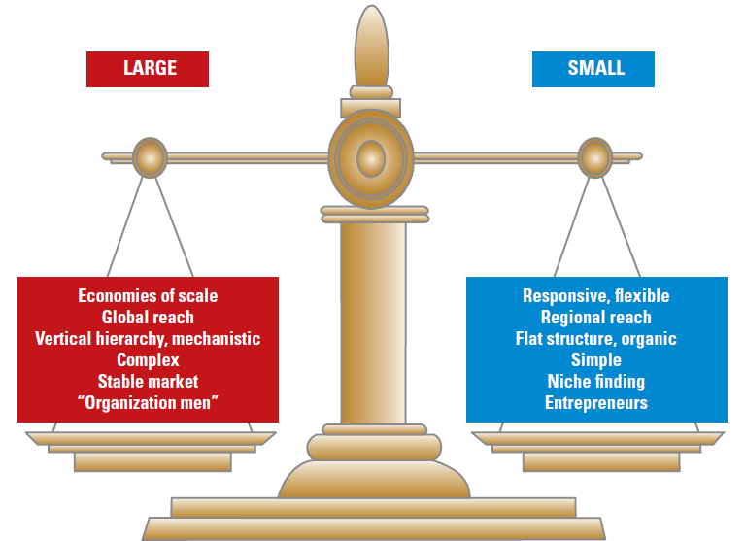
Differences Between Large and Small Organizations
©2017 Cengage Learning. All Rights Reserved. May not be scanned, copied or duplicated, or posted to a publicly accessible website, in whole or in part.

Slide 4
Stages of Life Cycle Development
Entrepreneurial Stage- company is created
Crisis: need for leadership
Collectivity Stage- identifying with the mission
Crisis: need for delegation
Formalization Stage- use of rules/procedures
Crisis: too much red tape
Elaboration Stage- collaboration/teamwork
Crisis: need for revitalization

Slide 5
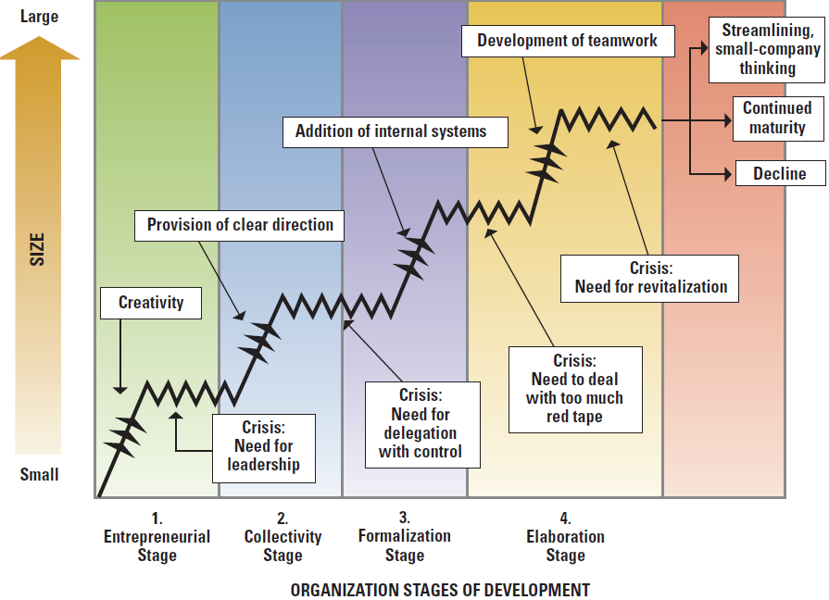
Organizational Life Cycle
©2017 Cengage Learning. All Rights Reserved. May not be scanned, copied or duplicated, or posted to a publicly accessible website, in whole or in part.

Slide 6
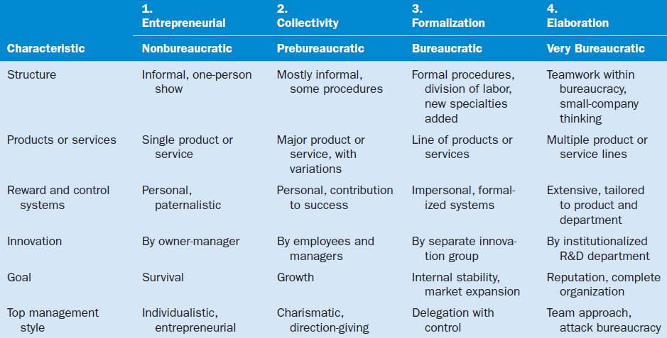
Organization Characteristics During Four Stages of Life Cycle
©2017 Cengage Learning. All Rights Reserved. May not be scanned, copied or duplicated, or posted to a publicly accessible website, in whole or in part.

Slide 7
What is Bureaucracy?
Weber defined bureaucracy as
─ a threat to liberty
─ the most efficient system for organizing
─ rational control
─ a new form of organization
Bureaucracy includes:
Rules and standard procedures
Clear tasks and specialization
Hierarchy of authority
Technical competence
©2013 Cengage Learning. All Rights Reserved. May not be scanned, copied or duplicated, or posted to a publicly accessible website, in whole or in part.

Slide 8
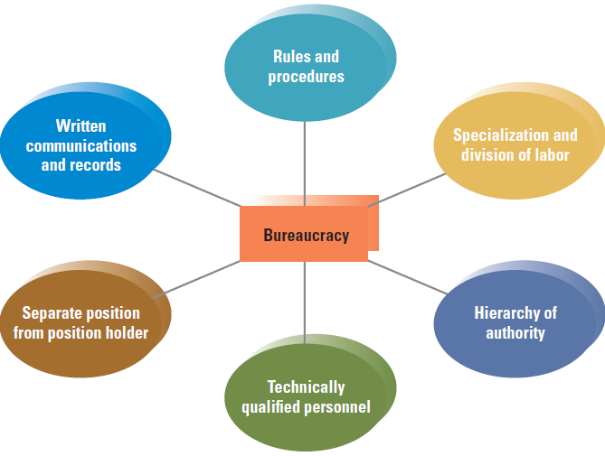
Weber’s Dimensions of Bureaucracy
©2017 Cengage Learning. All Rights Reserved. May not be scanned, copied or duplicated, or posted to a publicly accessible website, in whole or in part.

Slide 9
Size and Structural Control
Formalization – rules, procedures, and written documentation
Centralization – level of hierarchy with authority to make decisions
Personnel Ratios – clerical and professional support staff ratios
©2017 Cengage Learning. All Rights Reserved. May not be scanned, copied or duplicated, or posted to a publicly accessible website, in whole or in part.

Slide 10
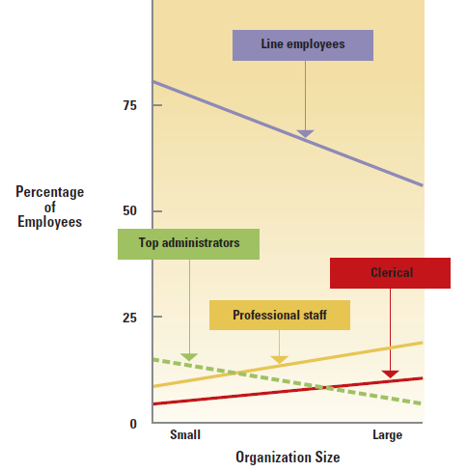
Percentage of Personnel Allocated to Administrative and Support Activities
©2017 Cengage Learning. All Rights Reserved. May not be scanned, copied or duplicated, or posted to a publicly accessible website, in whole or in part.

Slide 11
Bureaucracy in a Changing World
Bureaucracy worked for the industrial age
The system no longer works for today’s challenges
Organizations face new challenges and need to respond quickly
Over-bureaucratization is evident in the inefficiencies of large U.S. government organizations
Narrowly defined jobs and rules limit creativity, flexibility, and rapid response
Organizations use temporary structures for crises
©2017 Cengage Learning. All Rights Reserved. May not be scanned, copied or duplicated, or posted to a publicly accessible website, in whole or in part.

Slide 12
Approaches to Busting Bureaucracy
Google uses bullpen sessions every afternoon
Small geographic based teams
Increasing authority of workers
The increasing professionalism of employees is attacking bureaucracy
©2017 Cengage Learning. All Rights Reserved. May not be scanned, copied or duplicated, or posted to a publicly accessible website, in whole or in part.

Slide 13
Three Organizational Control Strategies
©2017 Cengage Learning. All Rights Reserved. May not be scanned, copied or duplicated, or posted to a publicly accessible website, in whole or in part.

Slide 14
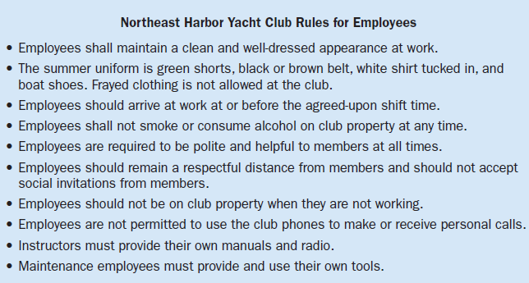
Examples of Rules at a Yacht Club
©2017 Cengage Learning. All Rights Reserved. May not be scanned, copied or duplicated, or posted to a publicly accessible website, in whole or in part.

Slide 15
Organizational Decline and Downsizing
The decrease of an organization’s resources over time is caused by:
Organizational atrophy
Vulnerability
Environmental decline or competition
Downsizing refers to intentionally reducing the size of a company’s workforce
©2017 Cengage Learning. All Rights Reserved. May not be scanned, copied or duplicated, or posted to a publicly accessible website, in whole or in part.

Slide 16
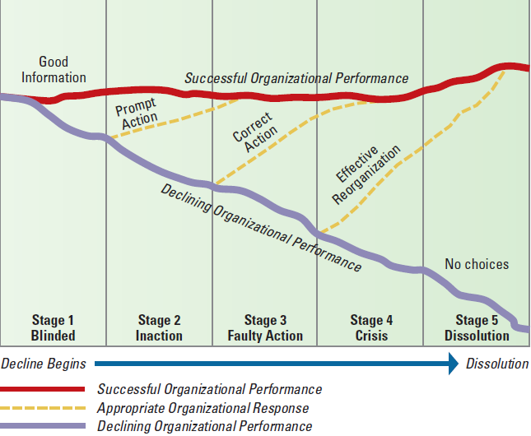
Stages of Decline and the Widening Performance Gap
©2017 Cengage Learning. All Rights Reserved. May not be scanned, copied or duplicated, or posted to a publicly accessible website, in whole or in part.

Slide 17
Downsizing Implementation
Establish Criteria for future work needs
Search for Alternatives
Communicate more not less
Provide assistance to displaced workers
Help the survivors thrive
©2017 Cengage Learning. All Rights Reserved. May not be scanned, copied or duplicated, or posted to a publicly accessible website, in whole or in part.

Slide 18
Design Essentials
Organizations experience pressures to grow
Organizations evolve through stages of the
life-cycle
Larger organizations usually adopt bureaucratic characteristics
All organizations require systems for
control
❖ Many organizations experience decline

