Slide 1
Decision-Making Processes
Organization Theory and Design
Twelfth Edition
Richard L. Daft
©2017 Cengage Learning. All Rights Reserved. May not be scanned, copied or duplicated, or posted to a publicly accessible website, in whole or in part.

Slide 2
Types of Decisions
Organizational decision making – process of identifying and solving problems
- Problem Identification
- Problem Solution
Programmed Decisions – repetitive and well defined
Nonprogrammed Decisions – novel and poorly defined
©2017 Cengage Learning. All Rights Reserved. May not be scanned, copied or duplicated, or posted to a publicly accessible website, in whole or in part.

Slide 3
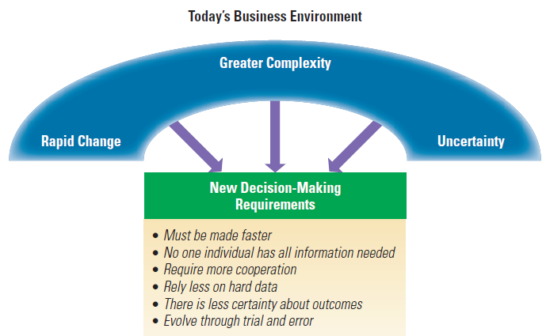
Decision Making in Today’s Environment
©2017 Cengage Learning. All Rights Reserved. May not be scanned, copied or duplicated, or posted to a publicly accessible website, in whole or in part.

Slide 4
Individual Decision Making
Rational approach – ideal method for how managers should make decisions
Bounded rationality perspective – how decisions are made under severe time and resource constraints
©2017 Cengage Learning. All Rights Reserved. May not be scanned, copied or duplicated, or posted to a publicly accessible website, in whole or in part.

Slide 5
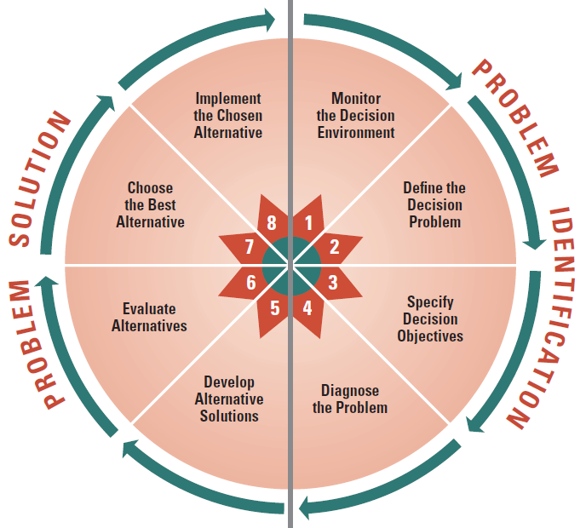
Steps in the Rational Approach
©2017 Cengage Learning. All Rights Reserved. May not be scanned, copied or duplicated, or posted to a publicly accessible website, in whole or in part.

Slide 6
Bounded Rationality Perspective
There is a limit to how rational managers can be—time and resource constraints
Nonprogrammed decisions
Constraints and Tradeoffs
Constraints impinge the decision maker
The Role of Intuition
Experience and judgment rather than logic
©2017 Cengage Learning. All Rights Reserved. May not be scanned, copied or duplicated, or posted to a publicly accessible website, in whole or in part.

Slide 7
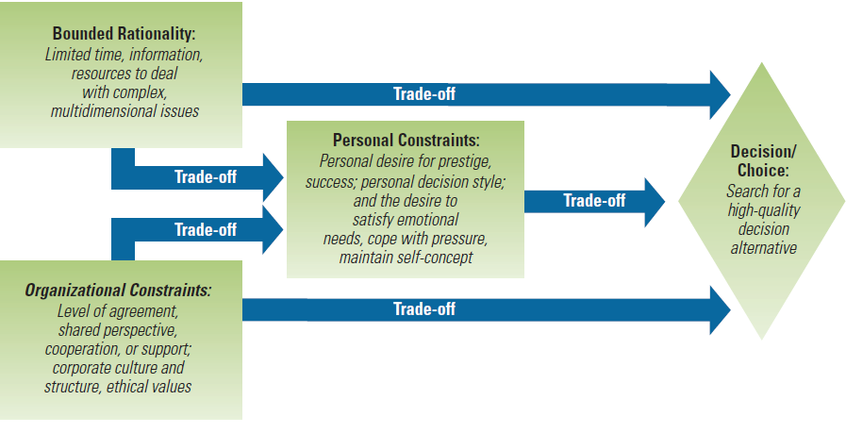
Constraints and Tradeoffs During Nonprogrammed Decision Making
©2017 Cengage Learning. All Rights Reserved. May not be scanned, copied or duplicated, or posted to a publicly accessible website, in whole or in part.

Slide 8
Organizational Decision Making
Management Science Approach
Carnegie Model
Incremental Decision Model
©2017 Cengage Learning. All Rights Reserved. May not be scanned, copied or duplicated, or posted to a publicly accessible website, in whole or in part.

Slide 9
Management Science Approach
Use of statistics to identify relevant variables
Remove human element
Very successful for military problems
Good tool for decisions where variables can be indentified and measured
A drawback of management science is that quantitative data are not rich and lack tacit knowledge
©2017 Cengage Learning. All Rights Reserved. May not be scanned, copied or duplicated, or posted to a publicly accessible website, in whole or in part.

Slide 10
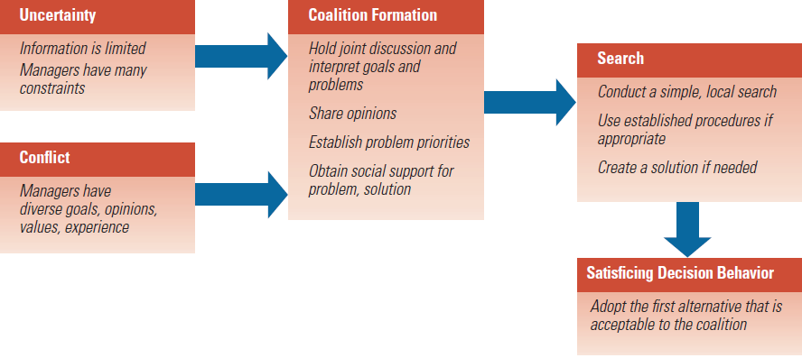
Carnegie Model
©2017 Cengage Learning. All Rights Reserved. May not be scanned, copied or duplicated, or posted to a publicly accessible website, in whole or in part.

Slide 11
Incremental Decision Model
Focus on structured sequence of activities from discovery to solution
Large decisions are a collection of small choices
Decision interrupts are barriers
Identification Phase
Development Phase
Selection Phase
Dynamic Factors
©2017 Cengage Learning. All Rights Reserved. May not be scanned, copied or duplicated, or posted to a publicly accessible website, in whole or in part.

Slide 12
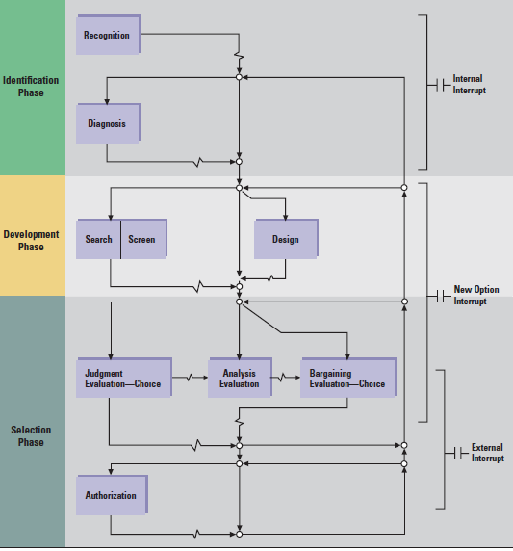
The Incremental Decision Model
©2017 Cengage Learning. All Rights Reserved. May not be scanned, copied or duplicated, or posted to a publicly accessible website, in whole or in part.

Slide 13
Problem Identification and Problem Solution
When problem and problem solution are uncertain
©2013 Cengage Learning. All Rights Reserved. May not be scanned, copied or duplicated, or posted to a publicly accessible website, in whole or in part.

Slide 14
Garbage Can Model
Pattern or flow of multiple decisions
Think of the whole organization
Explain decision making in high uncertainty - organized anarchy:
Problematic preferences
Unclear, poorly understood technology
Turnover
Streams of events instead of defined problems and solutions
©2017 Cengage Learning. All Rights Reserved. May not be scanned, copied or duplicated, or posted to a publicly accessible website, in whole or in part.

Slide 15
Consequences of the Garbage Can Model
Solutions may be proposed even when problems do not exist
Choices are made without solving problems
Problems may persist without being solved
A few problems are solved
©2017 Cengage Learning. All Rights Reserved. May not be scanned, copied or duplicated, or posted to a publicly accessible website, in whole or in part.

Slide 16
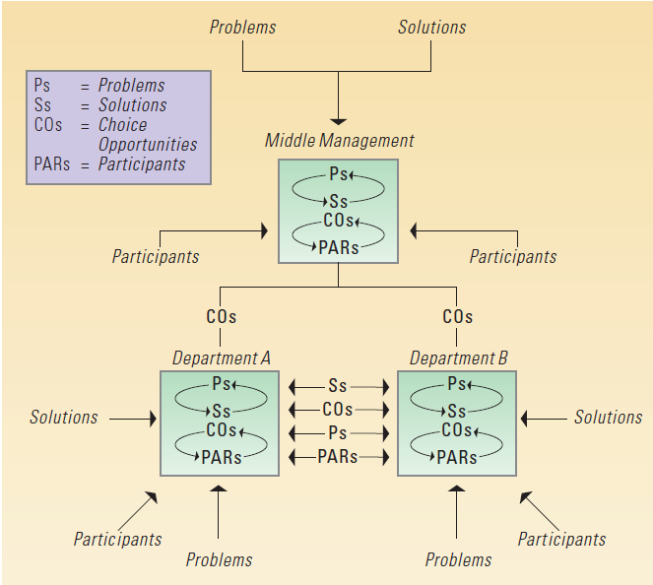
Illustration of Independent Streams of Events in the Garbage Can Model of Decision-Making
©2017 Cengage Learning. All Rights Reserved. May not be scanned, copied or duplicated, or posted to a publicly accessible website, in whole or in part.

Slide 17
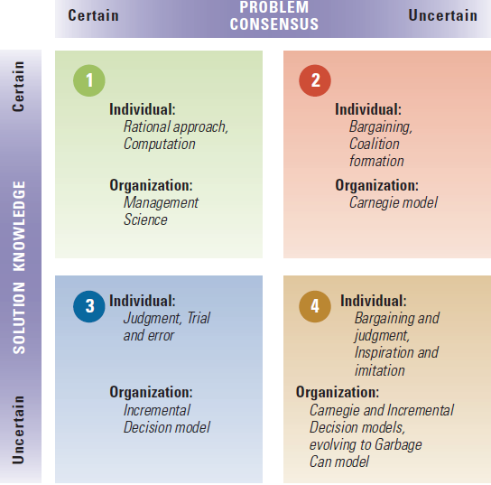
Contingency Framework for Using Decision Models
©2017 Cengage Learning. All Rights Reserved. May not be scanned, copied or duplicated, or posted to a publicly accessible website, in whole or in part.

Slide 18
Special Decision Circumstances
Today’s environment presents high-stakes, quick decisions
Managers must deal with:
High-velocity environments
Learning from decision mistakes
Understanding cognitive and personal biases
Escalating commitment
Prospect theory
Groupthink
Evidence-based management
Encourages dissent and diversity
©2017 Cengage Learning. All Rights Reserved. May not be scanned, copied or duplicated, or posted to a publicly accessible website, in whole or in part.

Slide 19
Design Essentials
Most decisions are not made in a logical
manner
Individuals make decisions, but organizational decisions are not made by a single individual
Conflict exists when problems are not agreed on
©2017 Cengage Learning. All Rights Reserved. May not be scanned, copied or duplicated, or posted to a publicly accessible website, in whole or in part.

Slide 20
Design Essentials
The garbage can model has become a
description of decision-making
Organizations operate in high-velocity
environments and must make decisions
with speed
Allowing biases to cloud decision making can have negative consequences

