Slide 1
Conflict, Power, and Politics
Organization Theory and Design
Twelfth Edition
Richard L. Daft
©2017 Cengage Learning. All Rights Reserved. May not be scanned, copied or duplicated, or posted to a publicly accessible website, in whole or in part.

Slide 2
Interdepartmental Conflict in Organizations
Groups may be dispersed across the organization
Intergroup conflict requires three ingredients:
- Group Identification
- Observable Group Differences
- Frustration
Conflict is similar to competition but more severe
©2017 Cengage Learning. All Rights Reserved. May not be scanned, copied or duplicated, or posted to a publicly accessible website, in whole or in part.

Slide 3
Sources of Conflict
Goal Incompatibility
Differentiation
Task Interdependence
Limited Resources
©2017 Cengage Learning. All Rights Reserved. May not be scanned, copied or duplicated, or posted to a publicly accessible website, in whole or in part.

Slide 4
Marketing-Manufacturing Areas of Potential Goal Conflict
©2017 Cengage Learning. All Rights Reserved. May not be scanned, copied or duplicated, or posted to a publicly accessible website, in whole or in part.

Slide 5
Rational versus Political Model
The rational model where behavior is not random or accidental
Goals are clear and choices are made logically
The political model involves push and pull debate regarding goals
Organization groups have separate interests and goals
©2017 Cengage Learning. All Rights Reserved. May not be scanned, copied or duplicated, or posted to a publicly accessible website, in whole or in part.

Slide 6
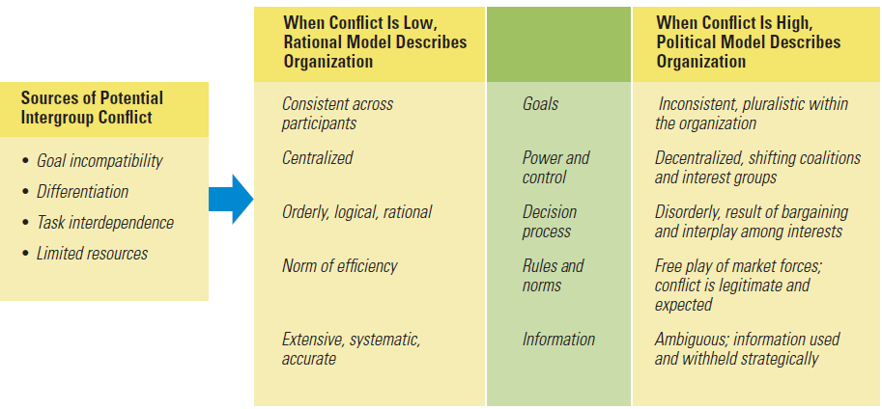
Sources of Conflict and Use of Rational versus Political Model
©2017 Cengage Learning. All Rights Reserved. May not be scanned, copied or duplicated, or posted to a publicly accessible website, in whole or in part.

Slide 7
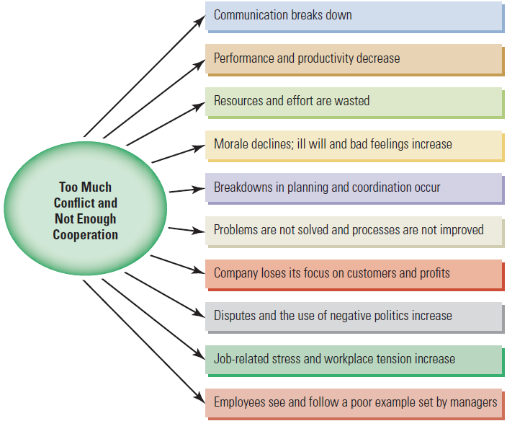
Top 10 Problems from Too Much Conflict
©2017 Cengage Learning. All Rights Reserved. May not be scanned, copied or duplicated, or posted to a publicly accessible website, in whole or in part.

Slide 8
Tactics for Enhancing Collaboration
Create integration devices
Use confrontation and negotiation
Schedule intergroup consultation
Practice member rotation
Create shared mission and superordinate goals
©2017 Cengage Learning. All Rights Reserved. May not be scanned, copied or duplicated, or posted to a publicly accessible website, in whole or in part.

Slide 9
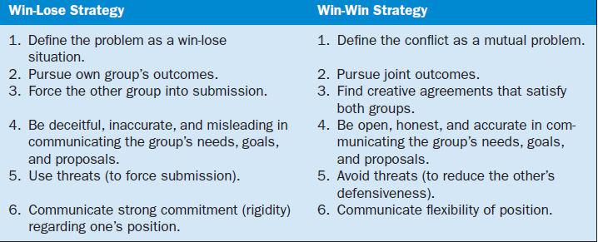
Negotiation Strategies
©2017 Cengage Learning. All Rights Reserved. May not be scanned, copied or duplicated, or posted to a publicly accessible website, in whole or in part.

Slide 10
Power and Organizations
Power is the potential ability of one person to influence other people
Individual versus Organizational Power
Legitimate Power
Reward Power
Coercive Power
Expert Power
Referent Power
©2017 Cengage Learning. All Rights Reserved. May not be scanned, copied or duplicated, or posted to a publicly accessible website, in whole or in part.

Slide 11
Power versus Authority
Authority is more narrow than power
Defined by the formal hierarchy and reporting relationships
Authority is vested in organizational positions
Authority is accepted by subordinates
Authority flows down the vertical hierarchy
Power can be exercised upward, downward, and horizontally
Authority is exercised downward along the hierarchy
©2017 Cengage Learning. All Rights Reserved. May not be scanned, copied or duplicated, or posted to a publicly accessible website, in whole or in part.

Slide 12
Vertical Sources of Power
Formal Position – legitimate power accrued to top positions
Resources – resources can be used as a tool for power
Control of Information – information is a primary business source
Network Centrality – being centrally located in the organization and having access
People – loyal executives/managers
©2017 Cengage Learning. All Rights Reserved. May not be scanned, copied or duplicated, or posted to a publicly accessible website, in whole or in part.

Slide 13
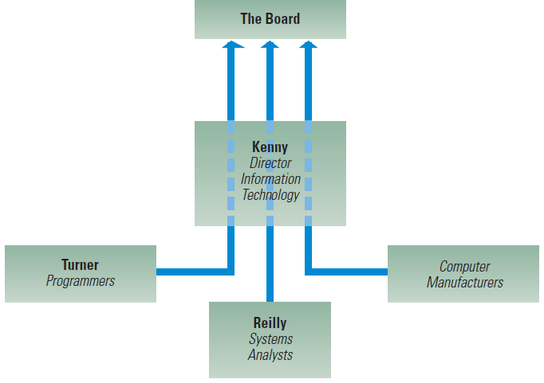
Information Flow for Computer Decision at Clark Ltd.
©2017 Cengage Learning. All Rights Reserved. May not be scanned, copied or duplicated, or posted to a publicly accessible website, in whole or in part.

Slide 14
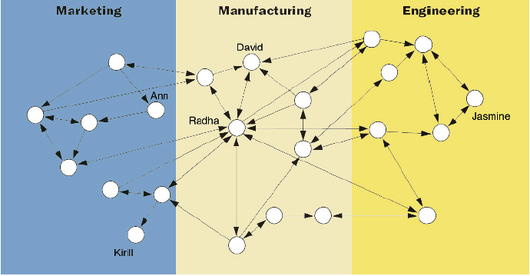
Illustration of Network Centrality
©2017 Cengage Learning. All Rights Reserved. May not be scanned, copied or duplicated, or posted to a publicly accessible website, in whole or in part.

Slide 15
The Power of Empowerment
Power sharing, the delegation of power or authority to subordinates
Empowerment benefits:
Employees receive information about company performance
Employees have knowledge and skills to contribute to company goals
Employees have the power to make substantive decisions
©2017 Cengage Learning. All Rights Reserved. May not be scanned, copied or duplicated, or posted to a publicly accessible website, in whole or in part.

Slide 16
Horizontal Sources of Power
Relationships across departments, divisions, units
Strategic Contingencies – groups most responsible for key organization issues
Power Sources – five power sources that departments may possess
©2017 Cengage Learning. All Rights Reserved. May not be scanned, copied or duplicated, or posted to a publicly accessible website, in whole or in part.

Slide 17
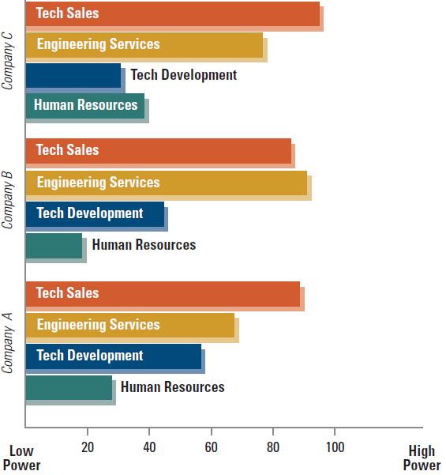
Ratings of Power among Departments in Industrial Firms
©2017 Cengage Learning. All Rights Reserved. May not be scanned, copied or duplicated, or posted to a publicly accessible website, in whole or in part.

Slide 18
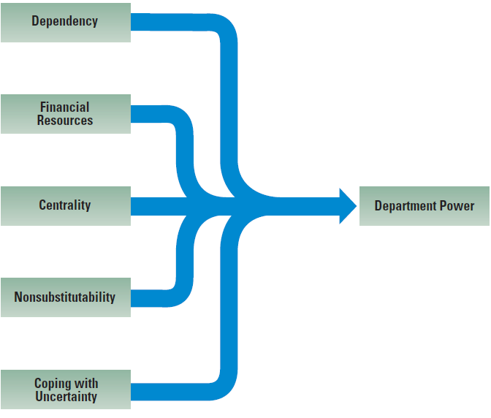
Strategic Contingencies That Influence Horizontal Power among Departments
©2017 Cengage Learning. All Rights Reserved. May not be scanned, copied or duplicated, or posted to a publicly accessible website, in whole or in part.

Slide 19
Political Processes in Organizations
Politics is the use of power to influence decisions toward goals
Organizational Politics - activities to acquire, develop, and use power to influence goals
Domains of political activity:
Structural Change
Management Succession
Resource Allocation
©2017 Cengage Learning. All Rights Reserved. May not be scanned, copied or duplicated, or posted to a publicly accessible website, in whole or in part.

Slide 20
Using Soft Power and Politics
Managers can rely on “hard power” which stems from a person’s position of authority
Effective managers often use “soft power” which is based on personal characteristics and building relationships

Slide 21
Power and Political Tactics in Organizations
©2017 Cengage Learning. All Rights Reserved. May not be scanned, copied or duplicated, or posted to a publicly accessible website, in whole or in part.

Slide 22
Design Essentials
Conflict, power, and politics are natural
outcomes of organizing
There are two views for organizations:
rational and political models
Managers should enhance collaboration
to reduce conflict
©2017 Cengage Learning. All Rights Reserved. May not be scanned, copied or duplicated, or posted to a publicly accessible website, in whole or in part.

Slide 23
Design Essentials
There are vertical and horizontal sources
of power
Certain characteristics make some departments more powerful than others
❖ Managers need political skills

