Slide 1
The External Environment
Organization Theory and Design
Twelfth Edition
Richard L. Daft
©2017 Cengage Learning. All Rights Reserved. May not be scanned, copied or duplicated, or posted to a publicly accessible website, in whole or in part.

Slide 2
The Organization Environment
All the elements that exist outside the boundary of the organization
Potential to affect all or part of the organization
Domain is the chosen environmental field of action
Sectors or subdivisions that contain similar elements
©2017 Cengage Learning. All Rights Reserved. May not be scanned, copied or duplicated, or posted to a publicly accessible website, in whole or in part.

Slide 3
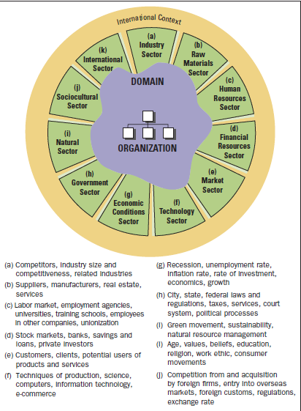
An Organization’s Environment
©2017 Cengage Learning. All Rights Reserved. May not be scanned, copied or duplicated, or p333osted to a publicly accessible website, in whole or in part.

Slide 4
The Task Environment
Sectors that the organization interacts with directly to achieve goals
Industry Sector
Raw Materials Sector
Market Sector
Human Resources Sector
International Sector
©2017 Cengage Learning. All Rights Reserved. May not be scanned, copied or duplicated, or posted to a publicly accessible website, in whole or in part.

Slide 5
General Environment
Sectors that indirectly impact a firm
Government sector: regulation
Natural sector: sustainability
Sociocultural sector: working conditions
Economic conditions: global recession
Technology sector: massive and constant changes
Financial resources: important to entrepreneurs
©2017 Cengage Learning. All Rights Reserved. May not be scanned, copied or duplicated, or posted to a publicly accessible website, in whole or in part.

Slide 6
International Environment
Can directly affect many organizations
Has grown in importance
International events influence domestic sectors of the environment
All organizations face domestic and global uncertainty
©2017 Cengage Learning. All Rights Reserved. May not be scanned, copied or duplicated, or posted to a publicly accessible website, in whole or in part.

Slide 7
The Changing Environment
As the environment becomes more complex,
Events become less stable
Financial resources become less available
The level of uncertainty increases
The environment influences organizations
Need for information changes
Need for resources changes

Slide 8
Elements of Uncertainty
Uncertainty: lack of sufficient information about environmental factors
Complexity: number and dissimilarity of external elements
Dynamism: whether the organization operates in a stable or unstable environment

Slide 9
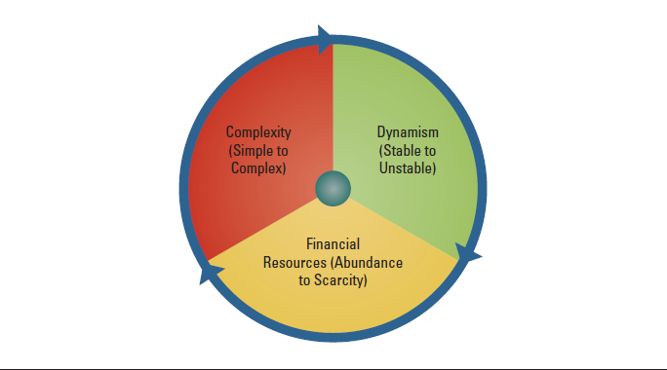
Factors Causing Uncertainty
©2017 Cengage Learning. All Rights Reserved. May not be scanned, copied or duplicated, or posted to a publicly accessible website, in whole or in part.

Slide 10
Dimensions of Environmental Uncertainty
Simple, stable environment: uncertainty is low
Complex, stable environment: greater uncertainty
Simple, unstable environment: even greater uncertainty
Complex, unstable environment: greatest uncertainty
©2017 Cengage Learning. All Rights Reserved. May not be scanned, copied or duplicated, or posted to a publicly accessible website, in whole or in part.

Slide 11
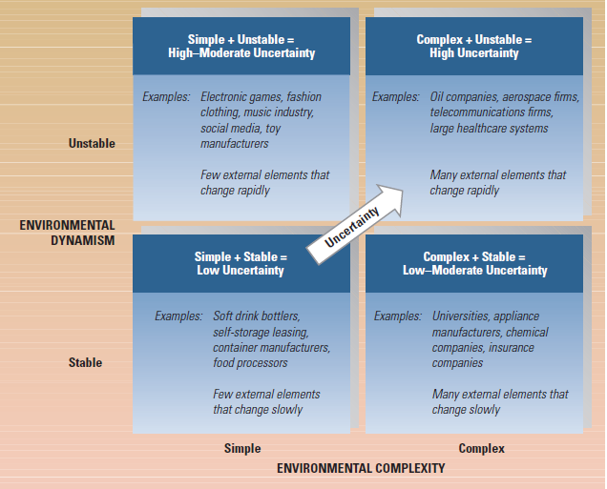
Framework for Assessing Environmental Uncertainty
©2017 Cengage Learning. All Rights Reserved. May not be scanned, copied or duplicated, or posted to a publicly accessible website, in whole or in part.

Slide 12
Adapting to Complexity and Dynamism
Organizations need the right fit between internal structure and the external environment
Adding Positions and Departments
Building Relationships
Boundary-spanning roles
Business intelligence
Differentiation and Integration
Organic vs. Mechanistic Management Process
Planning, Forecasting, and Responsiveness
©2017 Cengage Learning. All Rights Reserved. May not be scanned, copied or duplicated, or posted to a publicly accessible website, in whole or in part.

Slide 13
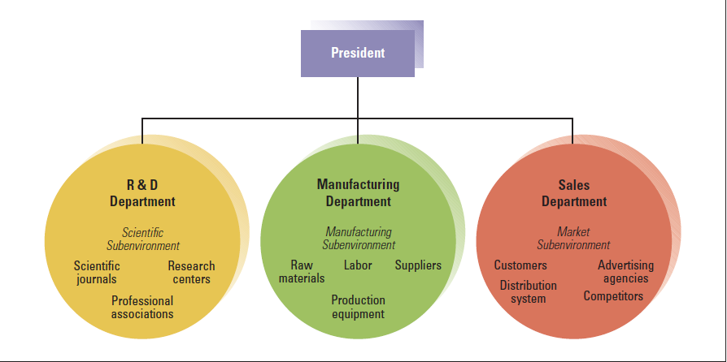
Organizational Departments Differentiate to Meet Needs of Sub-environments
©2017 Cengage Learning. All Rights Reserved. May not be scanned, copied or duplicated, or posted to a publicly accessible website, in whole or in part.

Slide 14
Different Goals and Orientations among Departments
©2017 Cengage Learning. All Rights Reserved. May not be scanned, copied or duplicated, or posted to a publicly accessible website, in whole or in part.

Slide 15
Environmental Uncertainty and Organizational Integrators
©2017 Cengage Learning. All Rights Reserved. May not be scanned, copied or duplicated, or posted to a publicly accessible website, in whole or in part.

Slide 16
Mechanistic and Organic Forms
Tasks are specialized
Tasks are rigidly defined
Strict hierarchy of authority and control
Knowledge and control of tasks are centralized
Communication is vertical
Employees contribute to the common task of the department
Tasks are adjusted and redefined through teamwork
Less hierarchy of authority and control
Knowledge and control of tasks are located anywhere in the organization
Communication is horizontal
©2017 Cengage Learning. All Rights Reserved. May not be scanned, copied or duplicated, or posted to a publicly accessible website, in whole or in part.

Slide 17
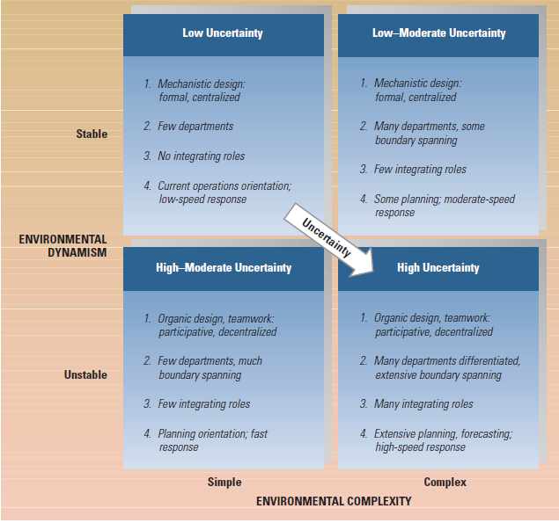
Contingency Framework for Uncertainty and Organizational Responses
©2017 Cengage Learning. All Rights Reserved. May not be scanned, copied or duplicated, or posted to a publicly accessible website, in whole or in part.

Slide 18
Dependence on Financial Resources
Resource-dependence perspective means organizations depend on the environment
Strive to acquire control over resources to minimize dependence
Organizations are vulnerable if resources are controlled by other organizations
Minimize vulnerabilities
Will team up with others when resources are scarce
©2017 Cengage Learning. All Rights Reserved. May not be scanned, copied or duplicated, or posted to a publicly accessible website, in whole or in part.

Slide 19
Influencing Financial Resources
Balance linkages and independence
Reach out and change or control elements in the environment
Establish favorable relationships with key
elements of the environment
Shape the environment by influencing key
sectors
©2017 Cengage Learning. All Rights Reserved. May not be scanned, copied or duplicated, or posted to a publicly accessible website, in whole or in part.

Slide 20
Organizing Strategies for Controlling the External Environment
©2017 Cengage Learning. All Rights Reserved. May not be scanned, copied or duplicated, or posted to a publicly accessible website, in whole or in part.

Slide 21
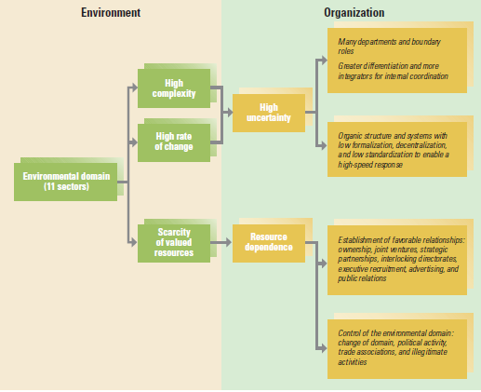
Environmental Characteristics and Organizational Actions
©2017 Cengage Learning. All Rights Reserved. May not be scanned, copied or duplicated, or posted to a publicly accessible website, in whole or in part.

Slide 22
Design Essentials
Dynamism and complexity have major
implications for organizations
Organizational environments differ regarding
uncertainty and resource dependence
The goal for organizations is managing
efficiencies and survival
©2017 Cengage Learning. All Rights Reserved. May not be scanned, copied or duplicated, or posted to a publicly accessible website, in whole or in part.

Slide 23
Design Essentials
Managers must understand how the
environment influences the structure and
functioning of an organization
When risk is great, organizations can establish linkages to maintain a supply of resources
Organizations can learn and adapt to the
environment and change and control the
environment

