Slide 1
Organizational Culture and Ethical Values
Organization Theory and Design
Twelfth Edition
Richard L. Daft
©2017 Cengage Learning. All Rights Reserved. May not be scanned, copied or duplicated, or posted to a publicly accessible website, in whole or in part.

Slide 2
What is Culture?
Values, norms, guiding beliefs, and understandings that are shared by members of an organization
Taught to new members as the correct way to think, feel, and behave
Organizational culture exists at two levels
Observable symbols
Underlying values
©2017 Cengage Learning. All Rights Reserved. May not be scanned, copied or duplicated, or posted to a publicly accessible website, in whole or in part.

Slide 3
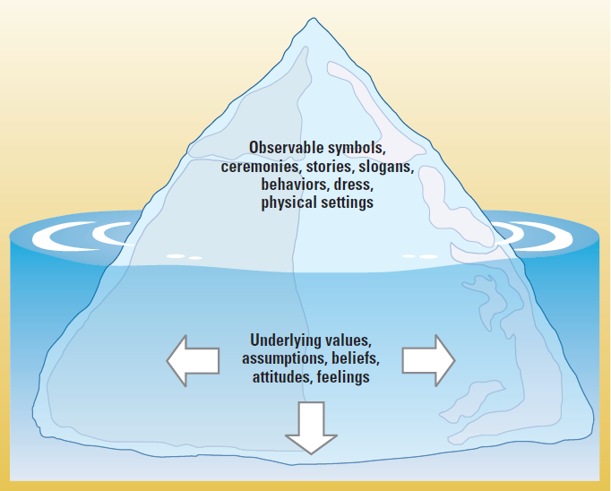
Levels of Corporate Culture
©2017 Cengage Learning. All Rights Reserved. May not be scanned, copied or duplicated, or posted to a publicly accessible website, in whole or in part.

Slide 4
Emergence and Purpose of Culture
Provides sense of organizational identity
Two critical functions in organizations:
To integrate members so they know how to relate to one another
To help organization adapt to external environment
Internal Integration – collective identity and know how to work together
External Adaption – how the organization meets goals and deals with outsiders
©2017 Cengage Learning. All Rights Reserved. May not be scanned, copied or duplicated, or posted to a publicly accessible website, in whole or in part.

Slide 5
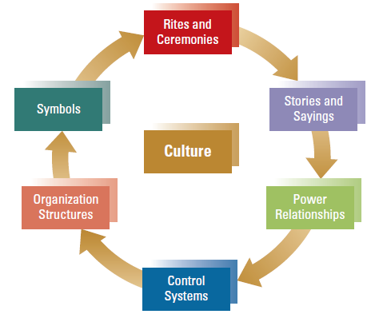
Observable Aspects of Organizational Culture
©2017 Cengage Learning. All Rights Reserved. May not be scanned, copied or duplicated, or posted to a publicly accessible website, in whole or in part.

Slide 6
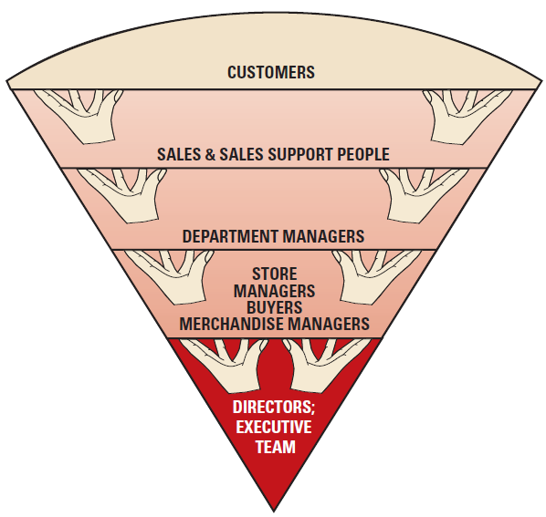
Organizational Chart for Nordstrom
©2017 Cengage Learning. All Rights Reserved. May not be scanned, copied or duplicated, or posted to a publicly accessible website, in whole or in part.

Slide 7
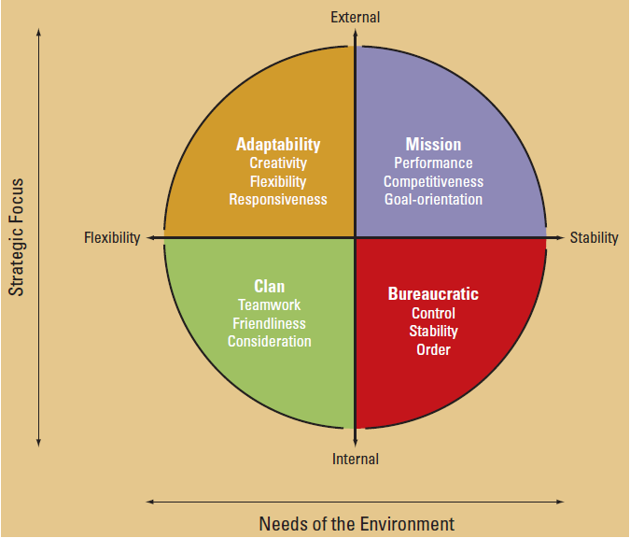
Organizational Design and Culture
Managers want a corporate culture that reinforces the strategy and structural design the organization needs to be effective within environment.
©2017 Cengage Learning. All Rights Reserved. May not be scanned, copied or duplicated, or posted to a publicly accessible website, in whole or in part.

Slide 8
Culture Strength and Organizational Subcultures
Culture strength is the degree of agreement among members of an organization about specific values
Subcultures reflect the common problems, goals, and experiences of a team or department
Different departments may have their own norms
©2017 Cengage Learning. All Rights Reserved. May not be scanned, copied or duplicated, or posted to a publicly accessible website, in whole or in part.

Slide 9
Organizational Culture, Learning, and Performance
Culture is important to learning and innovation during challenging times
Strong cultures include constructive adaptation
with the following values:
- Concern for employees and customers
- Flexible behavior
- Encouragement of risk taking, change,
and improvement
©2017 Cengage Learning. All Rights Reserved. May not be scanned, copied or duplicated, or posted to a publicly accessible website, in whole or in part.

Slide 10
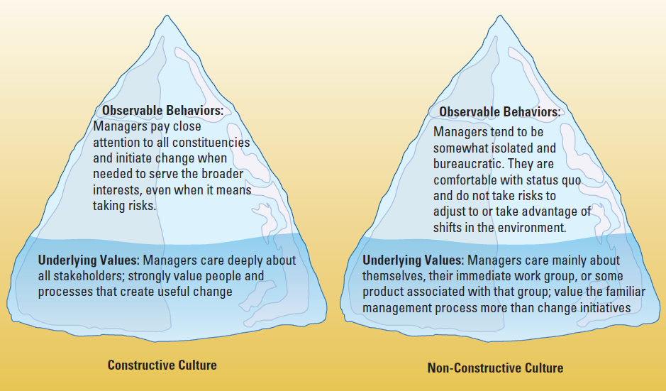
Constructive Versus Non-Constructive Cultures
©2017 Cengage Learning. All Rights Reserved. May not be scanned, copied or duplicated, or posted to a publicly accessible website, in whole or in part.

Slide 11
Ethical Values and Social Responsibility
Ethics
the code of moral principles and values that govern the behaviors of a person or group with respect to what is right or wrong
Managerial Ethics
Ethical decisions go beyond behaviors governed by law
Managerial ethics guide the decisions and behaviors of managers
Ethical Dilemma
─ a situation concerning right and wrong in which
values are in conflict
©2017 Cengage Learning. All Rights Reserved. May not be scanned, copied or duplicated, or posted to a publicly accessible website, in whole or in part.

Slide 12
Corporate Social Responsibility
Corporate Social Responsibility
management’s obligation to make choices and
take action so that the organization
contributes to the welfare and interest of all
organizational stakeholders- employees,
customers, shareholders, the community, the
broader society
Sustainability
environmental efforts woven into all decisions

Slide 13
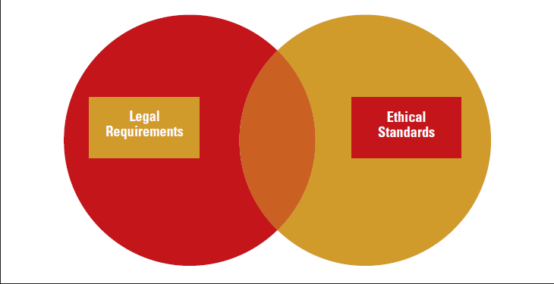
Relationship between the Rule of Law and Ethical Standards
©2017 Cengage Learning. All Rights Reserved. May not be scanned, copied or duplicated, or posted to a publicly accessible website, in whole or in part.

Slide 14
Corporate Social Responsibility (CSR)
Does it pay to be good?
Extension of the idea of managerial ethics
Increase in social responsibility
Customers and public are paying closer attention to what organizations do
Social responsibility can enhance a firm’s reputation
Companies measure nonfinancial factors that create value
©2017 Cengage Learning. All Rights Reserved. May not be scanned, copied or duplicated, or posted to a publicly accessible website, in whole or in part.

Slide 15
How Managers Shape Culture and Ethics
Value-Based Leadership
Formal Structure and Systems
Structure
Disclosure Mechanisms
Code of Ethics
Training Programs
Managers play key role in providing leadership and examples of ethical behavior
©2017 Cengage Learning. All Rights Reserved. May not be scanned, copied or duplicated, or posted to a publicly accessible website, in whole or in part.

Slide 16
Manager Rankings of Ethical Values by Generation

Slide 17
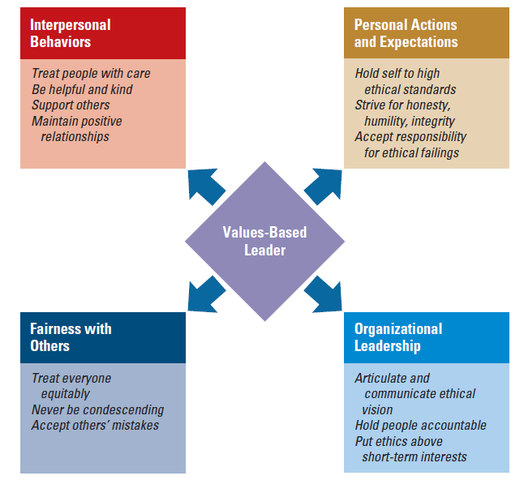
Characteristics of Values-Based Leaders
©2017 Cengage Learning. All Rights Reserved. May not be scanned, copied or duplicated, or posted to a publicly accessible website, in whole or in part.

Slide 18
Corporate Culture and Ethics in a Global Environment
The global environment presents tough ethical challenges
A global supply chain is an area of growing ethical concern
Countries have varied attitudes and beliefs
Components that characterize a global culture:
Multicultural rather than national values
Basing status on merit rather than nationality
Some companies work closely with overseas factories to improve working conditions
©2017 Cengage Learning. All Rights Reserved. May not be scanned, copied or duplicated, or posted to a publicly accessible website, in whole or in part.

Slide 19
Design Essentials
Cultural and ethical values help determine
the organization’s social capital and can
contribute to success
Managers can use rites and ceremonies, stories, symbols, structures, control systems, and power relationships to influence culture
Subcultures may emerge even in strong
cultures
©2017 Cengage Learning. All Rights Reserved. May not be scanned, copied or duplicated, or posted to a publicly accessible website, in whole or in part.

Slide 20
Design Essentials
Strong cultures can be constructive or non-
constructive
Managerial ethics and corporate responsibility
are important aspects of organizational values
Managers can shape culture and ethics through formal systems
Global companies face challenges in establishing strong cultural and ethical values.

