Slide 1
Chapter 4:
Focus on the Big Picture, Not the Numbers
Team 3: Cody Bruce, Alex Buslawski, Jessica Bussell,
Matthew Jimenez, Fabio Pinzon, Corey Smith

Slide 2
Introduction
Chapter 2 talked about creating a strategy for your company
Companies should focus on the big picture, not the numbers
Difference between blue ocean moves and tactical red ocean moves
How to do this?
4 steps of visualizing strategy
Pioneer-Migrator-Settler Map

Slide 3
Step 1: Visual Awakening
Discuss changes in strategy before resolving the issues in difference of opinion about the current state of play is often a mistake
Executives often ignore the need for change
EFS (European Financial Services)
150 year-old financial service group
First one to adopt the process
Yielded a 30 percent revenue boost in its initial year

Slide 4
Step 2: Visual Exploration
Getting a first hand visual.
“A company should never outsource its eyes”

Slide 5
Step 3: Visual Strategy Fair
Any idea that takes more than ten minutes to communicate is probably too complicated to be any good.
Buyers from all markets had a basic set of needs and expected similar services. If you met those needs, customers would happily forgo everything else.
The teams were finally able to complete their mission and were able to draw a value curve that was a truer likeness of the existing strategic profile.

Slide 6
Step 4: Visual Communication
Communicating the future strategy is the most important part of developing a new strategy
On one page, distribute your before-and-after strategic profiles for easy comparison
Top management should communicate the new strategy to their direct subordinates, who should spread the word to their direct subordinates and so on

Slide 7
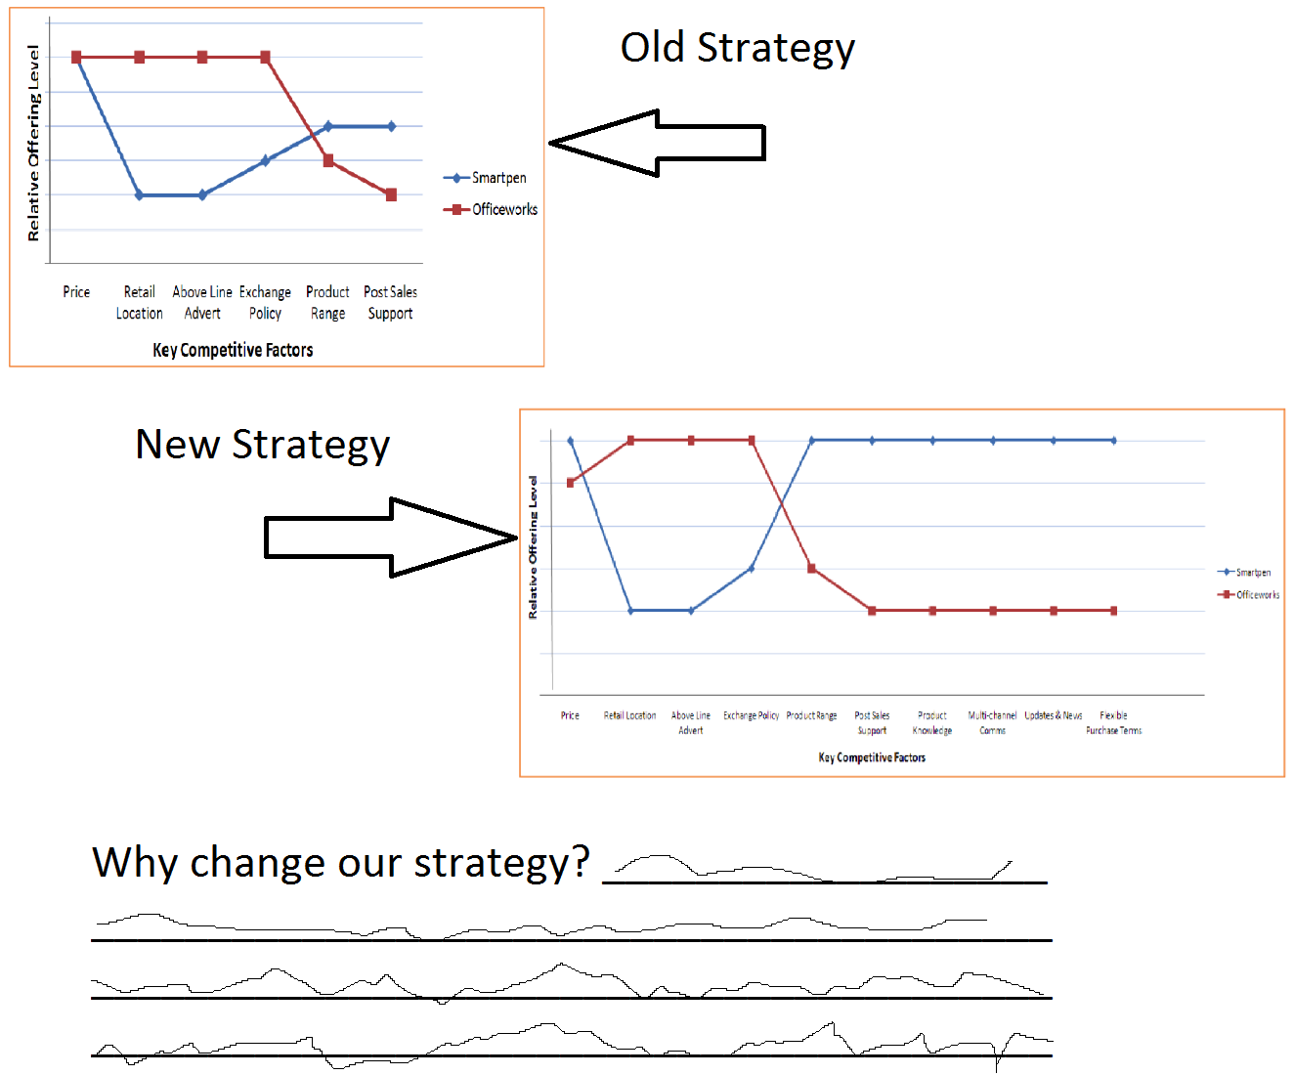
Example Strategy Handout

Slide 8
Using the Pioneer-Migrator-Settler Map
Pioneers
Are all powerful sources of profitable growth
Migrators
Offer improved value but not innovative value
Settlers
Do not contribute to growth

Slide 9
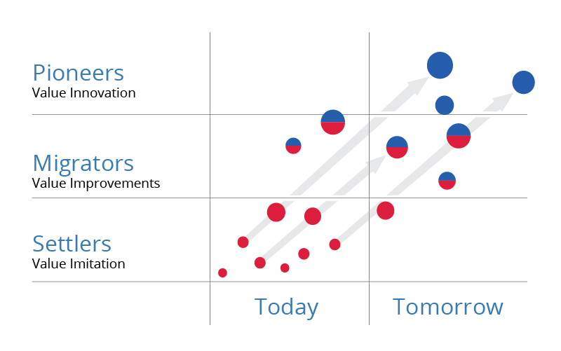

Slide 10
Pioneers
Value innovation
Mass following of customers
Value curve diverges from the competition on the strategy canvas

Slide 11
Migrators
Value improvements
Business offerings better than most
Can go either way, hence the name

Slide 12
Settlers
Value imitation
Offer the same value, more or less, as the rest of the industry
Today’s cash cows, but will generally not contribute much to future growth

Slide 13
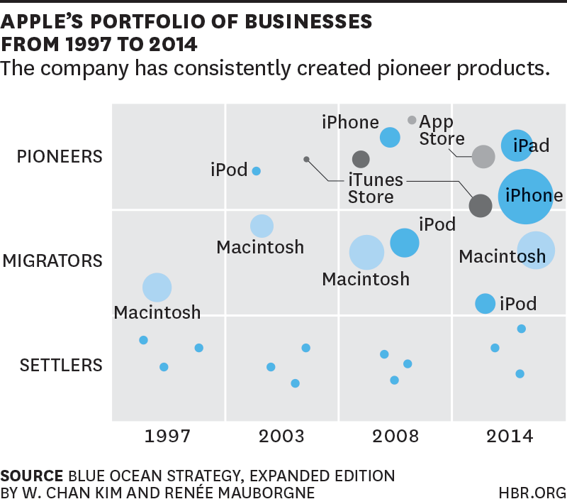
Apple PMS Map

Slide 14
Sources
http://bergconsulting.com.au/Berg_Consulting_Blog/what-is-blue-ocean-strategy-part-3-the-strategy-canvas
https://www.blueoceanstrategy.com/tools/pms-map/

Slide 15
http://www.cohep.com/contenido/biblioteca/portaldoc25_3.pdf?4684407c0b72f2fcdb5f939daff2874b

