Slide 1
Strategies for Competing in International Markets
Team 6: Courtney Estrada, Alexa Bumgarner, Dustin Lang, Zach Mays

Slide 2
Why Enter a Foreign Markets?
Gain access to new customers
Achieve lower cost through economies of scale
To further exploit its come competencies
Gain access to resources and capabilities located in foreign markets
To spread its business risk across a wider market

Slide 3
Competing Across Borders Makes Strategy-Making more Complex
Different countries have different home country advantages in different industries
There are location-based advantages to conducting particular value chain activities in different parts of the world
Different government policies, tax rates, inflation rates, and other economic conditions make the general business climate in some countries favorable
Companies face risk due to adverse shift in currency exchange rates
Differences in buyers tastes and preferences present a challenge for companies concerning customizing vs. standardizing their products and services

Slide 4
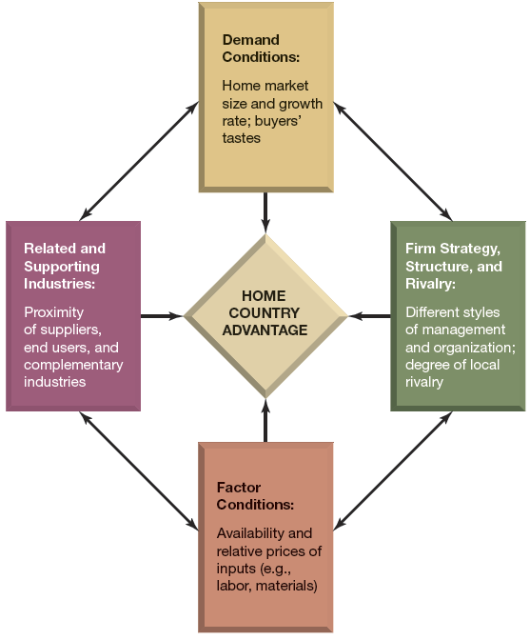
Porter’s Diamond of National Competitive Advantage
Home Country Advantage:
Demand Conditions
Factor Conditions
Related and Supporting Industries
Firm Strategy, Structure, and Rivalry

Slide 5
Locating Value Chain Activities Advantageously
Companies are building production facilities in low cost countries
Closer to needed resources
Research and Development
Shanghai GM

Slide 6
Government Policies & Economic Conditions in Host Countries
Some governments try to attract foreign business
While others try to make it more difficult
Political risks
Economic Risk

Slide 7
The Risk of Adverse Exchange Rate Shifts
A weaker U.S. dollar is an economically favorable exchange rate shift for manufacturing plants in the U.S.
Eliminates foreign cost advantage
Makes foreign goods more expensive for U.S. buyer
Enables U.S.-made good to be sold at lower prices in countries with stronger currency
Increases the dollar value of profits a company earns in foreign markets
Currency exchange rates are typically unpredictable

Slide 8
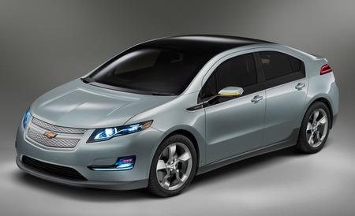
Differences in Demographic, Cultural, and Market Conditions
Buyers tastes vary from country-to-country
Leads to questions of customizing or standardizing products in each market

Slide 9
Strategic Options For Entering International Markets
Export
Licensing
Franchising
Foreign
Alliance and Joint Venture

Slide 10
Export Strategies
Good initial strategy
Minimal capital needed
Home based production and export strategy helps minimize direct investments in foreign countries
Can experience vulnerability
Manufacturing costs
Shipping costs
Changes in currency exchange rate
Tariffs and trade barriers

Slide 11
Licensing Strategies
Technology, brand, patents without capability or resources to enter international market
Income from royalties, but cost and risk goes to licensee
Disadvantage: lose some control
Examples: software and pharmaceutical companies

Slide 12
Franchising Strategies
For international expansion of services and retailers
McDonald’s, Yum! Brands, 7-Eleven, Hilton Hotels
Advantage: franchisee most of costs and risks while franchisor maintains quality control
Disadvantage: deciding if things should change to appeal to different cultures

Slide 13
Foreign Subsidiary Strategies
For companies that prefer direct control
Establish a subsidiary by:
Acquiring a foreign company
Establish operations from ground up
Greenfield venture

Slide 14
Alliance and Joint Venture Strategies
Reasons for cross-alliances
Knowledge of local government regulations, buying habits and product preferences
Capture economies of scale in production/marketing
Share distribution facilities and dealer networks
Learning from each other
Gain agreement on technical standards
Risks
Partner’s knowledge is useless
Communication challenges
Losing competitive advantage

Slide 15
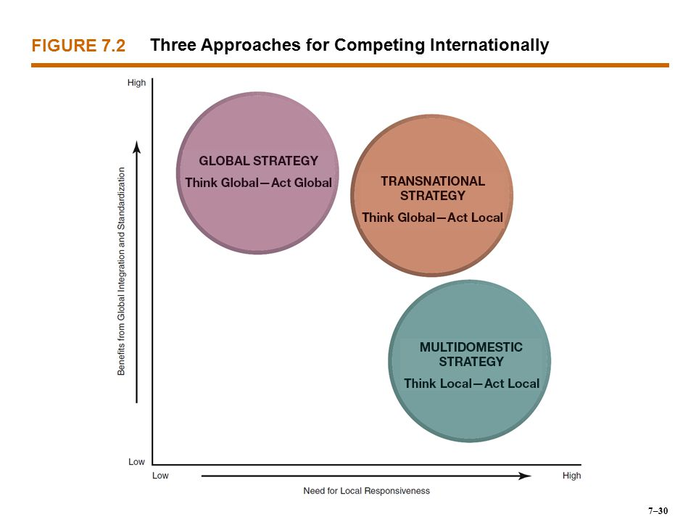
International Strategies

Slide 16
Multidomestic- “think-local, act-local”
Producing different product versions for different local markets
Adapting marketing/distribution to fit customs, cultures, regulations, market requirements
Only possible when decision making is decentralized
Local managers have more say
Drawbacks
Can be less innovative because efforts are not integrated across borders
Higher production/distribution costs
There isn’t one worldwide competitive advantage

Slide 17
Global- “think global, act-global”
Standardized, globally integrated approach
Sell same products/services under same brand name everywhere
Emphasis on building a global name
Beneficial when high volumes lower costs (spreading fixed costs)
Drawbacks:
Can’t address local needs as precisely as local rivals
Less responsive to changes in local market conditions
Raises transportation costs
Higher coordination costs

Slide 18
Transnational- “think-global, act-local”
Glocalization
Uses mass-customization techniques to address local preferences in a semistandard manner
Electronic Arts: two major design studies and four smaller studios worldwide
FiFA and NFL, NBA, NASCAR
Drawbacks
Most difficult to implement because of complexity of varying elements
Dealing with conflicting objectives
Costly and time-consuming, uncertain outcome

Slide 19
International Competitive Advantage
Use location to your advantage
Transfer resources from one country to another
Utilize opportunities specific to international businesses

Slide 20
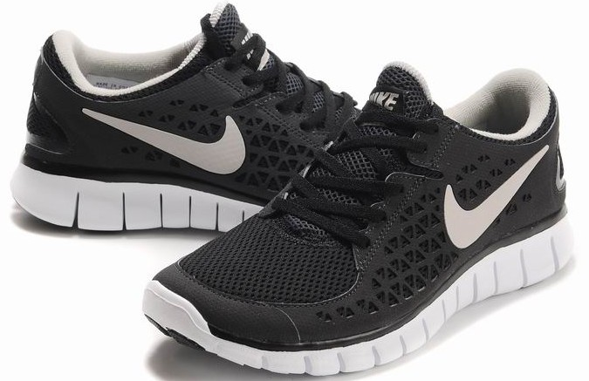
Using Location
Concentrated? Dispersed?

Slide 21
Transferring Resources

Slide 22
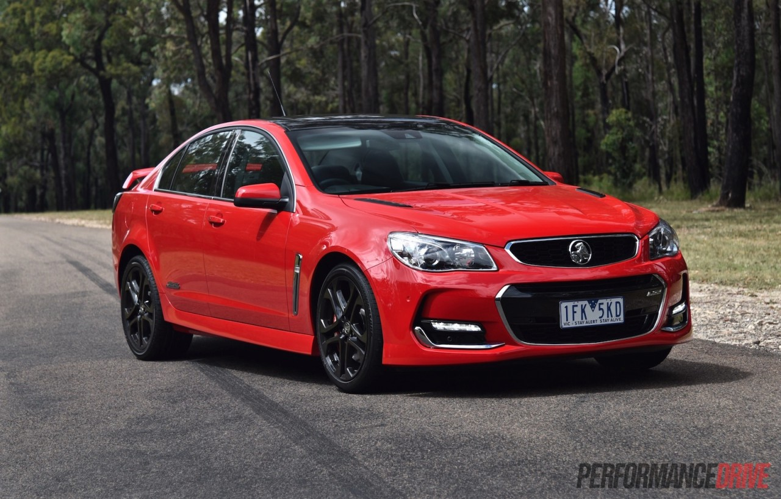
GM and its International Brands

Slide 23
Profit Sanctuaries
Most significant amount of company profits
Can be used to launch offensives and defend against rivals

Slide 24
GM Profit Sanctuaries
Profit sanctuary in United States
Allowed it to create a huge market share in China

