Slide 1
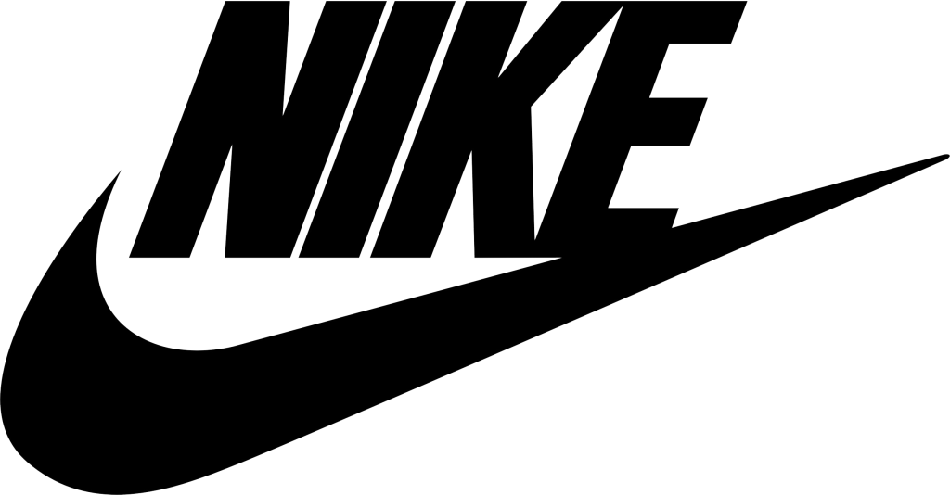
Chapter 7 Overcome Key Organizational Hurdles
Group 4: Hunter Tarman, Kate Penshorn, Omar Winters, Gabi Reid, and Ryan Reid

Slide 2
Outline
Cognitive Hurdle
Resource Hurdle
Motivational Hurdle
Political Hurdle
Challenging Conventional Wisdom

Slide 3
The Cognitive Hurdle
Overcoming the status quo
Current view on company needs
Is change really needed?

Slide 4
Cognitive Hurdle: Questions to Ask
How should we go about explaining the problems the company is facing?
What methods should we use to get others out of the Red Ocean comfort zone?
In what ways can we influence others to agree on the cause?
How do we convert the mindset of the company to a Blue Ocean strategy?

Slide 5
Hurdle Headaches
Pointing to the numbers
Creates distance from those you are trying to influence
Possibility of hostility: manipulation and distortion
Sensitivity of management
Those doing well feel unaffected
Those doing poorly feel threatened

Slide 6
Two Strategies of Shifting Company Perspective
Face-to-Face: Bring the people to the problem
The effect of firsthand experience – “Seeing is believing”
Show the worst reality
Effects of positive and negative stimuli
Meet Directly with Disgruntled Customers
Market surveys do not always grasp problem reasoning - Not what, but why?
There is no substitute for direct contact

Slide 7
Nike’s Cognitive Shift
Jerome Conlon: Nike’s early Planning Director
Status Quo:
Go-To-Market Efficiency – product designing, pricing, packaging, and selling
No pre-testing or advertising
Sales Orientation – the futures program
Paralysis by Analysis – load and burden of marketing planning
How did Nike turn the corner and create a premier marketing organization?

Slide 8
Nike’s Cognitive Shift
Facing the problem
Met with every department manager and discussed growth issues they would face – what managers could and would support
No feedback systems to gauge effectiveness
The strategy implementation had been tried but ultimately rejected
Providing a solution
Conlon’s two paper presentation
One showed a map of the current company “status quo”
The other gave new processes to open up the floor to ideas
Research tools; market planning; budget processing

Slide 9
Nike’s Cognitive Shift
Goal: Create a framework for analyzing the business more rigorously to justify increased investments in developing the brand further
Gaining company insight on how to…
Organize scarce resources
Better satisfy the customer needs
Achieve effective campaign impacts
Slow transition with careful planning
Market situation analysis
Marketing goals
Marketing strategies

Slide 10
Nike’s Birth of Brand Culture
Express the benefits to the company
Roles of Product Line Managers – staging the change
Developing perspective through visual aids, storytelling of brand strengths and expanding on potential benefits to come
Avoiding thoughts of paralysis
Assure product flows would not be slowed
Assure the still relevant need of all product line managers
Made communication throughout the company clear
The organization was given the ability to mesh and ultimately support the launch of marketing the brand.

Slide 11
Jump The Resource Hurdle
IS THERE MONEY TO SPEND ON NECESSARY CHANGES?

Slide 12
3 Ways to Free Resources
Hot Spots | Cold Spots | Horse-trading
Redistribute Resources | Redirect Resources | Engage in Trading

Slide 13
The Motivational Hurdle
The motivational hurdle is one that discourages and demoralizes staff
How do you motivate key players to move fast and tenaciously to carry out a break from the status quo?

Slide 14
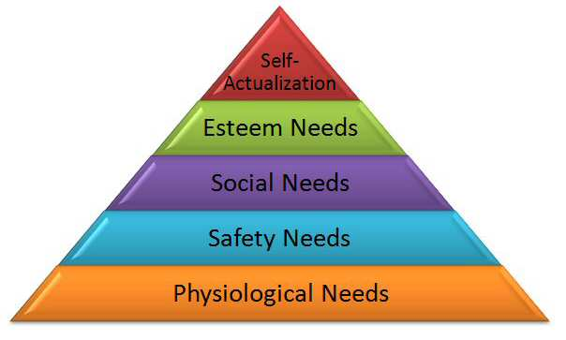
Nike uses Maslow’s Hierarchy of needs
HR managers for Nike Company ensure that their employees get acceptable basic pay, they are paid in time, and provided with a safe and comfortable working environment.
Adequate job security in the business environment. Create a non threatening working atmosphere.
Nike provides a healthy supportive culture, enjoyable atmosphere and sense of loyalty and belonging
Self-respect, usefulness and recognition from the company and colleagues.
Managers at Nike create an environment that facilitates the employees to achieve their self actualization
Notes:
The desire to satisfy the upper level of needs only develops after the lower order needs in the pyramid are satisfied.
This leadership style was introduced by Phil Knight, the former CEO and it is still being applied in the company.

Slide 15
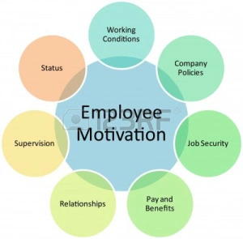
Nike Employee Motivation
Lush Headquarters
Onsite fitness center/ fitness discounts
Product discounts
Insurance
Retirement savings plan
Tuition assistance
Child care center
Notes:
The company performs a global workers survey after every two years to determine what engages and motivates their employees.

Slide 16
Nike’s “Free agent” HR model
Encourages new employees to begin interviewing around the company to make sure they are in the best job for them.
Often within first month of employment.
Nike is willing to endure the short-term pain of people moving around to get the long-term benefit of having motivated employees.
Notes:
Nike is sending a very clear message to their employees with this policy. “Don’t be afraid to venture out. We want you to find the perfect job for you. Even if it means that you’ll leave the job you just got into”
Nike realizes that it might take several moves within the company before the employee finds the right place for them. They know the best way for employees to get into the perfect job for them is to openly let them persue that. They are so commited to this concept that they are willing to endure the short-term pain of people moving around in order to get the the long-term benefit of having motivated employees.

Slide 17
Political Hurdle
It is critical to know what politics are involved in your company and the people who can change decisions and go counter to management’s decisions.
You need more than someone who can be a good financial officer, you need a strategic leader who can implement new strategies.

Slide 18
Political forces
Angels – those who have the most to gain from the strategic shift
Devils – those who have the most to lose from the strategic shift
Consigliere – a politically adept but highly respected insider who knows in advance all of the pitfalls and key people who will support management.

Slide 19
Secure a Consigliere on Your Top Management Team
Must have:
Experience in the company
Knowledge about the employees and their wants
Respected by the majority
See who will support or quietly try to destroy the new incentive.

Slide 20
Leverage your Angels and Silence your Devils
Know who will naturally align with your new blue ocean strategy.
Know who will have the most to lose and will fight the new strategy.
Try to get the majority on your side by being fast to implement and knowing what they will counter your attack with.
Be ready to use undisputable facts to support your plan and defend your stance.
Discourage the war before it starts

Slide 21
Nike needs a CEO that:
understands the management team and the direction that they want the company to go.
is respected in the footwear and apparel market
can move quickly to implement new strategies and build an alliance to support it

Slide 22
Challenging Conventional Wisdom
Conventional Wisdom – moving the mass, using steep resources and long time frames.
Few companies have this option
Tipping point leadership – transforming the extremes, the people, acts, and activities that have a disproportionate influence on performance.
Fast core change and low cost to implement new strategy
Align employees’ actions with the new strategy.

Slide 23
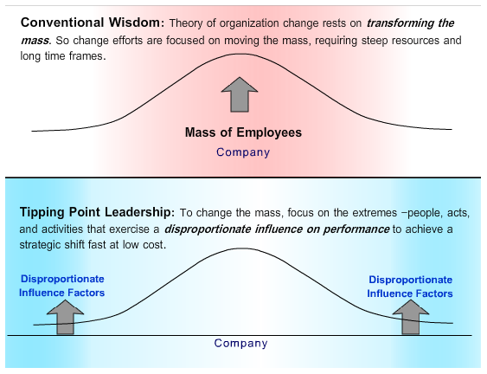

Slide 24
Conclusion
Four Hurdles
Cognitive Hurdle
Help employees see there is a need for change.
Resource Hurdle
Multiply the value of the current resources by using redirecting how and where resources are being used.
Motivational Hurdle
Help employees know what is coming and give them an incentive to see the strategy through.
Political Hurdle
Know who is going to fight with you and who will try to destroy the strategy before it starts.

