Slide 1
Creating Blue Oceans
Group 2: Michael Burns, Garrett Ellis, Matthew Goudie, Towns Garner, Monica Rael, William Peterson

Slide 2
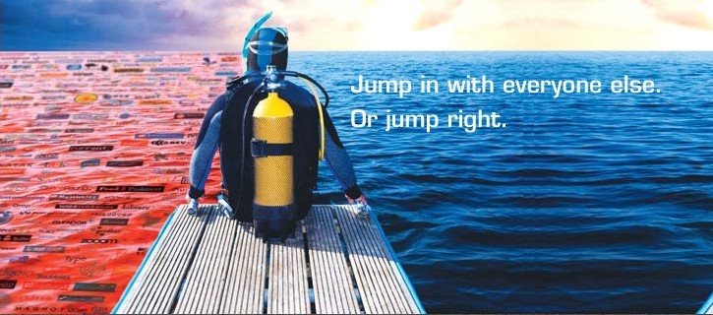
Intro
Red Oceans
Blue Oceans
Value Innovation
Cirque du Soleil
Formulating Strategy

Slide 3
Red Ocean
Represents “all the industries in existence today.”
The Known Market Space:
Industry boundaries are known and accepted
Competitive rules of the game are known
It's important for companies to grab a greater share of demand by outperforming their rivals.

Slide 4
What does the market space of a red ocean look like?
Many companies have a stake within the market,and produce the same kinds of products making it crowded.
Prospects for profit and growth are reduced
Products become commodities
Cut-throat competition turns the red ocean bloody
Most of strategic thinking is focused on Red oceans
Most strategic thinking is rooted in competition based ideals

Slide 5
Red Oceans: A Call to Change
WIthin these crowded market spaces supply is exceeding demand in more and more industries.
Competing for a share in these markets alone will no longer be enough to sustain high performance.
Companies need to be new and innovative to continue making an impact within their perspective markets
Some even need to go beyond competing to seize new profit and growth.

Slide 6
Blue Ocean
Denote all the industries not in existence today.
Unknown Market Space
Untapped market space
Demand creation
Opportunity for highly profitable growth
Most blue oceans are created from within red oceans by expanding the existing industry boundaries, although some are created well beyond the existing industry boundaries.
Competition is irrelevant for blue oceans because the rules of the game haven’t been set.

Slide 7
Creation of Blue Oceans
Blue oceans are a largely uncharted business model, therefore there is little practical guidance on how to create them.
Lacking an analytical framework and principles to effectively manage risk for the creation of blue oceans has left managers thinking that the creation would be too risky to pursue.

Slide 8
Continuing Creation of Blue Oceans
The term blue oceans may be new, but their existence is not.
Many of the industries we have today weren’t in existence in the past.
Cell phones
Automobiles
Music recordings
E-commerce
Coffee bars
Express delivery
Considering all the new industries that we have today, you can only imagine the industries that will be created in the future.

Slide 9
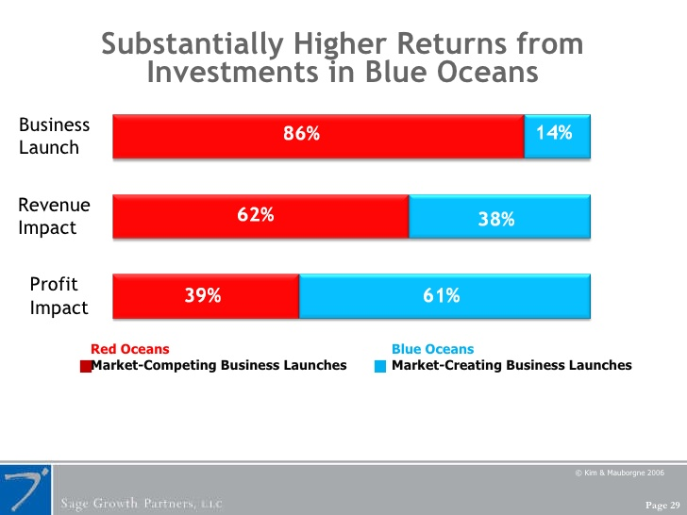
The Impact of Creating Blue Oceans

Slide 10
What does this mean?
Blue oceans makes up about ten percent of new companies. Though this is the case they bring in one third of revenues and two thirds of profits.
Given that business launches included the total investments made for creating red and blue oceans, the performance benefits of creating blue oceans are evident.

Slide 11
Increasing Importance of Creating Blue Oceans
In an increasing number of industries, supply exceeds demand.
This has lead to accelerated commoditization of products and services, increasing price wars, and shrinking profit margins.
Therefore, brands are becoming more similar, which has lead to consumers selecting products based on price.
Overcrowding of industries has caused differentiating brands harder as the economy experiences ups and downs.

Slide 12
Value Innovation
What separates winners and losers in creating blue oceans is their approach to strategy
Companies caught in the red ocean have a very conventional approach, simply racing to competition with the rest of the industry.
Creators of blue oceans don’t use their competition as their benchmark. They follow Value Innovation.
Value innovation is the cornerstone of blue ocean strategy: instead of focusing on beating the competition, you focus on making the competition irrelevant by creating a leap in value for buyers and your company, thereby opening up new market space.

Slide 13
Value Innovation Cont.
Value innovation places equal emphasis on value and innovation.
Value without innovation is just value creation. Something that improves value but is not sufficient enough to make you stand out in the marketplace.
Innovation without value ends to be technology driven, market pioneering, or shooting beyond what buyers are ready to accept.

Slide 14
Achieving Value innovation
Value innovation occurs when companies align innovation with utility, price and cost positions.
Value innovation is a new way of thinking about strategy, resulting in a creation of blue ocean and breaking away from competition.
It addresses the most commonly accepted dogmas of competition based strategy: the value-cost trade off.

Slide 15
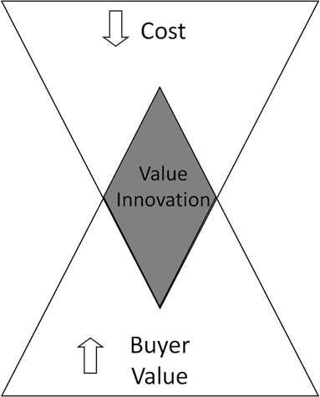

Slide 16
How Cirque du Soleil achieved value innovation
Traditional circus Live theatre
Animal acts (^C)
Circus stars (^C)
Tent
Aerobatics
Clowns
Storyline
Artistic music
Dance
Multiple productions
Cirque du Soleil
Tent (unique venues reminiscent of tent)
Aerobatics retained, and fuzed with the many aspects of the theatre
Clowns (sophisticated style)

Slide 17
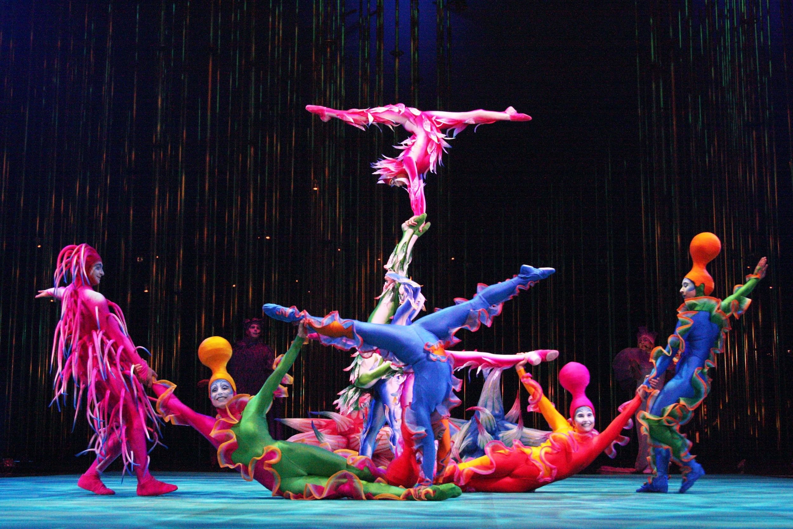
Cirque du Soleil
https://www.youtube.com/watch?v=x-1-gLv3aWs

Slide 18
Formulating and Executing Blue Ocean Strategy
Chapter 2: Introduces the analytical tools and frameworks that are essential for creating and capturing blue oceans.
Chapter 3: Identifies the paths by which you can systematically create market space across diverse industry domains.
Chapter 4: Shows how to design a company's strategic planning process to create value innovations.
Chapter 5: Shows how to minimize the size of the blue ocean
Chapter 6: Lays out the design of a strategy that allows you not only to provide a leap in value but also to build a viable business model
Chapters 7-10: Turn to the principles that drive effective execution of Blue Ocean Strategy.

Slide 20
Takeaways

