Slide 1
The Five Generic Competitive Strategies
Team 2: Michael Burns, Monica Rael, Mathew Goudie, Towns Garner, William Peterson, and Garrett

Slide 2
Competitive strategy:
Concerns the specifics of management’s game plan for competing successfully and securing a competitive advantage over rivals

Slide 3
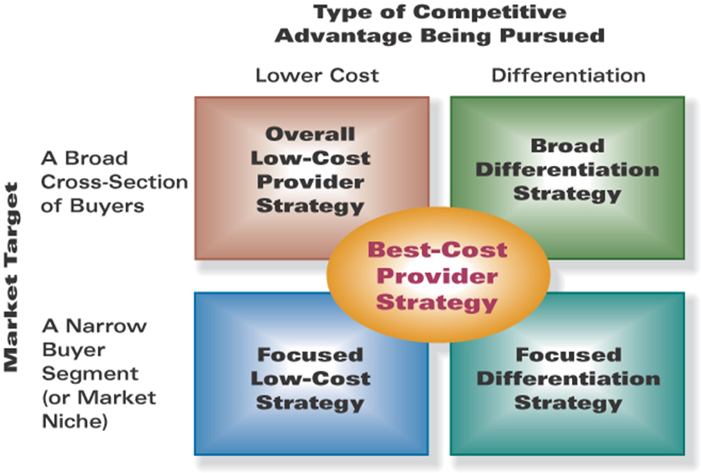
Introduction
Low-Cost Provider Strategy
Broad Differentiation Strategy
Focused Strategy Based Low Costs
Focused Differentiation Strategy
Best-Cost Provider

Slide 4
A Low-Cost Provider Strategy
Strive to be the industry’s overall low-cost provider
Need to be able to make difficult to imitate by other companies
If other companies can easily duplicate this then their advantage will be short lived
Does not have to be the lowest possible price
An absolute lowest price sometimes makes the product less attractive
Columbia competes on a low-cost strategy
Patagonia has a higher cost due to their going green movement

Slide 5
Two Options of Low-Cost
A company can use their lower cost to undermine their competitors which makes their product more attractive to price sensitive buyers and will ultimately increase profit
The other option is to keep the same prices but to use lower costs on inputs which means that the company will have a higher profit margin and increases the return on investment

Slide 6
Two Major Avenues for Achieving a Cost Advantage
Perform value chain activities more cost-effectively than rivals
Revamp the firm’s overall value chain to eliminate or bypass some cost-producing activities altogether

Slide 7
Cost Efficient Management of Value Chain Activities
In order to manage better than competitor’s companies can initiate some or all of the following:
Striving to capture all available economies of scale
Taking full advantage of experience/learning curve effects
Trying to operate facilities at full capacity
Improving supply chain efficiency
Adopting labor-saving operating methods

Slide 8
Revamping the Value Chain to Lower Cost
Through redesigning the company’s value chain system it can develop a large cost advantage.
Eliminating costly work steps
Bypass certain cost-producing value chain activities
Important revamping activities include:
Selling to direct customers and bypassing the activities and costs of distributors and dealers
Streamlining operations by eliminating low-value-added or unnecessary work steps and activities
Reducing materials handling and shipping costs by having suppliers locate their plants or warehouse close to the company’s own facilities

Slide 9
Keys to Success in Achieving Low-Cost Leadership
Practice frugality in most aspects of your business
Seldom hesitate to spend aggressively on resources that promise to drive costs out of the business
Purchasing these kinds of assets ensure that you stay superior to your competition
Essential in achieving a competitive advantage as a low-cost provider
Walmart is the most well known company that encapsulates this strategy
Has adopted state-of-the-art technology throughout its operations
Important to note; walmart carefully estimates the cost savings of new technologies before it rushes to invest in them

Slide 10
Patagonia vs Competitors Low-Cost strategies
Patagonia, along with North Face falls behind their competitors when it comes to a low cost strategy
Focuses more on the Environmental Differentiation strategy
Care more about making their customers think twice about the effect of their purchases on the environment
Gain followers by following through on their green initiatives
Columbia and Magellan Sportswear focus more on direct-to-consumer strategy
Saves them money by allowing them to be more flexible when it comes to cancellations
Gain their followers by having an easily accessible product for a reasonable price

Slide 11
Advantages of being a low cost provider
Price competition among rival sellers is vigorous
The products of rival sellers are essentially identical and readily available from many eager sellers
It is difficult to achieve product differentiation in ways that have value to buyers
Most buyers use the product in the same ways
Buyers incur low costs in switching their purchases from one seller to another

Slide 12
Pitfalls in pursuing a low-cost strategy
Biggest mistake is to get carried away with aggressive price cutting
Important to remember that higher unit sales and market shares do not automatically translate into higher profits
Relying on an approach to reduce costs that can be easily copied by rivals
If everyone can do it it won’t give you the edge you need to outdo them
Becoming too fixated on cost reduction
Risks losing market ground if buyers start opting for more upscale products

Slide 13
A Broad Differentiation Strategy
Differentiation strategies are intended to attract buyer’s whenever buyer’s needs and preferences are too diverse to be fully satisfied by a standardized product.
A differentiation strategy calls for a customer value proposition that is unique.
This strategy achieves its aim when an attractively large number of buyers find the customer value proposition appealing and become strongly attached to a company’s differentiated attributes.
Successful differentiation allows a firm to do one or more of the following
Command a premium price for its product.
Increase unit sales by acquiring more customers that are won over by the differentiating features.
Gain buyer loyalty to its brand by creating a differentiating strategy that buyers are strongly attracted to.

Slide 14
A Broad Differentiation Strategy (cont.)
Differentiation enhances profitability whenever a company’s product can command a higher price or produce larger unit sales that more that cover the added cost of achieving the differentiation.
Failed differentiation occurs when buyers don’t value the brand’s uniqueness sufficiently and/or the differentiation approach is easily matched by competitor’s.

Slide 15
Uniqueness Drivers: Keys to Creating a Differentiation Advantage
QUALITY CONTROL PROCESSES
PRODUCT FEATURES AND PERFORMANCE
CUSTOMER SERVICES
SALES & MARKETING
UNIQUENESS DRIVERS
PRODUCTION R&D
EMPLOYEE SKILL, TRAINING, EXPERIENCE
TECHNOLOGY AND INNOVATION
INPUT QUALITY
Notes:
UNIQUENESS DRIVERS:

Slide 16
Revamping the Value Chain to Increase Differentiation
Approaches to enhancing differentiation through changes in the value chain system include:
Coordinating with channel allies to enhance customer perceptions.
Coordinating with suppliers to better address customer needs.

Slide 17
Delivering Superior Value via a Broad Differentiation Strategy
Four basic routes to achieve a differentiating strategy that that is innovated and offers customer something that rivals can’t:
Incorporate product attributes and user features that lower the buyer’s overall cost of using the product
Incorporate tangible features that increase customer satisfaction with the product, such as product specifications, functions, and styling
Incorporate intangible features that enhance buyer satisfaction in noneconomic ways.
Signal the value of the company’s product offering to buyers.

Slide 18
When a differentiation strategy works best
When a buyer’s needs/uses of the product are diverse:
When there are many ways to differentiate the product or service and many buyers perceive these differences as having value:

Slide 19
When differentiation strategy works best
When few rival firms are following a similar differentiation path:
When technical change is fast-paced and competition revolves around rapidly evolving product features:

Slide 20
Pitfalls of a differentiation strategy
A differentiation strategy is always doomed when competitors are able to quickly copy most or all of the appealing product attributes a company comes up with.
attributes should be time-consuming/burdensome to imitate
The company's differentiation strategy produces a ho-hum market reception because buyers see little value in the unique attributes of the company's product.
The differentiated offering was unpopular

Slide 21
Pitfalls of a differentiation strategy
Over spending on efforts to differentiate the company’s product offering. Thus eroding profitability.
Try to keep differentiating costs below the premium the attributes can command to increase profit margins.
Or try to offset thin margins per unit by selling additional units and accumulating profit with high numbers of units sold.

Slide 22
Focused (Market Niche) Strategies
Focused Strategy Approaches
Focused Low Cost Strategy
Focused Market Niche Strategy

Slide 23
When should a Focused Low-Cost or Focused Differentiation Strategy be used?
When the target market niche is big enough to be profitable and to offer good growth potential
When industry leaders do not see that having a presence in the niche is crucial to their own success.
When it is costly or difficult for multi segment competitors to meet the needs of target market niche buyers .
When rivals have little or no interest in the target segment

Slide 24
Risks That Come With These Strategies
Competitors could find ways to match the firm’s capabilities in serving the target niche
The specialized preferences and needs of niche members to shift over time toward the product attributes desired by the majority of buyers.
As attractiveness of the segment increases, it draws in more competitors, intensifying rivalry and splintering segment profits.

Slide 25
A Best-Cost Provider Strategy
Best-cost provider strategies are a hybrid of low-cost provider and differentiation strategies that aim at providing desirable attributes (quality, features, performance, service) while beating rivals on price.
Make upscale products at a lower cost
Give customers more value for the money.

Slide 26
Competitive Strength of Best Cost Provider
A best cost provider’s competitive advantage comes from matching close competition on important product attributes, at a lower price.
Success depends on creating this competitive advantage.
The best-cost producer can beat out both a low-cost provider and a differentiator when:
Standard features won't meet needs of buyers
Buyers are sensitive on value and price.

Slide 27
Risks of Best-Cost Provider
Best -cost providers may get stuck between low cost and differentiation strategies.
Low cost providers may be able to steal customers away with the lowest price possible.
While High-end differentiators might be able to take customers with superior technology or attributes.

Slide 28
Takeaways
Each Generic Strategy:
Each Positions the firm differently in its market.
•Establishes a theme for how the firm intends to outcompete rivals on different basis.
•Sets boundaries and guidelines for strategy as the market changes.
•Has different ways of maintaining the basic strategy.

Slide 29
Citations
Thompson, A. A., Strickland, A. J., & Gamble, J. (2008). Crafting and executing strategy: The quest for competitive advantage: Concepts and cases. Boston: McGraw-Hill/Irwin.

