Slide 1
Evaluating a Company’s Resources, Capabilities, and Competitiveness
Group 5: Spirit Airlines
Samuel Johnson, Alexiz Green, Katy Nolen, Josh Caffey, Kelsey Blake, Lucie Morren

Slide 2
Introduction
While chapter 3 focused on external analysis, chapter 4 looks at what managers can do to evaluate their company’s internal situation.
Conducting a thorough internal analysis gives management an idea of if their strategy is providing any strategic competitive advantages over competitors.
The analysis is focused on answering the following 6 questions:

Slide 3
Introduction Continued
Questions 1: How well is the company’s present strategy working?
Question 2: What are the company’s competitively important resources and capabilities?
Question 3: What are the Company’s Strengths and Weaknesses in Relation to the Market Opportunities and External Threats?
Question 4: Are the company’s cost structure and customer value proposition competitive?
Question 5: Is the company competitively stronger or weaker than key rivals?
Question 6: What strategic issues and problems merit front-burner managerial attention?

Slide 4
Learning Objectives
How to assess how well a company’s strategy is working.
Grasp how a company’s resources and capabilities are central to its strategic approach and how to evaluate their potential for competitive advantages.
Assess a company’s strengths and weaknesses in light of the market.
How a company’s value chain affects their cost structure and customer value proposition.
Why internal analysis is important for managerial decision making.

Slide 5
Questions 1: How well is the company’s present strategy working?

Slide 6
3 Best Indicators of How Well a Strategy is Working
The company is reaching financial goals and strategic objectives.
Profit Margin, Debt-to-Asset Ratio, Days of Inventory
Their financial performance is above industry average.
Costs vs Competitors, Return on Asset, Stock Price
If they are gaining customers and market share.
Customer Acquisition and Retention, Company Image and Reputation

Slide 7
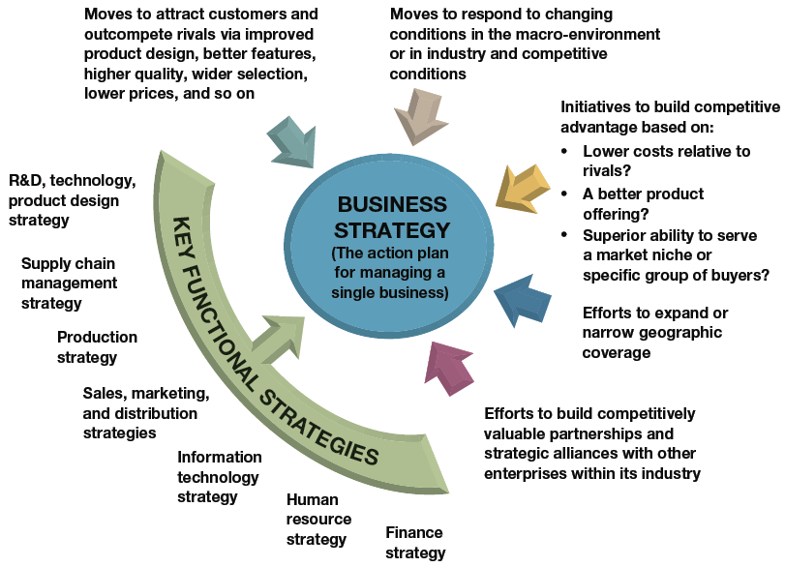

Slide 8
Spirit Airlines Company Strategy
“Our ultra low-cost carrier, or ULCC, business model allows us to compete principally by offering customers our Bare Fares. We then give customers Frill Control, which provides customers the freedom to save by paying only for the options they choose such as bags, advance seat assignments, and refreshments.”

Slide 9
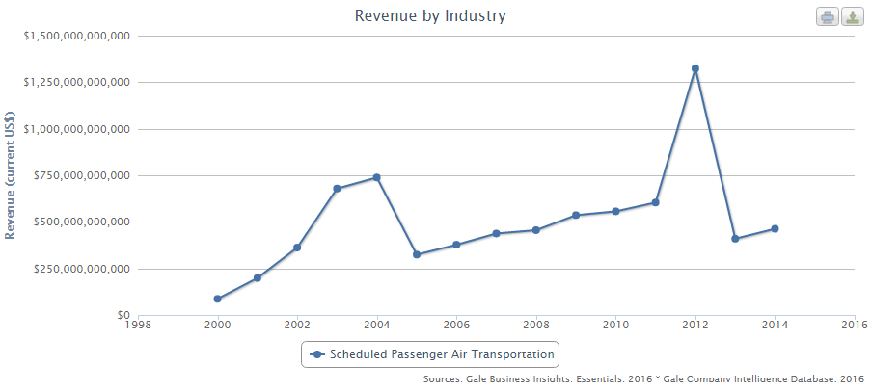
Industry Revenue

Slide 10
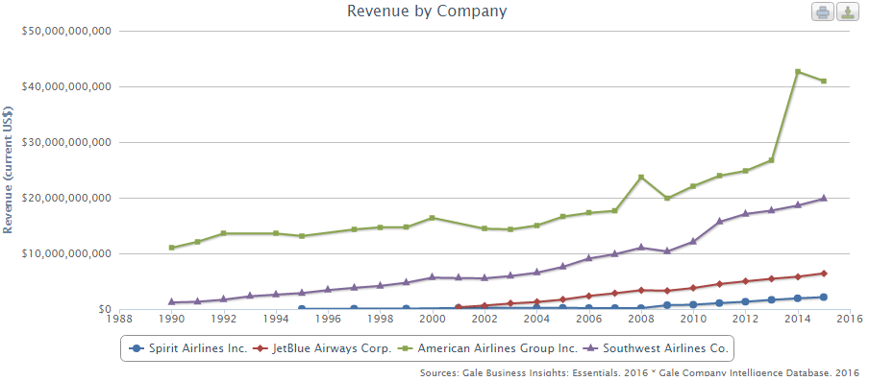
Revenue vs Competition

Slide 11
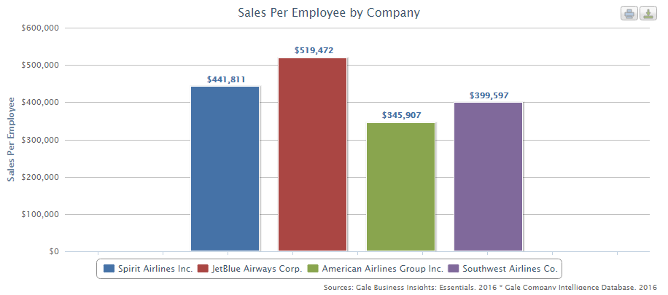
Sales Per Employee

Slide 12
Spirit’s Strategy Results
2015 was their 9th year of continuous growth.
23.8% profit margin; highest in company history.
Total traffic grew by 27.1%

Slide 13
Question 2: What are the company’s competitively important resources and capabilities?

Slide 14
Competitive Assets
A company’s resources and capabilities
Determine a company’s competitive power
Resource and Capability Analysis
Powerful tool used in determining competitive success
Two- Step process

Slide 15
Capability Capacity of a firm to perform a certain internal activity competently.
Resource A productive input that is owned or controlled by the firm.
Tangible
Intangible

Slide 16
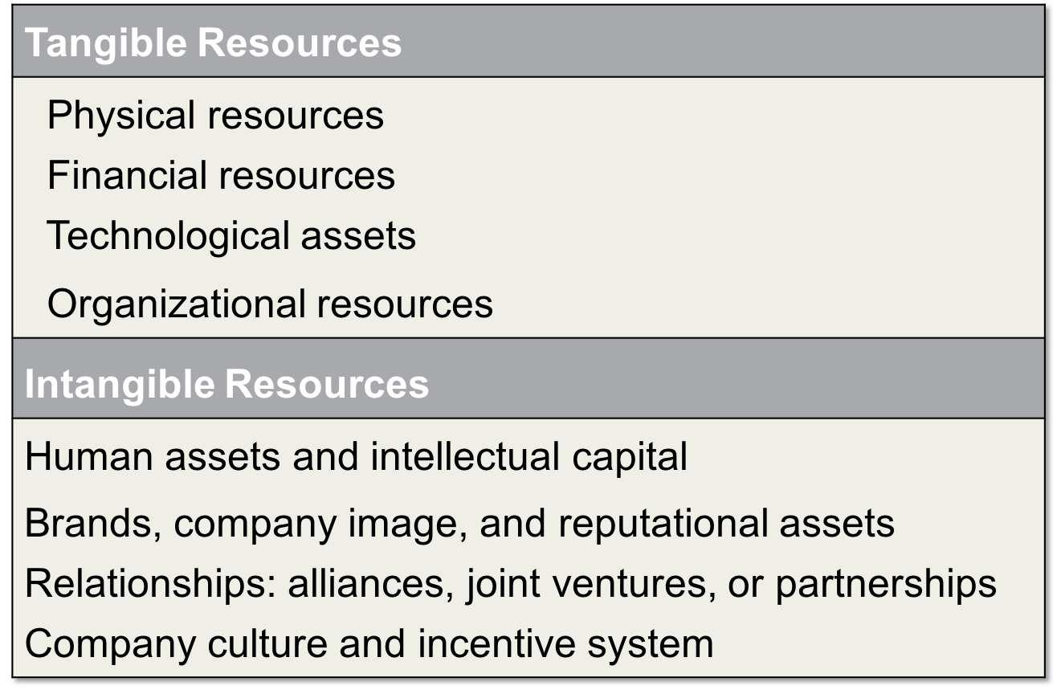

Slide 17
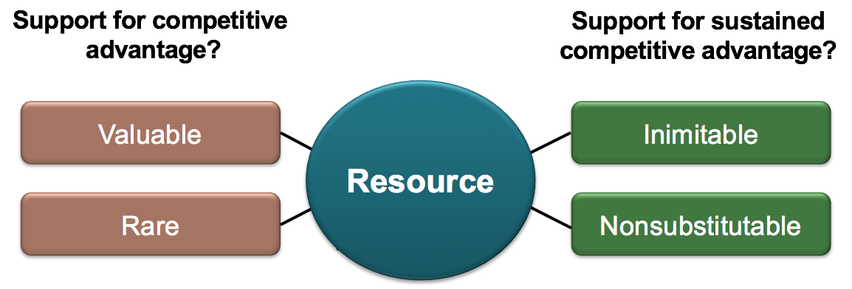
VRIN Tests for Competitive Advantage
Valuable- Is the resource or capability competitively valuable?
Rare- Is it something rivals lack?
Inimitable- Is it hard to copy?
Non-Substitutable- Is it invulnerable to the threat of substitutes?

Slide 18
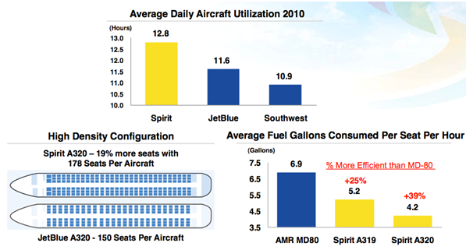
Spirit Airlines
Ultra Low Cost Carrier

Slide 19
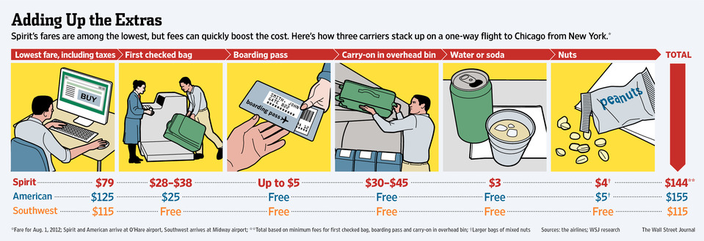

Slide 20
Question 3: What are the Company’s Strengths and Weaknesses in Relation to the Market Opportunities and External Threats?

Slide 21
Strengths
SWOT Analysis
Competence
Core Competence
Distinctive Competence
Weaknesses
Competitive deficiency/liability

Slide 22
SWOT Analysis cont.
Market Opportunities
External Threats
Moderate, imposing, “sudden-death”

Slide 23
Spirit Airlines SWOT Analysis
Strengths
Affordable
Brand recognition
Loyalty program
Higher seat capacity
Operates in US, Mexico, Caribbean, Latin America
Weaknesses
No entertainment/catering
Limited destinations
Extra fees (baggage, seating choice, etc.)

Slide 24
Spirit Airlines SWOT Analysis, cont.
Opportunities
Technological advancement (cheaper entertainment)
Growing popularity of low cost air travel
Threats
Low service quality leading to loss of customers
Fuel price increase
Outdated technology

Slide 25
Interpreting SWOT Analysis
Draw conclusions about current situation
Translate conclusions into strategic actions
Take action to improve strategy and business prospects

Slide 26
Question 4: Are the company’s cost structure and customer value proposition competitive?

Slide 27
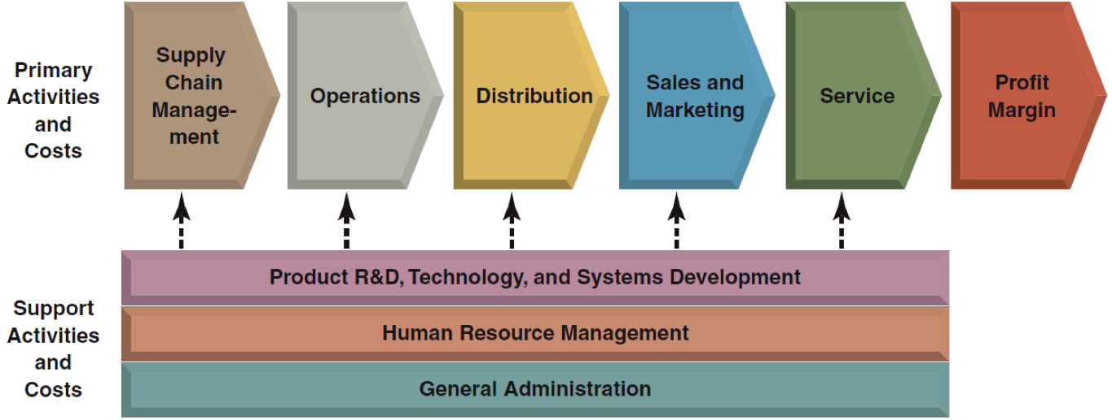
Value Chain
Spirit Airlines Value Chain
Operation- simple

Slide 28
Value Chain Analysis
Compares value chain of rival companies
Process of Value Chain Analysis

Slide 29
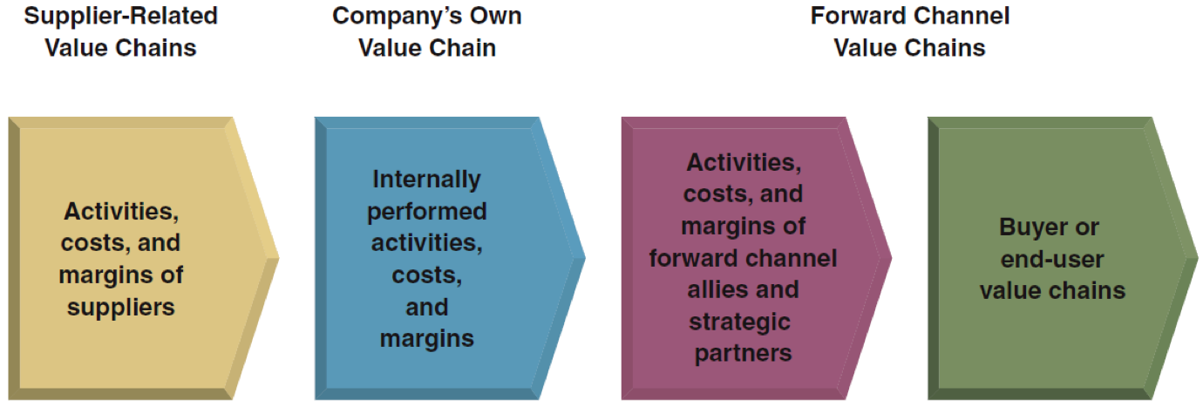
Value Chain System

Slide 30
Benchmarking
Identify the “best practices” in performing an activity
Evaluates those best practices

Slide 31
Remedy for Cost or Value Disadvantage
Company’s own internal activities
Implementing best practices
Suppliers part in overall value chain system
Switching to lower-price substitute inputs
Distribution of the value chain system
Switching to cheaper distribution channels

Slide 32
Question 5: Is the company competitively stronger or weaker than key rivals?

Slide 33
Company’s Overall Competitive Strength
How does the company rank relative to competitors on each of the important factors that determine market success?
All things considered, does the company have a net competitive advantage or disadvantage versus major competitors?
Notes:
-Two questions are of particular interest in determining company’s overall competitive strength
-Quantitative strength ratings are an easy-to-use method for answering the two questions above!

Slide 34
Quantitative Strength Ratings
Make a list of industry’s key success factors
Assign weights to each of the measures of competitive strength
Calculate weighted strength ratings
Sum the weighted strength ratings
Draw conclusions
Notes:
Maybe discuss some of where the information for quantitative strength ratings comes from
-Industry & competitive analysis - key success factors & competitive forces that separate industry winners form losers
-Benchmarking data & scouting key competitors - basis for judging the competitive strength of rivals on such factors as cost, key product attributes, customer service, image & reputation, financial strength, technological skills, distribution capability, & other factors
- Resource & capability analysis - which of these factors are competitively important, given the external situation, & whether company’s competitve advantages are sustainable
SWOT analysis - more comprehensive & forward-looking picture of company’s overall situation
Step 1: 6-10 measures usually suffice
-Include other telling measures of competitive strength or weakness
Step 2: Sum of weights for each measure must add up to 1.0
-Base these measures on their perceived importance
Step 3: Using a 1-10 rating scale (1 = very weak, 10 = very strong)
-Calculate ratings by scoring each competitor on each strength measure
Step 4
- Sum ratings on each factor to get an overall measure of competitive strength for each company being rated
Step 5
-Focus on size & extent of the company’s net competitive advantage or disadvantage & to take specific note of areas of strength & weakness
*Company should utilize the strength scores in deciding what strategic moves to make*

Slide 35
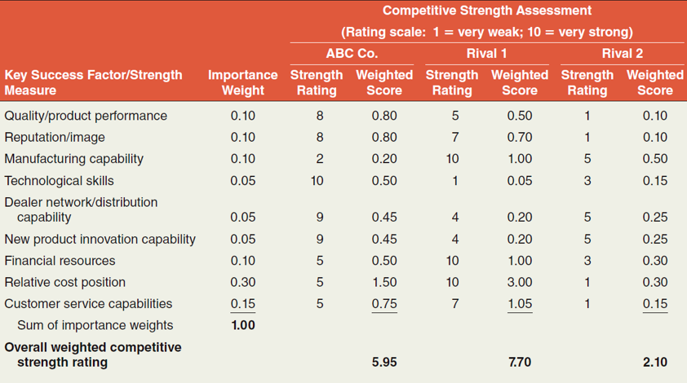
Competitive Strength Assessment

Slide 36
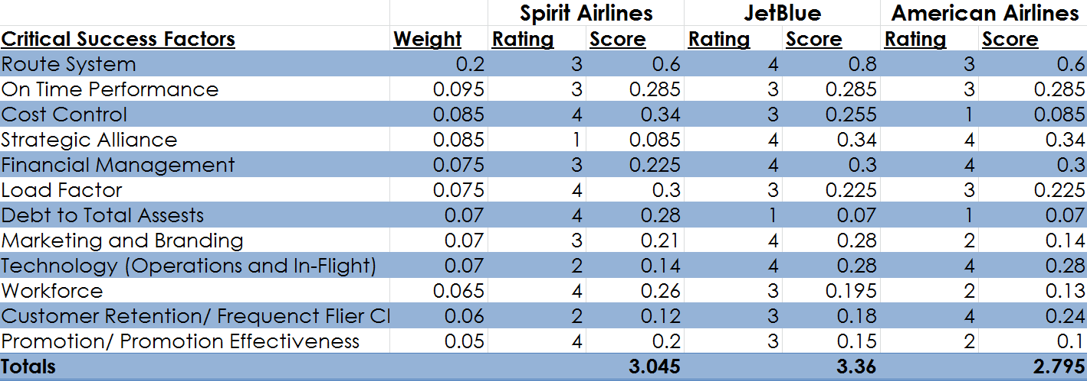
Competitive Strength Assessment-Spirit Airlines

Slide 37
Question 6: What strategic issues and problems merit front-burner managerial attention?

Slide 38
The “Worry List”
“How to…”
“What to do about…”
“Whether to…”
Purpose: Identify issues/problems that need management attention
Notes:
How to combat the price discounting of rivals
How to reduce the company’s high costs
Whether to correct the company’s deficiencies by acquiring a rival company with the missing strengths
Whether to expand into foreign markets
What to do about growing buyer interest in substitute products
-Purpose is not to figure out what specific actions to take!

Slide 39
Conclusion
How to assess how well a company’s strategy is working.
Grasp how a company’s resources and capabilities are central to its strategic approach and how to evaluate their potential for competitive advantages.
Assess a company’s strengths and weaknesses in light of the market.
How a company’s value chain affects their cost structure and customer value proposition.
Why internal analysis is important for managerial decision making.

Slide 40
Works Cited
http://bi.galegroup.com.lib-e2.lib.ttu.edu/essentials/comparisonTool/industry?u=txshracd2579&entities=481111&metric=revenue#tab=chart
http://bi.galegroup.com.lib-e2.lib.ttu.edu/essentials/comparisonTool/company?u=txshracd2579&entities=327223|962767|300316|308031&metric=revenue#tab=chart
http://files.shareholder.com/downloads/ABEA-5PAQQ9/2881052366x0x875726/6C03279F-ADF1-4C6E-93EB-A61657F574CF/SAVE-2015.12.31-10K_-_FINAL.PDF
http://marketrealist.com/2015/11/spirit-airlines-manage-low-cost-structure/

Slide 41
Work Cited Continued
https://frobertjacobs.wordpress.com/2012/05/12/spirit-airlinescost-reduction-leads-to-profitabilitiy/
http://blog.tripchi.com/seth-bailey/new-fleet-vs-old-fleet/
http://www.slideshare.net/MarissaPi/spirit-airlines-a-strategic-management-case-study
http://www.mbaskool.com/brandguide/airlines/9002-spirit-airlines.html

