Slide 1
Chapter 9: Ethics, Corporate Social Responsibility, Environmental Sustainability, and Strategy
Team 5: Alexiz Green, Josh Caffey, Lucie Morren, Kelsey Blake,
Sam Johnson, and Katy Nolen

Slide 2
Learning Objectives
Where do ethical standards come from - universal or dependent on local norms?
How and why ethical standards impact the tasks of crafting and executing strategy
Drivers of unethical strategies and business behavior
Why company strategies should be ethical
Corporate social responsibility
Environmental sustainability

Slide 3
Business Ethics
The application of ethical principles and standards to the actions and decisions of business organizations and the conduct of their personnel.
3 Schools of Thought:
Ethical Universalism
Ethical Relativism
Ethics and Integrative Social Contracts Theory

Slide 4
Ethical Universalism
The most fundamental conceptions of right and wrong are universal and transcend culture, society, and religion
Draws collective views of multiple societies and cultures to put boundaries on what constitutes ethical and unethical business behavior
Develop a Code of Ethics

Slide 5
Ethical Relativism
When there are cross-country or cross-cultural differences in ethical standards, it is appropriate for local ethical standards to take precedence over what the ethical standards may be in a company’s home market.
Challenges:
The use of underage labor
The payment of bribes and kickbacks
United Airlines bribery scandal
Problematic for multinational companies

Slide 6
Integrative Social Contracts
Integrative social contract theory
“First-order” and “Second-order”

Slide 7
Ethical Standards and Strategies
Code of Ethics
Ethics Code Litmus Test
5 tests to perform
Honesty
Legal
Conscience
Consequences
Publicity

Slide 9
Spirit Airlines Code of Ethics
Compliance with Laws and Regulations
Fair Dealing

Slide 10
Drivers of Unethical Strategies & Business Behavior
Faulty oversight, enabling the pursuit of personal gain & self-interest
Self-dealing
Heavy pressure to meet or beat short-term performance targets
Short-termism
Company culture that puts profitability & business performance ahead of ethical behavior

Slide 11
Why Should Company Strategies Be Ethical?
The 2 main reasons a company’s strategy should be ethical:
Unethical strategies are morally wrong and will reflect badly on the company.
Ethical strategies can be good business and serve the self-interest of the shareholders.

Slide 12
Moral Case for Ethical Strategy
Begins with managers who have strong moral character.
Demonstrate their commitment to the company’s values, business principles, and conduct.
Understand that there is a huge difference between words and actions when ethical standards are involved.

Slide 13
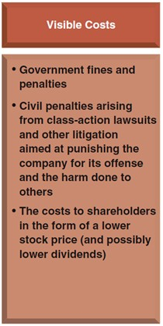
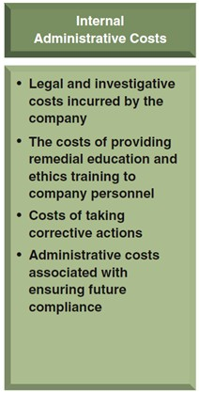
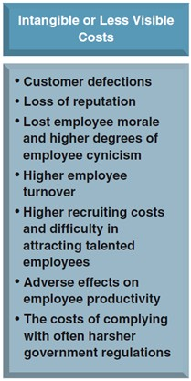

Slide 14
Spirit Airlines Ethical Strategy
Chicago Booth Review:
“Confiding in friends that you will soon be flying Spirit Airlines tends to elicit the same response as if you had just confessed to putting your parents in a home.”

Slide 15
Public Perception of Spirit Airlines
Skytrax downgraded them to 2 stars in 2013; the lowest of any carrier in the nation.
Passengers were 3 times more likely to complain from 2009-13.
In Fall of 2014, online Time poll finds passengers would rather fly with snakes than Spirit.

Slide 16
Defenders of Spirit
Defenders of Spirit say that the complaints stem from customers not understanding the “Ultra Low Cost” carrier business model and what that entails.
Spirit CEO Ben Baldanza on the issue:
“The reason that people are so shocked about the carry-on bag right now is that they just don’t get it. They are just outraged that, ‘I used to get this for free and now have to pay for it.’”

Slide 17
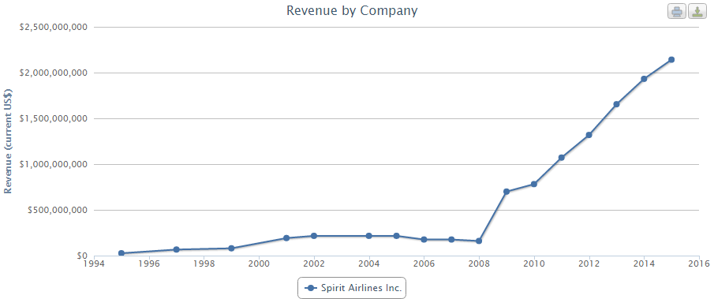
Where is the consequence?

Slide 18
Corporate Social Responsibility (CSR)
Obligation to foster social betterment
Balance shareholders’ expectations with concerns of other company stakeholders
Social conscience

Slide 19
Corporate Social Responsibility (CSR) Strategy
Particular set of socially responsible endeavors
Typically linked to company’s core values
5 components

Slide 20
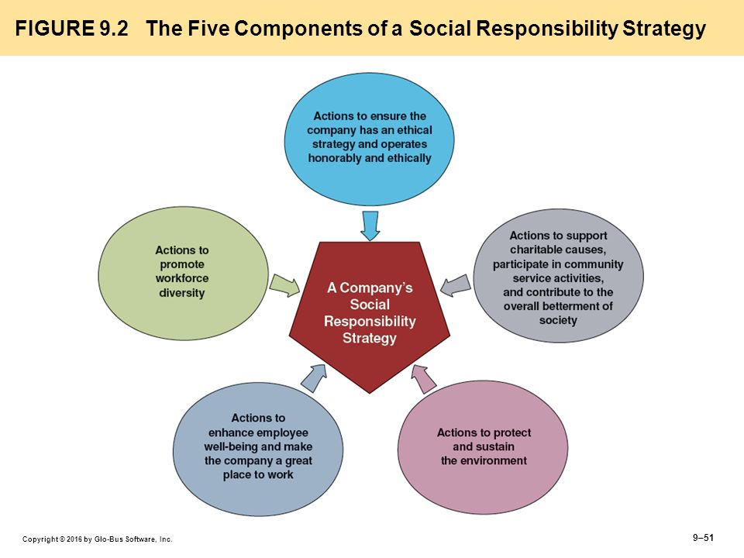

Slide 21
Triple Bottom Line (TBL)
Economic
Profit
Social
People
Environmental
Planet

Slide 22
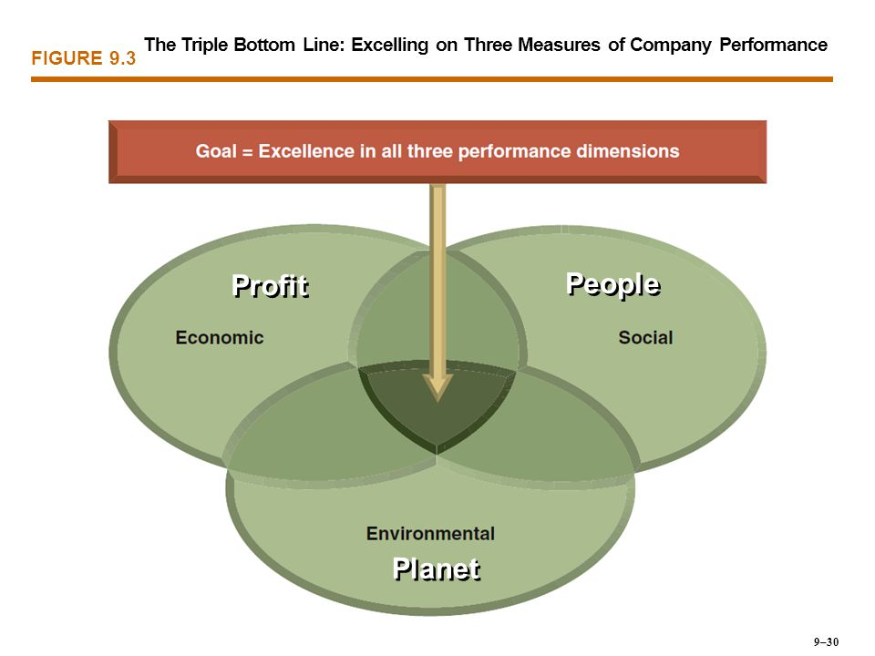

Slide 23
Environmental Sustainability
Sustainability-
The relationship of a company to its environment and its use of natural resources
Sustainable Business Practices-
Practices capable of meeting the needs of the present without compromising the ability to meet the needs of the future.

Slide 24
Environmental Sustainability Strategy
A company’s deliberate actions to...
Protect the Environment
Provide for the longevity of natural resources
Maintain ecological support systems for future generations
Guard against ultimate endangerment of the planet

Slide 25
Southwest Airlines Sustainability
“At Southwest Airlines, we are committed to conservation and mitigation of our environmental impacts. With efficiency as a core element of our business and climate change strategies, we strive to minimize our impact on the environment while remaining true to our triple bottom line of Performance, People, and Planet.”
Biofuel
Jet Fuel Efficency
Greenhouse Gas Emissions
Ground Support Equipment
LUV Seat
Waste Management

Slide 26
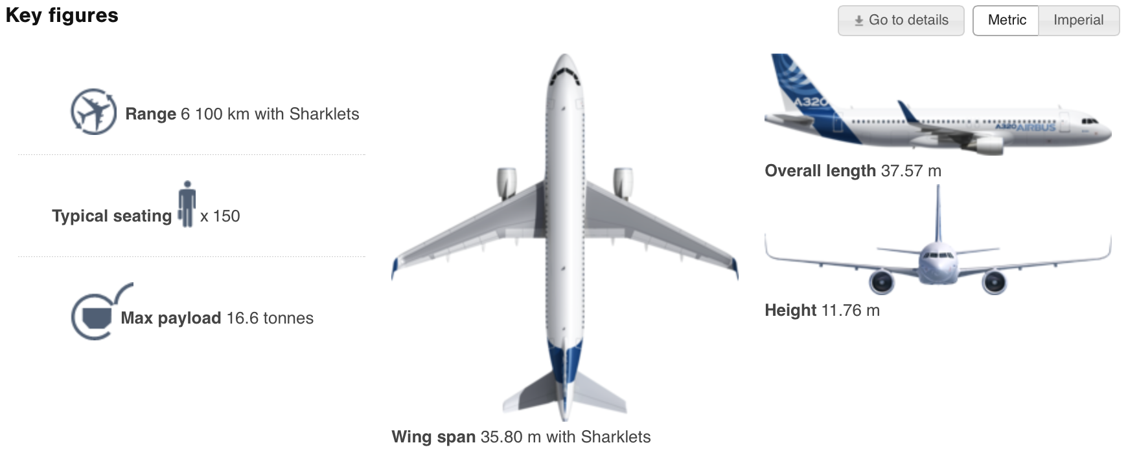
Airbus A320NEO

Slide 27
Work Cited
https://www.southwest.com/html/southwest-difference/southwest-citizenship/environmental-initiatives/
https://www.washingtonpost.com/business/economy/former-chris-christie-ally-pleads-guilty-in-bribery-case-involving-united-flight/2016/07/15/8cfbe14a-49e7-11e6-acbc-4d4870a079da_story.html
https://www.ncconsumer.org/news-articles/class-action-lawsuit-brought-against-spirit-airlines-for-deceiving-customers.html
http://www.airbus.com/aircraftfamilies/passengeraircraft/a320family/a320/specifications/
http://www.classaction.org/spirit-airlines
http://review.chicagobooth.edu/magazine/summer-2015/why-spirit-airlines-is-so-terrible

