Slide 1
Summary of Lessons Learned: Part 2
Kathleen Armitage, Megan Vandenburg, Jordan Horton, Ashley Reyna, Ryan Trottier, Hannes Ronneblad

Slide 2
The Five Generic Competitive Strategies
A low-cost provider strategy
A broad differentiation strategy
A focused low-cost strategy
A focused differentiation strategy
A best-cost provider strategy

Slide 3
Broad Market v. Narrow Market
and
Lower Cost v. Differentiation

Slide 4
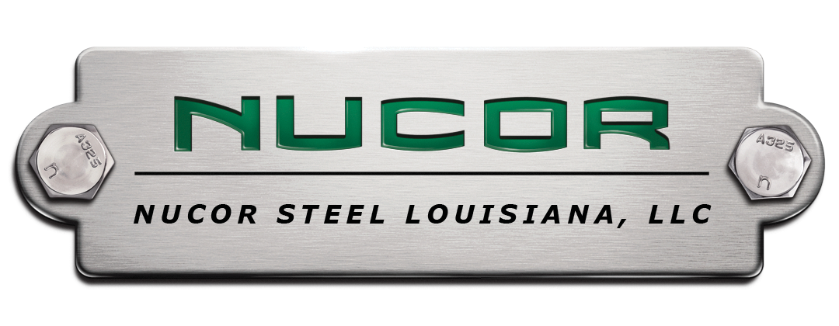
Low-Cost Provider
Two Avenues to Gain Cost Advantage
Execute value chain more cost effectively than competitors
Cut out any costly activities in the value chain

Slide 5
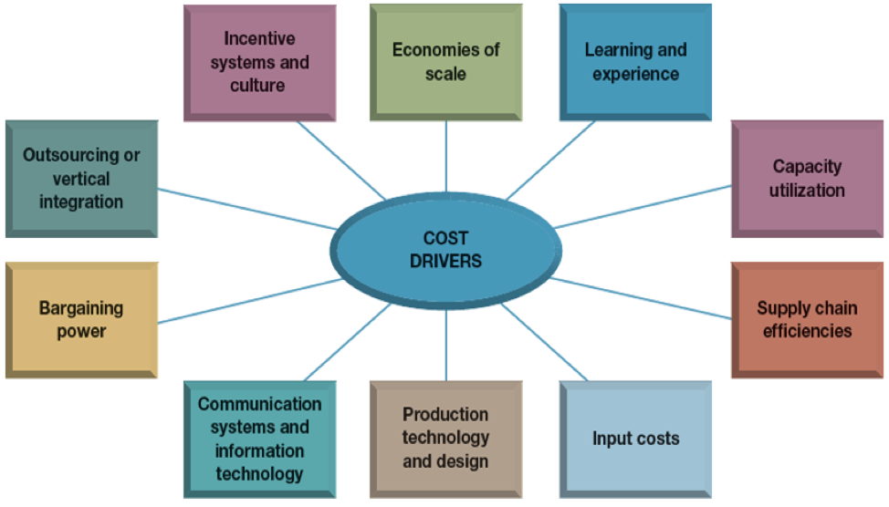

Slide 6
Broad Differentiation
What do buyers think is important and valuable?
What are they willing to pay for?
Differentiation can be achieved by:
Unique taste
Multiple features
Outstanding service
Technological leadership

Slide 7
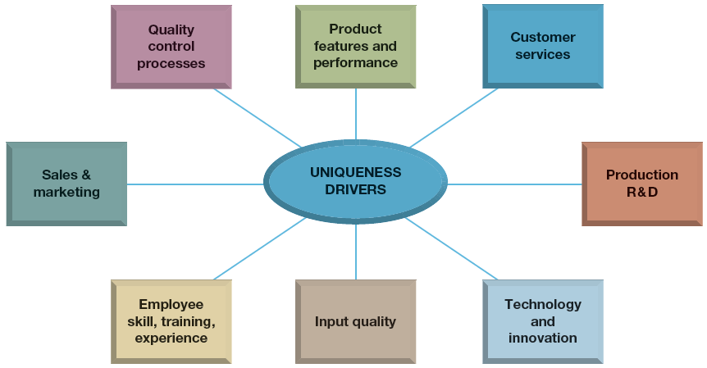

Slide 8
Focused Low-Cost & Focused Differentiation
Low-Cost
Limits customer base
Common
Able to lower cost to please smaller population of people
Focused Differentiation
Seeks to address needs of small, unique group of customers
Target market must be big enough to reach a profit
Notes:
Focused on narrow piece of market, niche

Slide 9
Best Cost Provider
Provides a lower cost for desirable or valuable goods and services.
“Middle ground”
Not the lowest cost or the highest value

Slide 10
Strategic Offense
•A strategic offense should exploit the power of a company’s strongest competitive asset
•There are seven principal offensive strategy options
–Offering an equally good or better product at a lower price
–Leapfrogging competitors by being the first to market with next-generation products
–Pursuing continuous product innovation to draw sales and market share away from less innovative rivals
–Pursuing disruptive product innovations to create new markets
–Adopting and improving on the good ideas of other companies
–Using hit-and-run or guerrilla warface tactics to grab market share from complacent or distracted rivals
–Launching a preemptive strike to secure an industry’s limited resources or capture a rare opportunity
Notes:
Companies in the athletic gear industry are at each others throats in the competitive market. Innovation is the key in this industry; wearable technology is the hot topic in competition right now.

Slide 11
Choosing which Rivals to Attack
•There are four targets for offensive attacks
–Market leaders that are vulnerable
–Runner-up firms with weaknesses in areas where the challenger is strong
–Struggling enterprises that are on the verge of going under
–Small local and regional firms with limited capabilities

Slide 12
First-Mover or Last-Mover
•First-Movers are the market pioneers
–They are the companies that spend more in development and take on the most risk because they are the first to put a new product on the market.
•Last-Movers are followers
–These are the companies that wait for the First-Movers to do all the heavy lifting and then they copy them; they try to improve on the ground work laid out by the First-Movers

Slide 13
Scope of the Firm
•The scope of the firm is the focus on what the company will preform internally and externally.
•The firm needs to decide if it wants to produce goods within its own factories, if it wants to outsource production, or if it wants to acquire another company that already does what they want to do.
–Horizontal acquisition, Vertical acquisition, Outsourcing, Etc.

Slide 14
Benefits of an Alliance or Partnership
•Picking a good partner
•Being sensitive to cultural differences
•Recognizing that the alliance must benefit both sides
•Ensuring that both parties live up to their commitments
•Structuring the decision-making process so that actions can be taken swiftly
•Managing the learning process and making adjustments as needed

Slide 15
BOS Chapter 4: Focus on the big picture, not the numbers
4 steps of visualizing strategy
Visual Awakening
See where your strategy needs to change
Visual Exploration
Observe distinctive advantages of alternatives products and services
Visual Strategy Fair
Use feedback from “to be” strategy canvas to develop future strategy
Visual Communication
Communicate before-and-after strategic profiles to compare

Slide 16
Pioneer-Migrator-Settler Map
Pioneers
Strategist
Settler
Settle for status quo
Migrator
Offer some improvement

Slide 17
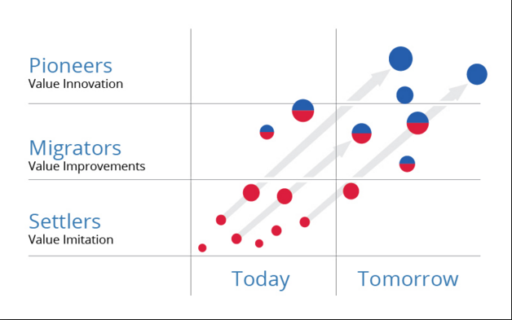
PMS MAP

Slide 18
BOS Chapter 5: Reach Beyond Existing Demand
Shift focus from:
Existing customers
Finer segmentation
Customer differences
To:
Noncustomers
Desegmentation
Customer commonalities

Slide 19
Three Tiers of Noncustomers
First tier:
“Soon-to-be”
Second tier:
“Refusing”
Third tier:
“Unexplored”
Your market

Slide 20
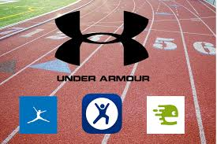
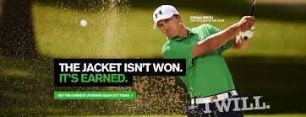
How Under Armour Addressed Tiers
Under Armour explored third-tier noncustomers by entering into the technology industry with apps like My Fitness Pal and Map My Run.
Under Armour subtly entered the golf world and turned second-tier “refusing” noncustomers into loyal customers.

Slide 21
CES: Chapter 6- Strengthening a Company’s Position
“Strategic offensives should exploit the power of a company’s strongest competitive assets”
There are six principal options for an offensive strategy
Offering an equally good or better product at a lower price
Leapfrogging competitors

Slide 22
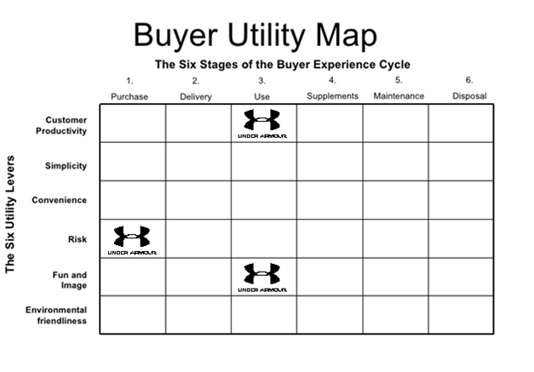
BOS: Chapter 6: Get the Strategic Sequence Right
Notes:
The buyer utility map helps to get managers thinking from a demand-side perspective. It outlines all the levers companies can pull to deliver exceptional utility to buyers as well as the various experiences buyers can have with a product or service. This mindset helps managers identify the full range of utility spaces that a product or service can potentially fill. It has two dimensions: The Buyer Experience Cycle (BEC) and the Utility levers.
The most commonly used lever is that of customer productivity, in which an offering helps a customer do things faster or better. For Under Armour the customer productivity shows up under the “use” category, since their mission is to Make all athletes better.
One of Under Armour’s brand values is reliability, which reduces the risk of buying their products for the customers.
Under Armour want to tell a great story, and they want people to associate them with hard work, motivation and a sense of enjoying whatever challenge stands in front of you, which makes the use of their products a fun thing for the customers.

Slide 23
Notes:
I guess Under Armour is positioned as a “same form” product type since the apparel market cannot differentiate their products too much from each other, OR they can be positioned as a “different form, same function” company since they are trying to be innovative with their materials of their products, etc.
The price range of Under Armour is actually wide, the prices can go from low to high. But I would still say that their pricing is mid-level because athletic apparel is quite simple to imitate and the use of patents are not very efficient in this type of market, in fact Under Armour does not hold any fabric or process patents, and hence its product portfolio could be copied by “free riders” in the future., but the resource protection in this case comes from strong brand recognition and quality of their products which makes it possible for Under Armour to position most of their products above low-cost providers.

Slide 24
Target Costing
Streamlining – reducing high-cost, low-value added activities in your value chain.
Partnering - Expertise and economies of scale - Low-cost advantage
Changing the price model of the industry - ex. NetJets
Notes:
Streamlining – reducing high-cost, low-value added activities in your value chain.
Partnering - Expertise and economies of scale
- Low-cost advantage
Under Armour mostly use partnering in their target costing, in order to get the expertise they are looking for to better serve their customers.
Ex. Under Armour has a strategic partnership with IBM to use IBM Watson's cognitive computing technology to provide meaningful data from its IOT kit and UA Record app (which is their health and fitness system).
Another example of one of their partnerships is the NBA FIT App combines the best of Under Armour Connected Fitness and the NBA’s resources into a single mobile experience. It is the only fitness app on the market to feature training videos and tips from NBA and WNBA players as well as strength and conditioning coaches.

Slide 25
CES Ch 7: Strategies for Competing in Foreign Markets
Why do companies enter foreign markets?
Gain access to new customers
To achieve lower costs through economies of scale, experience, and increased purchasing power.
To spread business risk across a wider market base

Slide 26
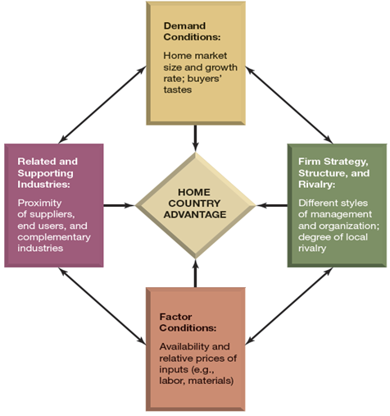
Porter's Diamond of Competitive Advantage
Home Country Advantage
Demand Conditions
Factor Conditions
Related and Supporting Industries
Firm Strategy, Structure, and Rivalry

Slide 27
THE 5 STRATEGIC OPTIONS FOR ENTERING FOREIGN MARKETS
Exports
Licensing
Franchising
Establishing a foreign subsidiary
Alliance & Joint Ventures

Slide 28
Advantages
Exports
Limited involvement in foreign markets
Licensing/Franchising
Avoid risk of foreign markets that are economically unstable
Foreign Subsidiary
High level of control and avoid entry barriers
Alliance & Joint Ventures
Benefit greatly from a foreign partner’s familiarity with local market conditions and government regulations

Slide 29
Disadvantages
Exports
Tariffs or other trade barriers
Licensing/Franchising
Loss of operational and quality control
Foreign Subsidiary
High acquisition cost as well as complexity of the acquisition process
Alliance & Joint Ventures
Differences in corporate values and ethical standards.

Slide 30
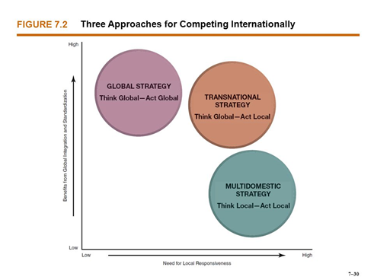
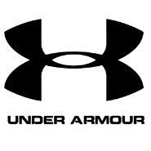
Three Approaches for Competing Internationally
Multidomestic Strategy
Global Strategy
Transnational Strategy

Slide 31
Citations
http://www.businessinsider.com/how-under-armour-plans-to-do-something-nike-failed-to-do-conquer-the-golf-world-2016-3
http://www.baltimoresun.com/business/under-armour-blog/bs-bz-under-armour-fitness-technology-20150207-story.html
http://www.nytimes.com/2015/06/15/business/media/under-armour-is-swinging-for-the-stars.html?_r=0

