Slide 1
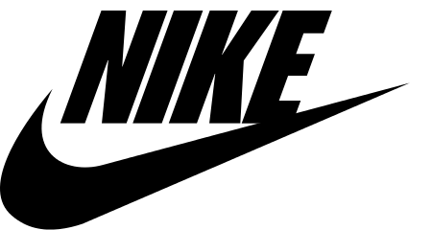
Chapter 6: Strengthening a Company’s Competitive Position
Group 4: Hunter Tarman, Kate Penshorn, Gabi Reid, Omar Winters, Ryan Reid

Slide 2
Know Your Competitive Assets
Brand Awareness
Production/Distribution Systems
Technological Capacity
Customer Satisfaction

Slide 3
Offensive
Consider your strengths and their weakness
Pick up signals of vulnerability and limited capabilities
Know which rivals to challenge and how to challenge them

Slide 4
Methods of Offensive Strategy
Cost effective value
Leapfrogging
Adopt and improve
Guerrilla warfare
Preemptive strike

Slide 5
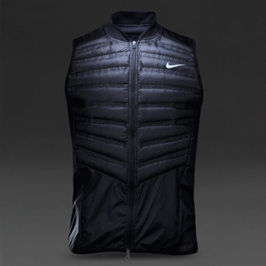
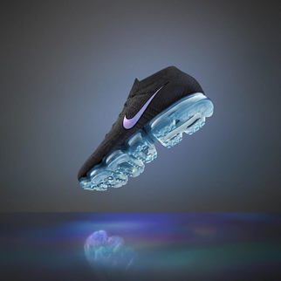
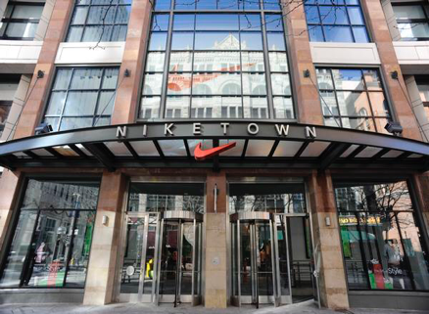
NIKE Offense
High Brand Recognition
NIKE Running Store
NIKETOWN
Strong Outsourcing Alliances
Adaptive to new consumer preferences
NIKE Aeroloft 800 Vest
NIKE Air VaporMax Flyknit

Slide 6
Creating Defensive Barriers
Signal Retaliation
Public announcements of commitment
Maintaining a cash reserve
Occasional counter to petty attack attempts
Block Channels
Close gaps with vacant niches
Discourage Brand experimentation
Grant volume discounts to distributors

Slide 7
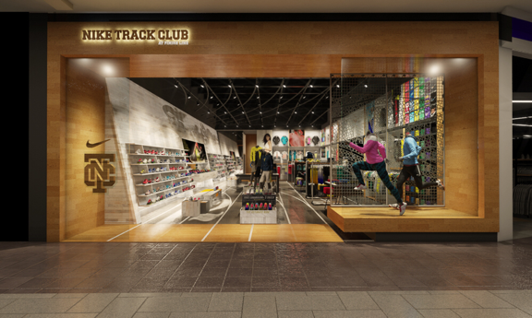
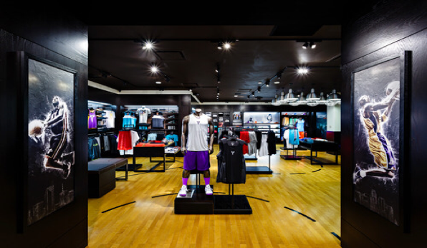
NIKE Defense
Retail Partnerships
Foot Locker
Finish Line
NIKE Loyalty
NIKE+
NIKE DTC Approach
Warehouse stores
"House of Hoops"
Online sales

Slide 8
Timing a Company’s Offensive and Defensive Strategic Moves
Advantage or Disadvantage
Depends on...
WHEN a move is made
WHAT move is made

Slide 9
Advantages for First Mover:
Reputation and Strong Brand Loyalty
Switching Costs
Property Rights
Learning Curve
Set the Technical Standard for the Industry

Slide 10
Advantages for Late Mover:
Lower Costs
Better-Performing Products
Leapfrog
Certainty

Slide 11
So should your company be a first mover or not?
Does market depend on the development of complementary products, or services that are currently not available?
Is a new infrastructure required before buyer demand can surge?
Will buyers adjust to new skills or adopt new behaviors?
Will buyers face high switching costs in the new products or services?
Are there other competitors that might delay or derail the efforts of a first mover?

Slide 12
Strengthening a Company’s Market Position through it’s Scope of Operations
Horizontal Scope - a range of product and service segments that the firm serves within its product or service market.
Vertical Scope – industry’s entire calue chain system, from initial activities such as raw-material production to retailing and after-sale service activities.

Slide 13
Horizontal Scope
Mergers and acquisitions – this expands the same product of service line the company is already competing in.
Example: Nike Buying Hurley
Create a more cost efficient operation out of the combined companies. Ex. Hurley being produced by Nike manufactures.
Expanding a company’s geographic coverage. Ex. Hurley is now carried at Nike.com and more places around the world.
Extending into new product categories. Ex. Nike going into more lifestyle clothing.
Gaining quick access to new technologies or other resources Ex. Hurley now has more R&D and customer information.
Lending the convergence of industries due to changes in technology and new market opportunities. Ex. Nike saw they they could interest non customers who do not like the sporty style.

Slide 14
Pros to Mergers and Acquisitions
Improve operating efficiency
Product differentiation
Reducing market rivalry - buying market rivals
Increasing the bargaining power over suppliers and buyers – more sales volume

Slide 15
Cons to Mergers and Acquisitions
Cost savings often are smaller than expected
Corporate cultures and clash against each other
Key employees often leave
Ex. Nike bought Umbro soccer gear but never saw any gains into the soccer market.

Slide 16
Vertical Scope
Add technological capabliities
Strengthen firm’s competitive position
Boost profitability

Slide 17
Achieving Vertical Integration
Backward integration – to manufacture instead of purchasing from suppliers.
Must beat suppliers efficacy and keep the quality
Forward integration – to sell to consumers directly
Can help drive profits but can hurt retail connections

Slide 18
Cons to Vertical Integration
Raises the Capital investment, which raises risk
Buying manufacturing plants, opening company specific company stores, hiring more labor
Reduces Flexibility in accommodating shifting buyer preferences
Company might have to close full departments and fire employees in product lines

Slide 19
Outsourcing
The act of obtaining goods or services from an outside or foreign supplier in place of obtaining the goods or services in house.

Slide 20
Nike “Just does it”
Largest supplier of athletic shoes in the world.
Outsourcing is what has made Nike into the billion dollar industry that is is today.
Currently outsourcing to multiple countries including: China, Indonesia, Vietnam, Taiwan, South Korea, and the Philippines.
Half a million people throughout the world have been hired to help produce their products.

Slide 21
Nike outsourcing continued
**They outsource one ninety nine percent of their shoes production**
Manufactures only key technical components of its “Nike Air” system.
Nike creates maximum value by focusing on preproduction and Postproduction activities.
Nike even outsources their advertising component! (Wieden & Kennedy)

Slide 22
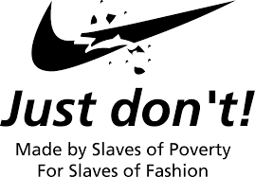
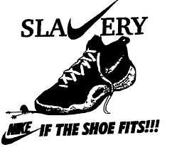
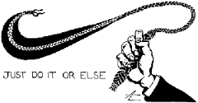
Sweatshop Problem
History
1970: Began outsourcing to S. Korea
1991: Large public outcry for Labor Abuses
1998: Nike steps up to fix the problem
2011: Nike company still feels the backlash by not fixing their mistake earlier.

Slide 23
Disadvantages/Risks
Unsafe and abusive labor practices
Effects on U.S. Economy and Job loss
Lack of Customer Focus
Loss of Managerial Control
Threat to security and confidentiality
Quality Problems

Slide 24
Outsourcing is not what is used to be..
This trend began in the 1980’s is not paying off the way it did back in those days.
The competition for the worker’s skills is increasing so wages are higher.
Wages in China and india have been going up by 10-20% a year for the past decade.
Compensation for Senior Chinese managers now either matches or exceeds pay in America and Europe.

Slide 25
Advantages of Outsourcing
Cut costs
Employ workers for less, cheaper plant operations.
Increases Competitiveness
With the saved money they can price their products competitively
Finances and Risk reduction
Nike can bypass some of the taxes they would pay in the U.S.
When using subcontractors, Nike has less risk with insurance liabilities.

Slide 26
Alliances and Partnerships
Strategic alliance – formal agreement between two companies that work to toward a strategically relevant objective.
Joint venture – a new corporate entity that is owned by two companies and share in profits and expenses.

Slide 27
Strategic Alliances
Helps companies share information and innovative developments
Need good partners
Both sides must benefit
Sensitive to other companies cultural differences

Slide 28
Drawback to Strategic Alliances
Partner could get proprietary information
Could become dependent on other companies
Companies can be a poor fit to combine resources for innovation

Slide 29
How to make a Strategic Alliances Work
Create a system to manage alliances
Build relationships and establish trust
Protect from the threat of opportunism by setting up safeguards
Make commitments to partners and demand commitments from them as well

