Slide 1
Chapter 5: Reach Beyond Existing Demand
Group 5: Sam Johnson, Kelsey Blake, Katy Nolen, Alexiz Green, Lucie Morren, Josh Caffey

Slide 2
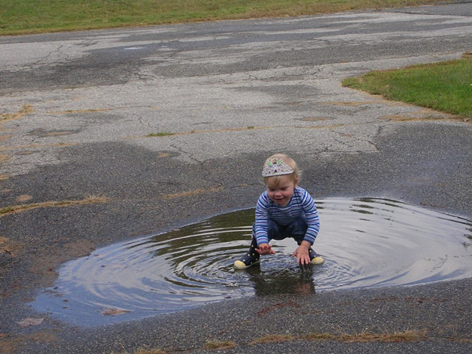
Introduction
How do you maximize the size of the blue ocean you are creating?

Slide 3
Reach Beyond Existing Demand
Companies must challenge two conventional strategies
The focus on existing customers
The drive for finer segmentation that accommodates buyer differences
These strategies risk creating target markets that are too small

Slide 4
Reaching Beyond Existing Demand Cont.
Instead of focusing on current customers… Focus on noncustomers
Instead of focusing on differences… Focus on commonalities
Shifting this focus creates NEW CUSTOMERS that did not exist before

Slide 5
Spirit Airlines Blue Ocean
Spirit saw there were people who would or could not fly because of price.
They also recognized that frequent fliers wanted cheaper airfares as well.
Spirit created frill-control to address this problem.

Slide 6
Identifying Noncustomers
Unlocking the noncustomer market is challenging
A company must deepen their understanding of the tiers of noncustomers

Slide 7
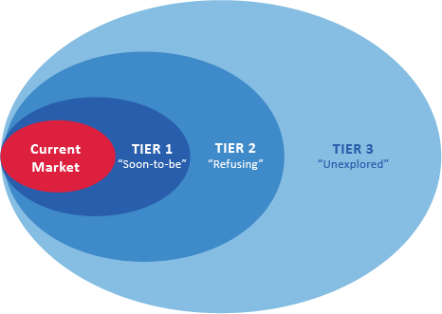
The Three Tiers of Noncustomers

Slide 8
First-Tier Noncustomers
“Soon-to-be” Noncustomer
Edge of your market, looking to leave
Converts existing customers’ thinking
What are the key reasons they want to leave?

Slide 9
Second-Tier Noncustomers
“Refusing” noncustomers who consciously choose against your market
Find the offerings unacceptable or beyond their means
What are the key reasons second-tier noncustomers refuse to use the products or services of your industry?
Look for commonalities across responses

Slide 10
Third-Tier Noncustomers
Distant Markets
“Unexplored” Noncustomers
Never thought of market offerings as an option

Slide 11
Spirit Airlines Noncustomers
First Tier Noncustomers:
The 2014 Frill Control Campaign
On time performance/employee maintenance and luggage transportation
Second Tier Noncustomers:
Students Driving Home
$9 Fare Club
Third Tier Noncustomers:
Expanding in smaller cities within foreign countries

Slide 12
Go For The Biggest Catchment
First Tier- “Soon To Be”
Second Tier- “Refusing”
Third Tier- “Unexplored”
Varies across time and industries, focus on the tier or tiers that offer the biggest catchment

Slide 13
Conclusion: Keys to Maximizing Blue Ocean Size
Think:
Non Customers before Customers
Commonalities before Differences
Desegmentation before segmentation
Maximizing size isn’t enough, you must profit from it to create a sustainable win-win outcome

Slide 14
Works Cited Page
https://www.google.com/search?q=puddle&biw=1920&bih=940&site=webhp&tbm=isch&imgil=jM0ywCPLdAnozM%253A%253BSZM-7kKYqv-eGM%253Bhttp%25253A%25252F%25252Fwww.jsonline.com%25252Fblogs%25252Fpurple-wisconsin%25252F190196261.html&source=iu&pf=m&fir=jM0ywCPLdAnozM%253A%252CSZM-7kKYqv-eGM%252C_&usg=__NuU-dVUyywODdRqZ_imk-QjrctY%3D&ved=0ahUKEwjmuo-VjMfPAhVLMj4KHY4QDQsQyjcIZA&ei=ZL72V-b4Ccvk-AGOobRY#imgrc=jM0ywCPLdAnozM%3A
https://www.google.com/search?q=blue+ocean&source=lnms&tbm=isch&sa=X&ved=0ahUKEwiAqK6wjMfPAhXJeT4KHRKoD40Q_AUICCgB&biw=1920&bih=940#imgrc=Y5_e3FC4af-FBM%3A
https://www.google.com/search?q=the+three+tiers+of+noncustomers&espv=2&biw=1920&bih=940&source=lnms&tbm=isch&sa=X&ved=0ahUKEwiqzJePkMfPAhXGzz4KHaMxBWsQ_AUIBygC#imgrc=_
http://mediaroom.jetblue.com/media-room/press-releases.aspx
https://books.google.com/books?id=eCTD6PlO3Y8C&pg=PA11&lpg=PA11&dq=introduction+of+super+saver+fare+1977+american+airlines&source=bl&ots=7UzcBYlxpc&sig=6xNvwCTBmZoQFN7zGtdoYrQNJYc&hl=en&sa=X&ved=0ahUKEwirpeX_qMfPAhVMyoMKHYAtAOMQ6AEIKTAC#v=onepage&q=introduction%20of%20super%20saver%20fare%201977%20american%20airlines&f=false

