Slide 1
Charting a Company’s Direction
Team 1: Kathleen Armitage, Ryan Trottier, Megan Vandenburg, Ashley Reyna, Hannes Ronneblad, & Jordan Horton

Slide 2
Introduction
Crafting and executing strategy are the heart and soul of managing a business enterprise.
What are the various components of the strategy-making, strategy-executing process?
What’s the importance of the strategy-making, strategy-executing process?
Which kinds of strategic decisions tend to be made at which levels of management?

Slide 3
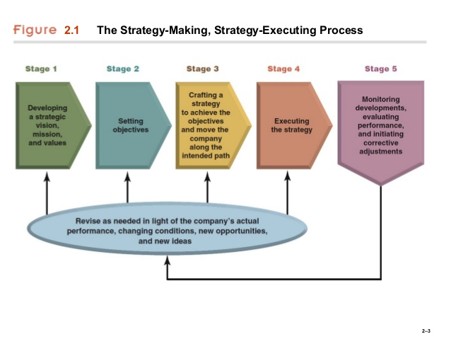

Slide 4
Stage 1: Developing a Strategic Vision, Mission Statement, and Set of Core Values
What is Strategic Vision?
It describes “where we are going?” and “why does this make sense for us?”; management's aspirations for the company and the course and direction charted to achieve them.
Forward-looking- What is our destination?
What steps do we need to take to achieve this goal?
It is the responsibility of the top executives to create a plan and to pass that down through the company ranks.
Be specific and distinctive - Create a short, easy to remember slogan; including direction and purpose.
“Empower Athletes Everywhere”

Slide 6
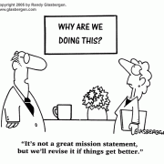
What is a Mission Statement?
It describes the scope and purpose of a company’s present business.
Identifies the products/services offered, what needs we your company satisfies and who they serve, and it gives the company its own identity.
“It is management’s answer to ‘make a profit doing what and for whom?’ that reveals the substance of a company’s true mission and business purpose.”
“MAKE ALL ATHLETES BETTER THROUGH PASSION, DESIGN, AND THE RELENTLESS PURSUIT OF INNOVATION.”
“MAKE GREAT PRODUCT, TELL A GREAT STORY, PROVIDE GREAT SERVICE, BUILD A GREAT TEAM”

Slide 7
Core Values
The beliefs, traits, and behavioral norms that company personnel are expected to display in conducting the company’s business and pursuing its strategic vision and mission.
When these are deeply set into a company’s culture it gives your employees the direction they need to achieve the strategic vision.
It teaches employees how to conduct business and what the company expects of them.
“Act like a global citizen, Think like an entrepreneur, Create like an innovator, Perform like a teammate.”

Slide 8
Stage 2: Setting Objectives
What is the purpose of setting objectives?
To convert the vision and mission into specific, measurable, timely performance targets
To focus efforts and align actions throughout the organization
To serve as yardsticks for tracking a firm’s performance and progress
To provide motivation and inspire employees to greater levels of effort
What kinds of objectives to set?
Financial Objectives
Communicate top management’s goals for financial performance
Are focused internally on the firm’s operations and activities
Strategic Objectives
Are the firm’s goals related to marketing standing and competitive position
Are focused externally on competition and the firm’s rivals

Slide 9
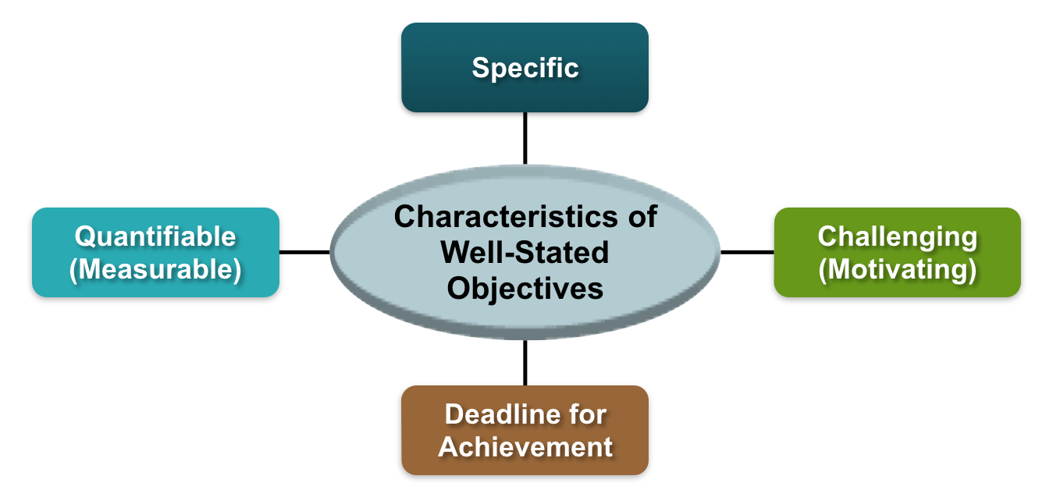
Converting the Vision and Mission into Specific Performance Targets

Slide 10
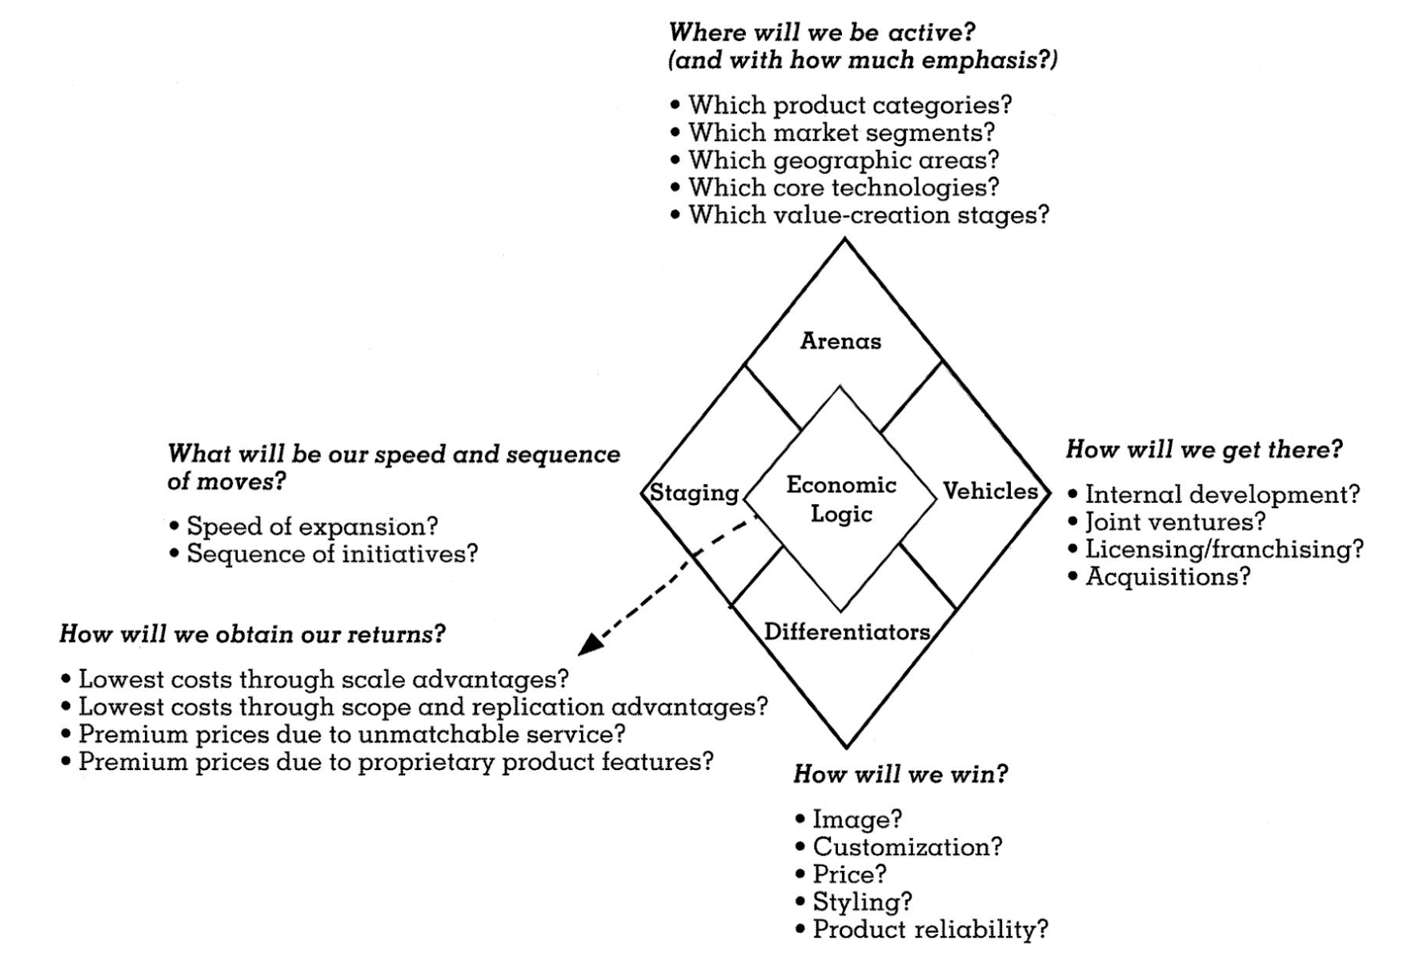
Stage 3
“Hows”
How to attract and please customers, how to compete against rivals, how to position the company in the marketplace, how to respond to changing market conditions, how to capitalize on attractive opportunities, how to achieve objectives
Good Strategy = Good Entrepreneurship

Slide 11
Corporate Strategy
Establishes overall strategy to manage businesses in a multibusiness company
Works to improve performance of each business in the company by way of:
Cross-business synergies
Competitive Advantage
Helps to determine which companies to keep and which markets to enter into
“Game plan”
CEO and senior executives

Slide 12
Under Armour
“A lot of brands are about that initial motivation — just do it, get up, and go — we talk about how sustaining that effort is what makes the difference for an elite athlete, and we want to be the brand to show you how to do it."- UA’s Adrienne Lofton
"If there's anything as we think about our business, the good news is that we're not strictly a North American story anymore, as this is a global company. And international is becoming more and more important to us, as we'll be closing in on it being 13% of our revenues, and possibly north of that, as we think about what 2016 will ultimately look like." -CEO Kevin Plank

Slide 13
Business Strategy
Focused on creating a strong market position, competitive advantage, and the performance of a single business unit.
Usually determined by business unit heads and senior executives. Other roles unit heads take on:
Keeping lower level strategies are consistent with overall strategy
Keeping corporate-level up to date on upcoming strategic topics

Slide 14
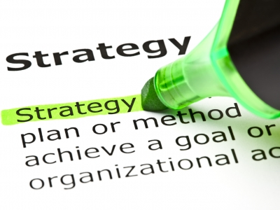
Functional - Area Strategies
Coordinates detail of a company’s business strategy
Certain functions addressed in this strategy are things like research and development, production, sales and marketing, distribution etc.
Delegated to head of respective functions
General Manager has the final approval

Slide 15
Operating Strategies
Works out the approaches for managing “key operating units”
Plants, distribution centers, etc,
Helps to accomplish plants objectives
Add a more detailed and complete plan to functional strategies
All strategies are important, regardless of where they fall in the strategy-making hierarchy.

Slide 16
Strategic Plan
A Strategic Vision + Mission + Objectives + Strategy = A Strategic Plan
All of these parts come together to form a path to where the company is going in the future, creating a strategic plan.
Strategy making begins at the top of the company insuring that all of the strategies have a common reference point and guideline to follow.

Slide 17
Stage 4: Executing the Strategy
Implementation of a strategy is the most demanding and time-consuming part of strategy management.
Initiatives to put the strategy in place and execute it proficiently must be launched and managed on many organizational fronts.
Managers need skin in the game.
Notes:
Managing the implementation of a strategy is the most demanding and time-consuming part of the strategy management process. Initiatives to put the strategy in place and execute it proficiently must be launched and managed on many organizational fronts. Each company manager has to answer the question “what needs to be done in my area to execute my piece of the strategic plan, and what actions should I take to get the process under way?” Good strategy execution requires diligent pursuit of operating excellence. It is a job for a company’s whole management team.
A mistake many companies make is that a good strategy is seen as sufficient to motivate effective execution. They assume that solid execution will come naturally, as people see the benefits and logic of the strategic plan and act accordingly to foster execution success. In reality, Execution takes hard work, communication of actions and benefits, and effective incentives to get managers to buy into the execution process. Managers need skin in the game and logical guidance about their roles in the execution scheme to make even a good strategy work.
As this arrow shows, execution consists of 3 main parts, Aligning the direction of the company, Building a good mindset (or culture), and make sure that your company have the capability to execute the strategy. A company that does this well is Under Armour.

Slide 18
Executing the Strategy
“Understanding the evolving needs of our athletes - how they interact, how they consume, and ultimately how they strive to live healthier lifestyles - will be key inputs to forging deeper relationships and becoming more relevant to how the consumer shops for our brand.” - Kevin Plank, CEO
Notes:
An example of a company that executes their strategy well is the company we chose - Under Armour. Since the market UA is in is already very saturated, Much of Under Armour’s “bite” in the market comes from its ability to execute. Their mission is TO MAKE ALL ATHLETES BETTER THROUGH PASSION, DESIGN AND THE RELENTLESS PURSUIT OF INNOVATION, and since this is part of Under Armour’s strategy they are executing it well by purchasing MapMyFitness, Endomondo and MyFitnessPal to establish the largest digital health and fitness social platform in the world. This infrastructure will most certainly lead to a competitive advantage. These purchases will not only give Under Armour a competitive advantage in the digital health market, it will also give them extremely valuable information about their customers, that goes along with their strategies of understanding their athletes and their needs, in order to lead the way and make them better.

Slide 19
Stage 5: Evaluating Performance and Initiating Corrective Adjustments
Monitor new external developments
Disruptive changes in the company’s environment
Evaluate the company’s progress
Market position, performance
Make corrective adjustments
Fine-tune strategic plans or change the company’s vision and mission, objectives, strategy, and/or strategy execution methods
Remember: “A company’s vision, mission, objectives, strategy, and approach to strategy execution are never final; managing strategy is an ongoing process.”

Slide 20
The Role of the Board of Directors in the Strategic Process (Corporate Governance)
Oversee the company’s financial accounting and financial reporting practices.
Critically appraise the company’s direction, strategy, and business approaches.
Evaluate the caliber of senior executives’ strategic leadership skills.
Institute a compensation plan for top executives that rewards them for actions and results that serve shareholder interests.
“Effective corporate governance requires the board of directors to oversee the company’s strategic direction, evaluate its senior executives, handle executive compensation, and oversee financial reporting process.”

Slide 21
Conclusion
There are 5 steps in the Strategy-Making, Strategy-Executing process
A strategic vision describes the route the company intends to take in developing and strengthening its business.
Setting objectives helps convert the vision and mission into performance targets
A strategic plan is composed of a Strategic Vision, Mission, Objectives, and Strategy
Executing the strategy is the most demanding and time consuming step.
Business strategy is focused on creating a strong market position, competitive advantage, and the performance of a single business unit.

Slide 22
Citations
Sozzi, B. (2016, May 02). Why Under Armour's Founder Couldn't Care Less if Sports Authority Vanishes. Retrieved September 12, 2016, from https://www.thestreet.com/story/13553278/1/why-under-armour-s-founder-couldn-t-care-less-if-sports-authority-vanishes.html
Schlossberg, M. (2015, September 08). Under Armour's underdog strategy to becoming the anti-Nike. Retrieved September 12, 2016, from http://www.businessinsider.com/under-armours-underdog-strategy-2015-9

