Slide 1
Summary of Lessons Learned
Team 7
MGT 4380
Adam Stroem, Jack Kelley, Henry Hilla
William Brunner, William Wendt, Giselle Luna

Slide 2
Strategic Vision
Our vision serves as the framework for our Roadmap and guides every aspect of our business by describing what we need to accomplish in order to continue achieving sustainable, quality growth.
People: Be a great place to work where people are inspired to be the best they can be.
Portfolio: Bring to the world a portfolio of quality beverage brands that anticipate and satisfy people's desires and needs.
Partners: Nurture a winning network of customers and suppliers, together we create mutual, enduring value.
Planet: Be a responsible citizen that makes a difference by helping build and support sustainable communities.
Profit: Maximize long-term return to shareowners while being mindful of our overall responsibilities.
Productivity: Be a highly effective, lean and fast-moving organization

Slide 3
Mission Statement
Coca-Cola's Mission:
To refresh the world...
To inspire moments of optimism and happiness...
To create value and make a difference.

Slide 4
Values
Our values serve as a compass for our actions and describe how we behave in the world.
Leadership: The courage to shape a better future
Collaboration: Leverage collective genius
Integrity: Be real
Accountability: If it is to be, it's up to me
Passion: Committed in heart and mind
Diversity: As inclusive as our brands
Quality: What we do, we do well

Slide 5
Strategic Vision
Our vision serves as the framework for our Roadmap and guides every aspect of our business by describing what we need to accomplish in order to continue achieving sustainable, quality growth.
People: Be a great place to work where people are inspired to be the best they can be.
Portfolio: Bring to the world a portfolio of quality beverage brands that anticipate and satisfy people's desires and needs.
Partners: Nurture a winning network of customers and suppliers, together we create mutual, enduring value.
Planet: Be a responsible citizen that makes a difference by helping build and support sustainable communities.
Profit: Maximize long-term return to shareowners while being mindful of our overall responsibilities.
Productivity: Be a highly effective, lean and fast-moving organization

Slide 6
Objectives
Financial
Strategic
Expanding its current successful productivity program by t0argeting annualized savings of $3 billion per year by 2019
Increasing investment in markets where current brand development is underfunded to bring about brand awareness.
Refranchising the majority of Company-owned North American bottling territories by the end of 2017 and a substantial portion of the remaining territories no later than 2020.
Water Replenishment Project
Coca-Cola Campaign's- "Worlds greatest Brand"

Slide 7
Vision
Portfolio
Mission
"Refresh the World"
Values
Diversity
Objective
Increasing brand awareness through investment
World's Greatest Brand
How?
-Latin America R&D
-Vending Machines
-"Taste The Feeling"

Slide 8
Red Oceans
"All the industries in existence today"
Crowded market
Bloody competition

Slide 9
Blue Oceans
Industries not in existence today
Product differentiation and low cost --> Making competition irrelevant
Unexplored business model --> High risk
Ex. Coca-Cola
Coke Zero
Vitaminwater

Slide 10
Value Innovation
The cornerstone of blue ocean strategy
Separates winners and losers
Beating competition vs.Making competition irrelevant
Value-cost trade-off
Differentiation and low cost

Slide 11
Cirque do Soleil
New circus concept
Combined traditional circus and live theatre
Value-cost trade-off --> blue ocean of new market space

Slide 12
Red Ocean vs. Blue Ocean
Red Ocean Strategy | Blue Ocean Strategy
Compete in existing market space | Create uncontested market space
Beat the competition | Make the competition irrelevant
Exploit existing demand | Create and capture new demand
Make the value-cost trade-off | Break the value-cost trade-off
Align the whole system of a firm's activities with its strategic choice of differentiation or low cost | Align the whole system of a firm's activities in pursuit of differentiation and low cost

Slide 13
Chapter 3: Evaluating a Company's External Environment
Political factors
Economic factors
Sociocultural forces
Technological factors

Slide 14
Porter's Five Forces
Competition from rivals
Competition from new entrants
Competition from producers of substitutes
Supplier bargaining power
Customer bargaining power

Slide 15
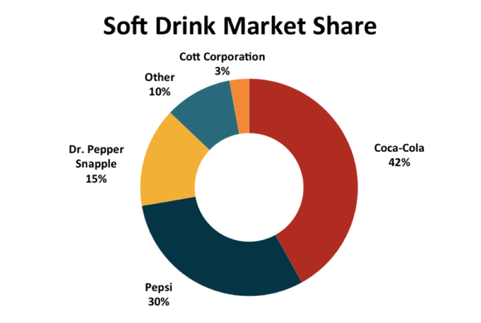
Coca-Cola and Porter's Five Forces
Coca-Cola is the market leader
Soft drink market is difficult to enter
Decent competition from substitutes
Limited supplier bargaining power
Some customer bargaining power

Slide 16
BOS Chapter 2 Analytical Tools and Framework
Coca-Cola's Strategic Canvas:
Capture's Current State of Play in the Known Market Place
Paints Picture of the Future Prospects for a Company

Slide 17
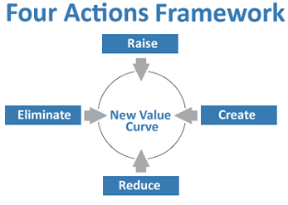
Implementing the Four Actions Framework
Raise key existing values.
Create new value to establish new market.
Reduce low performing factors.
Eliminate values that may be irrelevant to customers.

Slide 18
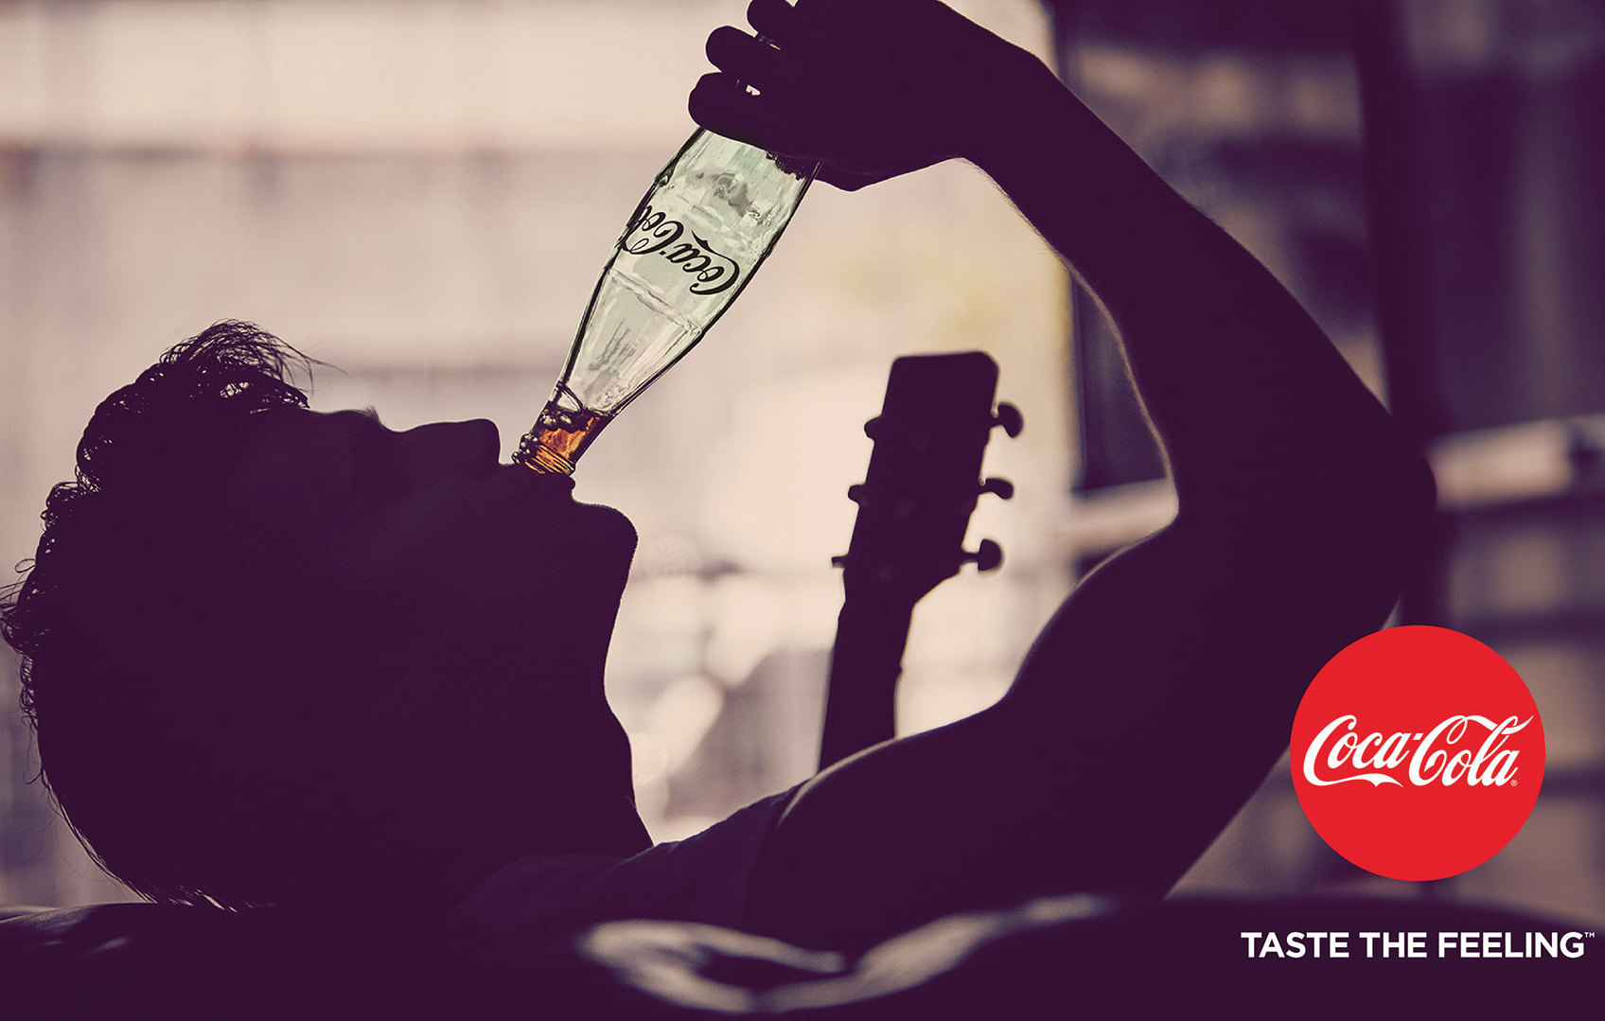
Three Characteristics of a Good Strategy
Focus – Maintain a clear and direct strategy
Divergence – What are your key values set you apart
Compelling Tagline – Clear message that displays focus

Slide 19
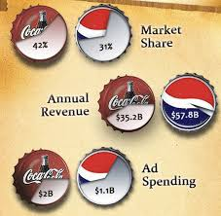
Coca Cola's Internal Strategy
How well is the company's present strategy working?
Is the company achieving what it says it will?
Is the company's financial performance above the industry average?
Is the company gaining customers and market share?

Slide 20
SWOT Analysis
How does your company's strengths and weaknesses in relation to the markets opportunities and threats?
Strengths- Global Presence, Marketing Strategies and Distribution Network
Weaknesses- Pepsi, Health Beverage Industry and Water Management
Opportunities- Diversification and Marketing the lesser selling products
Threats – Raw material Sourcing and Indirect competitors

Slide 21
Key Rivals
How does the company compete compared to key rivals?
Net competitive Advantage ?
Global Presence
Distribution
Brand Equity

Slide 22
Reconstruct Market Boundaries
From all six framework paths, is what remarkets the boundaries of the markets
The idea behind these frameworks is to see things in another way. Ex. Cirque du soleil vs regular circus

Slide 23
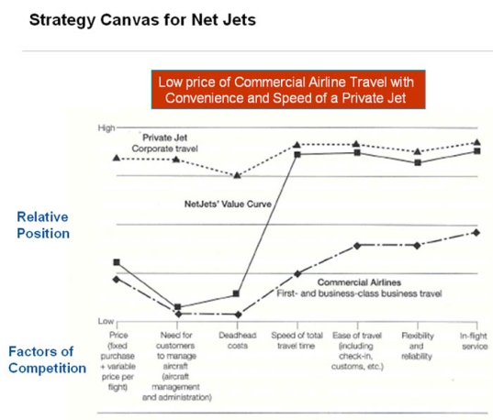
Reconstruct Market Boundaries
The gap in between each of these spots provide a possibility in new innovative ideas. Areas for improvement
Managers always have to be aware on how they will be able to reorder the market realities
The more innovated the better, the innovation is what will differentiate you from your competitor
Ex. Gold peak tea

Slide 24
Summary
Business strategies
Red Oceans
Blue Oceans
Porter's Five Forces
SWOT Analysis
Strategy gains
Reconstruct Market Boundaries

Slide 25
Glossary
http://all-free-download.com/free-vector/coca-cola-vector-logo-download.html -Logo
"Coca-Cola Journey Homepage." The Coca-Cola Company. N.p., 2016. Web. 25 Sept. 2016.- ' Be part of the Journey'
http://www.fool.com/investing/general/2014/08/25/soft-drinks-investing-essentials.aspx - market share chart

