Slide 1
Get the Strategic Sequence Right
Blue Ocean Strategy Chapter 6
Team 7
MGT 4380
Adam Stroem, Giselle Luna, Jack Kelley, Henry Hilla, Jake Wendt.

Slide 2
The Right Strategic Sequence
Buyer Utility
Strategic Price
Cost
Adoption Hurdles

Slide 3
Testing for Exceptional Utility
Must be able to use it
Must be simple
Quick to use

Slide 4
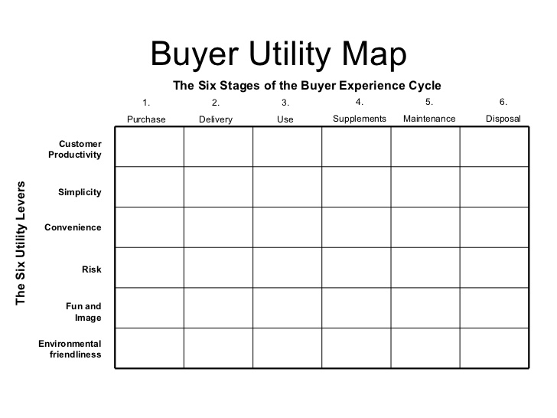
Applied to Coca-Cola

Slide 5
From Exceptional Utility to Strategic Pricing
To secure a strong revenue stream for your offering you must set the right strategic price. Ensures buyers..
Will want to buy
Compelling ability to pay for it i.e. they can afford to pay for it.

Slide 6
Strategic Price
Know from the start what price will capture the mass of target buyers
Volume is key
Value is usually tied to the TOTAL amount of people using it

Slide 7
Rise of Knowledge
Factors to consider...
Free riding
Rival vs. Non rival goods
Excludability
Legal or exclusive asset protection
The strategic price set must be able to attract and retain customers
You must make an offer your buyer cannot refuse from day 1

Slide 8
Price corridor of the Target Mass
The Price Corridor of the Target Mass
Identify price corridor of target mass.
Different Form, Same Function
Different Form and Function, Same Objective
Specify a level within price corridor
Upper – hard to imitate; legal protection; core capability asset
Mid – uncertain patents and asset protection
Lower – no protection *advised to be lower priced

Slide 9
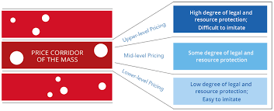
Step 1: identify the price corridor of the target mass.
Step 2: specify price level within that corridor.

Slide 10
From Strategic Pricing to Target Costing
What is Target Costing?
Strategic price- minus profit
Cost Structure
Profitable
Difficult to follow

Slide 11
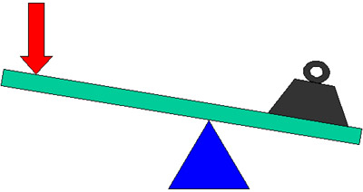
Three Principal Levers
Streamlining operations and introducing cost innovations
Partnering
Changing the price model of the industry

Slide 12
Streamlining operations and introducing cost innovations
Can product’s or service’s raw materials be replaced by less expensive ones?
Can high-cost, low-value added activities in your value chain be reduced?
Can the physical location of your product or service be shifted from prime locations to lower-cost locations?
Coca-Cola divesting production facilities

Slide 13
Partnering
New product or service
Production and distribution by themselves --> mistake
Secure needed capabilities and dropping their cost structure
Expertise and economies of scale
Low-cost advantage
Coca-Cola partnership with NutraSweet Company

Slide 14
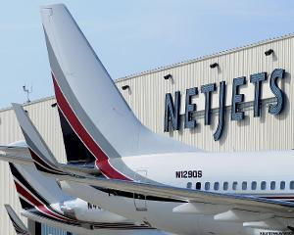
Changing the price model of the industry
Make their desired profit margin without compromising strategic price
NetJets
Freemium
"Free" and "Premium"

Slide 15
The Profit Model of Blue Ocean Strategy
The strategic price
The target profit
The target cost
Streamlining and cost innovations
Partnering
Pricing Innovation

Slide 16
From Utility, Price, and Cost to Adoption
Employees
Merryl lynch,go public(brokerage service)
Stock dropped 14%
Communicate awareness of threats
E-venture worked, rose 13%

Slide 17
From Utility, Price, and Cost to Adoption
Business Partners
Resistance of partners
Fear revenue drops from new ideas
SAP, AcceleratedSAP(enterprise software)
Require active coop of large companies
Lengthy implementations

Slide 18
From Utility, Price, and Cost to Adoption
The General Public
Opposing new business idea, public
Threaten political norms
Monsant, genetically modified foods
Attacks from environmental groups
Stakeholders voices are important

Slide 19
The Blue Ocean Idea Index
 |  | Coca-Cola | PepsiCo | DrPepper-Snapple
Utility | Exceptional Utility? Compelling Reasons to buy? | + | +/- | +/-
Price | Price easily accessible to the mass of buyers? | + | + | +
Cost | Cost structure meet target cost? | +/- | + | -
Adoption | Addressed adoption hurdles? | + | + | +
Simple Test of System View
Utility, Price, Cost, and Adoption

Slide 20
Summary Of Information Covered
The Right Strategic Sequence
Testing for Exceptional Utility
Strategic Pricing
Target Costing
Adoption
Blue Ocean Idea Index

Slide 21
Citations
(n.d.). Retrieved October 11, 2016, from http://image.slidesharecdn.com/blue-ocean-strategy-summary4461/95/blue-ocean-strategy-summary-21-728.jpg?cb=1181311682
(n.d) Retrieved October 11, 2016 from https://www.blueoceanstrategy.com/tools/price-corridor-mass/

