Slide 1
Summary of Lessons Learned
Michael Burns, Monica Rael, Garrett Ellis, Matt Goudie, William Peterson and Towns Garner

Slide 2
Intro
CES Chapter 8: Corporate Strategy
BOS Chapter 7: Overcome Key Organizational Hurdles
CES Chapter 9: Ethics and Strategy
BOS Chapter 8: Build Execution into the Strategy
CES Chapter 10: Building an Organization with a Good Strategy

Slide 3
Crafting and Executing Strategy Chapter 8: Corporate Strategy
Crafting A Diversification Strategy
Initiating actions to boost the combined performance of the corporation’s collection of businesses
Sticking closely with the existing business lineup and pursuing opportunities presented by those businesses
When To Consider Diversifying
It can expand into businesses where technologies and products complement its present business

Slide 4
Tests for Corporate Advantage
The Industry Attractiveness Test
The Cost of Entry Test
The Better-off Test
Notes:
Industry Attractiveness Test: It is based on the number of competitors, their relative strength, width of margins, and rate of growth in demand for its goods or services.
Cost of Entry Test: looking at the costs to enter into the market and if the cost is worth it
Better-off Test: the new unit must either gain competitive advantage from its link with the corporation or vice versa.

Slide 5
Diversification by Joint Venture
The firm enters into a partnership with another business to enter an industry
Join with other corporations to develop and create initiatives aimed at reducing the environmental footprint businesses leave behind.
Conservation Alliance
1% For the Planet
Notes:
Of the three diversification options (Acquisition, Internal Development, and Joint Ventures). Joint Ventures serves as the best option for Patagonia.
Conservative Alliance: alliance is to encourage businesses in the outdoor industry to contribute to environmental organizations
1% for the Planet: an alliance of businesses that donate part of their proceeds to environmental organizations to support sustainability and the preservation of the environment. Since it started to support 1% for the Planet in 1985, Patagonia has contributed more than $46 million in donations.

Slide 6
Related Diversification
Sustainable Apparel Coalition
Notes:
Makes more sense for Patagonia to follow a Related diversification path rather than an Unrelated.
-Patagonia partnered with Walmart and Adidas to form the Sustainable Apparel Coalition. This was not the first time Patagonia worked with Walmart; it had partnered with the firm in 2009 to collaborate on a sustainability assessment tool that would help Walmart monitor the sustainability of its supply chain. The Sustainable Apparel Coalition (SAC) is a broader alliance of companies that will create an index to measure sustainability criteria in business supply chains such as energy use and work conditions. The SAC is also creating an index called the Higg Index to measure the sustainability of apparel based upon the materials and processes used. Patagonia realizes that to create lasting change, it must not only improve its sustainability operations but also assist in helping other businesses learn how to reduce their impact on the environment.

Slide 7
Evaluating the Diversified Strategy
Evaluating Industry Attractiveness
Evaluating Business Unit Competitive Strength
Determining the competitive value of strategic fit in Diversified companies
Checking for Resource Fit
Ranking business units and assigning a priority for resource allocation
Crafting New Strategic moves to improve overall corporate performance

Slide 8
Chapter 7: Blue Ocean Strategy
How to overcome key organizational Hurdles in implementing a blue ocean strategy

Slide 9
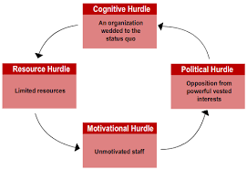

Slide 10
Tipping point leadership
Alternative to contemporary wisdom
People, acts, and activities
Leveraging disproportionate factors

Slide 11
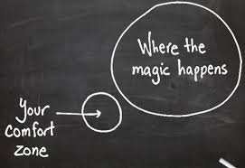
The cognitive hurdle
Problem: Blinds people from seeing that radical change is needed
Solution: Employees must come face-to-face with worst operational problems, and must hear first-hand customer complaints.

Slide 12
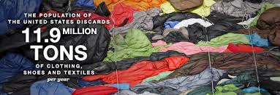
The limited resources hurdle
Problem: Not enough money, time, or other resources
Solution: reallocate resources in hot spots and cold spots through horse trading or innovation
Patagonia:

Slide 13
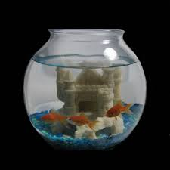
The motivational hurdle
Problem: discourages and demoralizes staff
Solution: Identify the “Kingpins” (ambassadors) and put them in a “fishbowl” of transparency

Slide 14
The political hurdle
Problem: internal and external resistance to change
Solution: secure a consigliere to identify your “devils” and “angels”. Leverage angels and silence devils.
Patagonia: conventional - organic cotton

Slide 15
Crafting and Executing Strategy Chapter 9
3 Schools of Thought of Business Ethics
Triple Bottom Line
Corporate Social Responsibility

Slide 16
3 Schools of Thought for Business Ethics
Ethical Universalism
ethical implications of an action applies universally to anyone, regardless of circumstance. The end justifies the means
Ethical Relativism
morality is relative to the norms of one's culture
Ethics and Integrative Social Contracts Theory
Provides a framework for confronting ethical decisions using macro and microsocial contracts

Slide 17
Triple Bottom Line
Economic
Repairing and Reusing
Social
Donations
Environmental
Keeping a close eye on all aspects of production

Slide 18
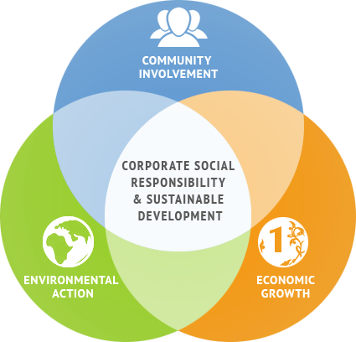
Corporate Social Responsibility
The ultimate goal of triple bottom line, which is to assess and take responsibility for the company's effects on environmental and social well being
https://youtu.be/059H62fBWmg

Slide 19
Blue Ocean Strategy Chapter 8
Build Execution into Strategy

Slide 20
Fair and Poor Process
Fair Process: People care about through which the outcome is produced as they do about the outcome itself.
Poor Process: Poor process can ruin strategy execution.

Slide 21
The Three E Principles of Fair Process
Engagement
Explanation
Clarity of Expectation
Taken together will create judgements of fair process.

Slide 22
Value of Recognition
Intellectual
Emotional

Slide 23
CES: Ch. 10

Slide 24
Guide of Chapter 10
A Framework for Executing Strategy
Building an Organization Capable of Good Building an Organization Capable of Good Strategy Execution: Three Key Actions Strategy Execution: Three Key Actions
Staffing the Organization
Developing and Strengthening Core Competencies and Competitive Capabilities
Execution Execution--Related Aspects of Organizing the Related Aspects of Organizing the Work Effort Work Effort

Slide 25
Crafting vs. Executing Strategy
Crafting the Strategy:
Is market driven
Success depends on:
Vision of business
Market positioning
Outcompeting rivals
Deploying resources to create competitive advantage.
Executing the Strategy:
Is operations driven
Success of execution depends on:
Continuous improvements
Motivating/rewarding people
Creating a culture of discipline and getting things done.

Slide 26
Framework for Executing strategy
This is the specific hows
The exact items to be placed on management's radar
Always needs to be customized to fit the firm's situation
Making minor changes to the existing strategy is different from implementing radically new changes.
It differs with manager, some are more adapt to achieving changes.
No concrete path to success for managers to take in executing strategy.

Slide 27
Building an Organization Capable of Good Strategy Execution: Three Key actions
Effective strategy execution is determined by three types of organization-building actions:
Staffing the organization: Putting together a good management team, recruiting and retaining employees with the necessary experience, and skills.
Developing and strengthening core competencies and capabilities: Performing value chain activities and matching them to match market conditions and expectations of customers.
Structuring the organization and work effort: Deciding how much decision making authority to push down onto low level employees and managers.

Slide 28
Takeaways
CES Chapter 8: Crafting a diversified strategy within your company
BOS CH. 7: How to overcome key organizational Hurdles in implementing a blue ocean strategy
Cognitive hurdle
Limited resources hurdle
Motivational hurdle
Political hurdle
CES CH. 9: 3 Schools of Thought for Business Ethics
Triple Bottom Line
Corporate Social Responsibility
BOS CH. 8: Build Execution into strategy
CES CH. 10: Execution of strategy

