Slide 1
Summary of Lessons Learned
Section: 003
Company: Coca-Cola
Austin Reuter
Swade Draper
Seth Rizer
Alan Page
Gabriela Trejo

Slide 2
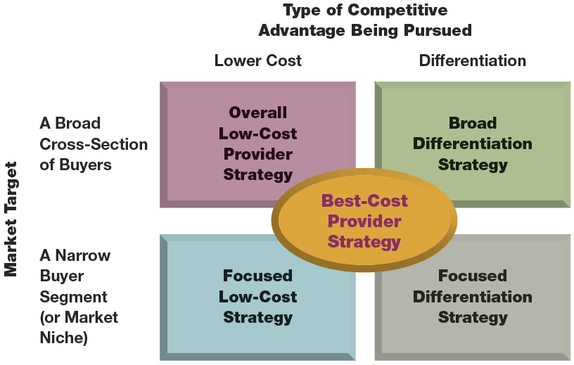
CES Ch 5: 5 Generic Competitive Strategies

Slide 3
CES Ch 5:
2 Way to Achieve a Cost Advantage
Perform value chain activities more cost-effectively than rivals
Revamp firm’s overall value chain to eliminate or bypass some cost producing activities

Slide 4
CES Ch 5

Slide 5
CES Ch 5
Revamping the value chain system to lower costs
Selling direct to consumers
Streamlining operations by eliminating low-value-added or unnecessary work steps and activities
Reducing materials handling and shipping costs
Low cost provider strategy
Price competition is vigorous
Identical products
Difficult to achieve product differentiation
Buyers use products in the same way
Low cost in switching from one seller to another
Pitfalls
HIgher unit sales and market share doesn’t equal higher profit
Easily copied approach to reduce costs
Becoming too fixated on cost reduction

Slide 6
CES Ch 5

Slide 7
CES Ch 5
When differentiation strategy works best
Buyer needs and uses of the product are diverse
Many ways to differentiate the product or service that have value to buyer
Few rivals are following a similar differentiation approach
Technological change is fast-paced
Pitfalls
Easily copied
Buyers see little value in the unique attributes
Overspending to differentiate the products

Slide 8
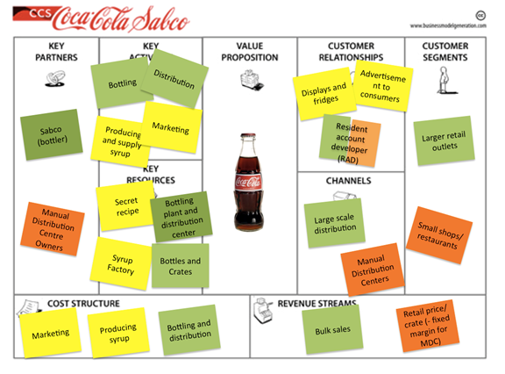
Chapter 4: Focusing On The Big Picture, Not Numbers

Slide 9
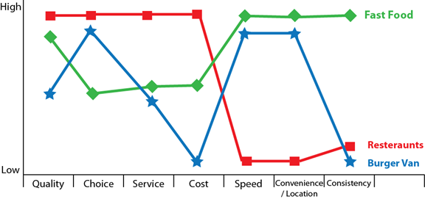
Step 1: Visual Awakening
Analyze Current Strategy
Create Strategy Canvas vs Competitors

Slide 10
Step 2: Visual Exploration
Hands on research
Determine Advantages
Identify wins/ opportunities

Slide 11
Step 3: Visual Strategy Fair
Step 4: Visual Communication
Create New Strategy
Request feedback
Adjust strategy
Keep it simple, visual, and easy

Slide 12
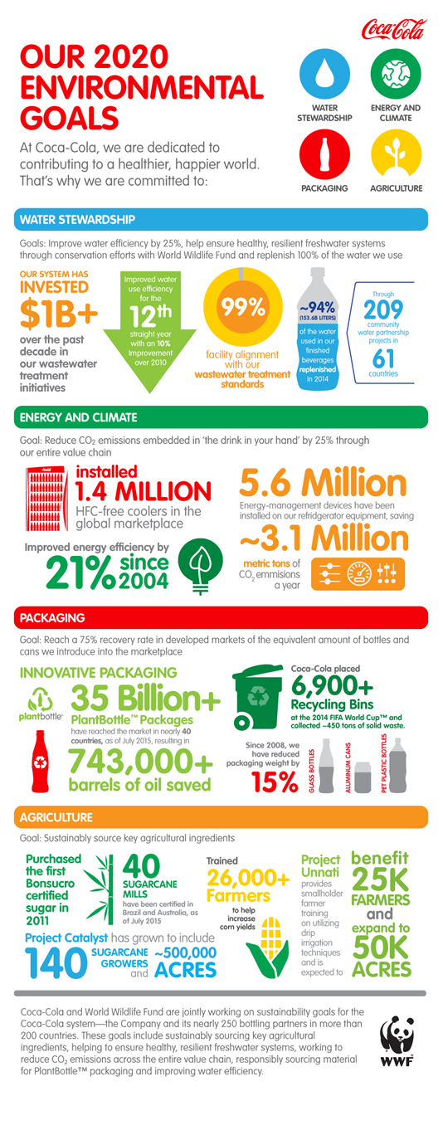

Slide 13
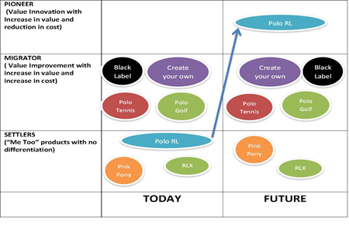
Pioneer-Migrator-Settler Map

Slide 14
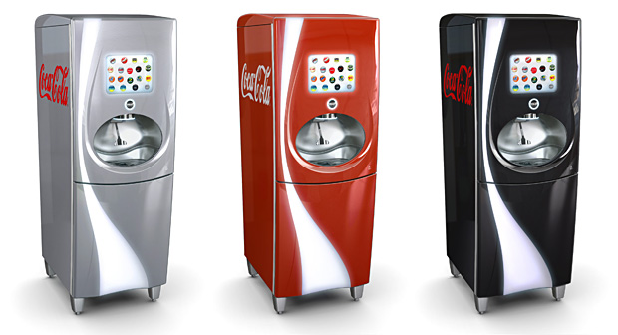
CES: Strengthening a Company’s Competitive Position
Offensive
Low Price
Leapfrogging
Innovating
Adoption & Improvement
Guerrilla Warfare
Preemptive Strike

Slide 15
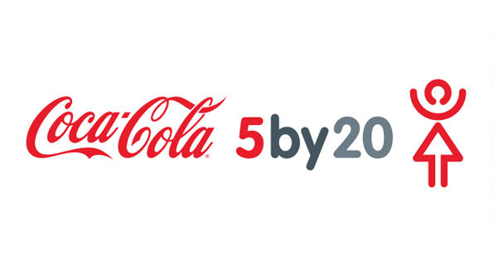
CES: Strengthening a Company’s Competitive Position
Defence
Block Challengers
Signal Challengers

Slide 16
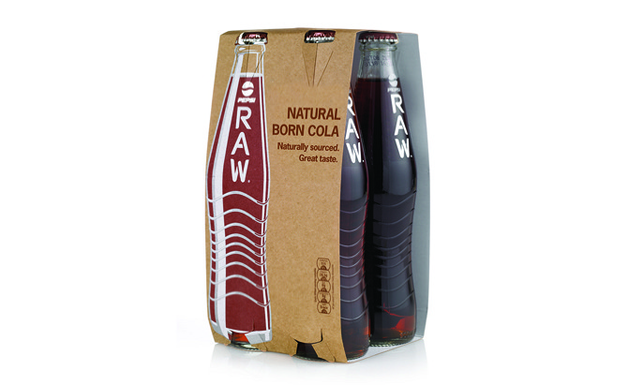
CES: Strengthening a Company’s Competitive Position
First Mover:
Brand Loyalty
Switching Costs
Property Rights
Learning Curve
Set the Standard

Slide 17
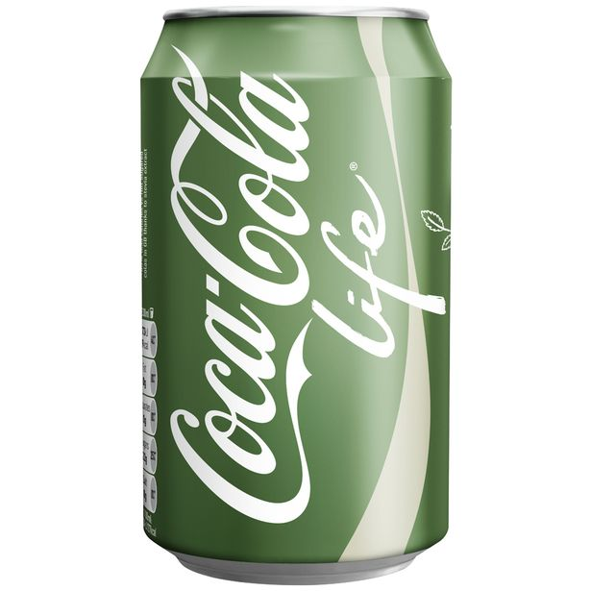
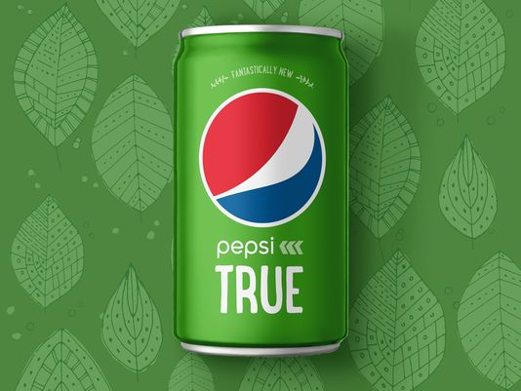
CES: Strengthening a Company’s Competitive Position
Late Movers and Disadvantages
Higher Benefit for Lower Cost
Does Not Meet Expectation
Leapfrogging
Market Uncertainty

Slide 18
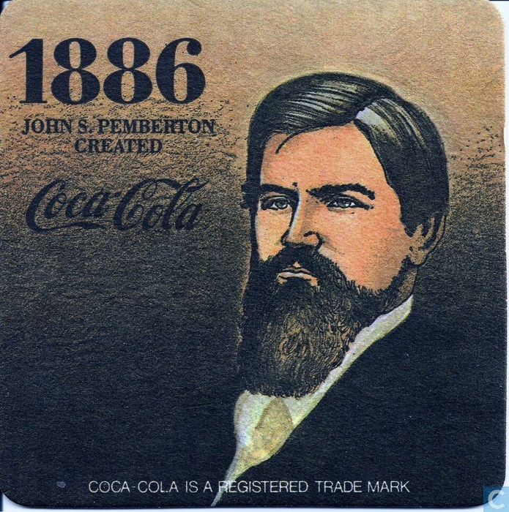
CES: Strengthening a Company’s Competitive Position
Outsourcing
Local Outsourcing
Monsanto
Hershey’s

Slide 19
BOS CH 5: Reach Beyond Existing Demand
To reach beyond existing demand you must:
Think Commonalities before Differences
Think Desegmentation before Finer Segmentation
Think Non Customers before Customers

Slide 20
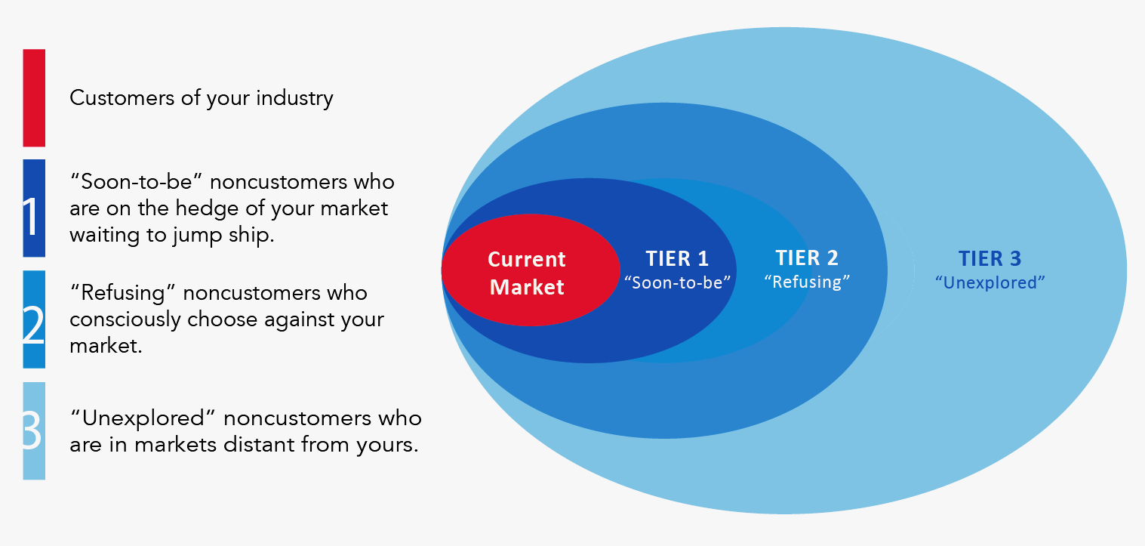
Noncustomers (3 Tiers)

Slide 21
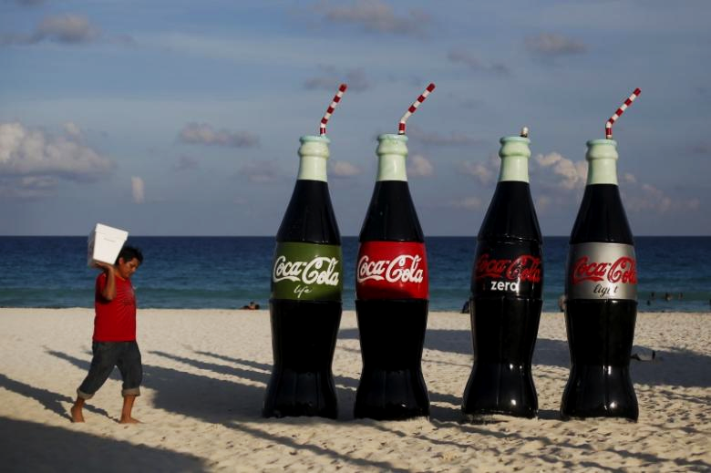
Go Big or go Home
No specific rule on which tier to focus on and when.
Focus on the tier that represents the biggest catchment at the time
BUT. When commonalities reach across multiple tiers, you should look across all tiers.

Slide 22
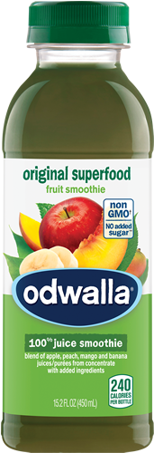
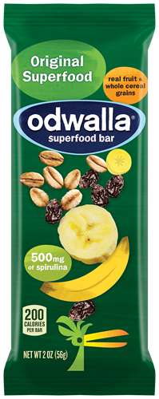
Coca-Cola (reaching across all 3 tiers)
Tier 1
Some people are looking for healthier alternative
Tier 2
Some people don’t like sodas.
Tier 3
Some people don’t necessarily want a beverage

Slide 23
Chapter 7: Strategies For Competing In International Markets
Coca-Cola:
In more than 200 countries, with over 450 brands
“Think Global, Act Local”- Transnational Strategy
High need for local responsiveness, benefit from global integration and standardization

Slide 24
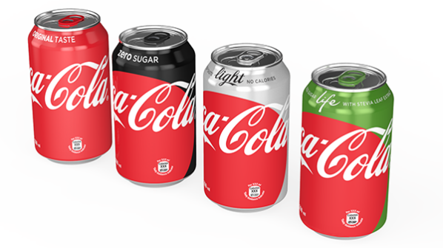
Competitive Advantage Globally
Consistent production of concentrates, beverage bases, and syrups
Sold to over 250 bottling partners worldwide
Bottling partners manufacture, package, merchandise and distribute on a local scale
Partners are in charge of localized strategies
Coca-Cola Company responsible for marketing efforts of brands
“One Brand”

Slide 25
Ensuring International Long-Term Success
Created BIG in January 2006-Bottling Investments Group
Ensures independent bottling franchises get expertise and investments needed for long-term sustainability
Find a qualified bottler to assume operations and continue to grow the business once it’s stable

Slide 26
Chapter 6 : Getting The Strategic Sequence Right
Buyer Utility- Is there exceptional buyer utility?
Price- Is this price easily accessible to the target mass of buyers?
Cost- Can you attain your cost target to profit at your strategic price?
Adoption- Are you addressing any adoption hurdles?

Slide 27
Coca Cola BOI
Coca-Cola
Pepsi-Co
Dr.Pepper/Snapple
Compelling reasons to buy? | + | +/- | +/-
Easily accessible to the target mass of buyers? | + | + | +
Cost structure meet target cost? | +/- | + | -
Are you addressing any adoption hurdles? | + | + | +/-
Utility
Price
Cost
Adoption

