Slide 1
B.O.S Conclusion
Gabriela Trejo
Swade Draper
Seth Rizer
Austin Reuter
Alan Page
Coca-Cola
003

Slide 2
Barriers to Imitation
Companies will go without creditable challenges for 10-15 years
Brand image conflict prevents companies from imitating
Natural monopoly blocks imitation when the size of a market can’t support another player
Patents or legal permits block imitation
High volume generated by a value innovation leads to rapid cost advantages, placing potential imitators at an ongoing cost disadvantage

Slide 3
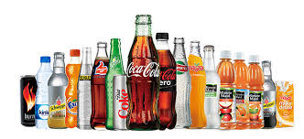
Barriers to Imitation
Alignment Barrier
Value, Profit, People
Differentiation
Low-cost
Coke
Differentiation
Has a different product to sell to people's needs and wants

Slide 4
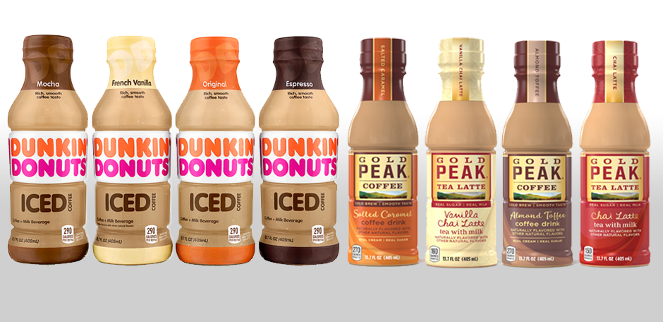
Barriers to Imitation
Cognitive & Organizational Barrier
Value innovation vs conventional logic
Imitation requires change
Coke
Looks to create value through partnerships, sustainability efforts, company culture
Entering into the Ready-to-Drink Coffee category in 2017

Slide 5
Barriers to Imitation
Brand Barrier
BOS conflicting with image
Value-innovation builds loyalty
Shuns imitators
Coke
Huge brand barrier to entry in the carbonated soft-drink industry due to over 100 years of advertising
This brand is hard to compete with due to the loyalists to Coca-Cola
Has maintained a consistent brand image over the years even with new products

Slide 6
Barriers to Imitation
Economic & Legal Barrier
Natural monopoly
Value-innovator gaines cost advantage
Network Externalities
Patents or legal permits
Coke
Snapple/ Dr. Pepper did not produce their own “Freestyle” machine

Slide 7
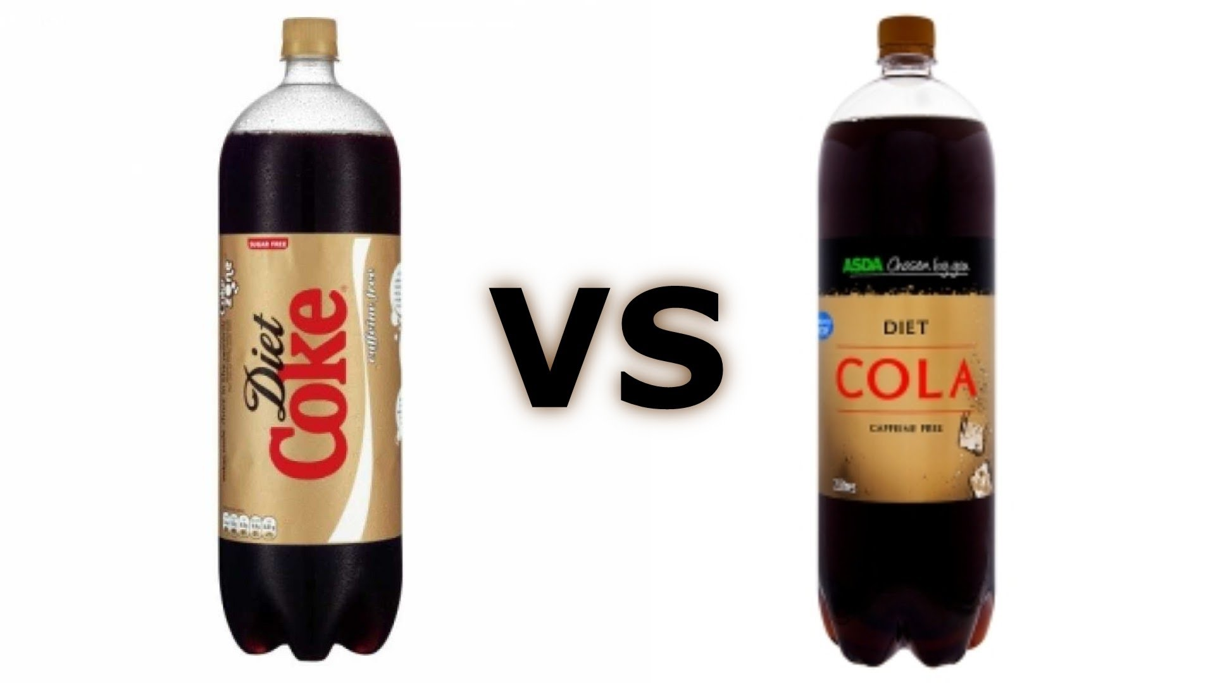
When to Value-Innovate
Eventually your blue ocean will be imitated
Defending yourself against imitators could be a trap
Making your company strategy switch from customer to competition centered

Slide 8
When to Value-Innovate
Use strategy canvas to help avoid traps
Value curve signals when to:
Find new blue ocean
And when not to
Stay a moving target
Distance yourself from imitators
Always be one step ahead
Dominate your blue ocean
The more intense the competition, the redder the ocean
Reach out for new value innovation

Slide 9
When to Value-Innovate
Use 6 principles of Blue Ocean strategy as a guide
Will not end competition
Probably will intensify competition
Will help you stay on to of the over-crowded business world
Blue and Red Oceans coexist
Master both strategies
Make competition irrelevant

Slide 10
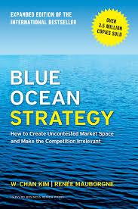
The End

