Slide 1
Blue Ocean
Strategy
Chapter 1 by Team 2
Section: 003
Alicia Amodeo, Jared Coronado, Jason Guevara, Reed Harman & Jessica Stoddard

Slide 2
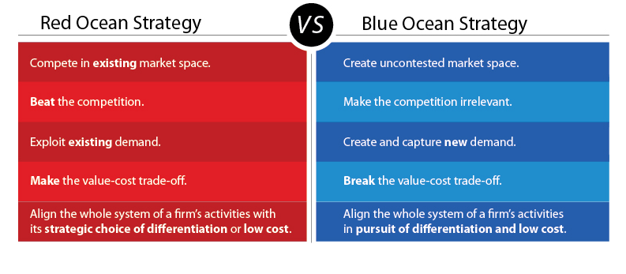
New Market Space

Slide 3
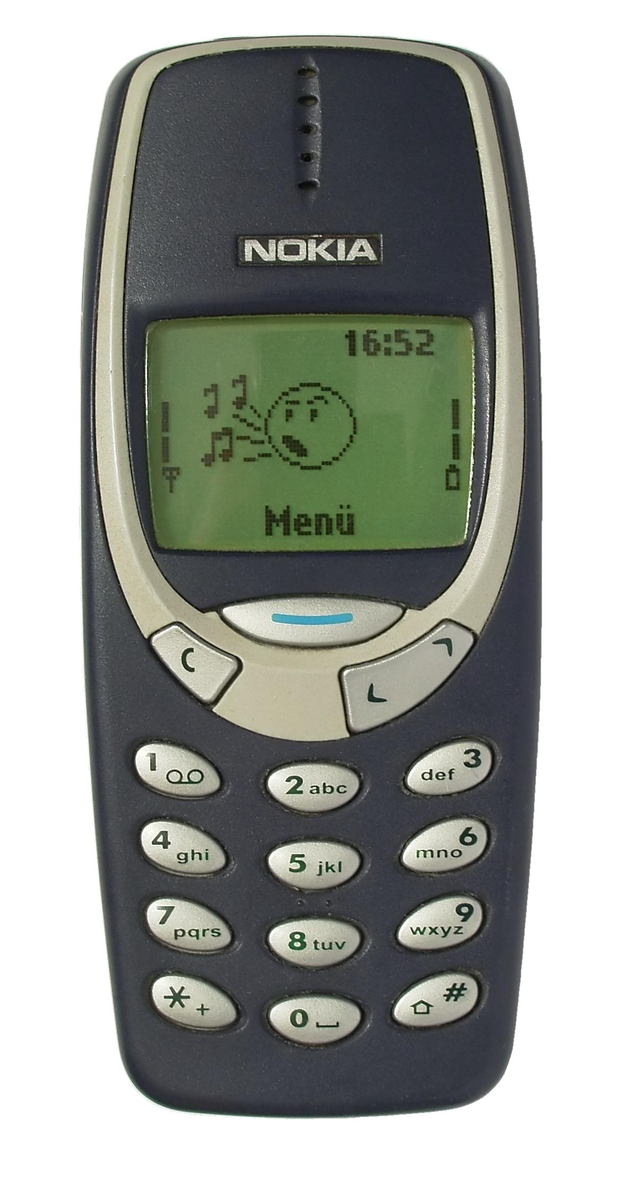
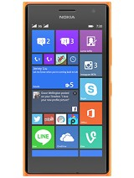
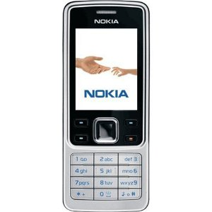
Nokia, where they went wrong
2007 - Nokia was earning more than 50% of the profits in the mobile-phone industry
Didn’t realize how important the transition into smartphones would be
Tried to make a comeback partnering with Windows

Slide 4
Toothpaste brands are an example of a red ocean initiative
1886 - Dr. Sheffield created tubed toothpaste
Now - Sensodyne, Colgate, Crest, Pronamel, Oral-b

Slide 5
YETI is an example of a successful blue ocean strategist.
-Targeting certain niche markets
-Creating an irrelevant product
- Using social media to build the brand
-Creating a cooler that could deliver high performance

Slide 6
A blue ocean taking on blood...
-Creating a new product line
-Targeting new markets

Slide 7
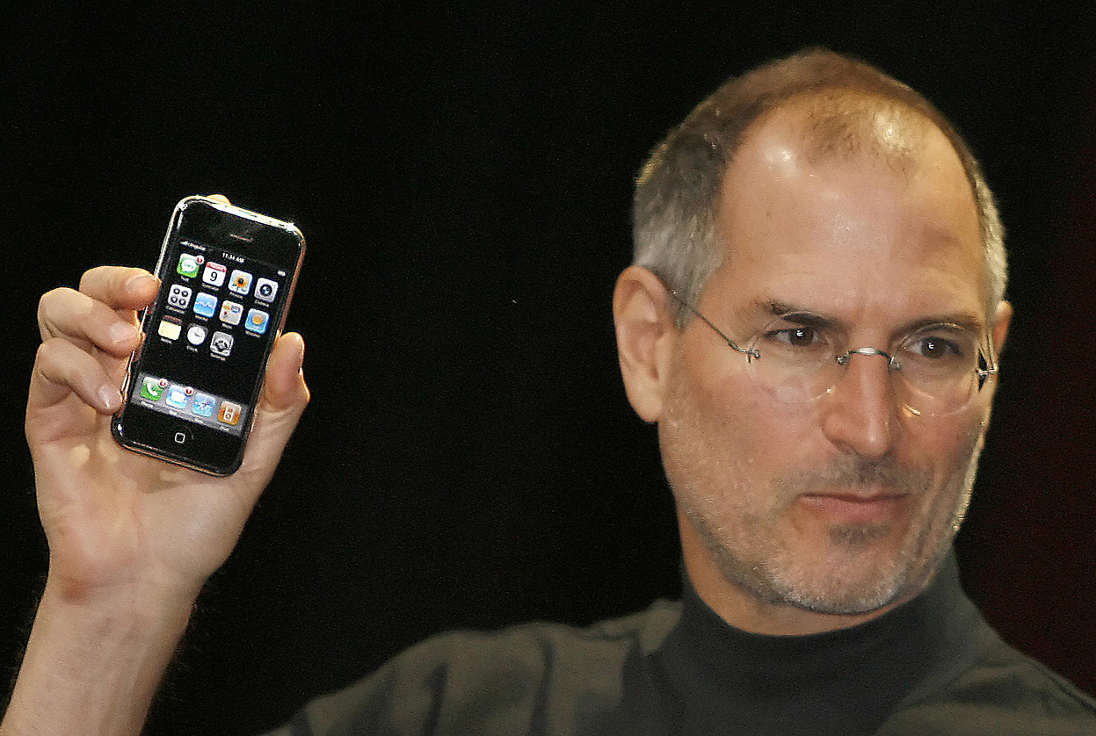
Example of strategic move
-Putting 3 separate devices in 1.
-Creating a phone with a touch screen interface.
-Putting computer software in a phone

Slide 8
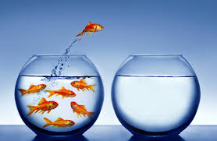
120 Years Ago What Was Unknown?
Industries Never stand still
SIC system replaced by NAICS system
Overriding focus of competition-based strategies
Continuation of Blue Oceans

Slide 9
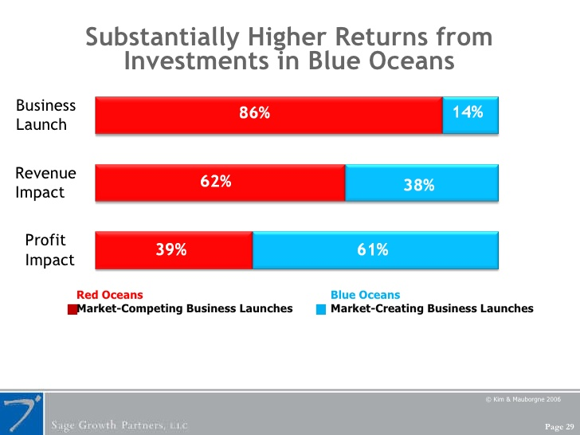
Impact of Creating Blue Oceans
Blue oceans impact in company’s revenue and profit
A study done with 108 companies
The Profit and Growth consequences of creating blue oceans

Slide 10
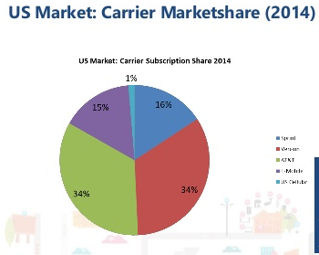
Cell Phone Carriers Drop off
2014 Carrier's Stock Drop
"You're seeing pricing competition, you're seeing promos. The marketplace is very, very competitive." -AT&T CFO John Stephens
Shares of Verizon plunged 6%
AT&T stock fell 5%.
T-Mobile plummeted 10%
Sprint has dropped more than 16%

Slide 11
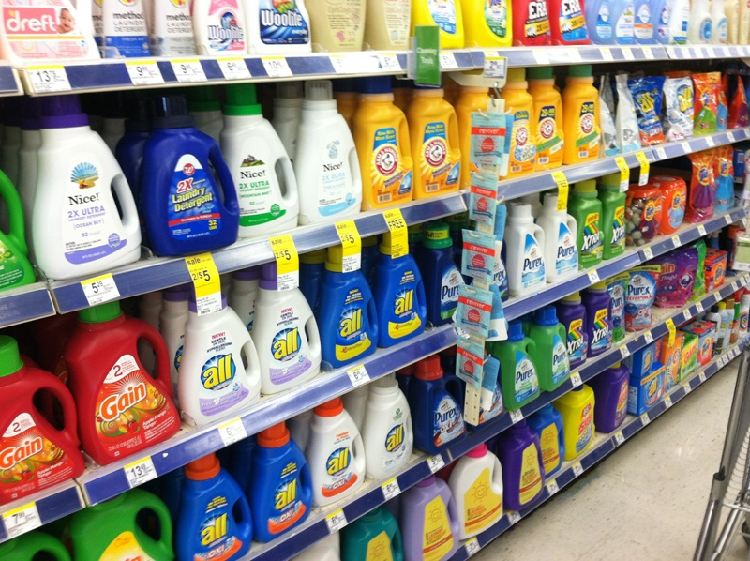
Rising Imperative of Creating Blue Oceans
Globalization, Dismantled Trade Barriers, Accelerated Technological Advances = rise in supply while demand decreases, remains stagnant
Accelerated commoditization of products and services
Brands in the same industry are becoming more similar → Price competition
Price wars → Shrinking profit margins

Slide 12
In overcrowding industries, differentiating brands becomes tough for consumers
Business environment has evolved but strategy and management approaches are slow to keep up
Management needs to strive for blue oceans
Notes:
“Connect people with their world, everywhere they live, work and play … and do it better than anyone else.”- AT&T

Slide 13
The Cornerstone of Blue Ocean Strategy
Value Innovation
Focuses on making the competition irrelevant
Opens up new market space
Company aligns innovation with utility, price, and cost positions

Slide 14
Cirque Du Soleil Strategy
“Reinvented the circus industry”
Identify new types of audiences
Remain in a blue ocean marketplace

Slide 15
“What if your business could be in a league of its own? Instead of competing with others in your industry, what if you were setting the pace, creating unique products and profiting from lucrative new markets?
Generating that kind of environment is the goal of blue ocean strategy, a business theory that suggests companies are better off searching for ways to gain "uncontested market space" than engaging in traditional competition.”
By Katherine Arline, Business News Daily Contributor

