Slide 1
Blue Oceans Strategy Chapter 2: Analytical Tools and Frameworks
Gaston Arnold, Angel Ramirez, Yussef Benelbar, Jorge Pallares and Edwin
Apple

Slide 2
The Strategy Canvas
The strategy canvas is both a diagnostic and an action framework for building a compelling blue ocean strategy.
Captures the current state of play in the know market space.
This allows you to understand where the competition is currently investing, the factors behind the speaker the competes on in products, services, delivery, and what customers receipt from the existing competitive offerings on the market.

Slide 3
Shifting the Strategy Canvas
It is very important that you begin by reading orienting your strategy focus from competitors to water it is, and from customers turn on customers of the
Deviate from benchmarking at the existing field inches between differentiation cost leadership.
Shift your strategic focus from current competition to alternatives and non-customers.

Slide 4
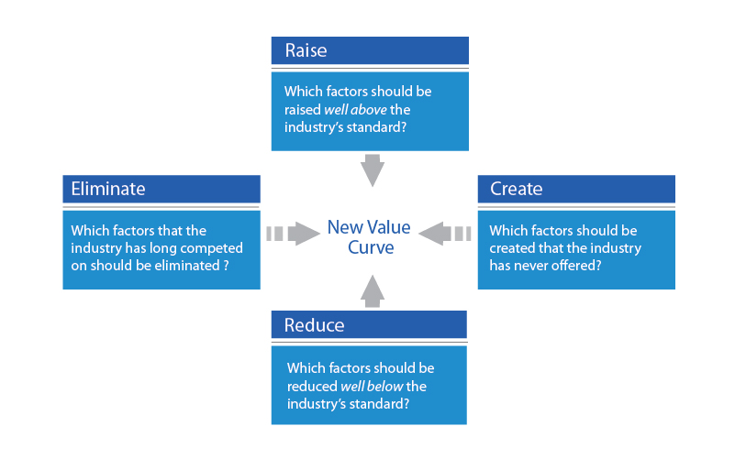
The Four Actions Framework
Reduce
Eliminate
Raise
Create

Slide 5
Apple Four Action of Framework
Reduce | Raise | Eliminate | Create
Supply Chain Issues | Applications | iOS issues | Sleek Design
Price | Software Complexity |  | User-Friendly

Slide 6
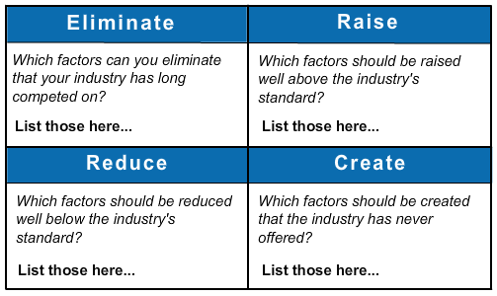
The Eliminate-Reduce-Raise-Create-Grid
Third tool for creating blue oceans
Pushes companies not only to ask the four questions but to ACT on them

Slide 7
Three Characteristics of a Good Strategy
Focus
Divergence
Tagline
“These three characteristics serve as an initial litmus test of commercial viability of blue ocean ideas”(Kim, Mauborgne)

Slide 8
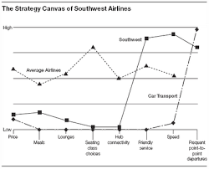
Focus
Identifying the key factors that your competitors compete on
Factors may include: Price, Quality, Efficiency, Speed, etc.
Focusing on that one factor
Southwest Airlines

Slide 9
Divergence
What sets you apart from the competitors?
Uniqueness
Divergence helps break out the industry’s average profile
Normally everyone is stuck on trying to keep up with the competition, losing sight of what makes them great.

Slide 10
Compelling Tagline
Clear-cut, compelling message that creates interests to the customer
Tagline Characteristics:
Truthful
Clear-cut
Short
Strong
Example: Nike “Just Do it”

Slide 11
Apple: Three Characteristics of a Good Strategy
Focus: Fashionable, Wireless Internet on Phone, & Applications
Divergence: Design
Compelling Tagline: “Think Different”
Notes:
Focus

Slide 12
Reading the Value Curves
The Value Curve- The basic component of the strategy canvas, is a graphic depiction of a company’s relative performance across its industry’s factors of competition.
A value curve allows companies to visibly see how they they can differentiate themselves from their competitors when trying to reach a blue ocean strategy.

Slide 13
Value Curve

Slide 14
Reading the Value Curves
The Blue Ocean Strategy
Does the business deserve to be a winner?
Requires three blue ocean criteria.
Focus
Divergence
Compelling Tagline

Slide 15
Reading the Value Curves
A company Caught in the Red Ocean
Value Curve should NOT resemble its competitors. If it does, competition is based on cost and quality.

Slide 16
Reading the Value Curves
Over Delivery without Payback
If a company shows high levels across their value curve, they maybe over supplying their customers and supplying elements that add incremental value.

Slide 17
Reading the Value Curve
Strategic Contradictions
Occurs when a company offers a high level on one competing factor and ignores other supporting factors.

Slide 18
Reading the Value Curves
An Internally Driven Company
Are competing factors stated in easy to understand language or in operational, internally driven terms.
The language used in a strategy canvas can portray whether a company’s strategic vision is built on an “outside-in” perspective (demand driven), or an “inside-out” perspective (operationally driven).

