Slide 1
Build Execution into Strategy
Group 6: Courtney Estrada, Alexa Baumgarner,
Dustin Lang, & Zachery Mays

Slide 2
Execution in a Blue Ocean
Strategy from the top down
“To build people’s trust and commitment deep in the ranks and inspire their voluntary cooperation, companies need to build execution into strategy for the start”
Fair process is key

Slide 3
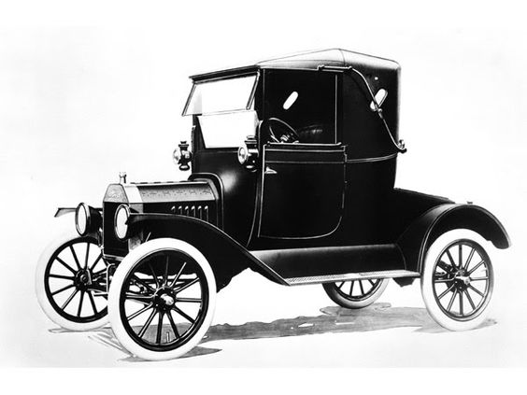
Poor Process Can Ruin Strategy Execution
How a “win-win” strategic move can be doomed from the start
Re-build trust
Ford and GM

Slide 4
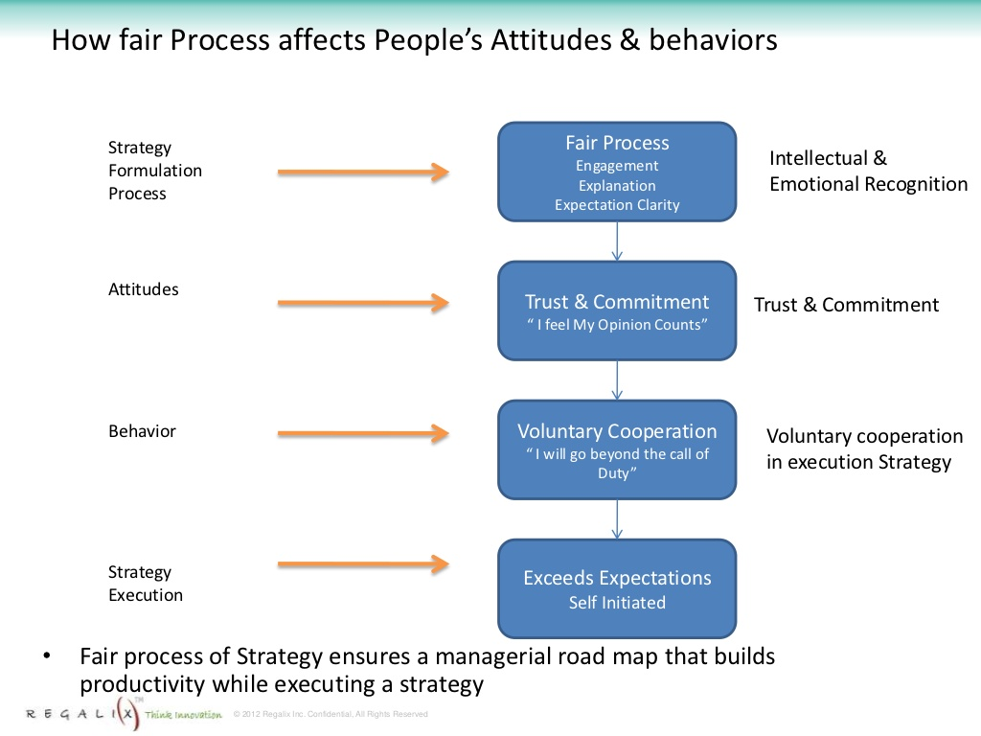
The Power of Fair Process
Procedural justice
Casual flow

Slide 5
The Three E Principles of Fair Process
Engagement
Explanation
Expectation Clarity

Slide 7
Elco’s Plan
Replace batch-manufacturing with cellular manufacturing
Install first at the Chester plant then at the High Park plant

Slide 8
“The theory was good. In practice, however, things took an unpredicted turn.”
-Blue Ocean Strategy, page 177.

Slide 9
Takeaways
Even a well thought out plan can go unexpectedly
Practicing fair process can make the worst employee better
People in the front line care about proper process as much as the top line
The Three E Principles
Engagement, explanation, expectation clarity
COMMUNICATION

Slide 10
Emotional and Intellectual Recognition
Emotional Recognition: Respected as a person
Intellectual Recognition: Respected as being intelligent

Slide 11
Intangible Capital
When employees are given emotional and intellectual recognition, they trust and cooperate with their company. This is a hugely important resource called “intangible capital.”

Slide 12
Consequences of Violating Fair Process
Employees withhold ideas
Low employee retention
Retributive Justice

Slide 13
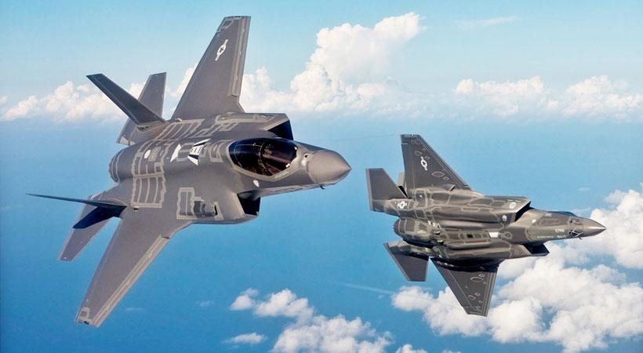
External Stakeholders
Lockheed Martin and Pentagon both failed to follow fair process
Project cost exponentially more time and money because of it

Slide 14
GM Ignition Switch Issue
30 million cars recalled
At least 124 deaths
No communication within company

Slide 15
Reimplementation of Fair Process

Slide 16
Conclusion

