Slide 1
Charting a Company’s Direction
Austin Reuter, Seth Rizer,
Gabriela Trejo, Alan Page, & Swade Draper

Slide 2
Activity
Objective
Build the tallest tower
Rules
You and your team may only use the resources on your table
No Cell phones or laptops
The marshmallow must be the top of the tower
You have 5 minutes to plan and make the tower
Tower must stand on its own
Winner
Gets free Chick-fil-A

Slide 3
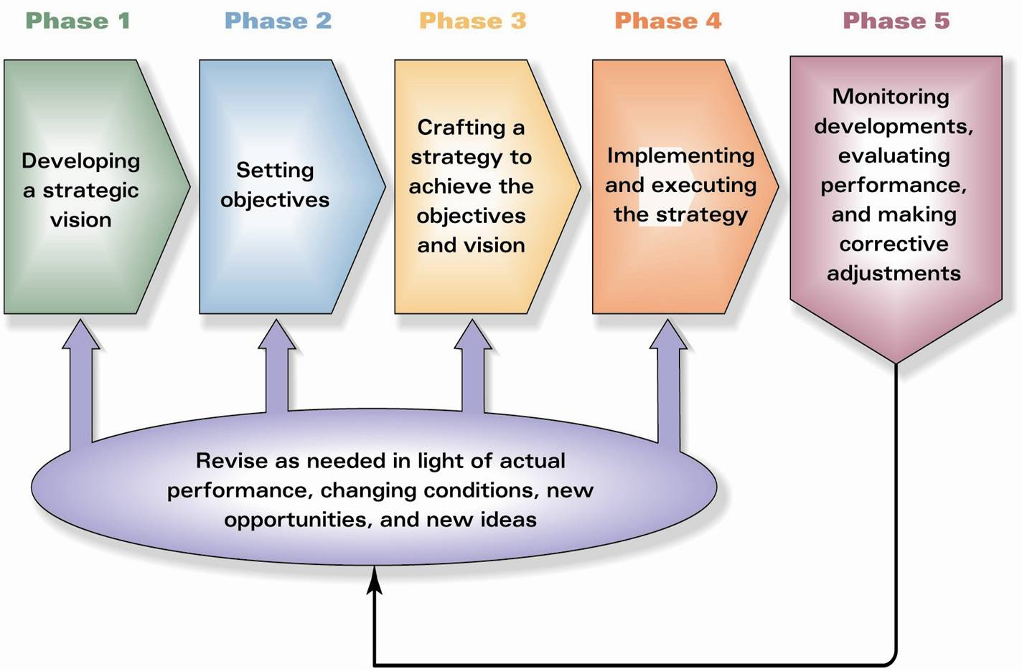
https://images.search.yahoo.com

Slide 4
Strategic Plan
Maps out where a company is headed, establishes strategic and financial targets, and outlines the competitive moves and approaches to be used in achieving the desired results
The first three stages of the strategic management processes

Slide 5
Stage 1: Developing
Develop a strategic vision
The views and conclusions about the company’s long term direction
Decide what product-market-customer business mix seems optimal
Tells the stakeholders what direction the company is headed
Be distinct, specific, and avoid broad statements
Should be able to direct lower-level managers on decisions in line with the company’s values

Slide 6
Communication
Communicating the Strategic Vision
Must be effectively communicated to everyone in the company
Executives must provide a compelling rationale for a drastic new vision and direction
To win support for the new vision put “where are we going and why” in writing
Keep it short so employees remember it
Why a well communicated vision matters
Cements executives views on long-term direction
Reduces risk of directionless decision making
Tool for winning employee support
Gives direction to lower-level managers
Helps organization prepare for the future

Slide 7
Mission Statement
Mission Statement- the enterprise’s present business and purpose
Who we are, what we do, and why we are here
Developing the mission statement
Identifies the company’s products and/or services
Specify the buyer needs that the company wants to satisfy and the customer group to satisfy
Gives the company its own identity
Youtube mission statement- “To provide fast and easy video access and the ability to share videos frequently”
The vision and mission statement are linked to the core values of the company

Slide 8
Stage 2: Setting Objectives
Purpose: Convert the vision and mission into specific performance targets
Objectives should be:
Measurable, quantifiable, and should contain deadlines
Why measurable?
Focus efforts and align actions throughout organization
Serve as “yardsticks” for tracking a company’s performance and progress
Motivate to reach for higher goals and extend greater effort

Slide 9
Stretch Objectives
Best way to promote outstanding company performance is through setting targets high enough to stretch an organization to perform at it’s full potential and deliver the best possible results.
Helps promote:
Urgency in improving financial performance and business position
More intentional actions
Strategic intent: using all of the company’s resources and competitive actions on reaching these objectives

Slide 10
Types of Objectives to Set
Financial Objectives: financial performance target
Strategic Objectives: strengthening market standing, competitive position, future business prospects
Both should have both short-term (quarterly) and long-term(3 to 5 years)targets.
Short term should focus on delivering performance improvements in the current period to satisfy shareholder expectations for near-term progress
Long-term focus on what company position they should focusing on now to improve performance for later
Long-term>Short-term

Slide 11
Balanced Approach to Objective Setting
Don’t solely focus on financial indicators to predict a company’s future prospects
The most reliable leading indicators of a company’s future financial performance is its strategic outcomes to determine its market position and whether it’s weakening or strengthening
Balanced Scorecard-method for measuring strategic and financial objectives
Provides employees clear guidelines about how their jobs are linked to overall objectives
50% of Global Companies adopt this approach to setting objectives
Ex. UPS, Hilton Hotels, etc.

Slide 12
Setting Objectives for Every Organizational Level
Break down objectives for each separate business department, product lines, functional departments, etc.
Top-down process
Narrow objectives guide employees to better reach these goals
Team effort approach and consistently knowing strategic roles will produce desired results

Slide 13
Stage 3: Crafting a Strategy
Putting a strategy together entails addressing the “Hows”
How to attract customers
How to compete against rivals
How to respond to market change
How to capitalize on opportunities
How to achieve strategic and financial objectives
Good strategy makers can foresee a shift in the market before it happens and plan his/her strategy accordingly

Slide 14
Making a strategy involves all management levels
Top level management strategies
The CEO is ultimately responsible for leading of strategy implementation and execution.
Takes full credit/responsibility for the strategies successes and/or failures
Board Members and key subordinates are often sought after for advice/approval.
In most cases the CFO, VP of marketing, VP of production, vp of HR, etc help influence and fashion specific component of the chief strategy.
Lower level management strategies
Usually the bigger and more complex a company becomes the more important it is to delegate strategy crafting and implementation
Managers of specific operating units can often have a bigger advantage over top level managers when it comes to making in the field strategic decisions
In most companies today every manager have a role to play in the strategy making process

Slide 15
The Strategy Making Hierarchy
Corporate strategy (set of businesses as a whole)
Orchestrated by the CEO and other senior executives
How to gain advantage from managing a set of businesses
Business strategy (one for each diversified business)
Orchestrated by general managers of companies different lines of business (with input from executive heads)
How to gain and sustain a competitive advantage for a single line of business
Functional area strategies (within each business)
Orchestrated by the heads of major functional activities within a particular business
How to manage a particular activity within a business in ways that support the strategy.
Operating strategies (within each functional area)
Orchestrated by managers of strategicaly important activities
How to manage activities of strategic value within each functional area

Slide 16
Uniting the Strategy Making Hierarchy
All pieces of the company's strategy making hierarchy but fit together
If not the overall company strategy could be compromised and impair company performance
CEO and top executives are responsible for achieving unity
Rule of thumb: strategy-making must start at the top of the organization and work its way down

Slide 17
Stage 4: Executing the Strategy
Most demanding part of strategy development
Takes the most time
Tests manager's ability
Direct change
Motivate employees
Meet goals
Management action plan
“What needs to be done?”
“What do I need to do to accomplish the plan?”
Diligent pursuit of operating excellence
Success hinges on skills and cooperation

Slide 18
Principle Aspects of Managing Execution
Creating a strategy-supporting structure
Staffing
Developing strategy-supporting structure
Allocating ample resources
Ensure policies facilitate execution
Organizing “Best Practices”
Installing systems to enable activities
Motivating people
Creating a company culture
Lead others

Slide 19
Stage 5
Evaluating Performance and Initiating Corrective Adjustments
Managers must Determine
Is current strategy a Good Fit?
Do they have a competitive Advantage?
Strong Performance?
Maintain Course?
Establish New Plan?

Slide 20
Corporate Governance
Senior Managers are responsible for executing a company's strategy.
Board of directors oversee the strategic management process and ensure management performance aligns with strategy.
http://www.hk.tricorglobal.com

Slide 21
Board of Directors Role
Oversee company's financial accounting and financial reporting
Ensure Financials Meet GAAP
Create and Manage Audit Committee
Oversee CEO and top executives
Responsible for accuracy of Financial Statements

Slide 22
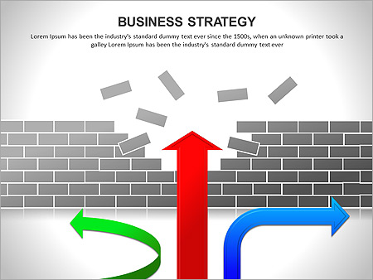
Board of Directors Role
2. Appraise company’s
Direction
Strategy
Business Approaches
The board makes independent judgments about the validity and wisdom of management’s proposed strategic actions.
https://images.search.yahoo.com/yhs/search;

Slide 23
Board of Directors Role
3. Evaluate Senior Executives
Create metrics to measure executives performance.
Evaluates current CEO
Is current strategy on track?
How well strategy is executed?
How well issues are problem solved by other managers?
Exercise due diligence in evaluating leadership skills of other senior executives in line to succeed the CEO.

Slide 24
Board of Directors Role
https://images.search.yahoo.com
4. Institutes Compensation Plan
Determines Top Executives Pay
Determines Bonus Structure
Establish metrics for bonuses
https://images.search.yahoo.com

Slide 25
FINISH

