Slide 1
CES: Chapter 9 Ethics, Corporate Social Responsibility, Environmental Sustainability, and Strategy
Team 5
Jamie Bowlin, Kristen Righter,
Kristine Kauneckas & Chris Williams

Slide 2
WHAT DO WE MEAN BY BUSINESS ETHICS?
Business Ethics: is the application of ethical principles and standards to the actions and decisions of business organizations and the conduct of their personnel.
Ethical business principles are not materially different from ethical principles in general.

Slide 4
WHERE DO ETHICAL STANDARDS COME FROM – ARE THEY UNIVERSAL OR DEPENDENT ON LOCAL NORMS?
School of Ethical Universalism
School of Ethical Relativism
Integrated Social Contracts Theory

Slide 5
School of Ethical Universalism
Common understandings across multiple cultures and countries about what constitutes right and wrong.
These transcend culture, society, and religion.

Slide 6
School of Ethical Relativism
Different societal customs and cultures have different values and standards for right and wrong.
What is ethical or not depends on local customs and social norms.

Slide 7
Integrated Social Contracts Theory
The middle position between ethical universalism and ethical relativism.

Slide 8
HOW AND WHY ETHICAL STANDARDS IMPACT THE TASKS OF CRAFTING AND EXECUTING STRATEGY
The litmus test of whether a company’s code of ethic is cosmetic is the extent to which it is embraced in crafting strategy and in operating the business day to day.
Sarbanes-Oxley Act

Slide 10
DRIVERS OF UNETHICAL BUSINESS STRATEGIES AND BEHAVIOR
“Business of business is business not ethics”
There is three main drivers:
Faulty oversight
Heavy pressures on managers
Company culture that puts profitability above all else
When there are incentives that drive unethical outcomes, then research shows that even the most ethical people may falter - Azish Filabi, Ethical Systems

Slide 11
Wells Fargo
http://www.newsy.com/videos/wells-fargo-will-pay-the-price-for-phony-account-scandal/

Slide 12
WHY SHOULD COMPANY STRATEGIES BE ETHICAL?
Two main reasons:
Promotes positive company image
Good business and serves the self interests of shareholders

Slide 13
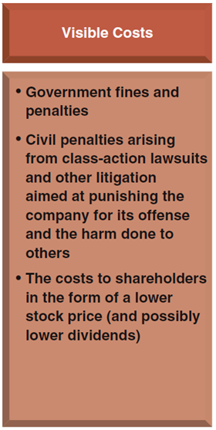
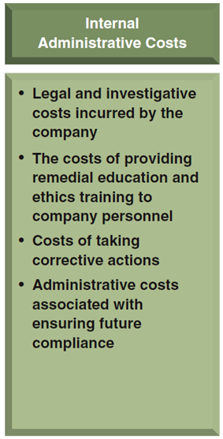
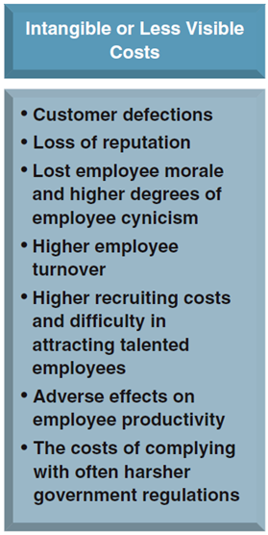
Costs of Ethical Wrongdoing

Slide 14
Wells Fargo
http://time.com/4501088/wells-fargo-ceo-senate-hearing/

Slide 15
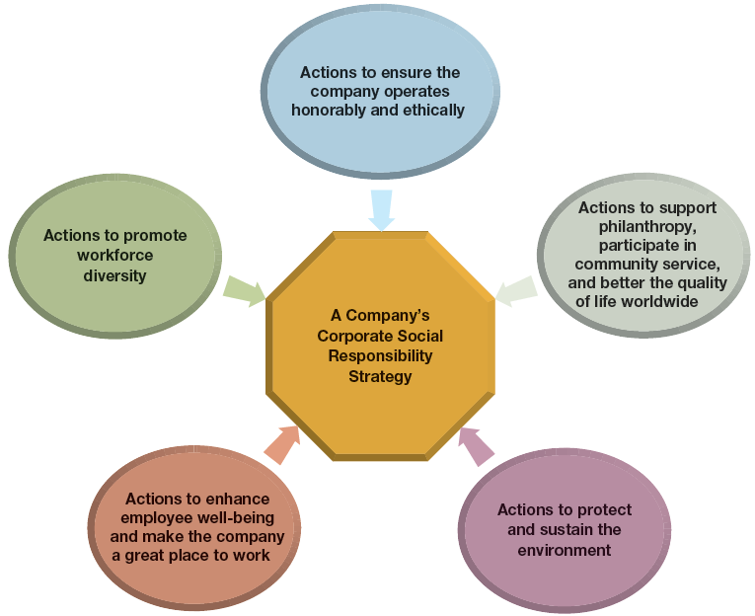
The Five Components of a Corporate Social Responsibility Strategy

Slide 16
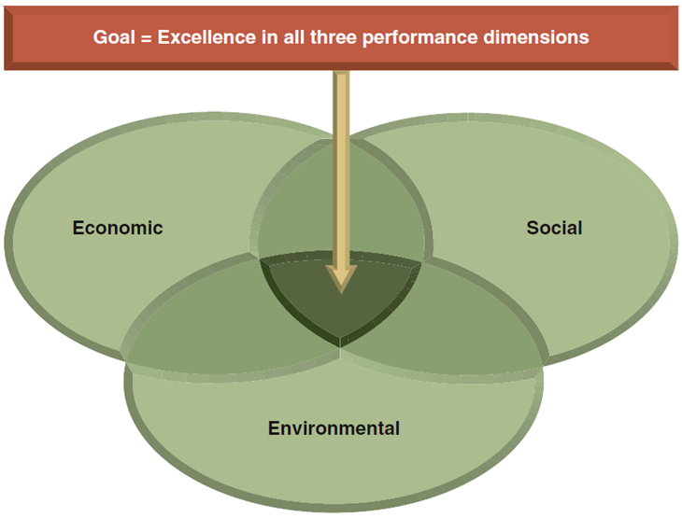
Corporate Social Responsibility and the Triple Bottom Line

Slide 17
Sustainability in Business Practices
Environmental Sustainability: The relationship of a company to its environment and its use of natural resources.
Sustainable Business Practices: Those that meet needs of the present without compromising the ability to meet the needs of the future.

Slide 18
Creating the Link
The CSR strategies and environmental sustainability strategies provide valuable social benefits and fulfill customer needs in a fashion that can lead to competitive advantage.

Slide 19
The Moral Case for Corporate Social Responsibility and Environmentally Sustainable Business Practices
Every action a company takes can be interpreted as a statement of what it stands for.

Slide 20
The Business Case for Corporate Social Responsibility and Environmentally Sustainable Business Practices
Increased buyer patronage
Reduce the risk of reputation damaging incidence
Lower costs and enhance employee recruiting and workforce retention
Opportunities for revenue enhancement
Best long term interests of shareholders

